Slide 1
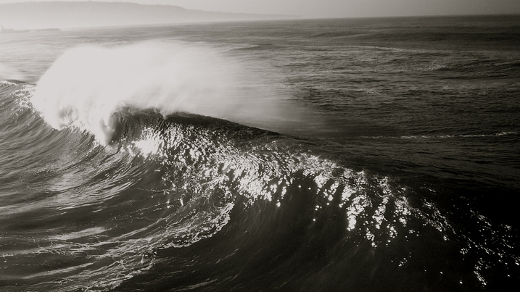
Learning Intention:
Explain how the properties of waves are shaped by weather patterns, natural formations and artificial structures, e.g. interference patterns, fetch, wave sets.
Success Criteria:
Complete Marine Education worksheet ‘9. That’s just swell”

Slide 2
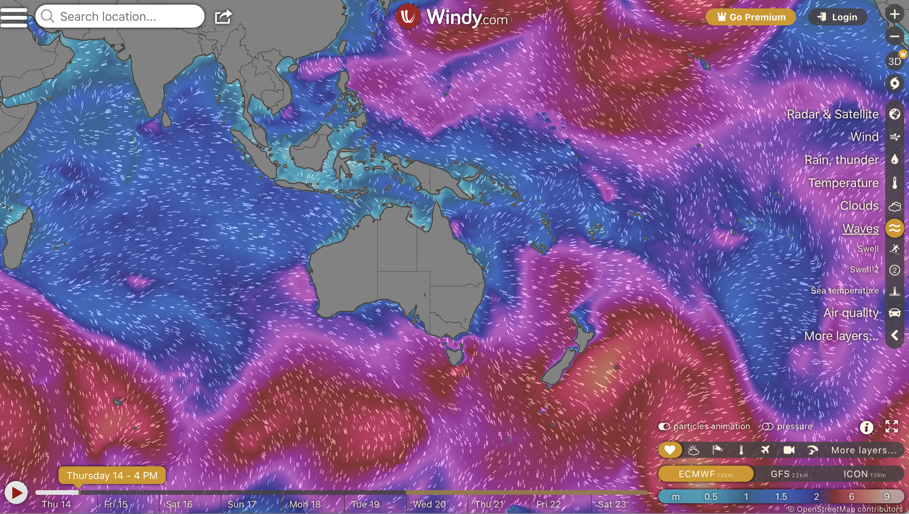
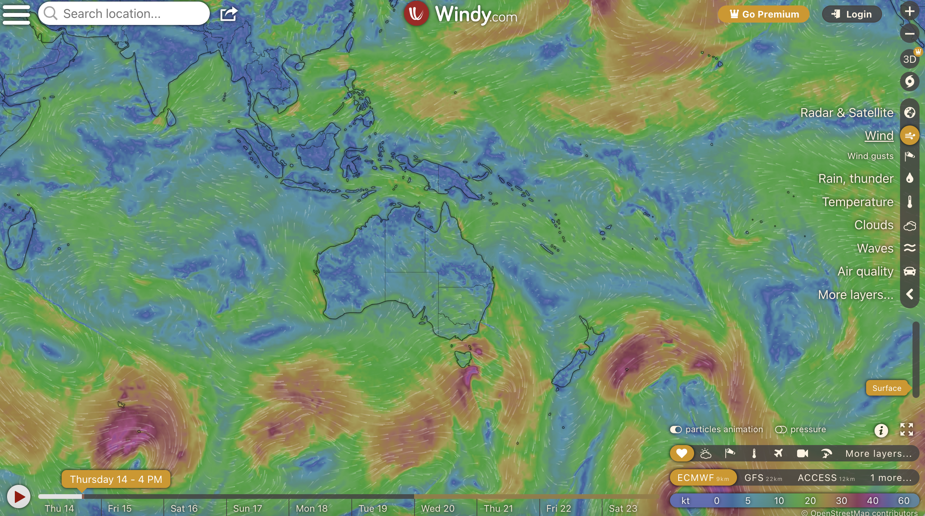
Waves are shaped by weather patterns
Waves
Wind (same time)

Slide 3
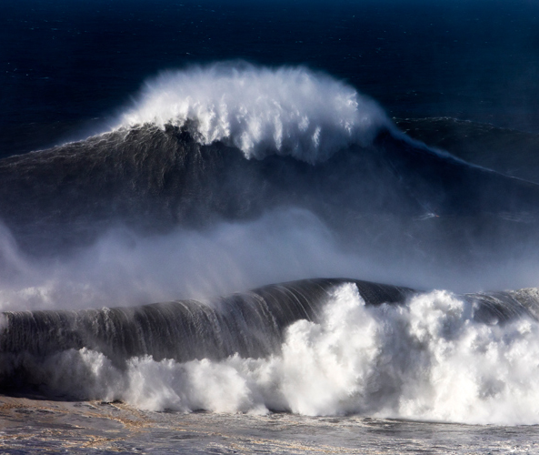
Remember…
wind-driven waves grow in size depending on 3 factors:
Wind…
Strength
Duration
Fetch

Slide 4
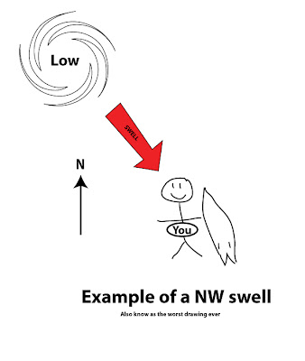
Once they’ve been made, waves travel towards the coast

Slide 5
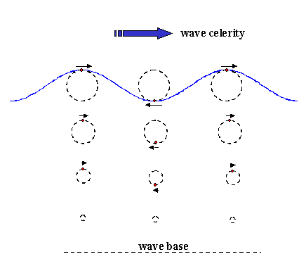
Some waves travel faster than others

Slide 6
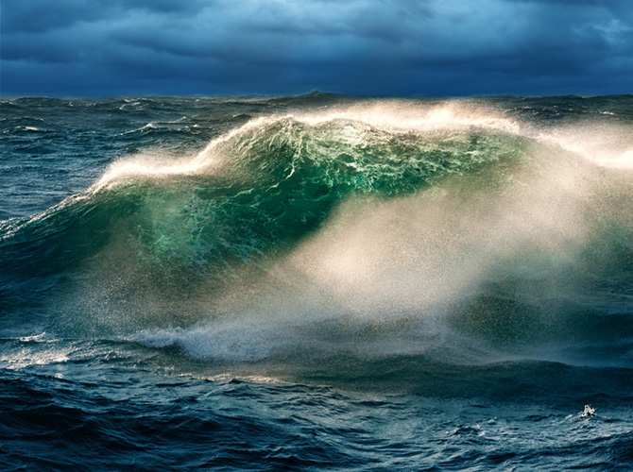
The faster waves eventually overtake the slower waves

Slide 7
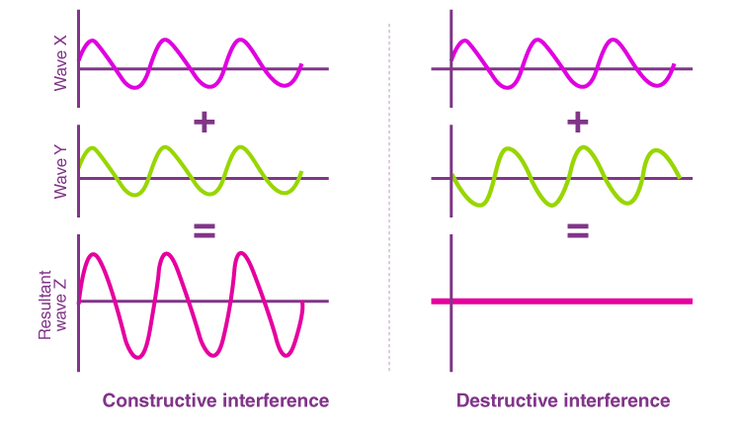
Wave interference patterns

Slide 8

Thus, waves arrive in SETS

Slide 9
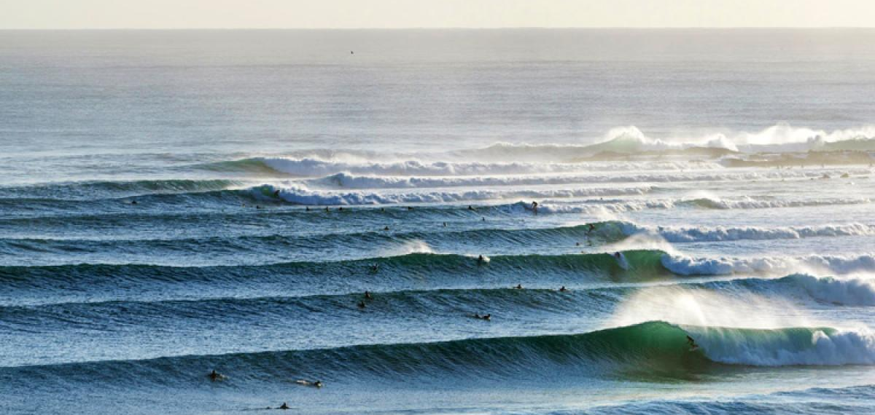
Average number of waves in a set?

Slide 10
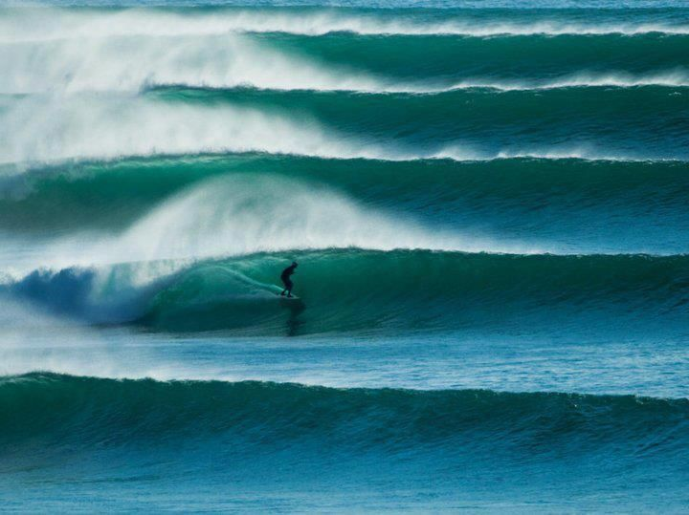
Biggest wave in a set?

Slide 11
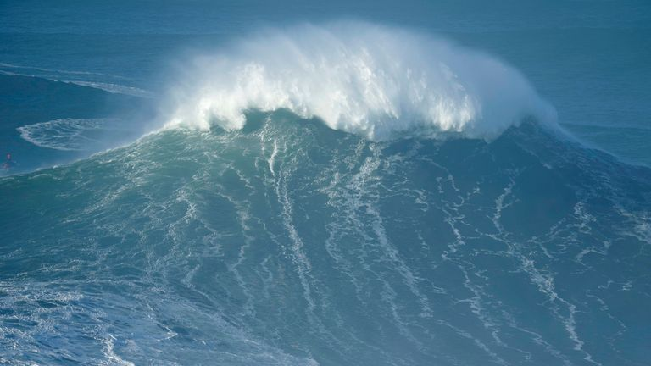
Rogue waves
(the constructive interference of 2 very big wave crests)

Slide 12
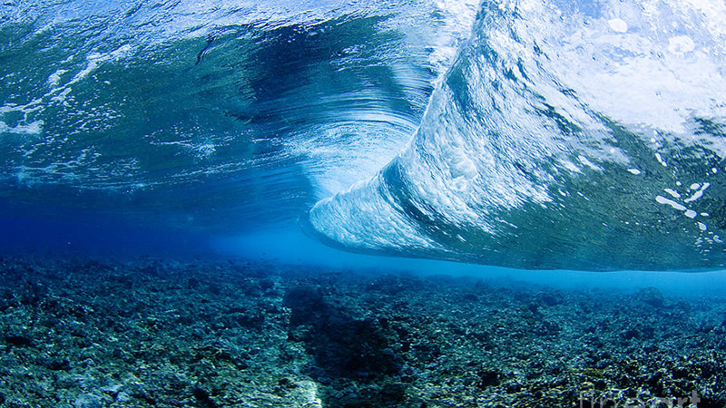
Waves are also shaped by natural formations

Slide 13
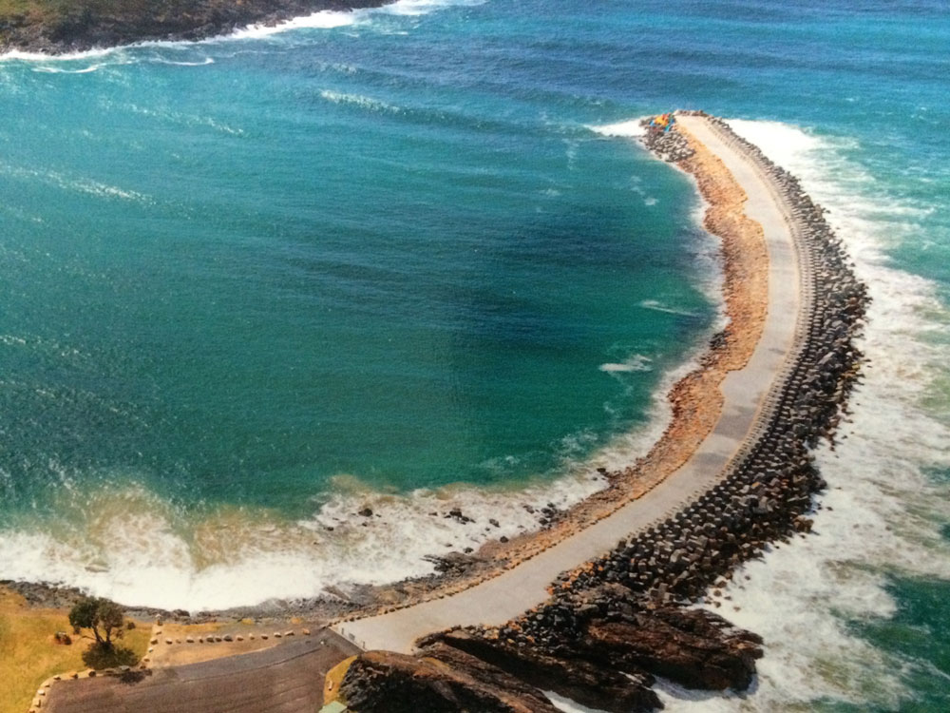
…and by artificial structures

Slide 14
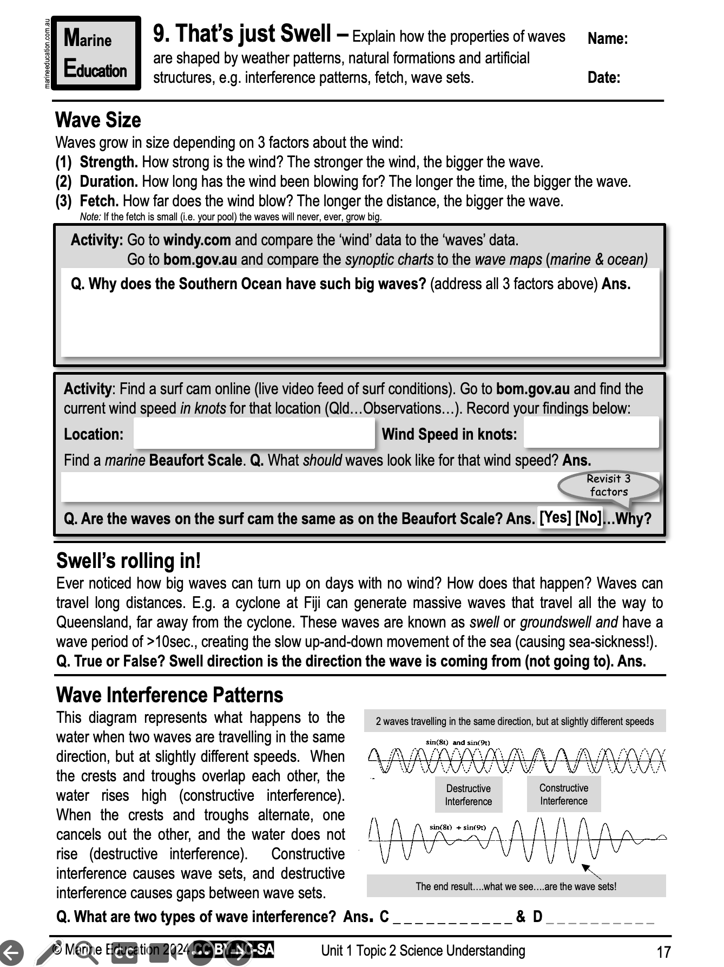
Learning Intention:
Explain how the properties of waves are shaped by weather patterns, natural formations and artificial structures, e.g. interference patterns, fetch, wave sets.
Success Criteria:
Complete Marine Education worksheet ‘9. That’s just swell”

