Slide 1
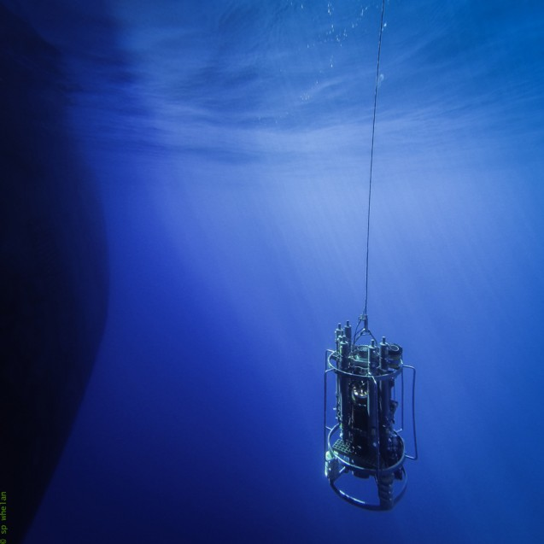
Learning Intention:
Explain how thermohaline circulation in the deep ocean is affected by salinity and water density
Success Criteria:
Complete Marine Education worksheet ‘9. The Global Ocean Conveyor Belt’
Notes:
https://news.climate.columbia.edu/2015/10/20/exploring-rugged-hills-turbulent-waters-4500-meters-down/

Slide 2
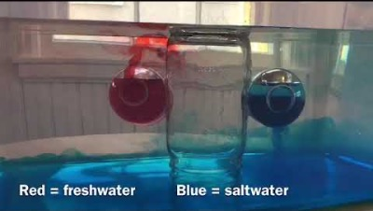
https://www.youtube.com/watch?v=E6GT2Vc5uog
Notes:
https://www.youtube.com/watch?v=E6GT2Vc5uog

Slide 3
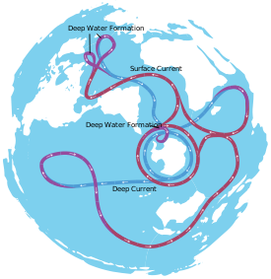
An oversimplified model of both deep and shallow water circulation depicts a global ocean conveyor belt of water movement. It is commonly referred to as the ‘global conveyor belt’ or ‘thermohaline circulation’.
It is hypothesized to take about 1000-2000 years to complete
a full circuit.
Path of thermohaline circulation viewed from Antarctica.

Slide 4
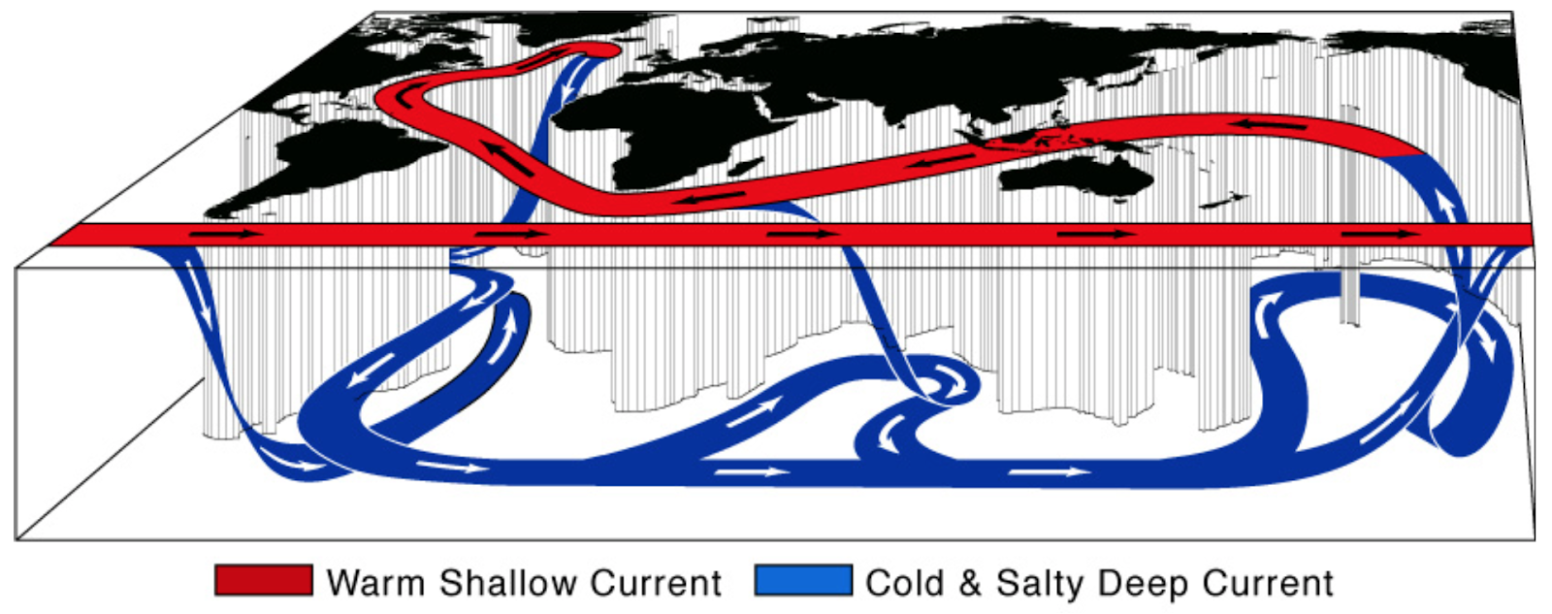
Cold, salty water sinks at DOWNwellings in cold regions of the world
(where ice caps form and leave the salt behind)
Notes:
https://dpictures.homes/two-main-currents-thermohaline-circulation

Slide 5
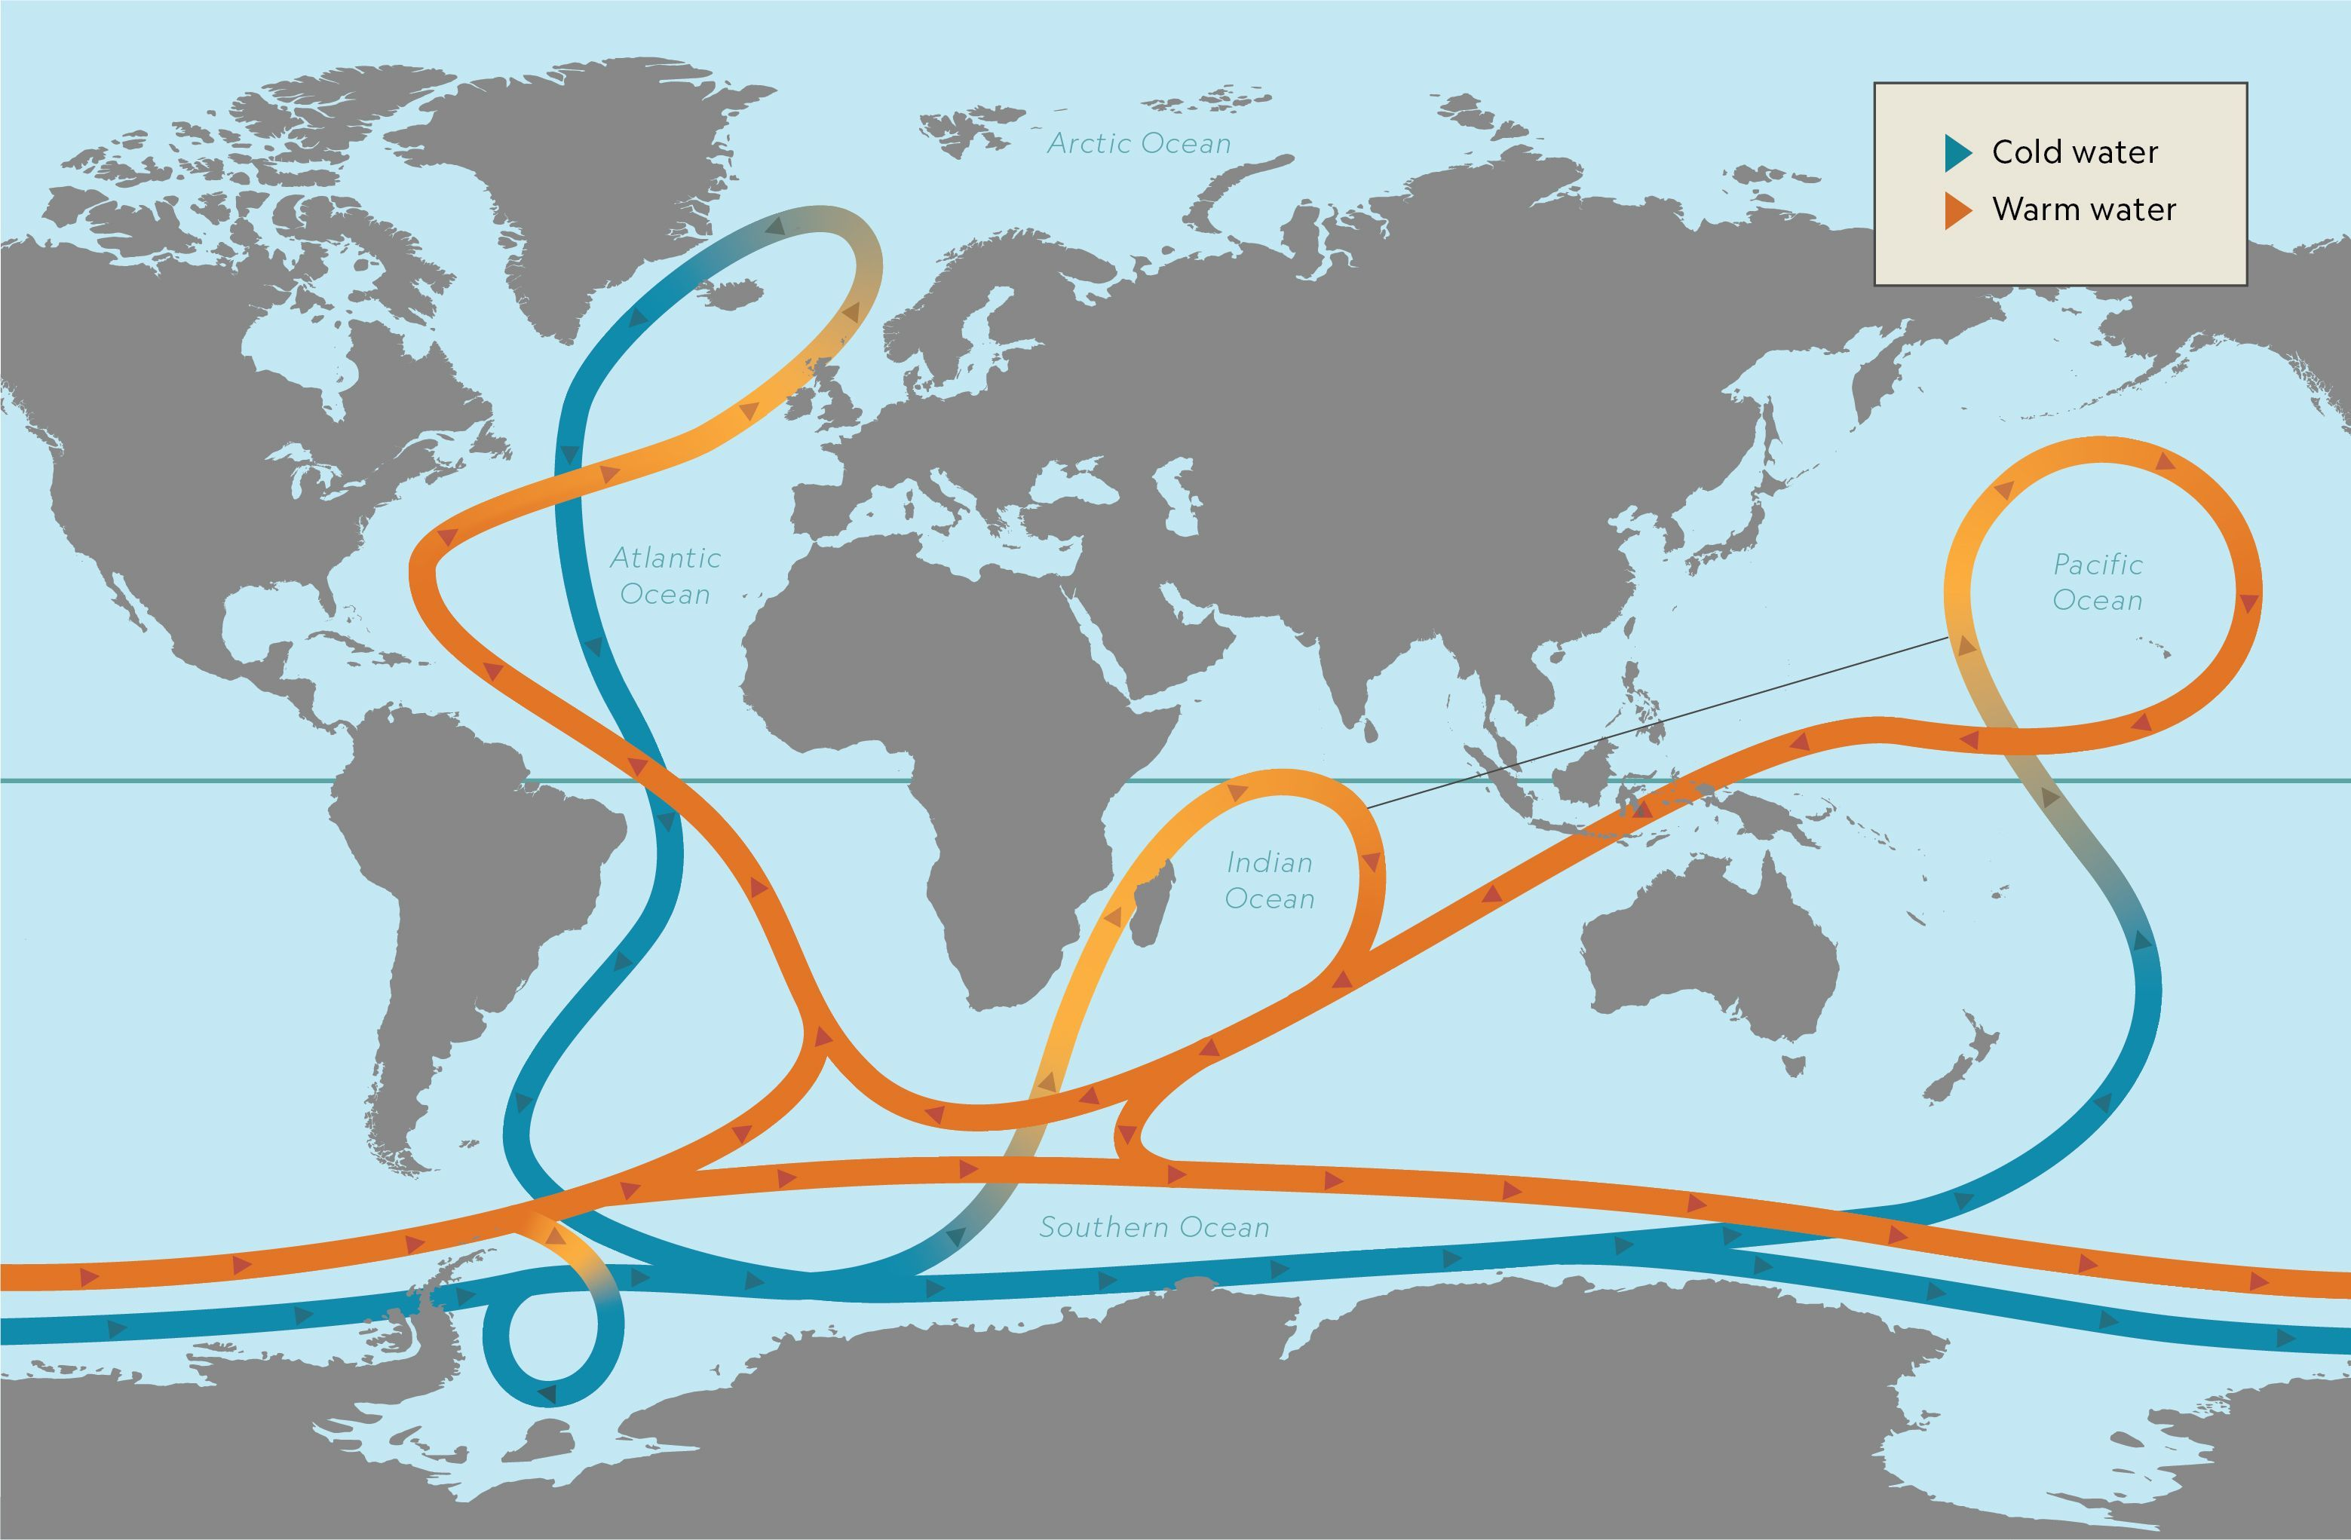
Notes:
https://www.pik-potsdam.de/~stefan/thc_fact_sheet.html

Slide 6
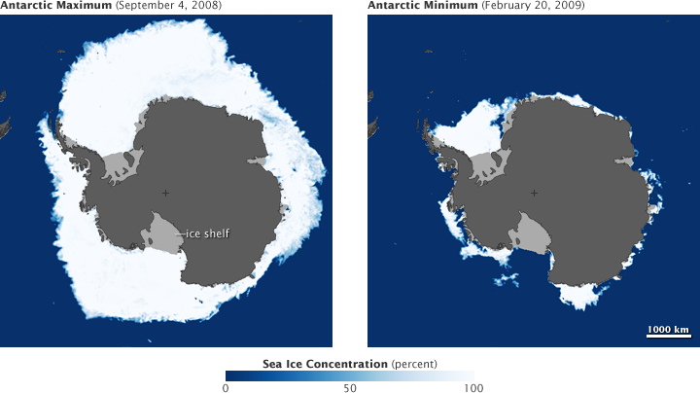
Ice forms in colder months, leaving the salt
behind

Slide 7
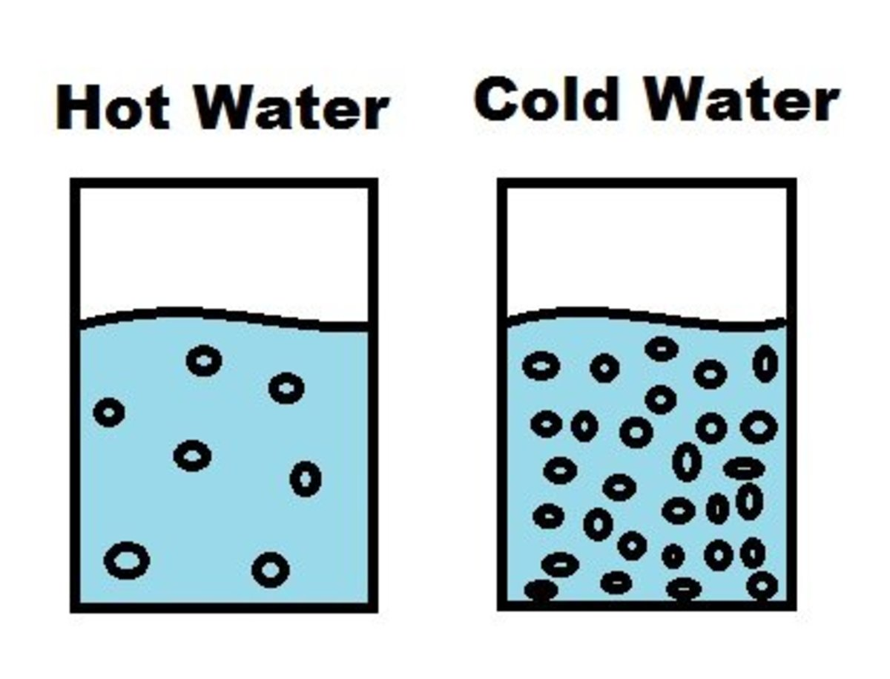
Cold water is more dense (thus heavier) than hot water because the H₂O molecules in cold water don’t jiggle with as much energy as they do in hot water.
This means that in
cold water, the H₂O molecules can be closer together and as a result, increases the density of the water.
Notes:
https://discover.hubpages.com/education/Does-Hot-Water-Weigh-More-Than-Cold-Water

Slide 8

Salt water is
more dense
(and thus heavier) than fresh water because it has salt
in it.
Notes:
https://discover.hubpages.com/education/Does-Hot-Water-Weigh-More-Than-Cold-Water

Slide 9
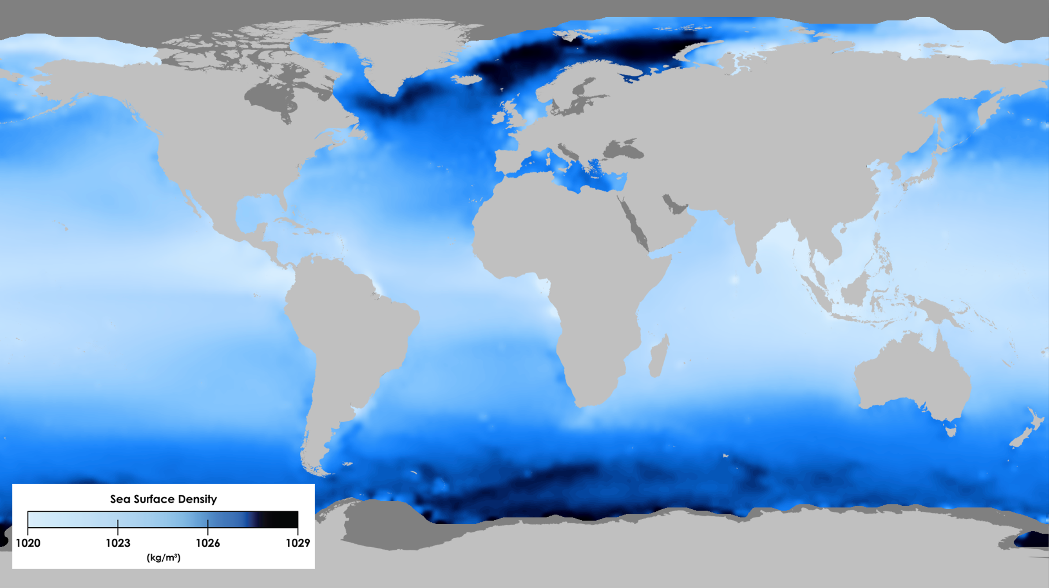

Slide 10

Water masses generally do not mix.
Instead, they are stacked, one on top of the other, in the order of their density.
The most dense
(heaviest)
at the bottom.

Slide 11
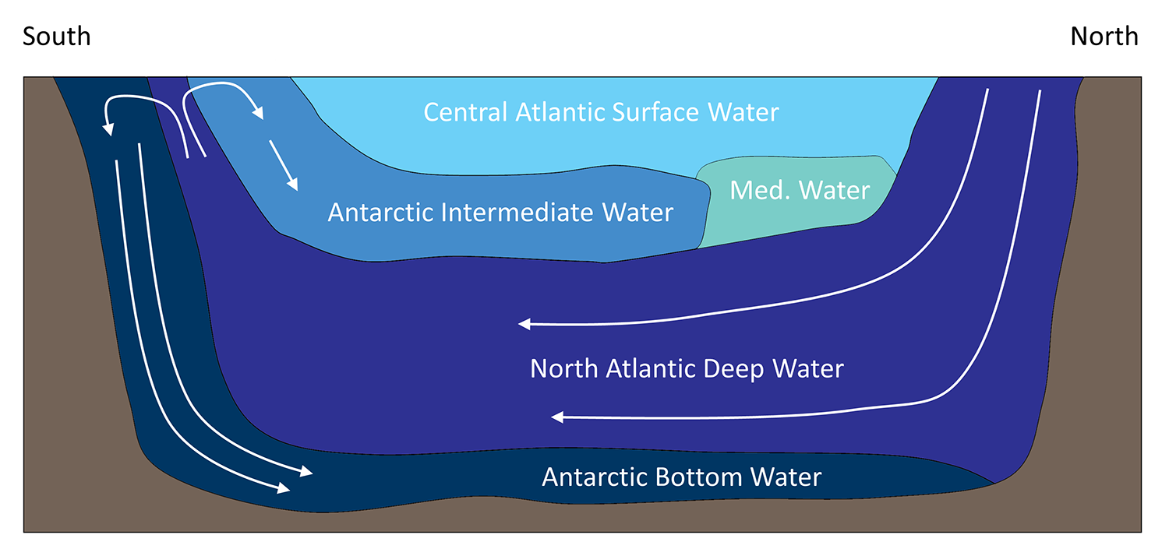
A water mass will only descend to a depth that is appropriate to its density,
sliding under less dense water and cruising over more dense water.
Notes:
https://rwu.pressbooks.pub/webboceanography/chapter/9-8-thermohaline-circulation/

Slide 12
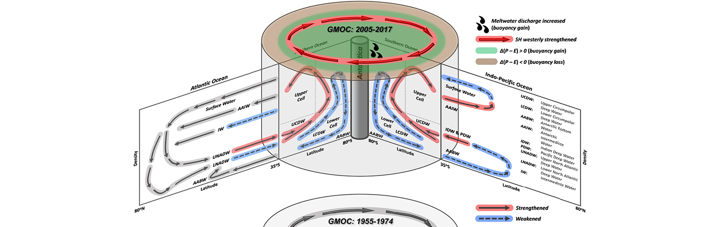
A water mass is “a volume of seawater with a distinctive density as a result of its unique profile of temperature and salinity”.
THC
Since 1974
The processes that affect seawater density really only happen at the surface.
Once it sinks, its density properties won’t really change.
Notes:
Image: https://www.aoml.noaa.gov/noaa-scientists-detect-reshaping-of-the-meridional-overturning-circulation-in-southern-ocean/
Text: https://rwu.pressbooks.pub/webboceanography/chapter/9-8-thermohaline-circulation/

Slide 13
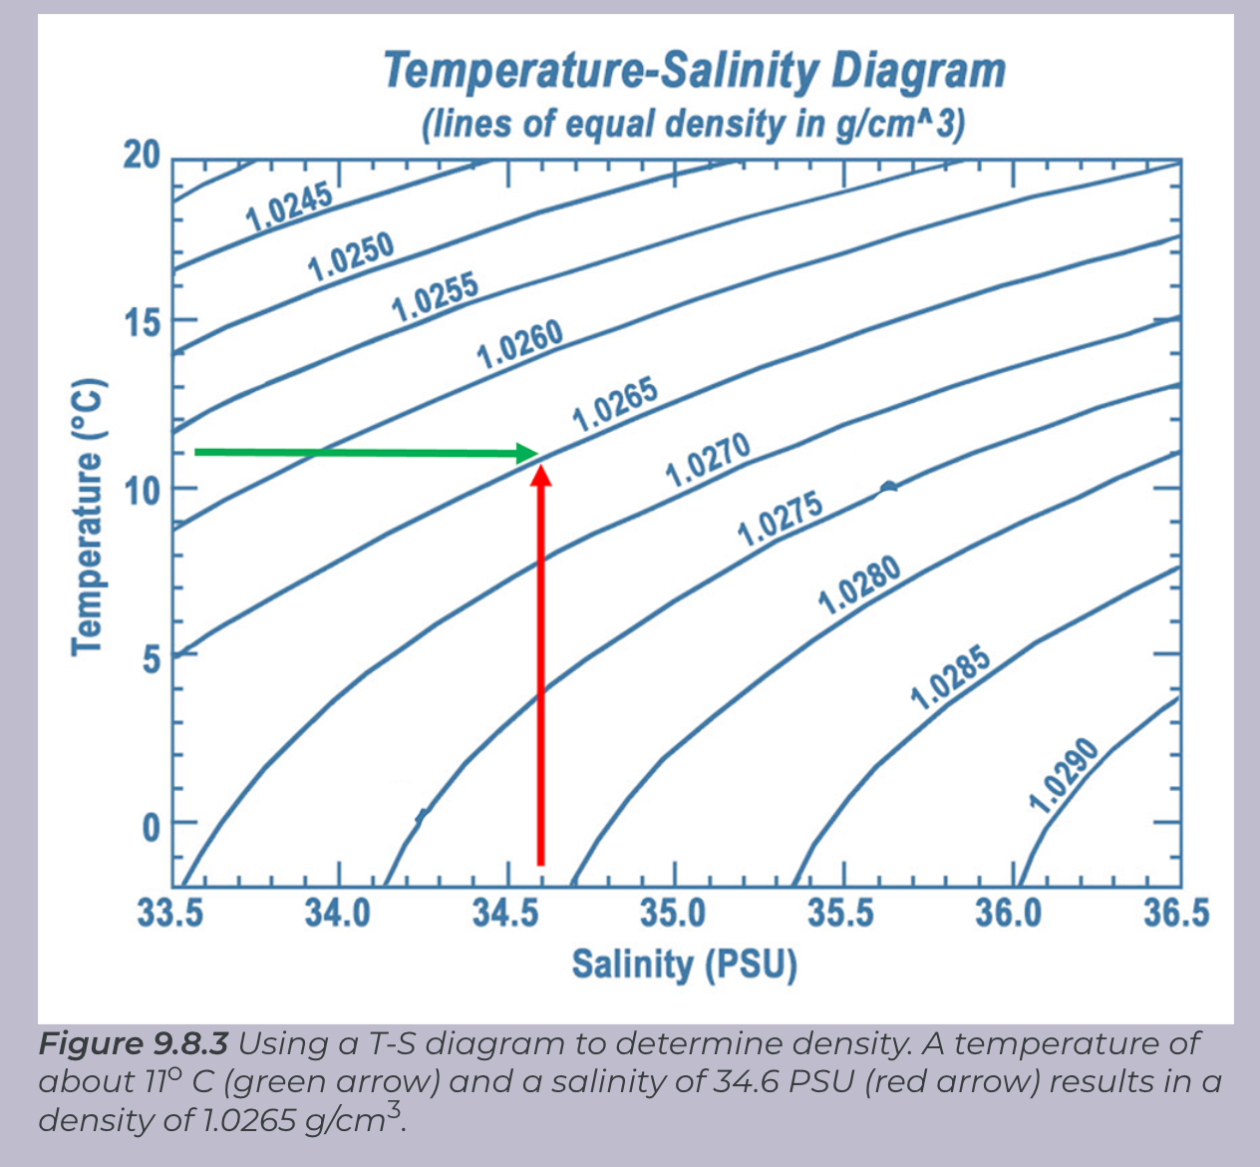
A temperature-salinity (T-S) diagram is used to identify the water mass relative to its temperature, salinity and thus density.
A T-S diagram shows lines of equal density, or isopycnals, for various combinations of temperature and salinity (Figure 9.8.3). You can then plot the values of temperature and salinity on the diagram, and use their point of intersection to calculate the density of the water.

Slide 14
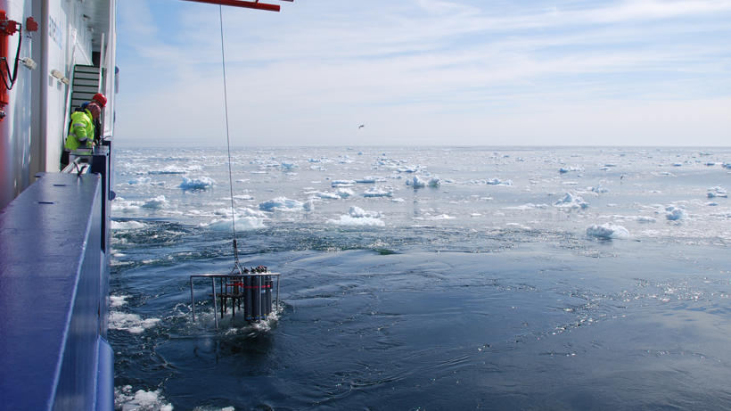
CTD: instrument designed to measure conductivity, temperature, and depth.
The icy waters of the Labrador Sea aboard the R/V Maria S. Merian. Credit: Rafael Abel

Slide 15
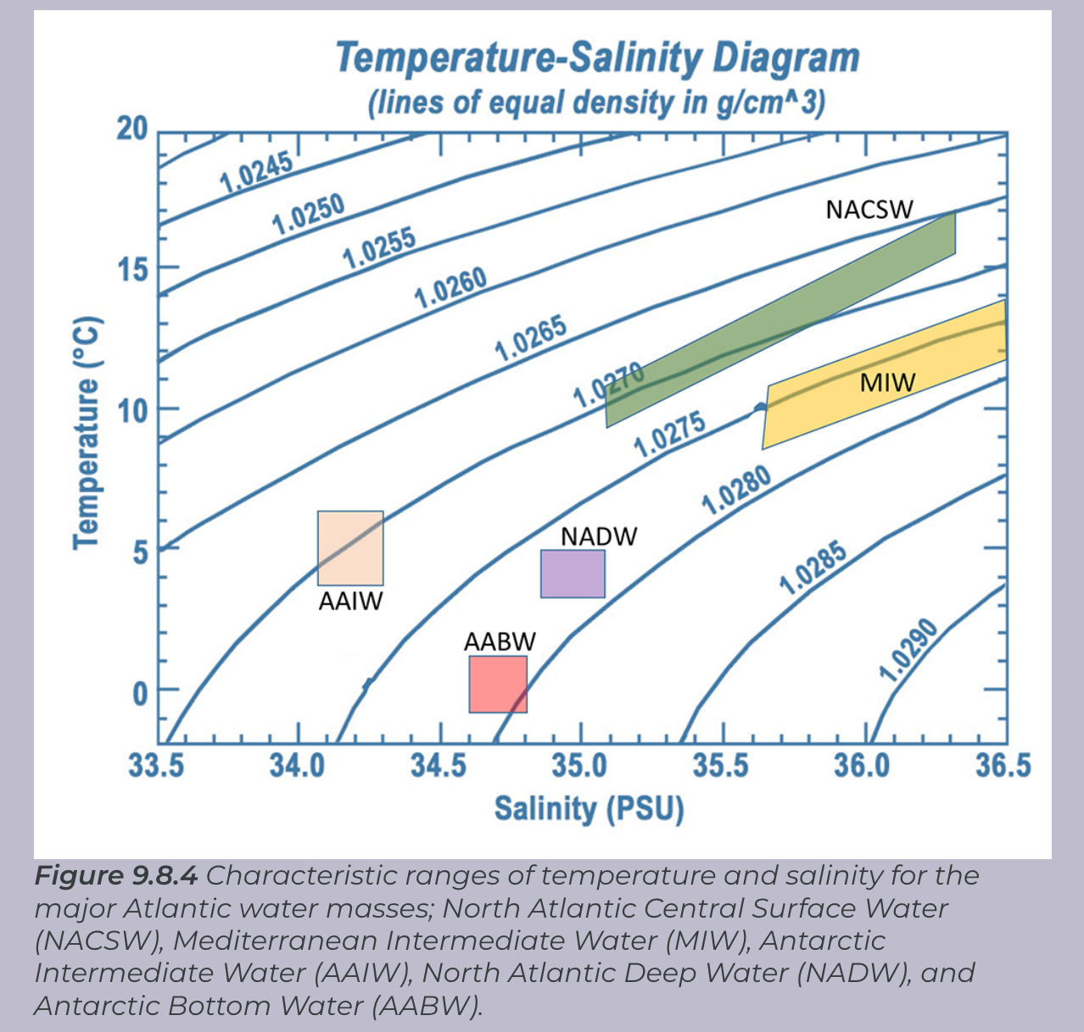
AABW (Antarctic Bottom Water) is the most dense and therefore sits at the bottom of the ocean.

Slide 16
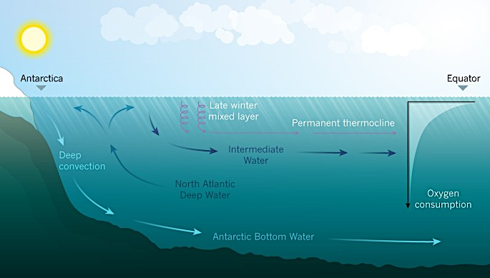
Notes:
https://www.nature.com/articles/542303a

Slide 17
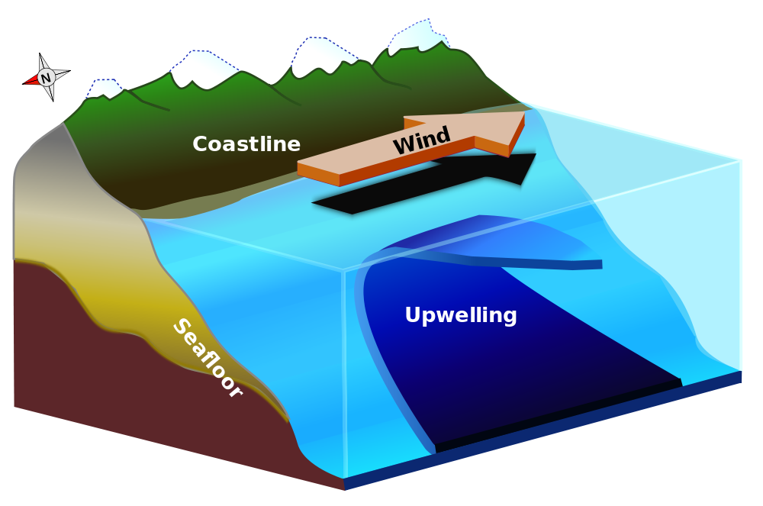
A water mass travels across entire oceans as an internal wave before it’s redirected towards the surface as an ‘upwelling’.
Notes:
https://www.discoveringgalapagos.org.uk/discover/geographical-processes/oceanography/upwelling/

Slide 18
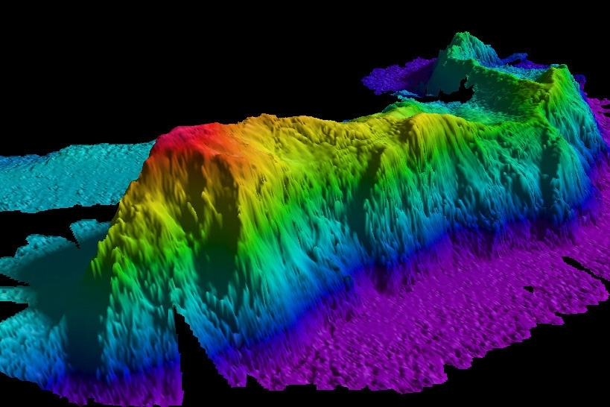
Notes:
https://www.rrisreet.top/ProductDetail.aspx?iid=390358560&pr=22.88

Slide 19
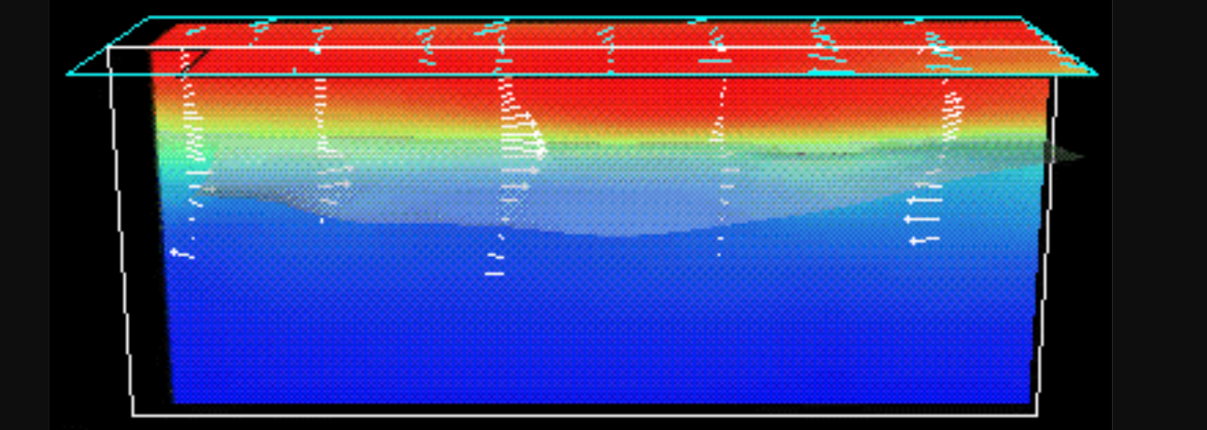
So long as it makes it to the surface !!
El Nino
South America
Australia
Notes:
http://www.atmo.arizona.edu/students/courselinks/spring16/atmo170a1s4/1S1P_stuff/el_nino/el_nino.html

Slide 20
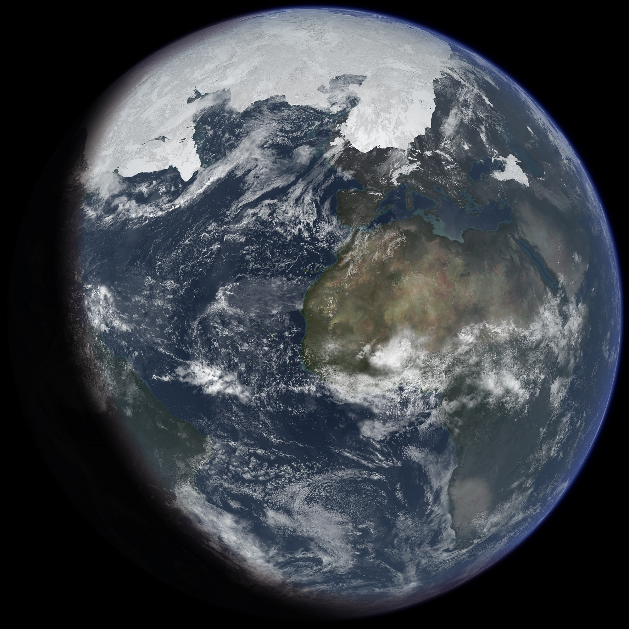
This global circulation pattern has a number of important implications for Earth’s environment.
For one, it is vital to the transport of heat around the globe, bringing warm water towards the poles, and cold water to the tropics, stabilizing temperature in both environments.
Artist's impression of ice age Earth at glacial maximum
Notes:
Image: https://www.universetoday.com/161458/new-climate-model-accurately-predicts-millions-of-years-of-ice-ages/

Slide 21
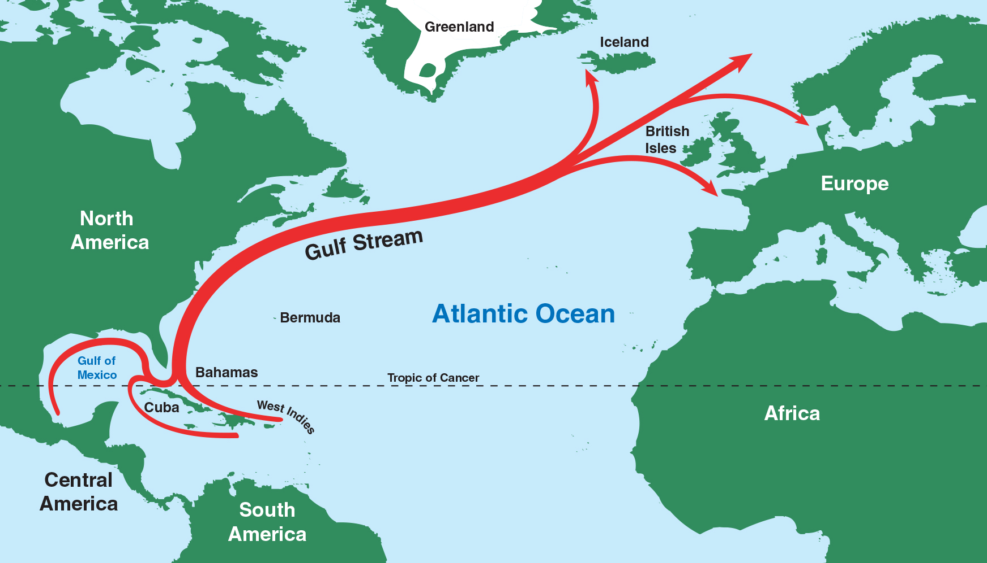
Notes:
https://rwu.pressbooks.pub/webboceanography/chapter/9-8-thermohaline-circulation/

Slide 22
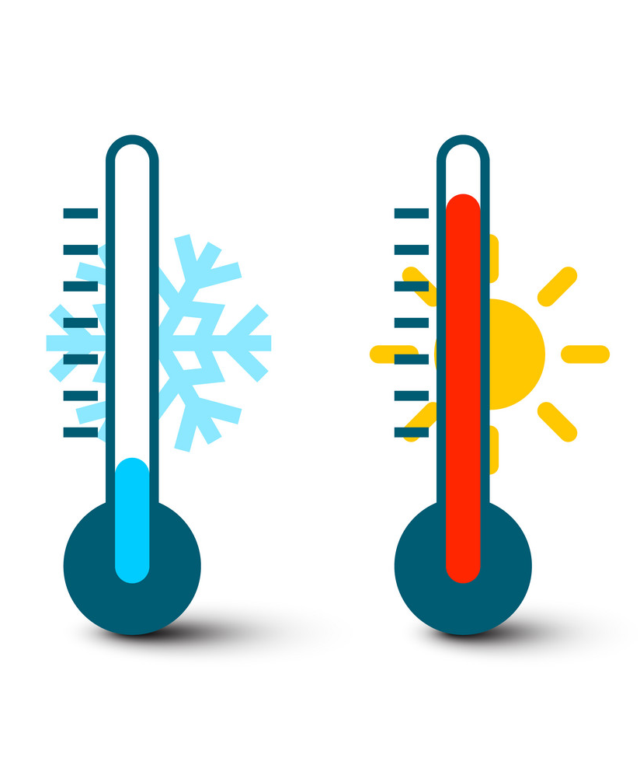
There are serious concerns that climate change is slowing down thermohaline circulation which could result in some crazy weather.
Recent evidence shows the strength of the Gulf Stream is slowing down.
It’s already lost about 15% of its strength since the mid-20th century.
That’s around 3,000,000 m³ less water being shifted per second.
This means that a lot of the heat that would have gone to Europe will instead stay along the east coast of the USA and in Florida.
Making Europe super cold and Florida USA super hot.
Europe
USA
Notes:
https://rwu.pressbooks.pub/webboceanography/chapter/9-8-thermohaline-circulation/
https://www.heraldnews.com/story/news/2019/08/09/the-gulf-stream-is-slowing/4504185007/

Slide 23
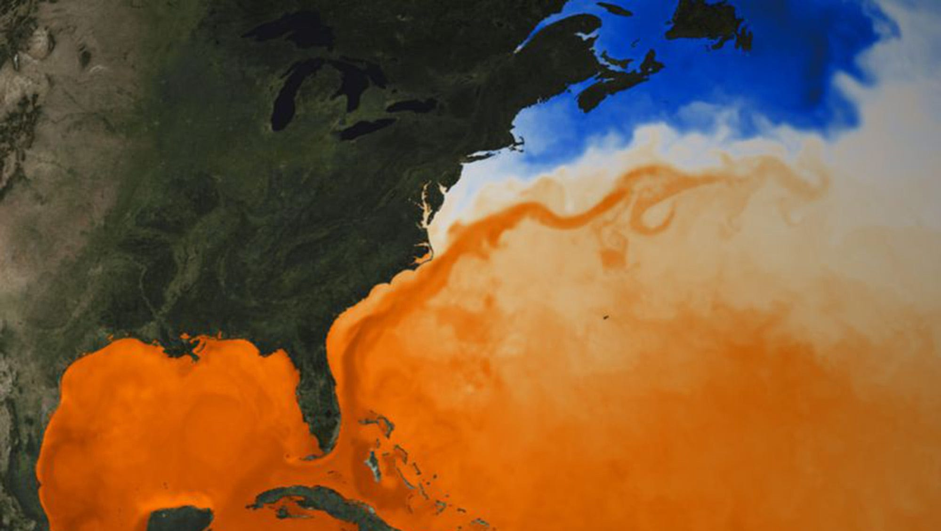
Gulf Stream
Notes:
https://www.heraldnews.com/story/news/2019/08/09/the-gulf-stream-is-slowing/4504185007/

Slide 24
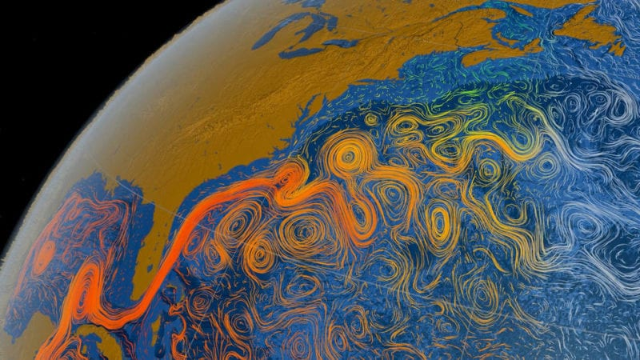
Notes:
https://havanatimes.org/news/study-climate-change-is-weakening-gulf-stream-ocean-currents/

Slide 25
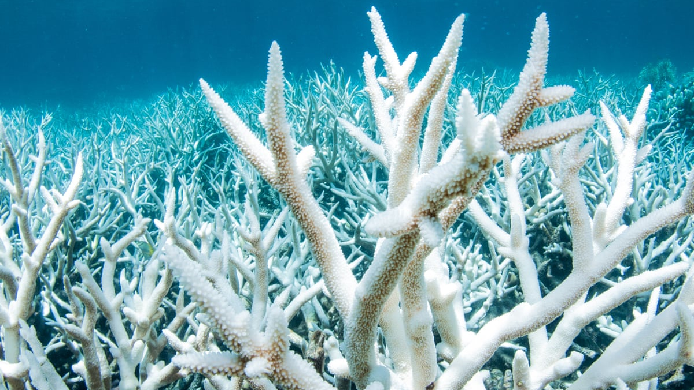
Marine Heat Wave Florida USA 2023

Slide 26

Europe cold snap 2022

Slide 27
Thermohaline circulation is also important for the transport of nutrients.
The Atlantic Ocean bottom water is low in nutrients because it’s had little time to accumulate.
But, by the time this bottom water reaches the Pacific Ocean, it has been accumulating the sinking nutrients for centuries.
So, nutrient concentrations are greater in the Pacific than the Atlantic.
Atlantic Ocean
Pacific Ocean
Notes:
https://rwu.pressbooks.pub/webboceanography/chapter/9-8-thermohaline-circulation/

Slide 28
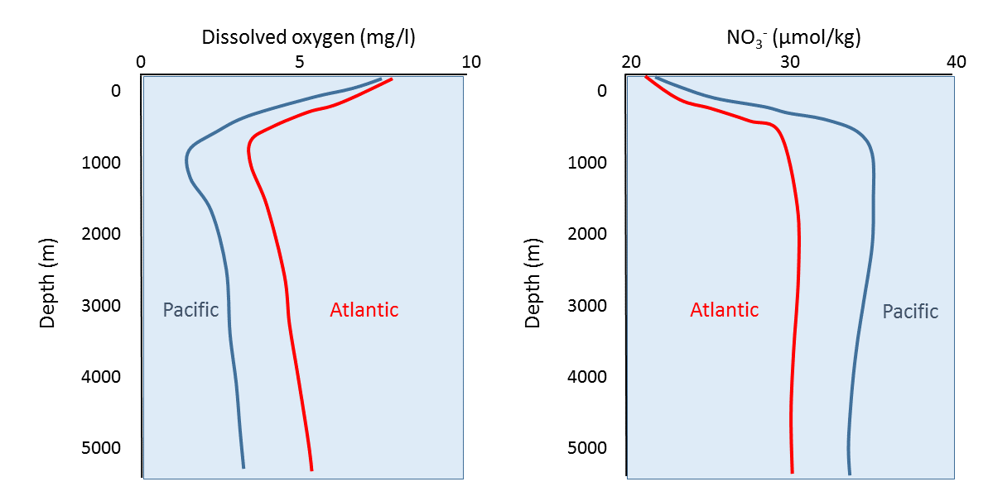
Younger (Atlantic) bottom water is also higher in oxygen than older (Pacific) bottom water.
Oxygen is used up in respiration and decomposition and there’s no photosynthesis that deep to replenish supplies.
(nutrients)
Notes:
https://rwu.pressbooks.pub/webboceanography/chapter/9-8-thermohaline-circulation/

Slide 29
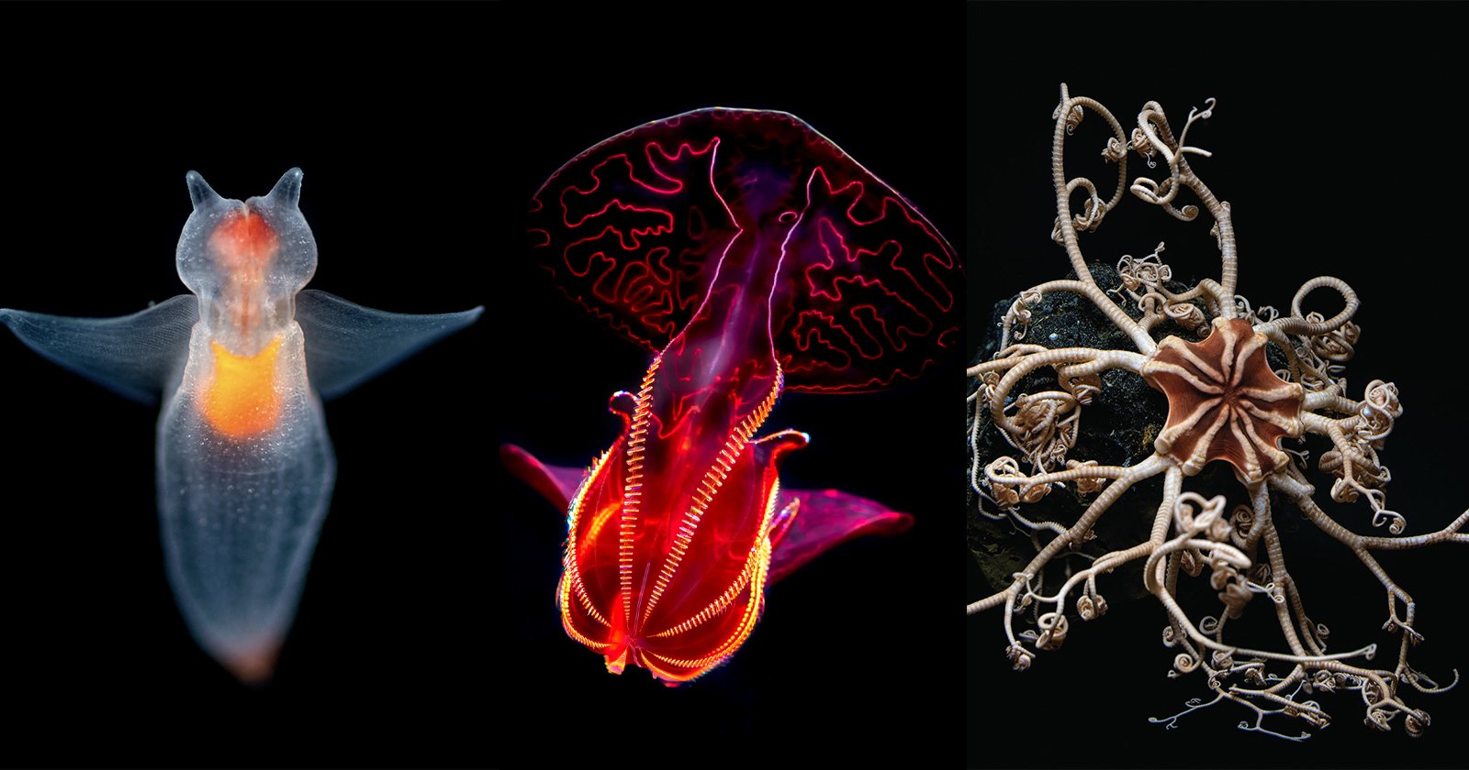
Another reason why thermohaline circulation is so important is because it delivers oxygen to deep water habitats.
All animals need oxygen to breathe.
Notes:
https://petapixel.com/2022/01/24/into-the-deep-photos-of-incredible-creatures-from-the-oceans-depths/

Slide 30
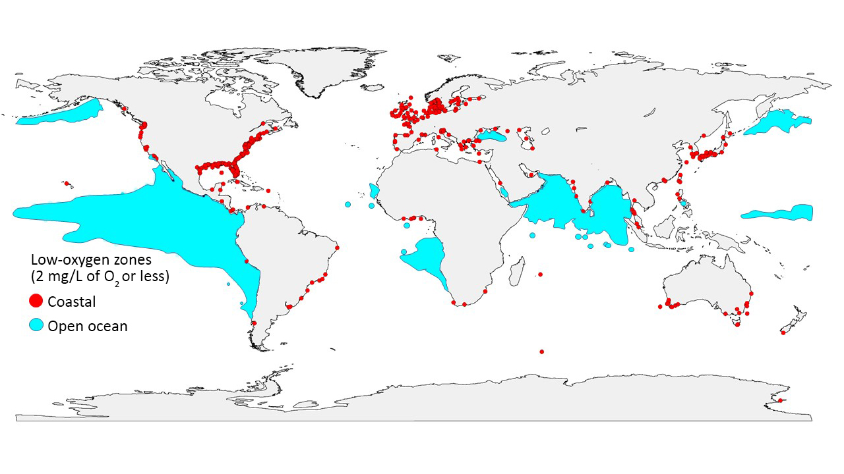
Oxygen ‘dead zones’
Notes:
Low-oxygen zones are spreading around the globe. Red dots mark places on the coast where oxygen has plummeted to 2 milligrams per liter or less, and blue areas mark zones with the same low-oxygen levels in the open ocean. (Credit: GO2NE working group. Data from World Ocean Atlas 2013 and provided by R. J. Diaz)
https://insider.si.edu/2018/01/earths-oceans-losing-breath-heres-global-scope/

Slide 31
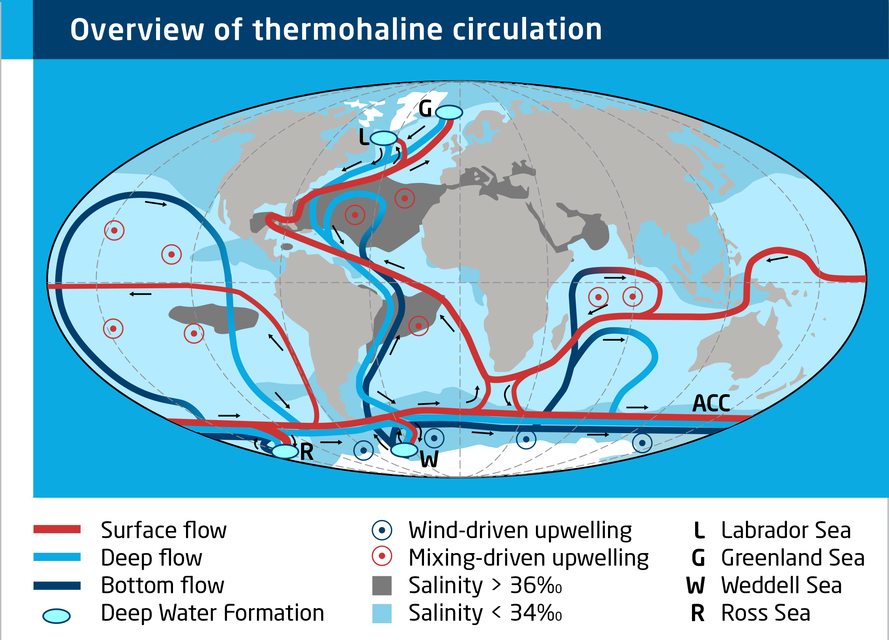
Notes:
https://www.meereisportal.de/en/learn-more/sea-ice-physics/sea-ice-and-ocean

Slide 32
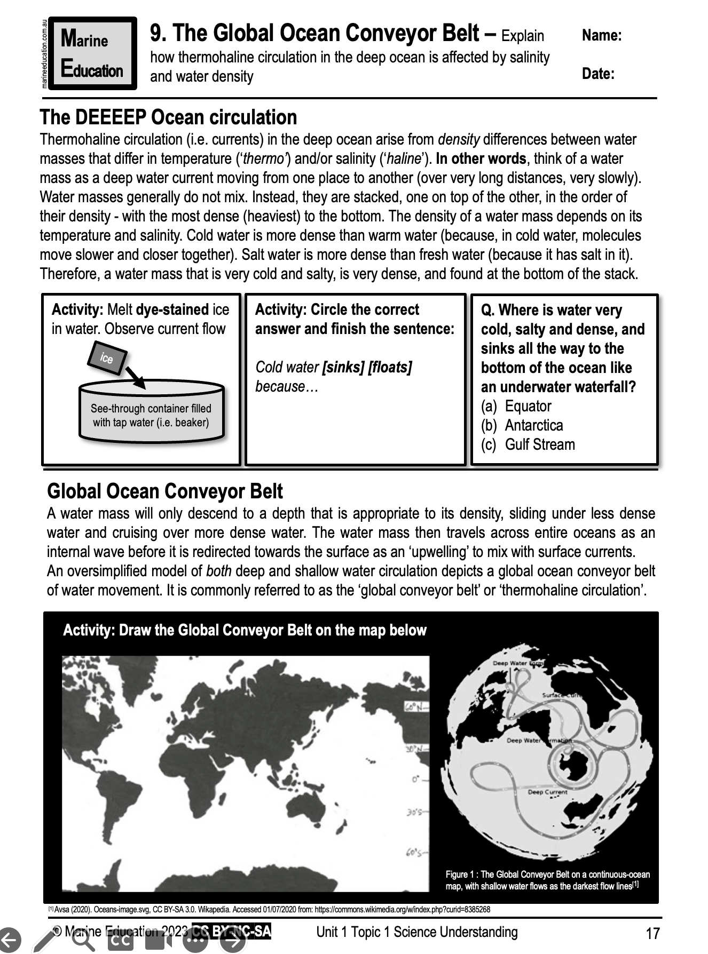
Learning Intention:
Explain how thermohaline circulation in the deep ocean is affected by salinity and water density
Success Criteria:
Complete Marine Education worksheet ‘9. The Global Ocean Conveyor Belt’
Notes:
https://www.grunge.com/462263/the-real-life-twilight-zone-explained/

