Slide 1
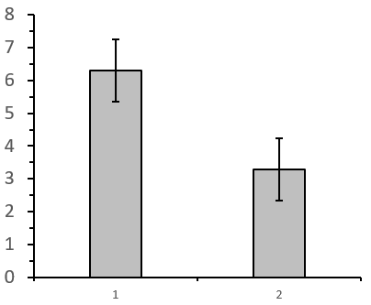
Marine
Education
Name:
Date:
marineeducation.com.au
Little Books of Statistics
Analyse and Create
Column Graphs
P = <0.0001
Dependent Variable (y)
Independent Variable (x)
y=mx + c
by Gail Riches
© Marine Education 2020

Slide 2
Marine
Education
marineeducation.com.au
© Marine Education 2020
No part of this publication may be reproduced, stored in a retrieval system or transmitted in any form or by means electronic, mechanical, photocopying, recording or otherwise without the prior written permission of the publisher.
ISBN: 978-0-6484089-6-3
Published by Marine Education 2020
ABN: 48765406873
Gail Riches
PO Box 394
Bli Bli Qld 4560
Email: info@marineeducation.com.au
www.marineeducation.com.au
Interested persons are invited to contact the author for information or to indicate errors and omissions.

Slide 3
Marine
Education
Table of Contents
marineeducation.com.au
The Column Graph
Error Bars
Research Question 1
Research Question 2
Research Question 3
1
29
Standard Deviation Error Bars
SEM
Error
Bars
32
43
CI Error
Bars
Which Error Bar to choose?
55
63
The P value
The t-test
67
71
© Marine Education 2020
Little Books of Statistics: Column Graphs
i

Slide 4
Marine
Education
Table of Contents
marineeducation.com.au
How to Create a Column Graph
in Excel
How to create the graph
89
90
How to add ERROR BARS
How to EDIT the
graph
103
108
How to EDIT
the y-axis
How to EDIT the x-axis
How to EDIT the columns
111
119
123
How to add
a caption
CHECKLIST
128
130
© Marine Education 2020
Little Books of Statistics: Column Graphs
ii

Slide 5
Marine
Education
The COLUMN Graph
marineeducation.com.au
The
Column
Graph
compares
two or more categories
using vertical columns
© Marine Education 2020
Little Books of Statistics: Column Graphs
1

Slide 6
Marine
Education
The COLUMN Graph
marineeducation.com.au
y
Categories
(columns)
1 | 2 | 3 | 4
x
Independent Variable
Note: sometimes called the explanatory or input variable
© Marine Education 2020
Little Books of Statistics: Column Graphs
2

Slide 7
Marine
Education
The COLUMN Graph
marineeducation.com.au
y
Dependent Variable
Height of columns
x
Note: sometimes called the response variable
© Marine Education 2020
Little Books of Statistics: Column Graphs
3

Slide 8
Marine
Education
The COLUMN Graph
marineeducation.com.au
 |  |  | Independent Variable (x)
 |  |  | Category 1 | Category 2
Dependent Variable (y) | Raw Data (Trials) | 1
 |  | 2
 |  | 3
 |  | 4
 |  | 5
Results Table (example)
Column Height
MEAN
© Marine Education 2020
Little Books of Statistics: Column Graphs
4

Slide 9
Marine
Education
Research Question 1
marineeducation.com.au
Is there a significant
difference in column height
between
Category 1
& Category 2?
© Marine Education 2020
Little Books of Statistics: Column Graphs
5

Slide 10
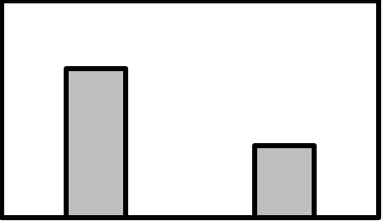
Marine
Education
Research Question 1
marineeducation.com.au
continued
For example
Category 1
Category 2
Note: assume the column height is a mean (average) value
© Marine Education 2020
Little Books of Statistics: Column Graphs
6

Slide 11
Marine
Education
Research Question 1
marineeducation.com.au
continued
We need
error bars!
© Marine Education 2020
Little Books of Statistics: Column Graphs
7

Slide 12
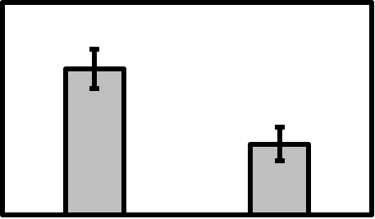
Marine
Education
Research Question 1
marineeducation.com.au
continued
Error bars
Do the error bars overlap?
NO
YES
Difference LIKELY
Difference UNLIKELY
© Marine Education 2020
Little Books of Statistics: Column Graphs
8

Slide 13
Marine
Education
Research Question 1
Marine
Education
marineeducation.com.au
marineeducation.com.au
continued
We also need a
P value!
© Marine Education 2020
Little Books of Statistics: Column Graphs
9

Slide 14
Marine
Education
Research Question 1
Marine
Education
marineeducation.com.au
marineeducation.com.au
continued
P=0.0002
Is the P value less than 0.05?
YES
NO
© Marine Education 2020
Little Books of Statistics: Column Graphs
10

Slide 15
Marine
Education
Research Question 1
Marine
Education
marineeducation.com.au
marineeducation.com.au
completed
P=0.0002
YES!
There IS a significant difference in column height between Category 1 and Category 2
because the error bars do NOT overlap
and the P-value is less than 0.05
© Marine Education 2020
Little Books of Statistics: Column Graphs
11

Slide 16
Marine
Education
Research Question 2
marineeducation.com.au
Well done!
Let’s try
another one…
© Marine Education 2020
Little Books of Statistics: Column Graphs
12

Slide 17
Marine
Education
Research Question 2
marineeducation.com.au
continued
Is there a significant
difference in column height
between
Category 3
& Category 4?
© Marine Education 2020
Little Books of Statistics: Column Graphs
13

Slide 18
Marine
Education
Research Question 2
marineeducation.com.au
continued
For example
Category 3
Category 4
Note: assume the column height is a mean (average) value
© Marine Education 2020
Little Books of Statistics: Column Graphs
40

Slide 19
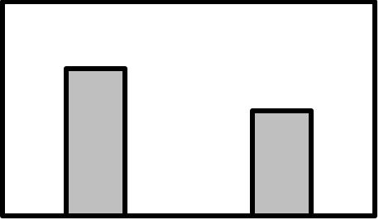
Marine
Education
Research Question 2
marineeducation.com.au
continued
We need
error bars!
© Marine Education 2020
Little Books of Statistics: Column Graphs
15

Slide 20
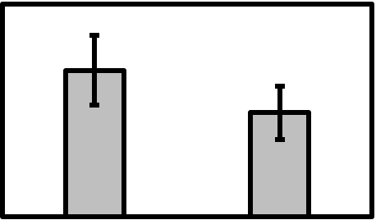
Marine
Education
Research Question 2
marineeducation.com.au
continued
Error bars
Do the error bars overlap?
NO
YES
Difference LIKELY
Difference UNLIKELY
© Marine Education 2020
Little Books of Statistics: Column Graphs
16

Slide 21
Marine
Education
Research Question 2
marineeducation.com.au
continued
We also need a
P value!
© Marine Education 2020
Little Books of Statistics: Column Graphs
17

Slide 22
Marine
Education
Research Question 2
marineeducation.com.au
continued
P=0.0636
Is the P value less than 0.05?
YES
NO
© Marine Education 2020
Little Books of Statistics: Column Graphs
18

Slide 23
Marine
Education
Research Question 2
marineeducation.com.au
completed
P=0.0636
NO!
There is NO significant difference in column height between Category 3 and Category 4
because the error bars overlap
and the P-value is more than 0.05
© Marine Education 2020
Little Books of Statistics: Column Graphs
19

Slide 24
Marine
Education
Research Question 3
marineeducation.com.au
Well done!
Let’s try
another one…
© Marine Education 2020
Little Books of Statistics: Column Graphs
20

Slide 25
Marine
Education
Research Question 3
marineeducation.com.au
continued
Is there a significant
difference in column height
between
Category 5
& Category 6?
© Marine Education 2020
Little Books of Statistics: Column Graphs
21

Slide 26
Marine
Education
Research Question 3
marineeducation.com.au
continued
For example
Category 5
Category 6
Note: assume the column height is a mean (average) value
© Marine Education 2020
Little Books of Statistics: Column Graphs
22

Slide 27
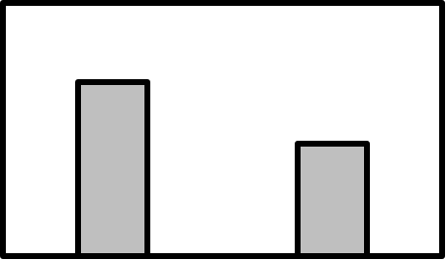
Marine
Education
Research Question 3
Marine
Education
marineeducation.com.au
marineeducation.com.au
continued
We need
error bars!
© Marine Education 2020
Little Books of Statistics: Column Graphs
23

Slide 28
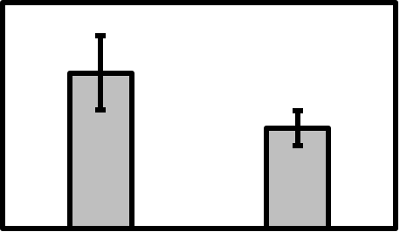
Marine
Education
Research Question 3
Marine
Education
marineeducation.com.au
marineeducation.com.au
continued
Error bars
Do the error bars overlap?
?
© Marine Education 2020
Little Books of Statistics: Column Graphs
24

Slide 29
Marine
Education
Research Question 3
Marine
Education
marineeducation.com.au
marineeducation.com.au
continued
We also need a
P value!
© Marine Education 2020
Little Books of Statistics: Column Graphs
25

Slide 30
Marine
Education
Research Question 3
Marine
Education
marineeducation.com.au
marineeducation.com.au
continued
P=0.0172
Is the P value less than 0.05?
YES
NO
© Marine Education 2020
Little Books of Statistics: Column Graphs
26

Slide 31
Marine
Education
Research Question 3
Marine
Education
marineeducation.com.au
marineeducation.com.au
completed
P=0.0172
YES!
There IS a significant difference in column height between Category 5 and Category 6
because the P-value is less than 0.05
© Marine Education 2020
Little Books of Statistics: Column Graphs
27

Slide 33

Marine
Education
Error Bars
marineeducation.com.au
WARNING!!!!
Never answer a research question using Error Bars. Only the P value can answer the research question. Error bars are there to accompany the P value.
This is because there are different types and sizes of error bars. For example, standard deviation (s) error bars will be a different size to standard error of the mean (SEM) error bars, which will be a different size to Confidence Interval (CI) error bars. It is the author’s choice which error bars to use.
Warning!!!
© Marine Education 2020
Little Books of Statistics: Column Graphs
29

Slide 34
Marine
Education
Error Bars
marineeducation.com.au
For example, all graphs below were made using the
SAME data and have the SAME P value (P=0.0712).
But the error bars are all different types and sizes.
P=0.712
Standard Deviation
(s or σ)
Error Bars
P=0.712
Standard Error
of the Mean (SEM)
Error Bars
P=0.712
Confidence Interval (CI)
Error Bars
They all have the same P-value (0.0712) which is more than 0.05 which means there is NO significant difference between A and B which means the error bars should only just be overlapping
© Marine Education 2020
Little Books of Statistics: Column Graphs
30

Slide 35
Marine
Education
Error Bars
marineeducation.com.au
What does each
Error Bar
mean?
and
Which one
should I use?
© Marine Education 2020
Little Books of Statistics: Column Graphs
31

Slide 36
Standard Deviation Error Bars
Marine
Education
marineeducation.com.au
Standard
Deviation
s or σ
(the spread of the data)
measures
PRECISION
E.g. were your repeats
all the same, or similar?
(as they should’ve been)
© Marine Education 2020
Little Books of Statistics: Column Graphs
32

Slide 37
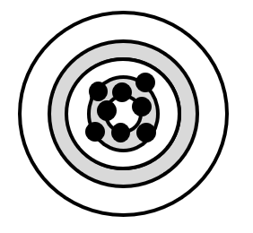
Standard Deviation Error Bars
Marine
Education
marineeducation.com.au
An error bar
indicates a
degree of ERROR
hence the name
E.g. with the mean as our target,
we always aim for values to be
close to the mean
© Marine Education 2020
Little Books of Statistics: Column Graphs
33

Slide 38
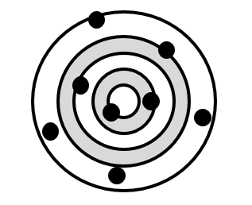
Standard Deviation Error Bars
Marine
Education
marineeducation.com.au
LOW PRECISION
LARGE
STANDARD DEVIATION
© Marine Education 2020
Little Books of Statistics: Column Graphs
34

Slide 39
Standard Deviation Error Bars
Marine
Education
marineeducation.com.au
marineeducation.com.au
HIGH PRECISION
SMALL
STANDARD DEVIATION
© Marine Education 2020
Little Books of Statistics: Column Graphs
35

Slide 40
Standard Deviation Error Bars
Marine
Education
marineeducation.com.au
LOW PRECISION
LARGE ERROR BAR
© Marine Education 2020
Little Books of Statistics: Column Graphs
36

Slide 41
Standard Deviation Error Bars
Marine
Education
marineeducation.com.au
HIGH PRECISION
SMALL ERROR BAR
© Marine Education 2020
Little Books of Statistics: Column Graphs
37

Slide 42
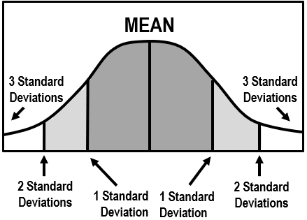
Standard Deviation Error Bars
Marine
Education
marineeducation.com.au
When values are bunched
close to the mean
Standard deviation is SMALL
Error Bars are SMALL
© Marine Education 2020
Little Books of Statistics: Column Graphs
38

Slide 43
Standard Deviation Error Bars
Marine
Education
marineeducation.com.au
Top of error bar =
mean + standard deviation
Bottom of error bar =
mean – standard deviation
Standard deviation
Mean
Standard deviation
© Marine Education 2020
Little Books of Statistics: Column Graphs
39

Slide 44
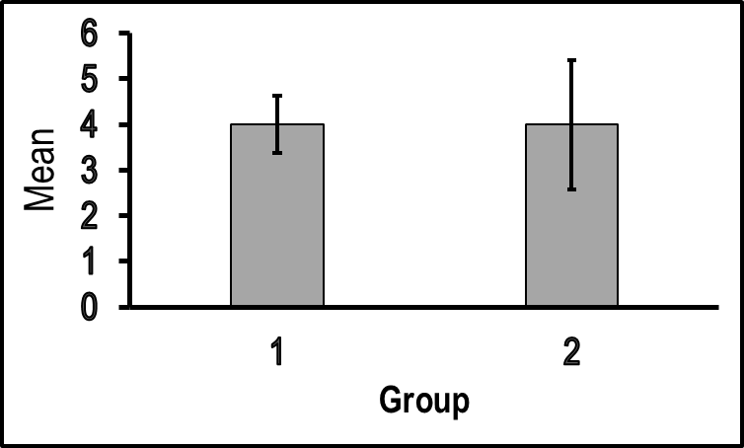
Standard Deviation Error Bars
Marine
Education
marineeducation.com.au
For example
Category 1
Category 3
Category 1
Raw Data:
3, 4, 4, 4, 4, 5
Mean: 4
Standard Deviation: 0.6
Category 3
Raw Data:
2, 3, 4, 4, 5, 6
Mean: 4
Standard Deviation: 1.4
© Marine Education 2020
Little Books of Statistics: Column Graphs
40

Slide 45
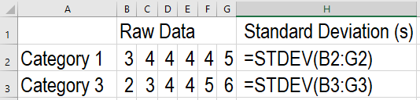
Standard Deviation Error Bars
Marine
Education
marineeducation.com.au
marineeducation.com.au
How to calculate standard deviation in excel
=STDEV( : )
Enter cell coordinates for raw data here
OR
after the first bracket, use your touch pad or mouse to highlight the raw data values
(then close bracket and press enter)
© Marine Education 2020
Little Books of Statistics: Column Graphs
41

Slide 47
Marine
Education
Standard Error of the Mean
Error Bars
marineeducation.com.au
Standard Error
of the Mean
(SEM)
measures
ACCURACY
e.g. how accurately does the sample mean represent the population mean?
main focus!
© Marine Education 2020
Little Books of Statistics: Column Graphs
43

Slide 48

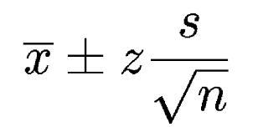
Marine
Education
Standard Error of the Mean
Error Bars
marineeducation.com.au
LOW ACCURACY
LARGE SEM
µ
µ
= population mean
= sample mean
© Marine Education 2020
Little Books of Statistics: Column Graphs
44

Slide 49
Marine
Education
Standard Error of the Mean
Error Bars
marineeducation.com.au
HIGH ACCURACY
SMALL SEM
µ
© Marine Education 2020
Little Books of Statistics: Column Graphs
45

Slide 50
Marine
Education
Standard Error of the Mean
Error Bars
marineeducation.com.au
LOW ACCURACY
LARGE ERROR BAR
Population Mean
µ
were we close? No
© Marine Education 2020
Little Books of Statistics: Column Graphs
46

Slide 51
Marine
Education
Standard Error of the Mean
Error Bars
marineeducation.com.au
HIGH ACCURACY
SMALL ERROR BAR
Population Mean
were we close? Yes
© Marine Education 2020
Little Books of Statistics: Column Graphs
47

Slide 52
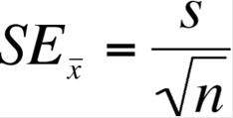
Marine
Education
Standard Error of the Mean
Error Bars
marineeducation.com.au
the precision of your dart throwing
√ number of darts
Note: SEM operates on the assumption that 68.2% of the sample means are within 1 standard deviation of the population mean, 95.4% within 2 standard deviations, and 99.7% are within 3, as per the normal distribution / bell curve.
© Marine Education 2020
Little Books of Statistics: Column Graphs
48

Slide 53
Marine
Education
Standard Error of the Mean
Error Bars
marineeducation.com.au
More darts (n)
Less error (SEM)
Standard Error of the Mean
(error in population mean estimate)
n
© Marine Education 2020
Little Books of Statistics: Column Graphs
49

Slide 54
Marine
Education
Standard Error of the Mean
Error Bars
marineeducation.com.au
SEM error bars
are always
smaller than
standard deviation (s) error bars
Because of this!
© Marine Education 2020
Little Books of Statistics: Column Graphs
50

Slide 55
Marine
Education
Standard Error of the Mean
Error Bars
marineeducation.com.au
Top of error bar =
mean + SEM
Bottom of error bar =
mean – SEM
SEM
Mean
SEM
© Marine Education 2020
Little Books of Statistics: Column Graphs
51

Slide 56
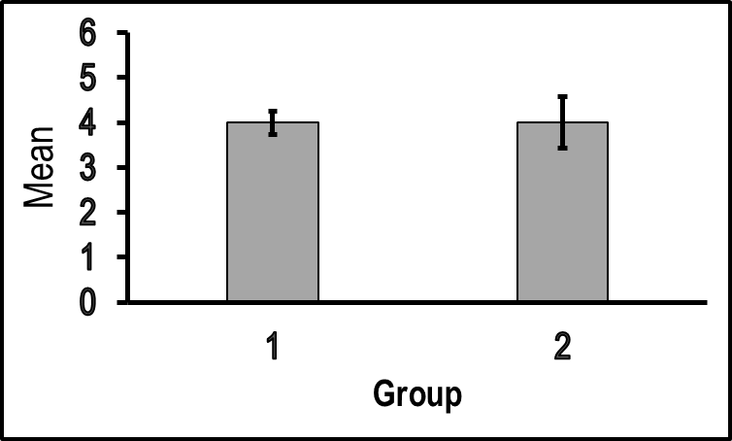
Marine
Education
Standard Error of the Mean
Error Bars
marineeducation.com.au
For example
Category 1
Category 3
Category 1
Sample Means
3, 4, 4, 4, 4, 5
Mean of Means: 4
Standard Error
of the Mean: 0.26
Category 3
Sample Means:
2, 3, 4, 4, 5, 6
Mean of Means: 4
Standard Error
of the Mean: 0.58
© Marine Education 2020
Little Books of Statistics: Column Graphs
52

Slide 57
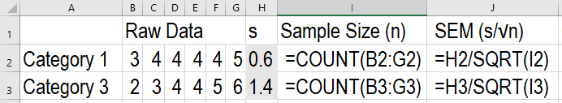
Marine
Education
Standard Error of the Mean
Error Bars
marineeducation.com.au
marineeducation.com.au
How to calculate SEM in excel
First, calculate sample size (n)
=COUNT( : )
Then, calculate SEM
=s/SQRT(n)
© Marine Education 2020
Little Books of Statistics: Column Graphs
53

Slide 59
Marine
Education
Confidence Interval
Error Bars
marineeducation.com.au
A Confidence Interval
(CI)
is a
range of values
that
you are confident
(by a certain percentage)
contain the
population mean
Large range = large error bars
Small range = small error bars
What is a CONFIDENCE INTERVAL (CI)?
© Marine Education 2020
Little Books of Statistics: Column Graphs
55

Slide 60
Marine
Education
Confidence Interval
Error Bars
Marine
Education
marineeducation.com.au
marineeducation.com.au
“I am 95% confident the population mean (µ) will be in the shaded area”
What is a CONFIDENCE INTERVAL (CI)?
95%
2.5%
2.5%
-1.96
+1.96
95% Confidence Interval
© Marine Education 2020
Little Books of Statistics: Column Graphs
56

Slide 61
Marine
Education
Confidence Interval
Error Bars
marineeducation.com.au
95% Confidence Interval Formula
What is a CONFIDENCE INTERVAL (CI)?
CI =
(95%)
± 1.96
When n > 100
Sample Mean
plus or minus
the Z value
(for a 95% level of confidence)
multiplied by the
SEM
© Marine Education 2020
Little Books of Statistics: Column Graphs
57

Slide 62
Marine
Education
Confidence Interval
Error Bars
marineeducation.com.au
Confidence Interval error bars are always
LARGER than standard deviation (s) error bars
or SEM error bars (s/√n)
CI =
(95%)
± 1.96
Because of this!
(e.g. 1.96 x SEM = roughly double the SEM error bars)
© Marine Education 2020
Little Books of Statistics: Column Graphs
58

Slide 63
Marine
Education
Confidence Interval
Error Bars
marineeducation.com.au
Top of error bar =
mean + CI
Bottom of error bar =
mean – CI
CI
Mean
CI
© Marine Education 2020
Little Books of Statistics: Column Graphs
59

Slide 64
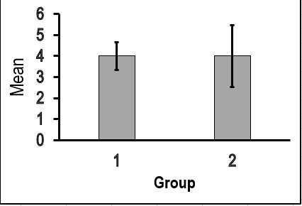
Marine
Education
Confidence Interval
Error Bars
marineeducation.com.au
For example
Category 1
Category 3
Category 1
Sample means:
3, 4, 4, 4, 4, 5
Mean of Means: 4
95% Confidence Interval: 0.66
Category 3
Sample means:
2, 3, 4, 4, 5, 6
Mean of Means: 4
95% Confidence Interval: 1.48
© Marine Education 2020
Little Books of Statistics: Column Graphs
60

Slide 65
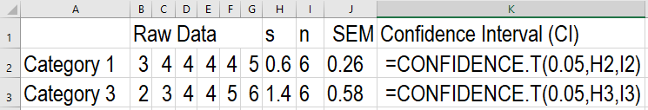
Marine
Education
Confidence Interval
Error Bars
marineeducation.com.au
marineeducation.com.au
How to calculate Confidence Interval in excel
=CONFIDENCE.T(α,s,n)
Alpha (α) is 0.05 for a
confidence interval of 95%
Remember the commas,
and NO spaces!
© Marine Education 2020
Little Books of Statistics: Column Graphs
61

Slide 67
Marine
Education
Which error bar to choose?
marineeducation.com.au
Which
error bar
should I use?
© Marine Education 2020
Little Books of Statistics: Column Graphs
63

Slide 68
Marine
Education
Which error bar to choose?
marineeducation.com.au
Use
standard deviation
error bars
if you want to communicate PRECISION
i.e. how much variation there is between individual observations
(that technically should all be the same)
© Marine Education 2020
Little Books of Statistics: Column Graphs
64

Slide 69
Marine
Education
Which error bar to choose?
marineeducation.com.au
Use
SEM error bars
if you want to communicate ACCURACY
i.e. In particular, how good is
your estimate of the
population mean?
main focus!
µ
µ
© Marine Education 2020
Little Books of Statistics: Column Graphs
65

Slide 70
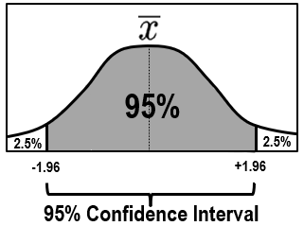
Marine
Education
Which error bar to choose?
marineeducation.com.au
Use
Confidence Interval error bars
if you want to communicate ACCURACY
by showing the range of values
likely to include the
population mean
by a certain percentage (e.g. 95%)
© Marine Education 2020
Little Books of Statistics: Column Graphs
66

Slide 71
Marine
Education
The P value
marineeducation.com.au
What is the
P value?
© Marine Education 2020
Little Books of Statistics: Column Graphs
67

Slide 72
Marine
Education
The P value
marineeducation.com.au
If P is less than 0.05
There IS a significant
difference between 2 groups
If P is more than 0.05
There is NO significant difference between 2 groups
© Marine Education 2020
Little Books of Statistics: Column Graphs
68

Slide 73
Marine
Education
The P value
marineeducation.com.au
Question: Which P value indicates there IS a significant difference between 2 groups?
P = 0.001
P = 0.06
P = 0.4
Because P is less than 0.05
© Marine Education 2020
Little Books of Statistics: Column Graphs
69

Slide 74
Marine
Education
The P value
marineeducation.com.au
The word SIGNIFICANT
is a science term
and simply means a STATISTICS test
such as a
t-test
was used to answer the
research question
© Marine Education 2020
Little Books of Statistics: Column Graphs
70

Slide 75
Marine
Education
The t-test
marineeducation.com.au
The P value is
calculated using a
t-test
© Marine Education 2020
Little Books of Statistics: Column Graphs
71

Slide 76
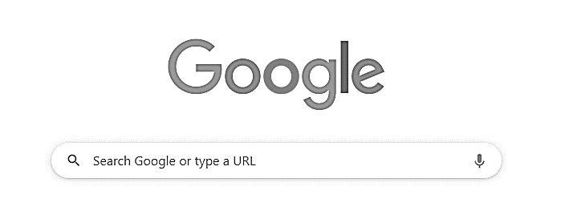
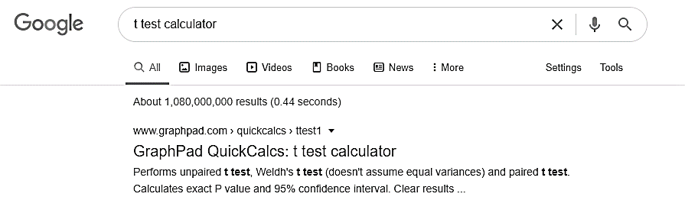
Marine
Education
The t-test
marineeducation.com.au
Step 1: Search t-test calculator
t-test calculator
Step 2: Open GraphPad
https://www.graphpad.com/quickcalcs/ttest1.cfm
© Marine Education 2020
Little Books of Statistics: Column Graphs
72

Slide 77
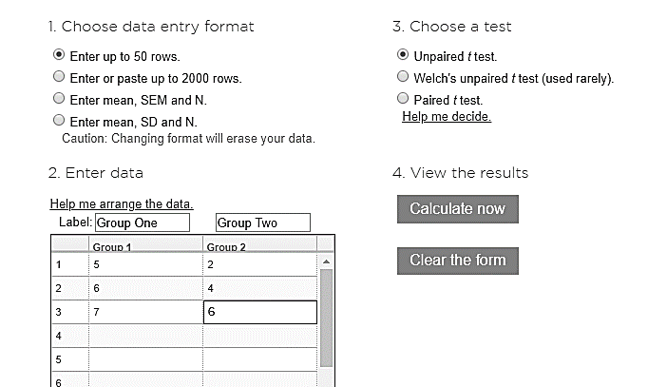
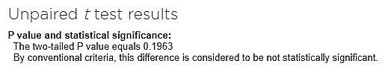
Marine
Education
The t-test
marineeducation.com.au
Step 3: Enter Data
For example:
Don’t change
Enter Data
Calculate now
Step 4: Click Calculate now
P value
© Marine Education 2020
Little Books of Statistics: Column Graphs
73

Slide 78
Marine
Education
The t-test
marineeducation.com.au
What is a
t-test?
A t-test is a type of inferential statistic used to identify any statistical difference between two groups
Mean
1
2
© Marine Education 2020
Little Books of Statistics: Column Graphs
74

Slide 79
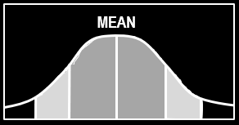
Marine
Education
The t-test
marineeducation.com.au
Assuming each group is of
normal distribution
(bell curve)
mean = median = mode
Number of scores (n)
Scores (e.g. raw data, or sample means)
© Marine Education 2020
Little Books of Statistics: Column Graphs
75

Slide 80
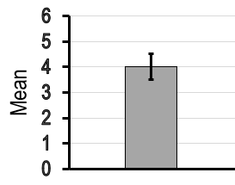
Marine
Education
The t-test
marineeducation.com.au
For example [3, 4, 4, 4, 4, 5]
© Marine Education 2020
Little Books of Statistics: Column Graphs
76

Slide 81
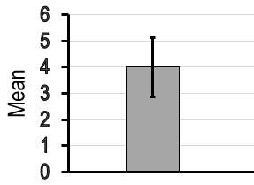
Marine
Education
The t-test
marineeducation.com.au
For example [2, 3, 4, 4, 5, 6]
© Marine Education 2020
Little Books of Statistics: Column Graphs
77

Slide 82
Marine
Education
The t-test
marineeducation.com.au
So, when you put 2 group distributions side-by-side…
x1
fix
x2
fix
Number of scores (n)
scores
© Marine Education 2020
Little Books of Statistics: Column Graphs
78

Slide 83
Marine
Education
The t-test
marineeducation.com.au
…how far apart are their means?
© Marine Education 2020
Little Books of Statistics: Column Graphs
79

Slide 84
Marine
Education
The t-test
marineeducation.com.au
….and how much do they overlap?
© Marine Education 2020
Little Books of Statistics: Column Graphs
80

Slide 85
Marine
Education
The t-test
marineeducation.com.au
Distance apart
Overlap
© Marine Education 2020
Little Books of Statistics: Column Graphs
81

Slide 86
Marine
Education
The t-test
marineeducation.com.au
Distance apart
(Distance between 2 group means)
x1 – x2
SE x1-x2
Note: subscripts indicate group number
© Marine Education 2020
Little Books of Statistics: Column Graphs
82

Slide 87
Marine
Education
The t-test
marineeducation.com.au
x1 – x2
SE x1-x2
Overlap of distributions
(Standard Error of the Difference)
© Marine Education 2020
Little Books of Statistics: Column Graphs
83

Slide 88
Marine
Education
The t-test
marineeducation.com.au
For example P = < 0.05
HIGH precision
SMALL error bars
© Marine Education 2020
Little Books of Statistics: Column Graphs
84

Slide 89
Marine
Education
The t-test
marineeducation.com.au
Little overlap
of distributions
© Marine Education 2020
Little Books of Statistics: Column Graphs
85

Slide 90
Marine
Education
The t-test
marineeducation.com.au
For example P = > 0.05
LOW precision
LARGE error bars
© Marine Education 2020
Little Books of Statistics: Column Graphs
86

Slide 91
Marine
Education
The t-test
marineeducation.com.au
Lots of overlap
(hiding any difference, if there is one)
© Marine Education 2020
Little Books of Statistics: Column Graphs
87

Slide 93
Marine
Education
marineeducation.com.au
Little Books of Statistics
How to Create a Column Graph
in
EXCEL
© Marine Education 2020
Little Books of Statistics: Column Graphs
89

Slide 94
Marine
Education
How to CREATE the graph
marineeducation.com.au
Research Question
Is there a
significant
difference in
the number of
Giant Clams
(Tridacna gigas) on Reef 1 (protected) and Reef 2 (unprotected)?
© Marine Education 2020
Little Books of Statistics: Column Graphs
90

Slide 95
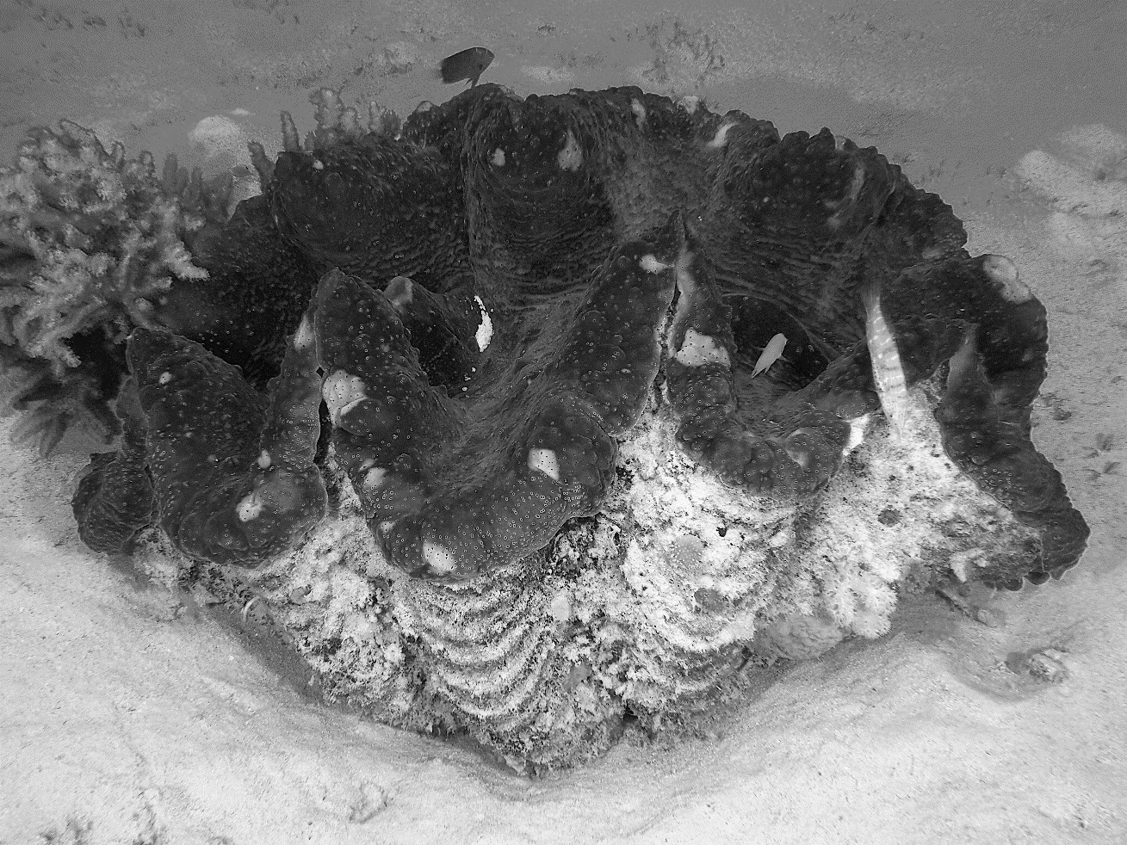
Marine
Education
How to CREATE the graph
marineeducation.com.au
Giant Clam (Tridacna gigas)
© Marine Education 2020
Little Books of Statistics: Column Graphs
91

Slide 96
Marine
Education
How to CREATE the graph
marineeducation.com.au
Methodology
Giant Clams
were counted
2 metres either side of 3x30m transects
in both
reef locations
© Marine Education 2020
Little Books of Statistics: Column Graphs
92

Slide 97
Marine
Education
How to CREATE the graph
marineeducation.com.au
Reef 1 (protected)
30m transect
Reef 2 (unprotected)
© Marine Education 2020
Little Books of Statistics: Column Graphs
93

Slide 98
Marine
Education
How to CREATE the graph
marineeducation.com.au
Re |  |  | Location
 |  |  | Reef 1 | Reef 2
Number of Giant Clams (T. gigas) | Raw Data (Transects) | 1 | 5 | 2
 |  | 2 | 6 | 4
 |  | 3 | 7 | 6
Results Table
MEAN
© Marine Education 2020
Little Books of Statistics: Column Graphs
94

Slide 99
Marine
Education
How to CREATE the graph
marineeducation.com.au
Calculate the MEAN (average)
WARNING! Do NOT graph the raw data.
Error bars are only used on graphs
that have graphed the mean (average)
© Marine Education 2020
Little Books of Statistics: Column Graphs
95

Slide 100
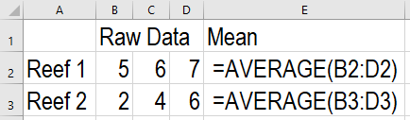
Marine
Education
How to CREATE the graph
marineeducation.com.au
marineeducation.com.au
How to calculate the Mean (average) in excel
=AVERAGE( : )
Enter cell coordinates for raw data here
OR
after the first bracket, use your touch pad or mouse to highlight the raw data values
(then close bracket and press enter)
© Marine Education 2020
Little Books of Statistics: Column Graphs
96

Slide 101
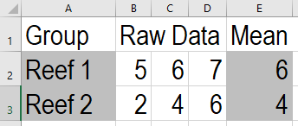
Marine
Education
How to CREATE the graph
marineeducation.com.au
Highlight category names
and mean values ONLY
Hint: Use the ctrl button to highlight separated values
Note: Ensure the categories are given names, using words
© Marine Education 2020
Little Books of Statistics: Column Graphs
97

Slide 102

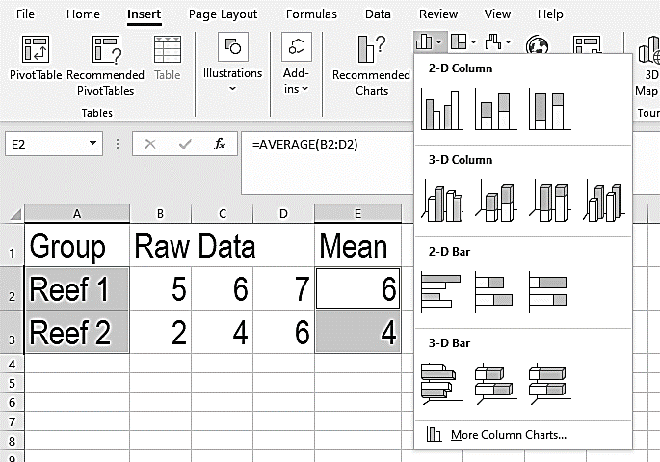
Marine
Education
How to CREATE the graph
marineeducation.com.au
Click on Insert tab
Select Column Chart
Insert
Select
2-D Column
(clustered column)
© Marine Education 2020
Little Books of Statistics: Column Graphs
98

Slide 103
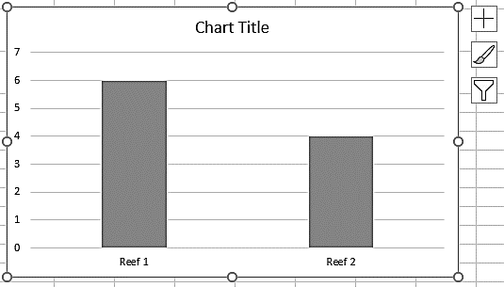
Marine
Education
How to CREATE the graph
marineeducation.com.au
Excel will generate a chart
that looks a little something
like this…
Now it is time to
add the error bars!
© Marine Education 2020
Little Books of Statistics: Column Graphs
99

Slide 104
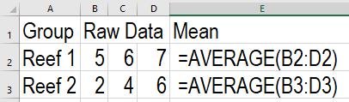
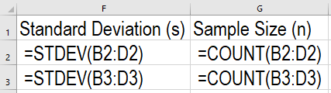
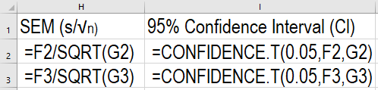
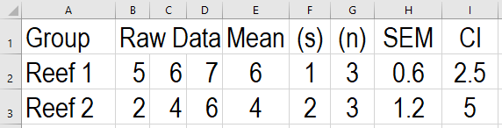
Marine
Education
How to CREATE the graph
marineeducation.com.au
Choose a value to calculate for your ERROR Bars (s, SEM or Cl)
© Marine Education 2020
Little Books of Statistics: Column Graphs
100

Slide 105

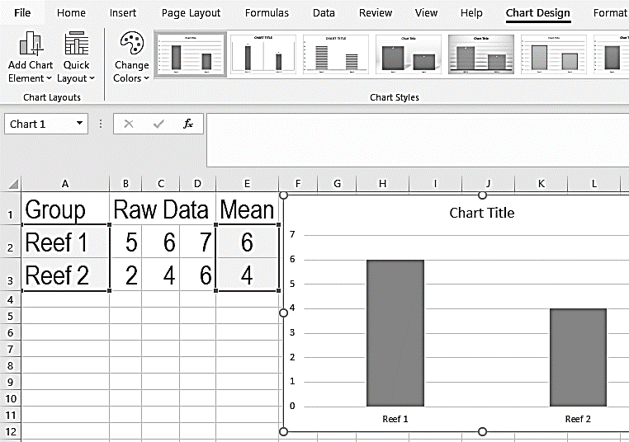

Marine
Education
How to CREATE the graph
marineeducation.com.au
Click on the Graph
Click Chart Design tab
Click Add Chart Element
(drop down box of options appears)
© Marine Education 2020
Little Books of Statistics: Column Graphs
101

Slide 106
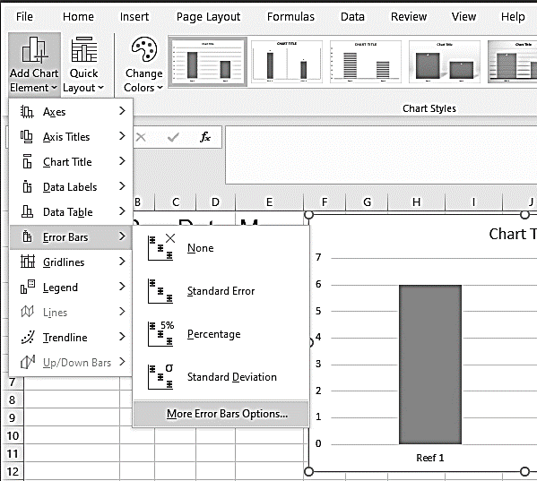
Marine
Education
How to CREATE the graph
marineeducation.com.au
Click on Error Bars
Select More Error Bars Options
Format Error Bars appears RHS
© Marine Education 2020
Little Books of Statistics: Column Graphs
102

Slide 107

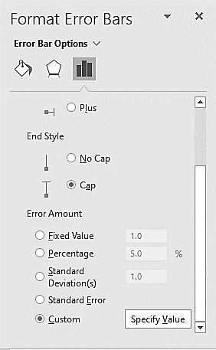
Marine
Education
How to add ERROR BARS
marineeducation.com.au
Select
(scroll down)
Select Custom
Select Specify Value
© Marine Education 2020
Little Books of Statistics: Column Graphs
103

Slide 108
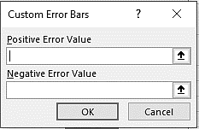
Marine
Education
How to add ERROR BARS
marineeducation.com.au
DELETE all default values
in Positive Error Value and Negative Error Value
Put your curser in
Positive Error Value
(to be ready to enter some data)
© Marine Education 2020
Little Books of Statistics: Column Graphs
104

Slide 109
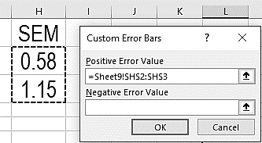
Marine
Education
How to add ERROR BARS
marineeducation.com.au
Use your touch pad or mouse to
Highlight ALL data
from the error bar
of your choice
(i.e. highlight data from both groups. NOT the heading)
For this example
I chose to use SEM error bars
© Marine Education 2020
Little Books of Statistics: Column Graphs
105

Slide 110
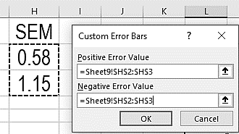
Marine
Education
How to add ERROR BARS
marineeducation.com.au
Repeat for the
Negative Error Value
When finished, the Positive Error Value and the Negative Error
Value should be the SAME
Click OK
© Marine Education 2020
Little Books of Statistics: Column Graphs
106

Slide 111
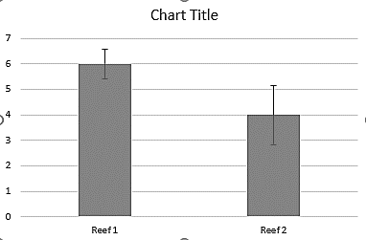
Marine
Education
How to add ERROR BARS
marineeducation.com.au
Error Bars should automatically appear on your graph
Now it’s time to EDIT the graph
e.g. customise the titles and axis,
delete the grid lines and
remove any colour from the graph
© Marine Education 2020
Little Books of Statistics: Column Graphs
107

Slide 112
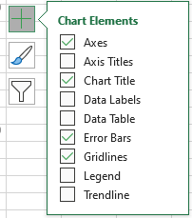
Marine
Education
How to EDIT the graph
marineeducation.com.au
Click on the Graph
Click
© Marine Education 2020
Little Books of Statistics: Column Graphs
108

Slide 113
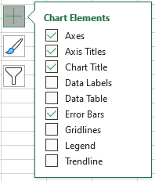
Marine
Education
How to EDIT the graph
marineeducation.com.au
Tick Axis Titles
Un-tick Gridlines
© Marine Education 2020
Little Books of Statistics: Column Graphs
109

Slide 114
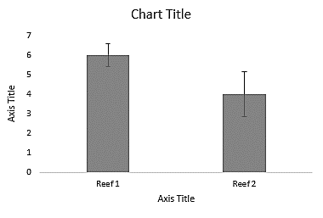
Marine
Education
How to EDIT the graph
marineeducation.com.au
Click on Chart Title
until curser appears. Backspace to delete.
Type (what it is)
Repeat for Axis Title
Note: Delete x-axis title if group headings already self-explanatory. Reminder: Don’t forget the units of measurement in brackets!
Hint: Use the Home tab to change font type, font size, etc.
© Marine Education 2020
Little Books of Statistics: Column Graphs
110

Slide 115
Marine
Education
How to EDIT the y-axis
marineeducation.com.au
Double Click
(or right click)
on the y-axis
to open Format Axis on the RHS
© Marine Education 2020
Little Books of Statistics: Column Graphs
111

Slide 116
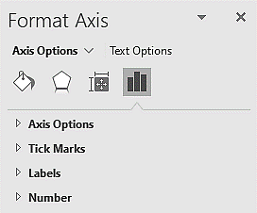
Marine
Education
How to EDIT the y-axis
marineeducation.com.au
Select
Select Axis Options
© Marine Education 2020
Little Books of Statistics: Column Graphs
112

Slide 117
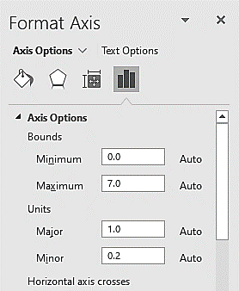
Marine
Education
How to EDIT the y-axis
marineeducation.com.au
Check or change the
BOUNDS: the smallest and biggest number on the axis
UNITS: the size of the spaces
between numbers on the axis
© Marine Education 2020
Little Books of Statistics: Column Graphs
113

Slide 118
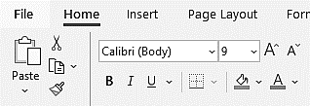
Marine
Education
How to EDIT the y-axis
marineeducation.com.au
Click on HOME tab
to change the
font type,
font size and
font colour
of the numbers on the y-axis
© Marine Education 2020
Little Books of Statistics: Column Graphs
114

Slide 119
Marine
Education
How to EDIT the y-axis
marineeducation.com.au
Select
Select Tick Marks
to put little markers on the y-axis
You might need to scroll down
© Marine Education 2020
Little Books of Statistics: Column Graphs
115

Slide 120
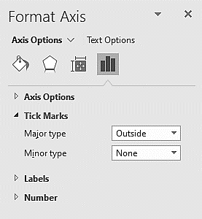
Marine
Education
How to EDIT the y-axis
marineeducation.com.au
Select Outside
© Marine Education 2020
Little Books of Statistics: Column Graphs
116

Slide 121

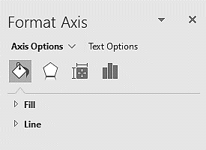
Marine
Education
How to EDIT the y-axis
marineeducation.com.au
Select
Select Line
© Marine Education 2020
Little Books of Statistics: Column Graphs
117

Slide 122

Marine
Education
How to EDIT the y-axis
marineeducation.com.au
Select Solid line
Change Color to Black
© Marine Education 2020
Little Books of Statistics: Column Graphs
118

Slide 123

Marine
Education
How to EDIT the x-axis
marineeducation.com.au
Double Click
(or right click)
on the x-axis
to open Format Axis on the RHS
© Marine Education 2020
Little Books of Statistics: Column Graphs
119

Slide 124
Marine
Education
How to EDIT the x-axis
marineeducation.com.au
Select
Select Line
© Marine Education 2020
Little Books of Statistics: Column Graphs
120

Slide 125
Marine
Education
How to EDIT the x-axis
marineeducation.com.au
Select Solid line
Change Color to Black
© Marine Education 2020
Little Books of Statistics: Column Graphs
121

Slide 126
Marine
Education
How to EDIT the x-axis
marineeducation.com.au
Click on HOME tab
to change the
font type,
font size and
font colour
of the numbers on the y-axis
© Marine Education 2020
Little Books of Statistics: Column Graphs
122

Slide 127


Marine
Education
How to EDIT the columns
marineeducation.com.au
Double Click
(or right click)
on a column
to open Format Data Series
on the RHS
© Marine Education 2020
Little Books of Statistics: Column Graphs
123

Slide 128

Marine
Education
How to EDIT the columns
marineeducation.com.au
Select
Select Fill
Note: It is important the reader can understand the meaning of your graph when printed in black and white. Therefore, remove all colour.
© Marine Education 2020
Little Books of Statistics: Column Graphs
124

Slide 129

Marine
Education
How to EDIT the columns
marineeducation.com.au
Select Solid Fill
Change Color to GREY
© Marine Education 2020
Little Books of Statistics: Column Graphs
125

Slide 130
Marine
Education
How to EDIT the columns
marineeducation.com.au
Select
Select Border
You might need to scroll down
© Marine Education 2020
Little Books of Statistics: Column Graphs
126

Slide 131

Marine
Education
How to EDIT the columns
marineeducation.com.au
Select Solid line
Change Color to BLACK
© Marine Education 2020
Little Books of Statistics: Column Graphs
127

Slide 132

Marine
Education
How to add a caption
marineeducation.com.au
Click on the Graph
Copy and Paste
(as a picture)
to your paper
© Marine Education 2020
Little Books of Statistics: Column Graphs
128

Slide 133

Marine
Education
How to add a caption
marineeducation.com.au
Add a caption to the bottom of your graph
(including the P value)
For example
Figure 1: There was no significant difference in the number of Giant Clams (Tridacna gigas) on Reef 1 (protected) and Reef 2 (unprotected) P=0.1963
© Marine Education 2020
Little Books of Statistics: Column Graphs
129

Slide 134
Marine
Education
CHECKLIST
marineeducation.com.au
Error Bars
No Gridlines
Chart Title
Axis Title/s
Units of measurement
(in brackets)
Correct scale on axis
Tick Marks on axis
Black and White
Caption (including P value)
© Marine Education 2020
Little Books of Statistics: Column Graphs
130

