Slide 1
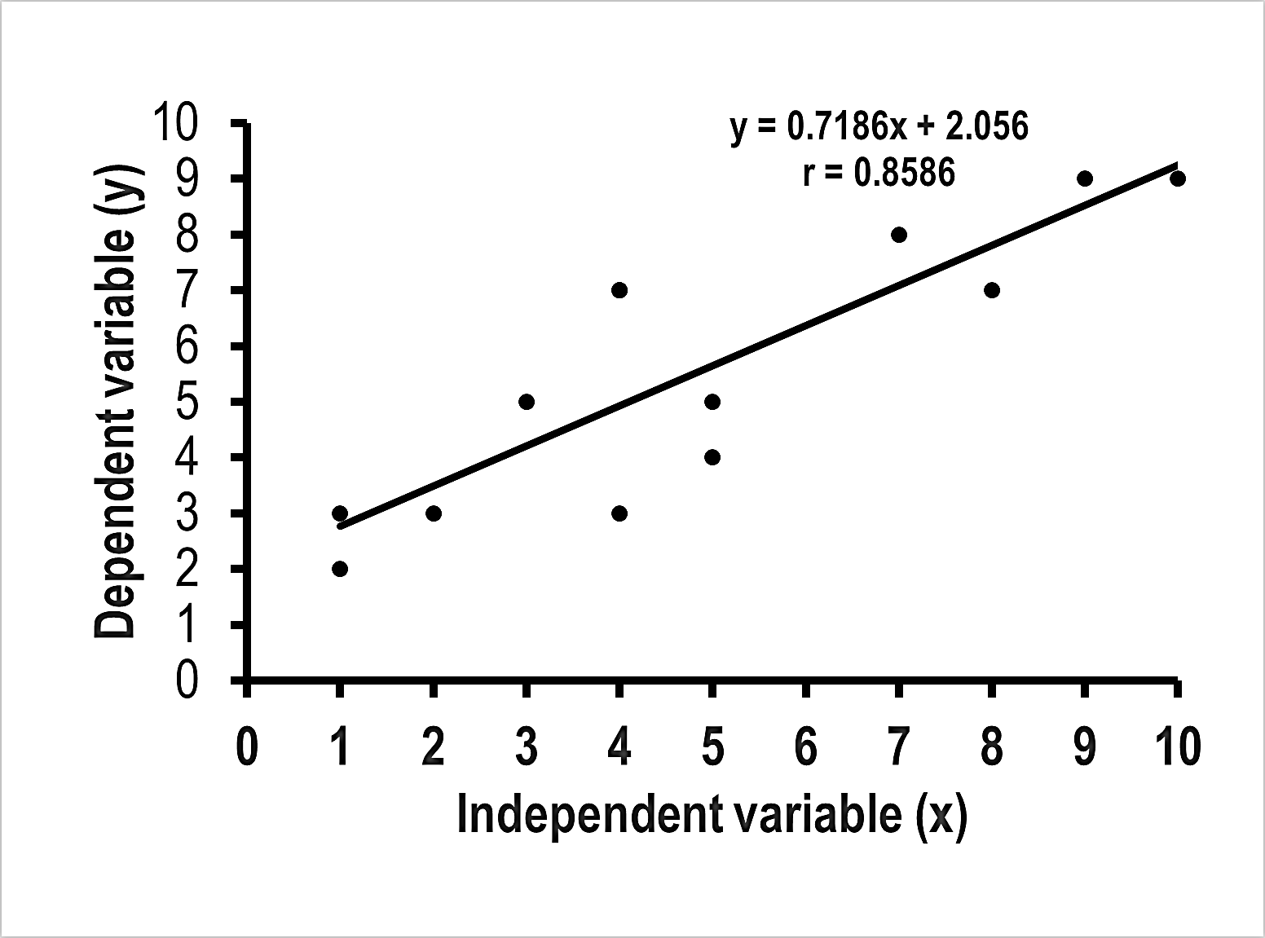
Marine
Education
Name:
Date:
marineeducation.com.au
Little Books of Statistics
Analyse and Create
Scatter Plot Graphs
y=mx + c
by Gail Riches
© Marine Education 2020

Slide 2
Marine
Education
marineeducation.com.au
© Marine Education 2020
No part of this publication may be reproduced, stored in a retrieval system or transmitted in any form or by means electronic, mechanical, photocopying, recording or otherwise without the prior written permission of the publisher.
ISBN: 978-0-6484089-7-0
Published by Marine Education 2020
ABN: 48765406873
Gail Riches
PO Box 394
Bli Bli Qld 4560
Email: info@marineeducation.com.au
www.marineeducation.com.au
Interested persons are invited to contact the author for information or to indicate errors and omissions.

Slide 3
Marine
Education
Table of Contents
marineeducation.com.au
The Scatter Plot
Graph
(x, y)
The trend line
1
13
LINEAR Relationships
Is there a linear relationship
between x and y?
21
Relationship DIRECTION
Relationship STRENGTH
(r value)
29
33
The trend line EQUATION
y = mx + c
R²
53
65
© Marine Education 2020
Little Books of Statistics: Scatter Plot Graphs
i

Slide 4
Marine
Education
Table of Contents
marineeducation.com.au
How to Create a Scatter Plot
Graph in Excel
How to create the graph
71
72
How to add a TRENDLINE
How to add an EQUATION
How to add the r value
75
79
80
How to EDIT
the graph
How to EDIT an axis
How to EDIT the dots
83
87
95
How to add
a caption
CHECKLIST
100
102
© Marine Education 2020
Little Books of Statistics: Scatter Plot Graphs
ii

Slide 5
Marine
Education
The SCATTER PLOT graph
marineeducation.com.au
The
Scatter Plot Graph
illustrates the
relationship between two variables
x and y
© Marine Education 2020
Little Books of Statistics: Scatter Plot Graphs
1

Slide 6
Marine
Education
The SCATTER PLOT graph
marineeducation.com.au
What are all
the dots on a
Scatter Plot
Graph?
© Marine Education 2020
Little Books of Statistics: Scatter Plot Graphs
2

Slide 7
Marine
Education
The SCATTER PLOT graph
marineeducation.com.au
Each dot is the
(x, y)
coordinate
for a point
on the graph
© Marine Education 2020
Little Books of Statistics: Scatter Plot Graphs
3

Slide 8
Marine
Education
The SCATTER PLOT graph
marineeducation.com.au
For example
x | 2 | 3 | 4
y | 4 | 6 | 8
8
y
6
(3, 8)
4
(2, 4)
2
1 | 2 | 3 | 4
x
© Marine Education 2020
Little Books of Statistics: Scatter Plot Graphs
4

Slide 9
Marine
Education
The SCATTER PLOT graph
marineeducation.com.au
x | 2 | 3 | 4
y | 4 | 6 | 8
8
6
(3, 8)
y
(3, 6)
4
(2, 4)
2
1 | 2 | 3 | 4
x
© Marine Education 2020
Little Books of Statistics: Scatter Plot Graphs
5

Slide 10
Marine
Education
The SCATTER PLOT graph
marineeducation.com.au
x | 2 | 3 | 4
y | 4 | 6 | 8
8
(3, 8)
(4, 8)
6
(3, 8)
y
(3, 6)
4
(2, 4)
2
1 | 2 | 3 | 4
x
© Marine Education 2020
Little Books of Statistics: Scatter Plot Graphs
6

Slide 11
Marine
Education
The SCATTER PLOT graph
marineeducation.com.au
The coordinates originate from
(x, y) PAIRS
collected as a pair
in the lab or
in the field
© Marine Education 2020
Little Books of Statistics: Scatter Plot Graphs
7

Slide 12
Marine
Education
The SCATTER PLOT graph
marineeducation.com.au
y
x
1 | 2 | 3 | 4
x
Independent Variable
Note: sometimes called the explanatory or input variable
© Marine Education 2020
Little Books of Statistics: Scatter Plot Graphs
8

Slide 13
Marine
Education
The SCATTER PLOT graph
marineeducation.com.au
y
Dependent Variable
y
x
1 | 2 | 3 | 4
Note: sometimes called the response variable
© Marine Education 2020
Little Books of Statistics: Scatter Plot Graphs
9

Slide 14
Marine
Education
The SCATTER PLOT graph
marineeducation.com.au
The Results Table
x Independent Variable | y Dependent Variable
Quantitative Data
Quantitative Data
Note: Quantitative Data is quantities (numbers, not words)
© Marine Education 2020
Little Books of Statistics: Scatter Plot Graphs
10

Slide 15
Marine
Education
The SCATTER PLOT graph
marineeducation.com.au
Can you see a
trend
in the dots?
And therefore a
relationship
between x and y?
© Marine Education 2020
Little Books of Statistics: Scatter Plot Graphs
11

Slide 17
Marine
Education
The trend line
marineeducation.com.au
What
is the
trend line?
Note: sometimes called the regression line
© Marine Education 2020
Little Books of Statistics: Scatter Plot Graphs
13

Slide 18
Marine
Education
The trend line
marineeducation.com.au
The trend line
is often called the
line of
best fit
Linear
trend
before
after
© Marine Education 2020
Little Books of Statistics: Scatter Plot Graphs
14

Slide 19
Marine
Education
The trend line
marineeducation.com.au
It is a line that
best fits
right through the middle of
all the dots
on a scatter plot
Exponential
trend
before
after
© Marine Education 2020
Little Books of Statistics: Scatter Plot Graphs
15

Slide 20
Marine
Education
The trend line
marineeducation.com.au
to highlight a
trend
(if there is one)
Linear
trend
before
after
© Marine Education 2020
Little Books of Statistics: Scatter Plot Graphs
16

Slide 21
Marine
Education
The trend line
marineeducation.com.au
Hey look at this!
You can use the trend line to predict ANY
value for y
© Marine Education 2020
Little Books of Statistics: Scatter Plot Graphs
17

Slide 22
Marine
Education
The trend line
marineeducation.com.au
When x = 4
16
12
y
8
4
2 | 4 | 6 | 8
X
y = 8
© Marine Education 2020
Little Books of Statistics: Scatter Plot Graphs
18

Slide 23
Marine
Education
The trend line
marineeducation.com.au
When x = 8
16
12
y
8
4
2 | 4 | 6 | 8
X
y = 16
© Marine Education 2020
Little Books of Statistics: Scatter Plot Graphs
19

Slide 25
Marine
Education
LINEAR Relationships
marineeducation.com.au
LINEAR
(straight line) relationships
Note: a relationship is sometimes called an
association or a correlation
© Marine Education 2020
Little Books of Statistics: Scatter Plot Graphs
21

Slide 26
Marine
Education
LINEAR Relationships
marineeducation.com.au
Research Question
Is there a
LINEAR
(straight line)
relationship between
x and y?
© Marine Education 2020
Little Books of Statistics: Scatter Plot Graphs
22

Slide 27
Marine
Education
LINEAR Relationships
marineeducation.com.au
For example
If x increases,
does y increase
or decrease?
© Marine Education 2020
Little Books of Statistics: Scatter Plot Graphs
23

Slide 28
Marine
Education
LINEAR Relationships
marineeducation.com.au
y
x
YES!
© Marine Education 2020
Little Books of Statistics: Scatter Plot Graphs
24

Slide 29
Marine
Education
LINEAR Relationships
marineeducation.com.au
y
x
YES!
© Marine Education 2020
Little Books of Statistics: Scatter Plot Graphs
25

Slide 30
Marine
Education
LINEAR Relationships
y
x
NO!
It is not ‘LINEAR’
© Marine Education 2020
Little Books of Statistics: Scatter Plot Graphs
26

Slide 31
Marine
Education
LINEAR Relationships
y
x
NO!
As x increases, y does NOT change
© Marine Education 2020
Little Books of Statistics: Scatter Plot Graphs
27

Slide 33
Marine
Education
Relationship DIRECTION
marineeducation.com.au
What is the DIRECTION
of the linear relationship between
x and y?
© Marine Education 2020
Little Books of Statistics: Scatter Plot Graphs
29

Slide 34
Marine
Education
Relationship DIRECTION
marineeducation.com.au
Line goes UP
from left to right
y
UP=Positive
UP
x
POSITIVE
© Marine Education 2020
Little Books of Statistics: Scatter Plot Graphs
30

Slide 35
Marine
Education
Relationship DIRECTION
marineeducation.com.au
Line goes DOWN
from left to right
DOWN
y
x
NEGATIVE
© Marine Education 2020
Little Books of Statistics: Scatter Plot Graphs
31

Slide 37
Marine
Education
Relationship STRENGTH
marineeducation.com.au
What is the STRENGTH
of the linear relationship between
x and y?
© Marine Education 2020
Little Books of Statistics: Scatter Plot Graphs
33

Slide 38
Marine
Education
Relationship STRENGTH
marineeducation.com.au
Are the dots close to the line?
© Marine Education 2020
Little Books of Statistics: Scatter Plot Graphs
34

Slide 39
Marine
Education
Relationship STRENGTH
marineeducation.com.au
YES
y
x
STRONGEST
© Marine Education 2020
Little Books of Statistics: Scatter Plot Graphs
35

Slide 40
Marine
Education
Relationship STRENGTH
marineeducation.com.au
MOSTLY
y
x
STRONG
© Marine Education 2020
Little Books of Statistics: Scatter Plot Graphs
36

Slide 41
Marine
Education
Relationship STRENGTH
marineeducation.com.au
Not really
y
x
WEAK
© Marine Education 2020
Little Books of Statistics: Scatter Plot Graphs
37

Slide 42
Marine
Education
Relationship STRENGTH
marineeducation.com.au
NO
y
x
There could still be a
strong relationship,
but one that is not LINEAR.
© Marine Education 2020
Little Books of Statistics: Scatter Plot Graphs
38

Slide 43
Marine
Education
Relationship STRENGTH
marineeducation.com.au
Another way
(a mathematical way)
to measure the STRENGTH
of a linear relationship between x and y
is the r value
© Marine Education 2020
Little Books of Statistics: Scatter Plot Graphs
39

Slide 44
Marine
Education
Relationship STRENGTH
marineeducation.com.au
The r value
is the
Pearson Correlation Coefficient
named after
English Mathematician
Carl Pearson
(1857-1936)
© Marine Education 2020
Little Books of Statistics: Scatter Plot Graphs
40

Slide 45
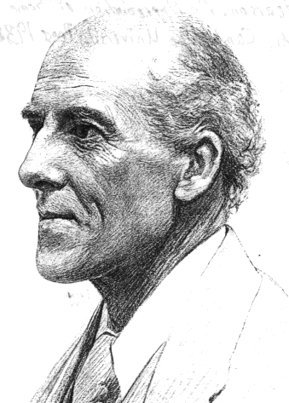
Marine
Education
Relationship STRENGTH
marineeducation.com.au
Statistics is the grammar of science
Carl Pearson
© Marine Education 2020
Little Books of Statistics: Scatter Plot Graphs
41

Slide 46
Marine
Education
Relationship STRENGTH
marineeducation.com.au
The r value
is based on the proximity of the dots
to the line
© Marine Education 2020
Little Books of Statistics: Scatter Plot Graphs
42

Slide 47
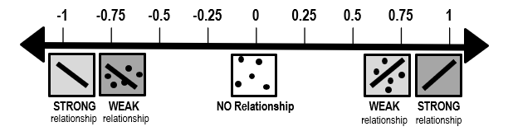
Marine
Education
Relationship STRENGTH
marineeducation.com.au
ALL Dots ON the line = STRONGEST relationship
STRONGEST
r = 1
STRONGEST
r = -1
© Marine Education 2020
Little Books of Statistics: Scatter Plot Graphs
43

Slide 48
Marine
Education
Relationship STRENGTH
marineeducation.com.au
When the dots are ON the line
the r value is
1 or -1
for positive relationships
for negative relationships
© Marine Education 2020
Little Books of Statistics: Scatter Plot Graphs
44

Slide 49
Marine
Education
Relationship STRENGTH
marineeducation.com.au
r = 1.0
y
x
STRONGEST
© Marine Education 2020
Little Books of Statistics: Scatter Plot Graphs
45

Slide 50
Marine
Education
Relationship STRENGTH
marineeducation.com.au
When the dots are CLOSE to
the line
the r value is
CLOSE to
1 or -1
© Marine Education 2020
Little Books of Statistics: Scatter Plot Graphs
46

Slide 51
Marine
Education
Relationship STRENGTH
marineeducation.com.au
r = 0.9
y
x
STRONG
© Marine Education 2020
Little Books of Statistics: Scatter Plot Graphs
47

Slide 52
Marine
Education
Relationship STRENGTH
marineeducation.com.au
As the dots get further away
from the line
the r value gets
further away from 1 or -1
and closer to zero
© Marine Education 2020
Little Books of Statistics: Scatter Plot Graphs
48

Slide 53
Marine
Education
Relationship STRENGTH
marineeducation.com.au
r = 0.6
y
x
WEAK
© Marine Education 2020
Little Books of Statistics: Scatter Plot Graphs
49

Slide 54
Marine
Education
Relationship STRENGTH
marineeducation.com.au
When the r value falls between
-0.5 and 0.5
there is NO relationship
Note: Some texts state it is between -0.25 and 0.25
© Marine Education 2020
Little Books of Statistics: Scatter Plot Graphs
50

Slide 55
Marine
Education
Relationship STRENGTH
marineeducation.com.au
r = 0.24
y
x
NO trend line
© Marine Education 2020
Little Books of Statistics: Scatter Plot Graphs
51

Slide 57
Marine
Education
The trend line EQUATION
marineeducation.com.au
The trend line EQUATION
y=mx+c
Note: sometimes the c is written as the letter b
Or, the entire equation is written as y = a + bx
© Marine Education 2020
Little Books of Statistics: Scatter Plot Graphs
53

Slide 58
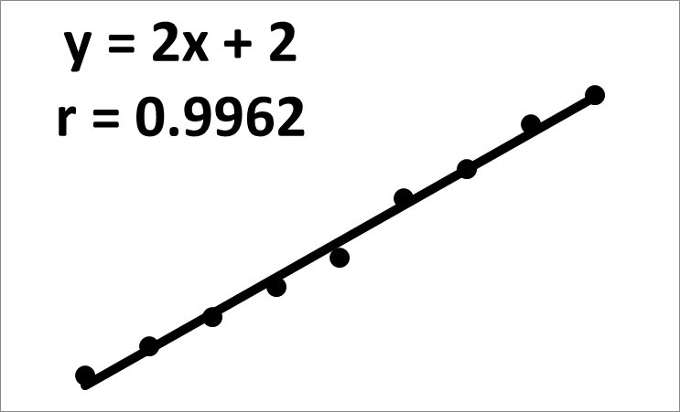
Marine
Education
The trend line EQUATION
marineeducation.com.au
Every trend line
has an EQUATION
that mathematically describes its position on the graph
y = 2x + 3
© Marine Education 2020
Little Books of Statistics: Scatter Plot Graphs
54

Slide 59
Marine
Education
The trend line EQUATION
marineeducation.com.au
y = mx + c
m and c
will be the only numbers you see
Note: If m is ONE, it will be left blank (multiplying by one does nothing)
Note: If c is ZERO, it will be left blank (adding zero does nothing)
© Marine Education 2020
Little Books of Statistics: Scatter Plot Graphs
55

Slide 60
Marine
Education
The trend line EQUATION
marineeducation.com.au
y = mx + c
m is the
slope or gradient
of the line
(and direction)
© Marine Education 2020
Little Books of Statistics: Scatter Plot Graphs
56

Slide 61
Marine
Education
The trend line EQUATION
marineeducation.com.au
m = rise / run
run
rise
Note: if the relationship is negative, m is negative
y = x + c
rise
run
© Marine Education 2020
Little Books of Statistics: Scatter Plot Graphs
57

Slide 62
Marine
Education
The trend line EQUATION
marineeducation.com.au
y = mx + c
c is the
y-intercept
Where the line intercepts
(e.g. touches, or would cross) the y-axis
© Marine Education 2020
Little Books of Statistics: Scatter Plot Graphs
58

Slide 63
Marine
Education
The trend line EQUATION
marineeducation.com.au
y = mx + c
y intercept
y
1
y = mx + 1
© Marine Education 2020
Little Books of Statistics: Scatter Plot Graphs
59

Slide 64
Marine
Education
The trend line EQUATION
marineeducation.com.au
HOW TO
use the
trend line EQUATION
to predict ANY value for y
© Marine Education 2020
Little Books of Statistics: Scatter Plot Graphs
60

Slide 65
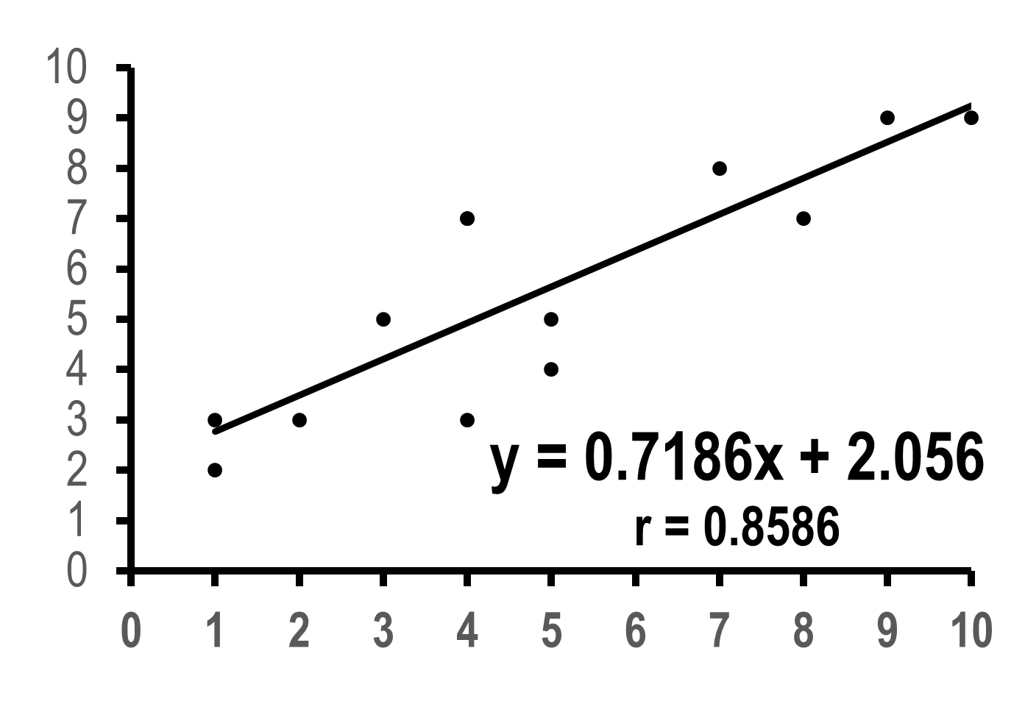
Marine
Education
The trend line EQUATION
marineeducation.com.au
When x is 2
what is y?
© Marine Education 2020
Little Books of Statistics: Scatter Plot Graphs
61

Slide 66
Marine
Education
The trend line EQUATION
marineeducation.com.au
marineeducation.com.au
When x is 2
x
Note: the brackets are to remind you of the multiply sign between m and x.
y = m(2) + c
© Marine Education 2020
Little Books of Statistics: Scatter Plot Graphs
62

Slide 67
Marine
Education
The trend line EQUATION
marineeducation.com.au
marineeducation.com.au
y = mx + c
m
c
y = 0.7186(2) + 2.056
© Marine Education 2020
Little Books of Statistics: Scatter Plot Graphs
63

Slide 68
Marine
Education
The trend line EQUATION
marineeducation.com.au
When x is 2
y
y = 3.4932
© Marine Education 2020
Little Books of Statistics: Scatter Plot Graphs
64

Slide 69
Marine
Education
R²
marineeducation.com.au
R²
The Coefficient of Determination
indicates the strength of your prediction based on the percent of data (as a decimal)
closest to the trend line
© Marine Education 2020
Little Books of Statistics: Scatter Plot Graphs
65

Slide 70
Marine
Education
R²
marineeducation.com.au
r x r = R²
© Marine Education 2020
Little Books of Statistics: Scatter Plot Graphs
66

Slide 71
Marine
Education
R²
marineeducation.com.au
For example
when r is 0.8
0.8 x 0.8 = 0.64
Thus, the strength of your prediction is 64%
© Marine Education 2020
Little Books of Statistics: Scatter Plot Graphs
67

Slide 72
Marine
Education
R²
marineeducation.com.au
and,
to convert it back…
√ R² = r
© Marine Education 2020
Little Books of Statistics: Scatter Plot Graphs
68

Slide 73
Marine
Education
R²
marineeducation.com.au
For example
when R² is 0.64
√ 0.64 = 0.8
© Marine Education 2020
Little Books of Statistics: Scatter Plot Graphs
69

Slide 75
Marine
Education
marineeducation.com.au
Little Books of Statistics
How to Create a Scatter Plot Graph
in
EXCEL
© Marine Education 2020
Little Books of Statistics: Scatter Plot Graphs
71

Slide 76
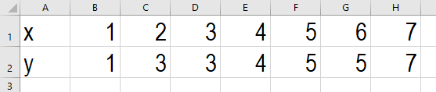
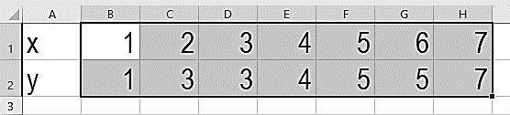
Marine
Education
How to CREATE the graph
marineeducation.com.au
Enter Raw Data in excel
with Independent variable (x) on top line
Highlight Raw Data
Do NOT include headings
For example
© Marine Education 2020
Little Books of Statistics: Scatter Plot Graphs
72

Slide 77
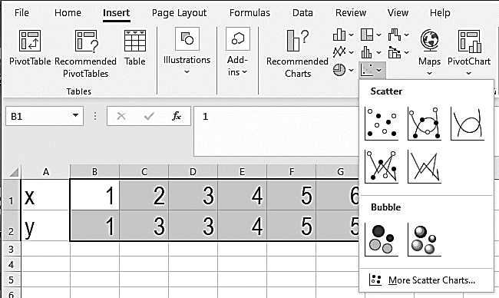
Marine
Education
How to CREATE the graph
marineeducation.com.au
Click on Insert tab
Select Scatter Plot
Insert
Select
Scatter
© Marine Education 2020
Little Books of Statistics: Scatter Plot Graphs
73

Slide 78
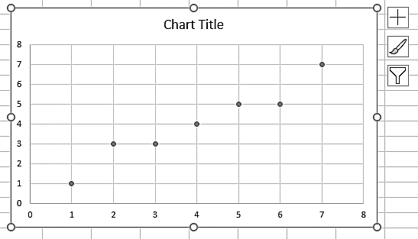
Marine
Education
How to CREATE the graph
marineeducation.com.au
Excel will generate a chart
that looks a little something
like this…
Now it’s time to add a trend line!
© Marine Education 2020
Little Books of Statistics: Scatter Plot Graphs
74

Slide 79

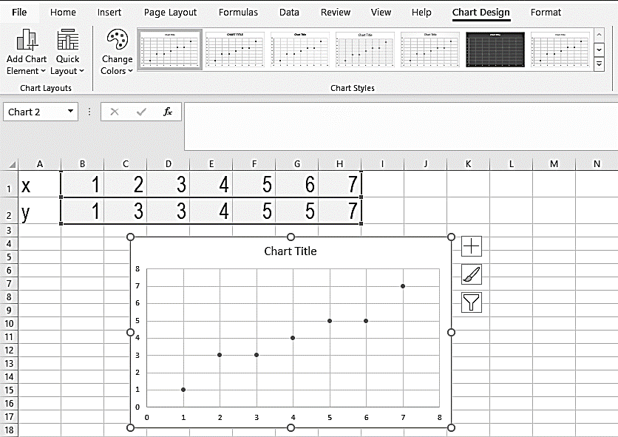

Marine
Education
How to add a TREND LINE
marineeducation.com.au
Click on the Graph
Click Chart Design tab
Click Add Chart Element
(drop down box of options appears)
© Marine Education 2020
Little Books of Statistics: Scatter Plot Graphs
75

Slide 80
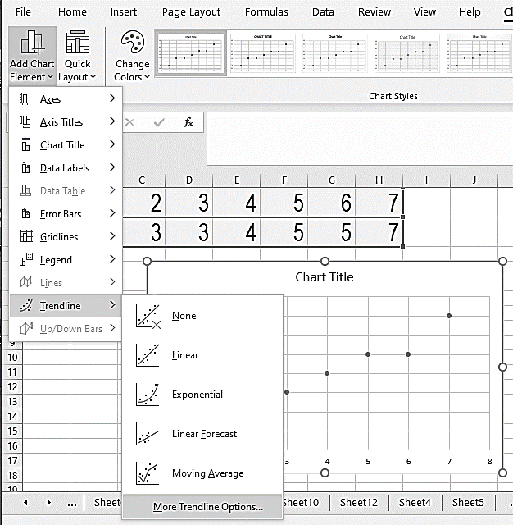
Marine
Education
How to add a TREND LINE
marineeducation.com.au
Click on Trendline
Select More Trendline Options
Format Trendline appears RHS
© Marine Education 2020
Little Books of Statistics: Scatter Plot Graphs
76

Slide 81

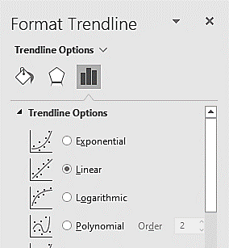
Marine
Education
How to add a TREND LINE
marineeducation.com.au
Select
Select Linear
© Marine Education 2020
Little Books of Statistics: Scatter Plot Graphs
77

Slide 82

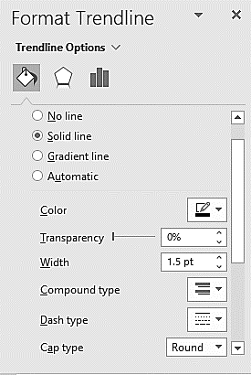
Marine
Education
How to add a TREND LINE
marineeducation.com.au
Select
Change Color to Black
Change Dash type to Solid Line
© Marine Education 2020
Little Books of Statistics: Scatter Plot Graphs
78

Slide 83
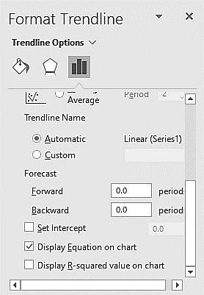
Marine
Education
How to add an EQUATION
marineeducation.com.au
Select
(scroll down)
Select Display Equation on Chart
© Marine Education 2020
Little Books of Statistics: Scatter Plot Graphs
79

Slide 84

Marine
Education
How to add the r value
marineeducation.com.au
Select
(scroll down)
Select Display R squared value on chart
© Marine Education 2020
Little Books of Statistics: Scatter Plot Graphs
80

Slide 85
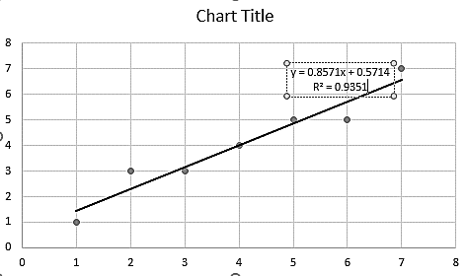
Marine
Education
How to add the r value
marineeducation.com.au
OPTIONAL: Change R² to r
Click on the text box
Delete R²
Type the r value instead
© Marine Education 2020
Little Books of Statistics: Scatter Plot Graphs
81

Slide 86
Marine
Education
How to add the r value
marineeducation.com.au
IMPORTANT!
CHECK if the r value is
between 0.5 and -0.5
If so, and there is
NO linear relationship
between x and y
DELETE the trend line
(and trend line equation)!
© Marine Education 2020
Little Books of Statistics: Scatter Plot Graphs
82

Slide 87
Marine
Education
How to EDIT the graph
marineeducation.com.au
Now it’s time to edit the graph!
E.g. customise the titles and axis, remove the gridlines and
remove any colour
from the graph.
© Marine Education 2020
Little Books of Statistics: Scatter Plot Graphs
83

Slide 88
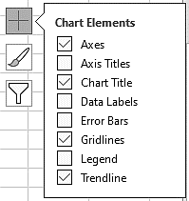
Marine
Education
How to EDIT the graph
marineeducation.com.au
Click on the Graph
Click
© Marine Education 2020
Little Books of Statistics: Scatter Plot Graphs
84

Slide 89
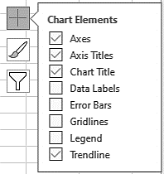
Marine
Education
How to EDIT the graph
marineeducation.com.au
Tick Axis Titles
Un-tick Gridlines
© Marine Education 2020
Little Books of Statistics: Scatter Plot Graphs
85

Slide 90
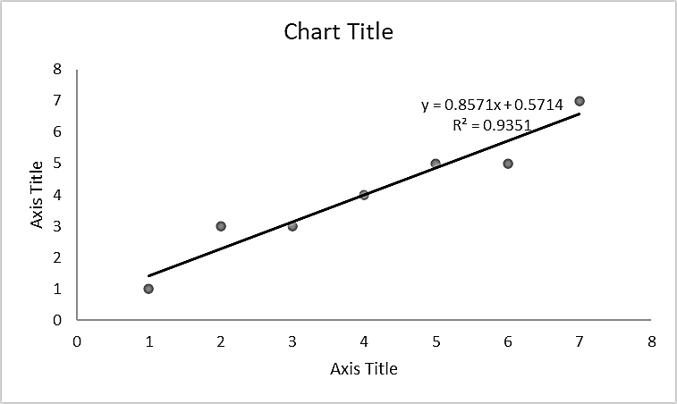
Marine
Education
How to EDIT the graph
marineeducation.com.au
Click on Chart Title
until curser appears. Backspace to delete.
Type (what it is)
Repeat for Axis Title
Reminder: Don’t forget the units of measurement in brackets! Hint: use the Home tab to change font type, font size, etc.
© Marine Education 2020
Little Books of Statistics: Scatter Plot Graphs
86

Slide 91
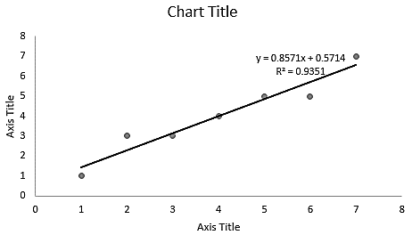
Marine
Education
How to EDIT an axis
marineeducation.com.au
Double Click
(or right click)
on an axis
to open Format Axis on the RHS
© Marine Education 2020
Little Books of Statistics: Scatter Plot Graphs
87

Slide 92
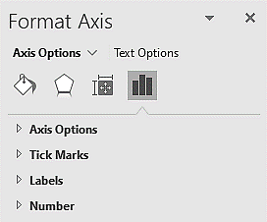
Marine
Education
How to EDIT an axis
marineeducation.com.au
Select
Select Axis Options
© Marine Education 2020
Little Books of Statistics: Scatter Plot Graphs
88

Slide 93
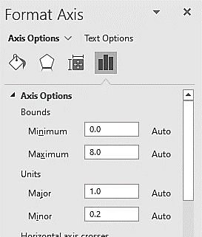
Marine
Education
How to EDIT an axis
marineeducation.com.au
Check or change the
BOUNDS: the smallest and biggest number on the axis
UNITS: the size of the spaces
between numbers on the axis
© Marine Education 2020
Little Books of Statistics: Scatter Plot Graphs
89

Slide 94
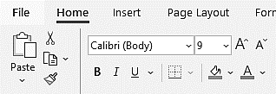
Marine
Education
How to EDIT an axis
marineeducation.com.au
Click on HOME tab
to change the
font type,
font size and
font colour
of the numbers on the axis
© Marine Education 2020
Little Books of Statistics: Scatter Plot Graphs
90

Slide 95
Marine
Education
How to EDIT an axis
marineeducation.com.au
Select
Select Tick Marks
to put little markers on the axis
You might need to scroll down
© Marine Education 2020
Little Books of Statistics: Scatter Plot Graphs
91

Slide 96
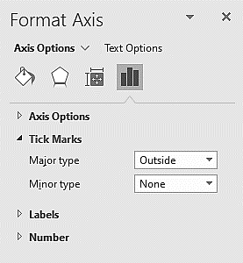
Marine
Education
How to EDIT an axis
marineeducation.com.au
Select Outside
© Marine Education 2020
Little Books of Statistics: Scatter Plot Graphs
92

Slide 97
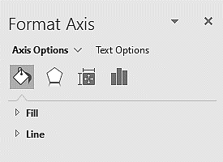
Marine
Education
How to EDIT an axis
marineeducation.com.au
Select
Select Line
© Marine Education 2020
Little Books of Statistics: Scatter Plot Graphs
93

Slide 98
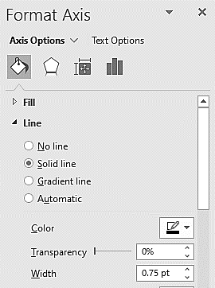
Marine
Education
How to EDIT an axis
marineeducation.com.au
Select Solid line
Change Color to Black
© Marine Education 2020
Little Books of Statistics: Scatter Plot Graphs
94

Slide 99
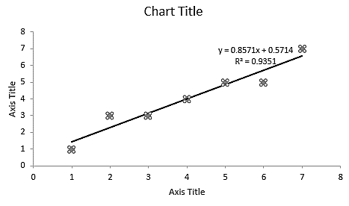

Marine
Education
How to EDIT the dots
marineeducation.com.au
Double Click
(or right click)
on a dot point
to open Format Data Series
on the RHS
© Marine Education 2020
Little Books of Statistics: Scatter Plot Graphs
95

Slide 100
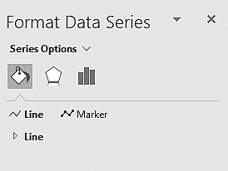
Marine
Education
How to EDIT the dots
marineeducation.com.au
Select
Select Marker
© Marine Education 2020
Little Books of Statistics: Scatter Plot Graphs
96

Slide 101
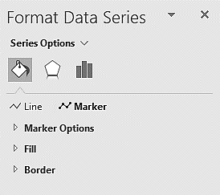
Marine
Education
How to EDIT the dots
marineeducation.com.au
Select Fill
Note: It is important the reader can understand the meaning of your graph when printed in black and white. Therefore, remove all colour.
© Marine Education 2020
Little Books of Statistics: Scatter Plot Graphs
97

Slide 102
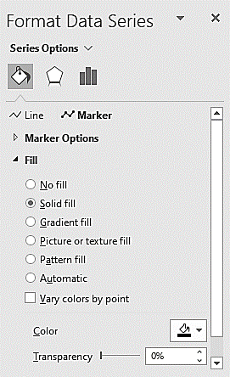
Marine
Education
How to EDIT the dots
marineeducation.com.au
Select Solid Fill
Change Color to Black
© Marine Education 2020
Little Books of Statistics: Scatter Plot Graphs
98

Slide 103
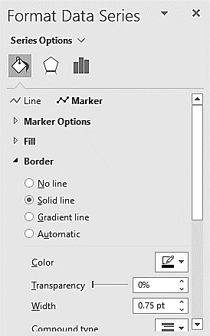
Marine
Education
How to EDIT the dots
marineeducation.com.au
Repeat for Border
© Marine Education 2020
Little Books of Statistics: Scatter Plot Graphs
99

Slide 104
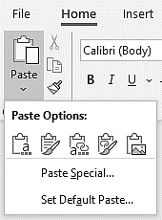
Marine
Education
How to add a CAPTION
marineeducation.com.au
Click on the Graph
Copy and Paste
(as a picture)
to your paper
© Marine Education 2020
Little Books of Statistics: Scatter Plot Graphs
100

Slide 105
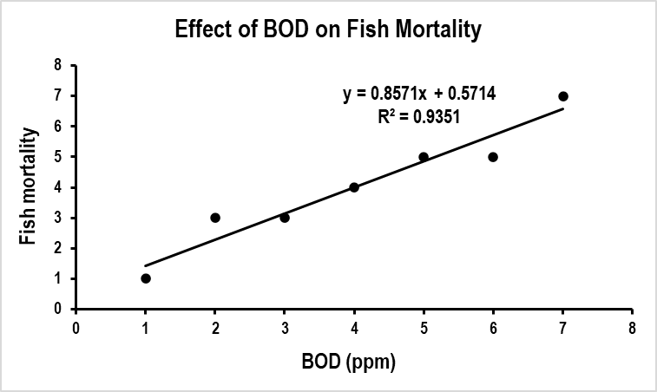
Marine
Education
How to add a CAPTION
marineeducation.com.au
Add a caption to the bottom of your graph
(including the r or R² value)
Figure 1: There was a strong, positive, linear relationship between Biological Oxygen Demand (BOD) and Fish Mortality (R²=0.9351).
© Marine Education 2020
Little Books of Statistics: Scatter Plot Graphs
101

Slide 106
Marine
Education
CHECKLIST
marineeducation.com.au
IF RELATIONSHIP EXISTS:
Trend line
Trend line equation
r or R² value
IN GENERAL:
No gridlines
Chart Title
Axis Titles
Units of measurement
(in brackets)
Correct scale on axis
Tick Marks on axis
Black and White
Caption (including r or R²)
© Marine Education 2020
Little Books of Statistics: Scatter Plot Graphs
102

