Slide 1
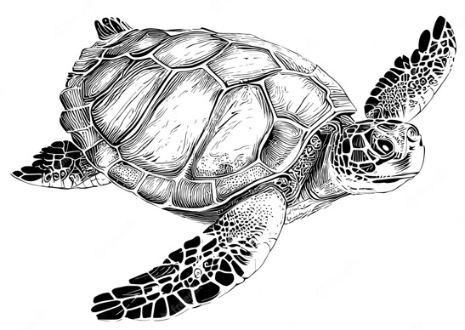
Marine
Education
Year 11 Marine Science
Student Workbook
Name:
Date:
marineeducation.com.au
Oceanography and Marine Biology
The Ocean Planet The Dynamic Shore Marine Ecology and Biodiversity
Marine Environmental Management
ANSWER BOOK
Content from Marine Science Syllabus
State of Queensland (QCAA) 2025 v1.2
By Gail Riches
© Marine Education 2024 CC BY-NC-SA

Slide 2

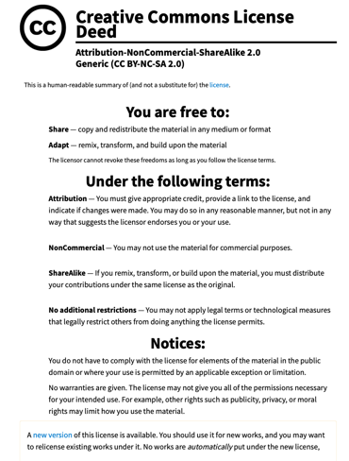
Marine
Education
marineeducation.com.au
© Marine Education 2024 CC BY-NC-SA
Published by Marine Education 2024
ABN: 48765406873
Author: Gail Riches
Email: info@marineeducation.com.au
www.marineeducation.com.au
Course Overview and Learning Objectives derived from Marine Science 2025 v1.2 General senior syllabus, October 2024.
Queensland Curriculum & Assessment Authority PO Box 307 Spring Hill QLD 4004 Australia.
https://www.qcaa.qld.edu.au/downloads/senior-qce/syllabuses/snr_marine_science_25_syll.pdf
Image (front page turtle): Dreamstime stock photos. ID 261684871 © AlyaBigJoy. Accessed April 10th 2024 from: https://www.dreamstime.com/sea-turtle-hand-drawn-engraving-style-sketch-underwater-animals-sea-turtle-hand-drawn-engraving-style-sketch-underwater-animals-image261684871
Interested persons are invited to contact the author for information or to indicate errors and omissions.
This publication is available to download free-of-charge from the Marine Education website: www.marineeducation.com.au
The sale of this product is strictly prohibited.
Printing at a commercial printer such as Office Works is permitted for school-use only.
Marine Education would like to thank all the teachers, students and industry professionals who kindly shared their work.
© Marine Education 2024 CC BY-NC-SA

Slide 3
Marine
Education
Course Overview
marineeducation.com.au
Marine Science
Year 11 (this booklet)
Assessment
Data Test 10%
Student Experiment 20%
Research Investigation 20%
Exam 50% (only examines SU dot points)
Year 12 (next booklet)
Assessment
Data Test 10%
Student Experiment 20%
Research Investigation 20%
Exam 50% (only examines SU dot points)
Unit 1
Oceanography
Topic 1: An ocean planet
Topic 2: The dynamic shore
Unit 2
Marine Biology
Topic 1: Marine ecology and biodiversity
Topic 2: Marine environmental management
Unit 3
Marine systems – connections and change
Topic 1: The reef and beyond
Topic 2: Changes on the reef
Unit 4
Ocean issues and resource management
Topic 1: Oceans of the future
Topic 2 Managing fisheries
Syllabus Objectives
Describe ideas and findings
Apply understanding
Analyse data
Interpret evidence
Evaluate conclusions, claims and processes
Investigate phenomena
Science Strands
Science understanding (SU) - this is the ONLY Strand that is assessed in the (50%) exam
Science as a human endeavour (SHE)
Science inquiry skills (SIS)
© Marine Education 2024 CC BY-NC-SA
Course Overview

Slide 4
Marine
Education
marineeducation.com.au
Table of Contents
Unit 1 Oceanography | Page
Topic 1: An ocean planet
Strand: SCIENCE UNDERSTANDING
Subject Matter: Oceanography
1. Explore the Floor: Describe bathymetric features of the ocean floor, including the continental margin, ocean-basin floor, deep-sea trenches, mid-ocean ridges, abyssal plain | 1
2. Geology Rocks!: Apply models to understand the geological features of Earth, e.g. sea floor modelling, tectonic plate movements, coastal landforms, stratigraphy. | 3
3. To reCYCLE: Describe the processes of the following cycles: water, carbon and oxygen | 5
Subject Matter: Ocean Currents
4. Water in motion: Describe how surface ocean currents are driven by temperature, wind and gravity | 7
5. Free postage & handling: Describe how water, heat and nutrients are distributed across coastal regions and global ocean basins, e.g. upwelling and downwelling, El Niño and La Niña events, Langmuir circulation, Ekman spiral. | 9
6. Wacky Water: Describe the physical and chemical properties of water, including structure, hydrogen bonding, polarity, action as a solvent, heat capacity and density | 11
7. All sorts of Clines: Describe the concept of ocean layers, including thermocline, halocline and pycnocline. | 13
8. The Shadow Zone: Describe how thermoclines and nutrients produce the oxygen minimum within the open ocean | 15
9. The Global Ocean Conveyor Belt: Explain how thermohaline circulation in the deep ocean is affected by salinity and water density | 17
Strand: SCIENCE AS A HUMAN ENDEAVOUR
10. Eyes looking down: Appreciate that development of satellite measurement techniques allows scientists to predict the direction and rate of plate movement. Consider how this has developed improved understandings of processes such as sea floor spreading and mantle convection. | 19
11. Keeping track: Consider how advances in remote sensing have enabled scientists to map ocean currents and develop models of the complex pathways involved in regulating global climate, such as the ‘global ocean conveyor belt’. | 20
© Marine Education 2024 CC BY-NC-SA

Slide 5
Marine
Education
marineeducation.com.au
Table of Contents
Unit 1 Oceanography (continued) | Page
12. Cloudy with a chance of meatballs: Understand that contemporary weather predictions are based on computer models but still rely on human input to determine the most accurate and reliable forecast. Consider how this scientific knowledge enables scientists to inform decision-making for coastline management and marine industries. | 21
13. Dodgy Debris: Appreciate that marine debris accumulation is a global phenomenon (e.g. ‘The Great Pacific Garbage Patch’). Consider how the causes and solutions (i.e. the use of scientific knowledge) of this issue are influenced by social, economic, cultural and ethical considerations. | 22
14. Are you up for the challenge?: Appreciate that knowledge of the oceans is limited and requires further investigation. | 23
15. EEeeZy Money: Recognise that decisions relating to resource management are affected by the economic development of a nation and the value placed on marine environment. | 24
Strand: SCIENCE INQUIRY
16. Convection prac: Investigate convection. | 25
17. Density Divides: Investigate thermoclines (e.g. using ice and water, and hot and cold coloured water); salinity (e.g. using student-made straw hydrometers); stratification (e.g. using salt and fresh water). | 26
© Marine Education 2024 CC BY-NC-SA

Slide 6
Marine
Education
Name:
Date:
marineeducation.com.au
Cognitive Verbs
Cognitive Verb | Description
Analyse | dissect to ascertain and examine constituent parts and/or their relationships; break down or examine in order to identify the essential elements, features, components or structure; determine the logic and reasonableness of information; examine or consider something in order to explain and interpret it, for the purpose of finding meaning or relationships and identifying patterns, similarities and differences
Apply | Use knowledge and understanding in response to a given situation or circumstance; carry out or use a procedure in a given or particular situation
Appreciate | recognise or make a judgment about the value or worth of something; understand fully; grasp the full implications of
Assess | Measure, determine, evaluate, estimate or make a judgement about the value, quality, outcomes, results, size, significance, nature or extent of something
Calculate | Determine or find (e.g. a number, answer) by using mathematical processes; obtain a numerical answer showing the relevant stages in the working; ascertain/determine from given facts, figures or information
Categorise | Place in or assign to a particular class or group; arrange or order by classes or categories; classify, sort out, sort, separate
Classify | Arrange, distribute or order in classes or categories according to shared qualities or characteristics
Consider | think deliberately or carefully about something, typically before making a decision; take something into account when making a judgment; view attentively or scrutinise; reflect on
Compare | Display recognition of similarities and differences and recognise the significance of these similarities and differences
Contrast | display recognition of differences by deliberate juxtaposition of contrary elements; show how things are different or opposite; give an account of the differences between two or more items or situations, referring to both or all of them throughout
Define | Give the meaning of a word, phrase, concept or physical quantity; state meaning and identify or describe qualities
Describe | Give an account (written or spoken) of a situation, event, pattern or process, or of the characteristics or features of something
Determine | establish, conclude or ascertain after consideration, observation, investigation or calculation; decide or come to a resolution
Discriminate | note, observe or recognise a difference; make or constitute a distinction in or between; differentiate; note or distinguish as different
© Marine Education 2024 CC BY-NC-SA
Cognitive Verbs

Slide 7
Marine
Education
Name:
Date:
marineeducation.com.au
Cognitive Verbs
Cognitive Verb | Description
Discuss | Examine by argument; sift the considerations for and against; debate; talk or write about a topic, including a range of arguments, factors or hypotheses; consider, taking into account different issues and ideas, points for and/or against, and supporting opinions or conclusions with evidence
Evaluate | Make an appraisal by weighing up or assessing strengths, implications and limitations; make judgements about ideas, works, solutions or methods in relation to selected criteria; examine and determine the merit, value or significance of something, based on criteria
Examine | investigate, inspect or scrutinise; inquire or search into; consider or discuss an argument or concept in a way that uncovers the assumptions and interrelationships of the issue
Explain | Make an idea or situation plain or clear by describing it in more detail or revealing relevant facts; give an account; provide additional information
Explain | Make an idea or situation plain or clear by describing it in more detail or revealing relevant facts; give an account; provide additional information
Explore | look into both closely and broadly; scrutinise; inquire into or discuss something in detail
Identify | Distinguish; locate, recognise and name; establish or indicate who or what someone or something is; provide an answer from a number of possibilities; recognise & state a distinguishing factor or feature
Infer | derive or conclude something from evidence and reasoning, rather than from explicit statements; listen or read beyond what has been literally expressed; imply or hint at
Interpret | use knowledge and understanding to recognise trends and draw conclusions from given information; make clear or explicit; elucidate or understand in a particular way; bring out the meaning of, e.g. a dramatic or musical work, by performance or execution; bring out the meaning of an artwork by artistic representation or performance; give one's own interpretation of; identify or draw meaning from, or give meaning to, information presented in various forms, such as words, symbols, pictures or graphs
Investigate | carry out an examination or formal inquiry in order to establish or obtain facts and reach new conclusions; search, inquire into, interpret and draw conclusions about data and information
Predict | give an expected result of an upcoming action or event; suggest what may happen based on available information
Recall | Remember; present remembered ideas, facts or experiences; bring something back into thought, attention or into one’s mind
Recognise | Identify or recall particular features of information from knowledge; identify that an item, characteristic or quality exists; perceive as existing or true; be aware of or acknowledge
Understand | Perceive what is meant by something; grasp; be familiar with (e.g. an idea); construct meaning from messages, including oral, written and graphic communication
© Marine Education 2024 CC BY-NC-SA
Cognitive Verbs

Slide 8
This page is intentionally blank

Slide 9
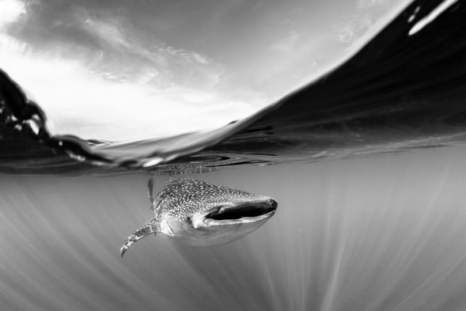
Marine
Education
Year 11 Marine Science
ANSWER BOOK
Name:
Date:
marineeducation.com.au
Unit 1 Topic 1
An ocean planet
Whale Shark. Photo © Christian Vizl
Content from Marine Science Syllabus
State of Queensland (QCAA) 2025 v1.2
By Gail Riches
© Marine Education 2024 CC BY-NC-SA
Notes:
https://www.fieldmag.com/articles/silent-kingdom-book-review-christian-vizl-ocean-photography

Slide 10
Marine
Education
1. Explore the Floor– Describe bathymetric features of the ocean floor, including the continental margin, ocean-basin floor, deep-sea trenches, mid-ocean ridges, abyssal plain
Note: bathymetric means the depths and shapes of underwater features ☺
Name:
Date:
marineeducation.com.au
Sub-marine Exploring
Three thousand meters underwater, the lights of a submarine illuminate black smoke venting out of the sea floor. Interestingly, life is plentiful at this alien-like location. It is a hydrothermal vent situated along a mid-ocean ridge (the longest and largest mountain ranges on Earth) on the deep ocean-basin floor. Other ocean-basin floor features include seamounts (undersea volcanoes >1km high), abyssal plains (undersea deserts that are the flattest areas on Earth) and deep-sea trenches (the deepest regions on Earth). Later, the submarine will steer towards a continental margin, starting with a gradual rise in depth, called the continental rise, followed by a steep climb towards the sunlit zone, called the continental slope, and finishing on a bright, shallow extension of the land, called the continent shelf.
Activity: Search Google Maps to gain a visualisation of the depths and bathymetry of the ocean. Zoom in to find each of the bathymetric features listed in the table below. Research them in more detail using various resources. Complete the table below. Provide descriptions in your own words.
Bathymetric Feature |  | Description
Deep ocean-basin Floor | Mid-ocean ridge | A divergent plate boundary & oceanic spreading centre where new oceanic crust (basalt) is formed. Chemosynthesis provides food in absence of light for tube worms, giant white clams etc.
 | Seamount | A volcanic mountain >1km that does not reach the surface (therefore is not an island). Seamounts are biodiversity hotspots. Increasingly prone to overfishing, i.e. orange roughy.
 | Deep-sea Trench | Steep sided depression in the ocean floor. Deepest regions on Earth. Form at convergent plate boundaries where subduction occurs. Marine snow and chemosynthesis supports life here.
 | Abyssal Plain | Underwater deserts. Flat. Often featureless. Typically covered in sediment from marine snow. Deposit feeders, suspension feeders and predators/scavengers live here.
Continental Margin | Continental Rise | Along the base of the continental slope where the deep ocean transitions to continental margin. A collection point for sediment falling down the continental slope.
 | Continental Slope | Steep sloping region of the continental margin. Gradients vary, particularly between ‘passive’ and ‘active’ continental margins. Submarine canyons & turbidity currents are also found here.
 | Continental Shelf | Drowned edge of a continent. Relatively shallow. Sunlight for photosynthesis. High biodiversity. Relatively flat (like a ‘shelf’). Many become exposed during glacial periods (e.g. GBR).
© Marine Education 2024 CC BY-NC-SA
Unit 1 Topic 1 Science Understanding
1

Slide 11
Marine
Education
Describe the bathymetric features of the ocean floor including the continental margin, ocean-basin floor, deep-sea trenches, mid-ocean ridges, abyssal plain
Name:
Date:
marineeducation.com.au
© Marine Education 2024 CC BY-NC-SA
NOTES AND EXAM REVISION
2

Slide 12
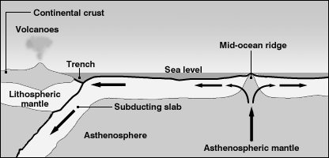
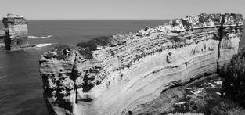
Marine
Education
2. Geology Rocks! – Apply models to understand the geological features of Earth, e.g. sea floor modelling, tectonic plate movements, coastal landforms, stratigraphy.
Name:
Date:
marineeducation.com.au
marineeducation.com.au
Making Models
A model is a simple representation of reality that helps us to understand how something works.
The geological features of the Earth, particularly those underwater, such as trenches, mid-ocean ridges and seamounts, are difficult for you and me to access, see and therefore understand. Models help us to visualise what they look like and why. Models also help us to simulate Earth processes, to understand what happened in the past, and predict what will happen in the future.
Activity: Conduct a convection experiment to model Earth’s convection currents
Puzzle Pieces
Picture Earth’s crust as a giant puzzle, with puzzle pieces called tectonic plates…..that move!
Sometimes the plates collide to make a trench (when one plate dives under another plate).
Sometimes the plates move apart to make new sea floor at a mid-ocean ridge.
Sometimes the plates move over ‘hot spots’ in Earth’s mantle to make seamounts (undersea volcanoes).
Activity: below, draw the plate tectonic arrangement for a trench and mid-ocean ridge
Rock Detective Stratigraphers study different rock layers (called strata) to interpret the history that each layer represents in time.
Study the rock layers pictured right.
Q. Where are the youngest rocks located?
Ans. [top] [middle] [bottom] Circle correct answer.
^{[1]} Hoban, G. (2014). Slowmation. Encyclopedia of Science Education. DOI: 10.1007/978-94-007-6165-0_250-3.
^{[2]} www.slowmation.com/
© Marine Education 2024 CC BY-NC-SA
Unit 1 Topic 1 Science Understanding
3

Slide 13
Marine
Education
Apply models to understand the geological features of the Earth
(e.g. sea floor modelling, tectonic plate movements, coastal landforms, stratigraphy)
Name:
Date:
marineeducation.com.au
© Marine Education 2024 CC BY-NC-SA
NOTES AND EXAM REVISION
4

Slide 14
Marine
Education
3. To reCYCLE – Describe the processes of the following cycles: water, carbon and oxygen
Name:
Date:
marineeducation.com.au
The Water (H2O) Planet
Water is essential to life on Earth. It changes from solid to liquid to gas (not necessarily in that order) and cycles between the Atmosphere, Biosphere, Hydrosphere and Lithosphere. Activity: Complete table
Atmosphere
Water vapour
Clouds
Snow
Rain
Biosphere
Water in body systems
Process | Description
Evaporation | Liquid → Gas
Condensation | Gas → Liquid
Precipitation | Rain, snow, hail etc.
Infiltration (soil) | Water on ground enters soil
Hydrosphere
Oceans
Rivers, Lakes
Glaciers & Melt Water
Lithosphere
Ground water
The Carbon Backbone of Life
Carbon is the letter ‘C’ on the Periodic Table. Every carbon atom has (not 1, 2 or 3 but) 4 spots available for other atoms to bond to. Thus, carbon is part of a countless number of molecules that make up life on Earth. When life dies, carbon is recycled to make new molecules. Activity: Complete table
Atmosphere
CO2 Gas
Biosphere
Body Parts
Photosynthesis Respiration
Process | Description
Decomposition | Decay, rotting, disintegration
Combustion | Burning
Dissolution | Dissolving
Excretion | The body expelling waste
Hydrosphere
Dissolved Carbon
e.g. carbon dioxide
carbonate & bicarbonate
Lithosphere
Detritus
Fossil Fuels
Limestone Rock
The Oxygen we breathe
Oxygen is the letter ‘O’ on the Periodic Table. We know it best as the air we breathe, or O2. Plants make oxygen via photosynthesis. Plants in the ocean include phytoplankton (plant plankton), seaweed (algae) and seagrass. Oxygen dissolves in water for marine life to respire. Activity: Complete table
Atmosphere
O2 Gas
Biosphere
Respiration
Photosynthesis
Process | Description
Photosynthesis (include formula) | 6CO2 + 6H2O → C6H12O6 + 6O2
Respiration (include formula) | Inhalation, exhalation and C6H12O6+6O2→ 6CO2 +6H2O+ATP
Oxidation (chemical weathering) | A chemical change in the presence of oxygen
Hydrosphere
Dissolved Oxygen
(D.O.)
Lithosphere
Rocks
Oxides
Silicates
© Marine Education 2024 CC BY-NC-SA
Unit 1 Topic 1 Science Understanding
5

Slide 15
Marine
Education
Describe the processes of the following cycles: water, carbon and oxygen
Name:
Date:
marineeducation.com.au
© Marine Education 2024 CC BY-NC-SA
NOTES AND EXAM REVISION
6

Slide 16
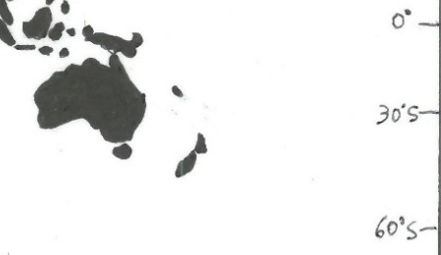
Marine
Education
4. Water in motion – Describe how surface ocean currents are driven by temperature, wind and gravity
(as opposed to ‘deep’ ocean currents driven by temperature & salinity)
Name:
Date:
marineeducation.com.au
Surface Currents Human beings live at the bottom of an ocean of air. This ocean of air – that is, of gas, the atmosphere, is in contact with water, the hydrosphere, over an area that covers more than 70% of Earth. As air molecules are dragged across the sea surface in a wind, they collide with water molecules at the ocean’s surface. This process, if prolonged, generates surface currents.
If wind makes currents…….what makes wind?
Pressure release
Wind is simply air moving from an area of high pressure (H) to an area of low pressure (L).
For example, when you release air from a balloon, the air travels from an area of high pressure (inside the balloon) to an area of low pressure (outside the balloon) felt as wind (see picture top right).
Note: Air does NOT move in straight lines between Highs & Lows that are 1000’s of kilometers apart. Instead, the air deflects left (southern hemisphere) or right (northern hemisphere) due to Earth’s rotation & the Coriolis Effect. This deflection also applies to global currents called gyres.
H
wind
L
Balloon
H
L
Activity: Draw an arrow to indicate the direction of the wind between H & L on the map above
Temperature
Temperature differences in the atmosphere initially create the areas of high & low pressure. Areas of high pressure (H) are created by air that is cold and sinking (remember convection?). Because the air is cold & sinking, it weighs more, with more downward pressure on Earth.
cold air sinking
Whereas, areas of low pressure (L) are created by air that is warm and rising. Because the air is warm & rising, it weighs less, with less downward pressure on Earth. Pressure readings are measured at sea level in hectopascals (hPa). L=rain!
warm air rising
H
L
e.g. 1020 hPa
e.g. 990 hPa
Activity: Compare data from MSLP weather maps on www.bom.gov.au with data on www.windy.com
Gravity
Gravity drives surface ocean currents called tidal currents, or tides. The rise and fall of the tide is caused by gravity. Water on Earth is pulled in certain directions in relation to the positioning of the Moon and Sun, causing tidal currents to rise and fall (ebb & flood) on a daily basis.
Moon
E.g. Imagine standing on the moon looking down at Earth. There is a tidal bulge of water directly below (and a second tidal bulge on the opposite side of Earth that you can’t see from the moon). As a coastline rotates into a tidal bulge, the tide rises (e.g. X). As it rotates out, the tide falls.
Water on Earth is pulled towards the moon to make a
‘tidal bulge’
Gravitational pull
Earth
Low Tide
High Tide
X
High Tide
Low Tide
Activity: Find the location with >4m tides in Qld. on www.bom.gov.au Ans.
marine & ocean tab
Sarina
© Marine Education 2024 CC BY-NC-SA
Unit 1 Topic 1 Science Understanding
7

Slide 17
Marine
Education
Describe how surface ocean currents are driven by temperature, wind and gravity
(as opposed to ‘deep’ ocean currents driven by temperature & salinity)
Name:
Date:
marineeducation.com.au
© Marine Education 2024 CC BY-NC-SA
NOTES AND EXAM REVISION
8

Slide 18
Marine
Education
5. Free postage & handling – Describe how water, heat and nutrients are distributed across coastal regions and global ocean basins, e.g. upwelling and downwelling, El Niño and La Niña events, Langmuir circulation, Ekman spiral.
Name:
Date:
marineeducation.com.au
Imagine the ocean without currents….There would be no recycling of food, no free-ride for migratory species, no dispersal of larvae from one ecosystem to the next. There would be no movement of heat around the earth, no oxygen in the deep oceans, or movement of sediment from one place to the next. Earth would be very different indeed. There are many different types of currents. Some have very interesting and quirky names. I wonder why? Let’s find out!
The Name Game: Name the current by matching their names to the descriptions below
Upwelling Downwelling Ocean gyres El Nino La Nina Langmuir circulation Ekman Spiral Rip Current Ocean Eddy Current
Note: Some feature more than once
Vertical currents that bring nutrient-rich, cold water UP from the bottom.
Australia
Sth. America
This current delivers nutrients UP from the deep. Primary producers (such as phytoplankton and algae) LOVE nutrients. They use them to carry out photosynthesis which helps them to grow and become food for consumers.
South
Pacific Ocean
e.g. Upwelling
Ocean Gyre
Upwelling
A current that flows in a downward spiral pattern deflecting left in the southern hemisphere and right in the northern hemisphere due to the Coriolis Effect. Physicist Ekman first explained it in 1902.
A surface current that resembles a ‘corkscrew’ type of flow, named after its discoverer Irving Langmuir. It produces long streaks that go for several kilometers and sit 10-50m apart
(0-6m deep). Sometimes the streaks carry floating material, bubbles or algae.
Langmuir circulation
Ekman Spiral
Deeper water
This name means ‘the little girl’ in Spanish.
Vertical currents that send water back DOWN to the bottom. Hint: the opposite to an upwelling
Wind
La Nina
Wave break
Wave break
Spiralling currents
Surface current
Main Flow direction….
Beach
Net flow
Rip current
~200m
Downwelling
Ekman Spiral
obstruction
The name means ‘the little boy’ or ‘Christ child’ in Spanish. It was first named by fishermen in Peru to warn their people of the occasional (unwelcomed) return of a warm water current around Christmas time. The warm water would stop nutrient-rich upwellings near Peru from reaching the surface. The name is now used by people around the world to cast blame on the havoc wreaked by weather due to the transfer of heat and energy from one side of the Pacific to the other.
Streaks of bubbles, algae etc.
El Nino
Langmuir circulation
Eddy
© Marine Education 2023 CC BY-NC-SA
Unit 1 Topic 1 Science Understanding
9

Slide 19
Marine
Education
Describe how water, heat and nutrients are distributed across coastal regions and global ocean basins (e.g. upwelling and downwelling, El Nino and La Nina events, Langmuir circulation, Ekman spiral)
Name:
Date:
marineeducation.com.au
© Marine Education 2024 CC BY-NC-SA
NOTES AND EXAM REVISION
10

Slide 20
Marine
Education
6. Wacky Water – Describe the physical and chemical properties of water, including structure, hydrogen bonding, polarity, action as a solvent, heat capacity and density
Name:
Date:
marineeducation.com.au
H2O has Mickey Mouse Ears
Most people recognize that the chemical formula for water is H2O. But what does this mean? Well, the H stands for hydrogen, of which there are two atoms. And the O stands for oxygen, of which there is one atom (note: you don’t write the number 1 in chemical formulas). What does it look like? The two hydrogen atoms are much smaller than the oxygen atom. The two hydrogen atoms sit 105° apart on top of the oxygen atom, like mickey mouse ears. Because of the positioning and positive charge of hydrogen atoms, one end of the water molecule is positively charged and the other end is negatively charged. Thus, it has a dipole (two-pole) structure. Opposite charges attract each other (think of a magnet). Thus, H2O molecules attract each other - the negative end of one H2O molecule attracts the positive end of another H2O molecule. The bond that forms in between the two water molecules, holding them together, is called a hydrogen bond.
Positive (+)
H
O
H
Negative (-)
Hydrogen bond
Q. What is a hydrogen bond (in water)? Ans.
The bond that forms between 2xH2O
molecules holding them together (due to their polarity or dipole structure).
Dis…solvent
One of water’s special properties is its tremendous solvent power – it’s ability to dissolve stuff. The dipole structure of the H2O molecule accounts for its unsurpassed properties as a solvent, attracting (not only other H2O molecules but also) other positively or negatively charged atoms, called ions, such as SALT ions Sodium (+) and Chloride (-).
That’s why sea water tastes so salty!
Dissolved Salt
-
Cl
Activity: Draw the arrangement of H2O molecules around a Chloride ion & a Sodium ion (pictured right). Make it so the Proton ‘ears’ (+) touch the Chloride (-) ion and the Oxygen ‘ends’ (-) touch the Sodium (+) ion. This is (roughly) what salt looks like when dissolved in water!
+
Na
Cold as ICE
Frozen water – ice – is less dense than liquid water, due to the arrangement of H2O molecules when it freezes. Activity: Compare models of ice and water. Q. If ice didn’t float, would we still survive? Ans.
High Heat Capacity
Water changes temperature very slowly due to its high heat capacity. Even though a huge amount of the sun’s heat shines on the ocean every day, water absorbs this heat with little change in temperature.
Thus, the ocean is very slow to change temperature, and in that time can travel very far! Water’s high heat capacity is also why atmospheric temperatures are more stable out at sea than on land.
Q. Why wear a wetsuit on a hot winter’s day? Ans. Because water has a [high][low] heat capacity.
(circle correct answer)
© Marine Education 2023 CC BY-NC-SA
(circle correct answer)
Unit 1 Topic 1 Science Understanding
11

Slide 21
Marine
Education
Describe the physical and chemical properties of water, including structure, hydrogen bonding, polarity, action as a solvent, heat capacity and density
Name:
Date:
marineeducation.com.au
© Marine Education 2024 CC BY-NC-SA
NOTES AND EXAM REVISION
12

Slide 22
Marine
Education
7. All sorts of Clines – Describe the concept of ocean layers, including thermocline, halocline and pycnocline
Note: ‘cline’ means ‘layer’
Name:
Date:
marineeducation.com.au
Thermocline: ‘thermo’ means temperature
It may surprise many people to learn that most of the ocean is 4-5°C. It is only the sunlit layers that are warm. All of the water below 1000m is 4-5°C – even in the tropics! Another surprise is that the temperature does not cool gradually with depth. It cools rapidly. A layer of warm water sits on top a layer of cold water, as though completely separate. The barrier that separates these two layers is called a thermocline.
Q. What is a Thermocline? Ans.
warm
thermocline
cold
A rapid change in temperature between two layers of water
Halocline: ‘halo’ means salt or salinity
A halocline is similar to a thermocline, but instead of a rapid change in temperature, it is a rapid change in salinity (dissolved salt content). A halocline can occur when fresh water is added to the ocean
(e.g. precipitation > evaporation, rivers flood, ice melts) or when water molecules are removed from the ocean (e.g. ice forms, evaporation > precipitation).
Q. What is a Halocline? Ans.
Fresh (or diluted) water
halocline
Salt water
Extra salty water
halocline
Salt water
A rapid change in salinity between two layers of water
Pycnocline: ‘pycno’ means density
A pycnocline is a rapid change in density (caused by a permanent thermocline and/or halocline). It is also the place where ‘mixed’ surface water transitions into deep water. Note: pycnoclines do NOT exist at the North or South pole due to upwellings and downwellings.
Q. What is a Pycnocline? Ans.
Mixed, surface water
Pycnocline layer
Deep water
A rapid change in density between mixed, surface water and deep water
Activity: Plot the following data^{[1]} (on graph paper) for an ocean in the low latitudes to
Identify the thermocline
Identify the halocline
Identify the pycnocline
Describe trends in the O2 profile
Depth (m) Temp (°C) Salinity (ppt) Oxygen (ml/L)
0
250
500
750
1000
2000
3000
4000
24.4
21.2
6.9
5.1
4.9
4.8
4.7
4.6
36.5
36.3
35.6
34.7
34.4
34.8
34.9
34.8
4.6
4.7
2.0
3.5
3.8
5.1
5.1
5.1
(c)
(a)
(b)
(d)
O2 min.
Hint: Plot depth on the y-axis, in quadrant four of a cartesian plain (x axis on top) so it looks like the ocean
^{[1]} Adapted from: Pinet, P. R. (1998). Introduction to Oceanography: Web Enhanced Edition. Jones and Barlett Publishers International (OceanLink). ISBN: 0763706140.
© Marine Education 2023 CC BY-NC-SA
Unit 1 Topic 1 Science Understanding
13

Slide 23
Marine
Education
Describe the concept of ocean layers, including thermocline, halocline and pycnocline
Note: ‘cline’ means ‘layer’
Name:
Date:
marineeducation.com.au
© Marine Education 2024 CC BY-NC-SA
NOTES AND EXAM REVISION
14

Slide 24
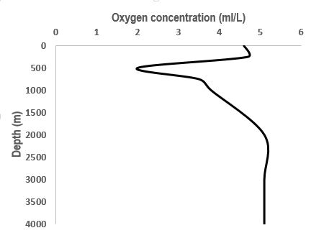
Marine
Education
8. The Shadow Zone – Describe how thermoclines and nutrients produce the oxygen minimum within the open ocean
Name:
Date:
marineeducation.com.au
The Oxygen Minimum is…
200-1000m
Where dissolved oxygen is at its ‘minimum’
Where permanent thermoclines slow down the falling motion of any dead organic matter (called ‘marine snow’)
Where a rich source of food (i.e. nutrients) accumulate
Where organisms deplete oxygen during respiration
and decomposition (i.e. decomposing bacteria)
Where the two principal sources of oxygen for the oceans (gas diffusion and photosynthesis) do NOT exist
O2 min.
Why is there NO gas diffusion or photosynthesis in the oxygen minimum? (circle correct ans.)
Ans. Because it is too [deep] [shallow] for the diffusion of oxygen from the atmosphere, and
because there is [too much] [not enough] light for photosynthesis.
Who was hiding in the shadow zone?
NAVY ships and sub-mariners use sonar (sound waves) to be able to ‘see’ underwater and to detect other submarines. Back in the 60’s, before modern sonar, the ocean offered some great secret hiding places.
At the base of the mixed layer where the thermocline begins, sound refracting upwards and downwards would create a ‘shadow zone’ where submarines would hide with almost complete immunity. Under certain temperature conditions, it was possible for a submarine beneath the mixed layer to be undetected at ranges of as little as 50m^{[1]}.
Activity: Write 5 dot points of information about the O2 Minimum layer that you did not know before:
200-1000m
Where dissolved oxygen is at its minimum
Where organisms deplete oxygen during respiration and decomposition
(i.e. decomposing bacteria) when feeding on an accumulation of falling food (‘marine snow’) slowed by the thermocline
Where the two principal sources of oxygen for the oceans (gas diffusion and photosynthesis) do NOT exist
Where submarines used to hide from detection by sonar and got the name ‘shadow zone’
^{[1]} Roger Revelle, John Lyman, Charles L., Bretschneider, Bernard J. Le Mehaute, Rear Admiral W. H. Groverman, U.S. Navy; Captatin E.T. Harding, U.S. Navy; Captain T.K. Teadwell, U.S. Navy, Walter I. Wittmann, Sitney R. Galler, I. Eugene Wallen, Gilbert Jaffe, Maurice Ewing, Richard C. Vetter, Captain Stevel N. Anastasion, U.S. Navy, Donald L. McKernan, Athelstan Spilhaus, Robert B. Abel, Commander Robert J. Alexander, U.S. Navy. Edited by Captain E. John Long, U.S> Naval Reserve (Retired) (1964). Ocean Sciences. United States Naval Institute, Annapolis, Maryland. Library of Congress Catalogue Card Number 64-18472.
© Marine Education 2023 CC BY-NC-SA
Unit 1 Topic 1 Science Understanding
15

Slide 25
Marine
Education
Describe how thermoclines and nutrients produce the oxygen minimum within the open ocean
Name:
Date:
marineeducation.com.au
© Marine Education 2024 CC BY-NC-SA
NOTES AND EXAM REVISION
16

Slide 26
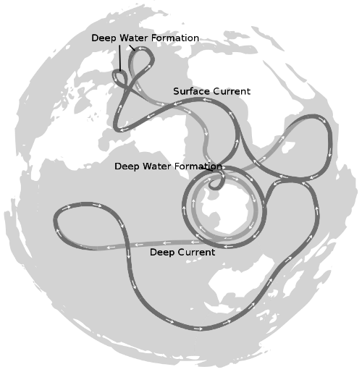
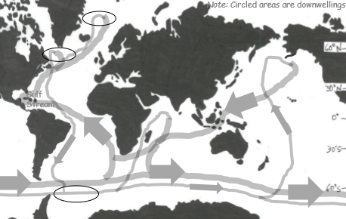
Marine
Education
9. The Global Ocean Conveyor Belt – Explain how thermohaline circulation in the deep ocean is affected by salinity and water density
Name:
Date:
marineeducation.com.au
The DEEEEP Ocean circulation
Thermohaline circulation (i.e. currents) in the deep ocean arise from density differences between water masses that differ in temperature (‘thermo’) and/or salinity (‘haline’). In other words, think of a water
mass as a deep water current moving from one place to another (over very long distances, very slowly).
Water masses generally do not mix. Instead, they are stacked, one on top of the other, in the order of
their density - with the most dense (heaviest) to the bottom. The density of a water mass depends on its temperature and salinity. Cold water is more dense than warm water (because, in cold water, molecules move slower and closer together). Salt water is more dense than fresh water (because it has salt in it). Therefore, a water mass that is very cold and salty, is very dense, and found at the bottom of the stack.
Activity: Melt dye-stained ice in water. Observe current flow
Activity: Circle the correct answer and finish the sentence:
Cold water [sinks] [floats] because…
it is more dense than warm water
Q. Where is water very cold, salty and dense, and sinks all the way to the bottom of the ocean like an underwater waterfall?
Equator
Antarctica
Gulf Stream
ice
See-through container filled
with tap water (i.e. beaker)
Global Ocean Conveyor Belt
A water mass will only descend to a depth that is appropriate to its density, sliding under less dense water and cruising over more dense water. The water mass then travels across entire oceans as an internal wave before it is redirected towards the surface as an ‘upwelling’ to mix with surface currents.
An oversimplified model of both deep and shallow water circulation depicts a global ocean conveyor belt of water movement. It is commonly referred to as the ‘global conveyor belt’ or ‘thermohaline circulation’.
Activity: Draw the Global Conveyor Belt on the map below
Figure 1 : The Global Conveyor Belt on a continuous-ocean map, with shallow water flows as the darkest flow lines^{[1]}
^{[1]} Avsa (2020). Oceans-image.svg, CC BY-SA 3.0. Wikapedia. Accessed 01/07/2020 from: https://commons.wikimedia.org/w/index.php?curid=8385268
© Marine Education 2023 CC BY-NC-SA
Unit 1 Topic 1 Science Understanding
17

Slide 27
Marine
Education
Explain how thermohaline circulation in the deep ocean is affected by salinity and water density
Name:
Date:
marineeducation.com.au
© Marine Education 2024 CC BY-NC-SA
NOTES AND EXAM REVISION
18

Slide 28
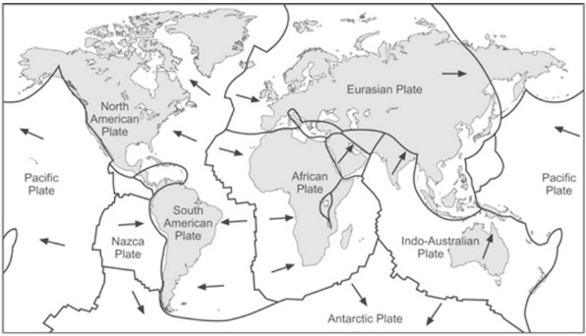
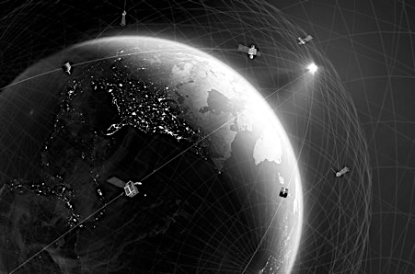
Marine
Education
10. Eyes looking down – Appreciate that development of satellite measurement techniques allows scientists to predict the direction and rate of plate movement. Consider how this has developed improved understandings of processes such as sea floor spreading and mantle convection
Name:
Date:
marineeducation.com.au
Geodesy, the science of measuring the Earth's shape and positions on it, allows the measurement of plate motion directly using GPS, the Global Positioning System. This network of satellites is more stable than the Earth's surface, so when a whole continent moves somewhere at a few cm. per year, GPS can tell.
Activity: Identify where seafloor spreading occurs in the image above.
Developed by the military for tracking subs and launching nuclear weapons, GPS is a network of satellites, equipped with an atomic clock, a computer, and a radio, orbiting Earth approximately every 12 hours.
Activity: Below, write the latitude and longitude coordinates for where you are now.
Latitude:
22.5752° S
Longitude:
144.0848° E
© Marine Education 2023 CC BY-NC-SA
Unit 1 Topic 1 Science as a Human Endeavour
19

Slide 29


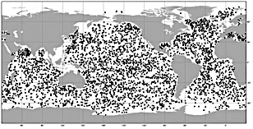
Marine
Education
11. Keeping Track - Consider how advances in remote sensing have enabled scientists to map ocean currents and develop models of the complex pathways involved in regulating global climate, such as the ‘global ocean conveyor belt’.
Name:
Date:
marineeducation.com.au
A lot has changed since the 1800s when our knowledge of sea surface currents were confined to Captain log books.
1800’s With the invention of the chronometer (in 1735) and the sextant (in 1757) information about sea surface currents began with Captain log books, specifically ship-drift reports on the voyage of the HMS Challenger expedition (1872-1876). Ship-drift reports reveal knowledge of sea surface currents documented as course alterations made by Captains to avoid drifting off course ^{[1]} .
1920’s Pictured right is an Ekman Current meter being deployed in 1922 to measure current speed and direction using a propeller equipped instrument. We still use current meters today. But they have less moving parts and include instruments such as acoustic dopplers.
1960s SOFAR floats were deployed at around 1000m in depth to exploit the ‘sound fixing and ranging’ (SOFAR) channel where sound travels very long distances (within a permanent thermocline - also oxygen minimum zone or ‘shadow zone’). SOFAR floats would intermittently send out sound blasts, typically at 260 Hz. Three or more moored (fixed) listening stations at known locations would receive the sound signals, all at different times, thus locating the SOFAR float in real-time (and the speed and direction of the current in which it was travelling). Later, it was realised that it was cheaper when the sound blast came from a fixed mooring array and the floats were the listening stations. When the transmit and receive roles were reversed, the floats were given a new name: RAFOS floats … SOFAR spelled backward.
Remote sensing now enables us to “sense” ocean currents “remotely” using satellites etc.
1970s The development of GPS lead to the ability to track drifters designed to follow the movement of surface waters. A drifter (unlike a float that is submerged) is an oceanographic device floating on the surface used to investigate ocean currents by tracking location. Because it’s on the surface, it can be tracked by satellite, often GPS. They also measure other parameters like sea surface temperature, salinity, barometric pressure, and wave height.
1990s Radar/satellite altimeters (altimetry) are meters attached to satellites that measure the dips and rises in the sea height. They were the next major breakthrough with the launch of satellites on altimeter missions in the early 1990s. Interestingly, the surface of the ocean isn’t flat -- there are high spots and low spots. Satellite altimeters measure the ocean surface height in relation to mean sea level. The return time of the signal from the satellite back to earth gives a measure of distance to the surface. Altimetry data helps identify areas of upwelling and downwelling, the location of ocean current features, eddies and sea level rise.
2000s Argo Floats - Argo is a global array of 3,000 free-drifting profiling floats (underwater robots) that measure the temperature and salinity of the upper 2000m of the ocean. This allows, for the first time, continuous monitoring of the temperature, salinity, and velocity of the upper ocean, with all data being relayed and made publicly available within hours after collection. The name Argo was chosen to emphasize the strong complementary relationship of the global float array with the Jason satellite altimeter mission.
Argo floats around the world
Question: What is the difference between a drifter and a float? Ans.
Drifters only drift on the surface. Floats such as argo floats go underwater as well.
^{[1]} Gould, W. J. (2022). HMS Challenger and SMS Gazelle – their 19th century voyages compared. Marine Physics and Ocean Climate, National Oceanography Centre, Southampton, SO14 3ZH, UK. Email: wjg@noc.ac.uk
© Marine Education 2023 CC BY-NC-SA
Unit 1 Topic 1 Science as a Human Endeavour
20

Slide 30
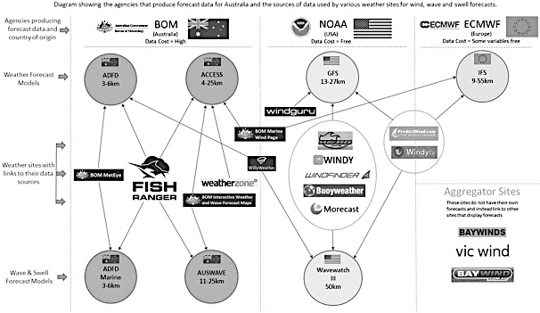
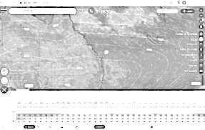
Marine
Education
12. Cloudy with a chance of meatballs – Consider that contemporary weather predictions are based on computer models but still rely on human input to determine the most accurate and reliable forecast. Consider how this scientific knowledge enables scientists to inform decision-making for coastline management and marine industries.
Name:
Date:
marineeducation.com.au
Weather models
A weather model is the main tool used to forecast weather. How does it work? First, we have weather instruments that collect weather data (from weather stations, radars, satellites and other weather instruments). Then, it’s time to make a weather forecast from all that data. How do we do that? We add the data to a bunch of mathematical equations. However, there’s so many mathematical equations involved – all complex of course - that it takes a powerful computer model to make sense of it all. Thus, a weather model is a special computer program that solves very complex mathematical equations for the purpose of making a weather forecast. Importantly, there’s more than one weather model. Popular models include: the ADFD model (Australian Digital Forecast Database), GFS (Global Forecast System) and the ECMWF (European Centre for Medium-Range Weather Forecasts). Each model has different equations. They can take hours to solve. When finished, the results are available to download. Weather forecast apps such as Windy.com download the data to make their forecasts. Some downloads are free. Others cost money^{[1]}.
Weather Site Data Source Comparison
On Windy.com you can choose which model to use! Click your location on their map, then click on the down arrow, look at the bottom of the screen and click on ‘Compare’ ^{[2]}.
Activity: compare models on Windy.com
^{[1]} FishRanger.com (2023). Weather Site Data Source Comparison. Accessed 11.07.2023 from: https://www.fishranger.com.au/weather_site_data_source_comparison
^{[2]} Windy.com (2023). Accessed 11.07.2023 from: https://www.windy.com/?-27.474,153.022,5,i:pressure
© Marine Education 2023 CC BY-NC-SA
Unit 1 Topic 1 Science as a Human Endeavour
21
Notes:
Windy.com

Slide 31
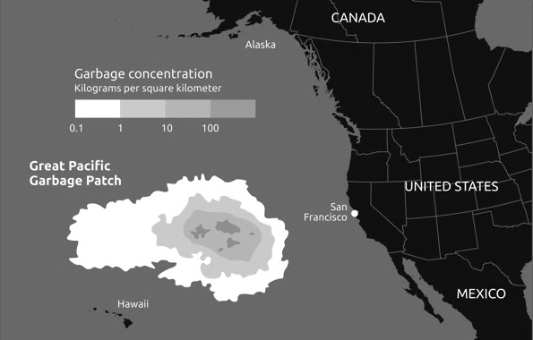
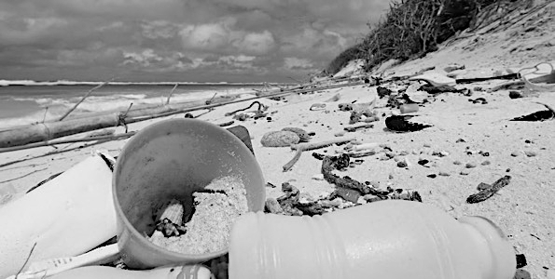
Marine
Education
13. Dodgy Debris – Appreciate that marine debris accumulation is a global phenomenon (e.g. ‘The Great Pacific Garbage Patch’). Consider how the causes and solutions (i.e. the use of scientific knowledge) of this issue are influenced by social, economic, cultural and ethical considerations
Name:
Date:
marineeducation.com.au
Above: The Great Pacific Garbage Patch. Source: https://theoceancleanup.com/
Below: Cocos (Keeling) Island swamped by plastic from Indonesia. Source: https://www.abc.net.au/news/science/2023-03-17/ocean-cleanup-plastic-pollution-great-pacific-garbage-patch/102075810
Activity: Discuss …. how does this happen, and ….what are the solutions?
Write your answers on the whiteboard divided into 4 categories:
social, economic, cultural and ethical considerations
© Marine Education 2023 CC BY-NC-SA
Unit 1 Topic 1 Science as a Human Endeavour
22

Slide 32
Marine
Education
14. Are you up for the challenge? – Appreciate that knowledge of the oceans is limited and requires further investigation
Name:
Date:
marineeducation.com.au
Activity: Identify reasons why knowledge of the oceans is limited and requires further investigation by completing the PEEL (Point, Evidence, Explain, Link) paragraph and referencing the reasons (stimulus) below.
Reason #1
Lack of sampling and expertise
Knowledge is limited because of a lack of sampling and taxonomic expertise. It is estimated that only 20-30% of all marine species have been discovered^{[1]}.
Reason #2
Challenging conditions
Knowledge is limited because of the challenges working underwater. Working underwater requires special equipment that is expensive and limited in scope^{[2]}.
Reason #3
Data-poor fisheries
Knowledge is limited because of the correlation between the value of a fishery and the amount of data collected on it. Fisheries considered of little value are allocated smaller amounts of time and money^{[3]}.
The first sentence of the PEEL paragraph states your main POINT or argument. The first sentence is already done for you….
Someone might read this and ask, ‘But what do you mean?’ or, ‘How do you know that is true and correct?’…’Prove it!’. You CAN’T just make a statement and NOT back it up with evidence and reason! Your chance to ‘prove it’ comes up next, in the sentences that follow…..
“Knowledge in the oceans is limited and requires further investigation.”
Find 3 pieces of EVIDENCE from the stimulus provided at the top of the page to complete the sentences below:
Evidence #1 (i.e. finish the first sentence in Evidence #1)
Evidence #2 (i.e. finish the first sentence of Evidence #2)
Evidence #3 (i.e. finish the first sentence of Evidence #3)
Explain your 3 pieces of evidence by providing more detail from the stimulus at the top of the page and complete the sentences below:
Explain Evidence #1 (i.e. the second sentence in Evidence #1) (in text citation).
Explain Evidence #2 (i.e. the second sentence of Evidence #2) (in text citation).
Explain Evidence #3 (i.e. the second sentence of Evidence #3) (in text citation).
Firstly, knowledge is limited because …
For example,…
of a lack of sampling and taxonomic expertise.
it is estimated that only 20-30% of all marine species have been discovered (Appeltans, et al., 2012).
Secondly, knowledge is limited because …
In addition,…
working underwater requires special equipment that is expensive and limited in scope (Costello, et al., 2010).
of the challenges working underwater.
Lastly, knowledge is limited because …
Furthermore,…
the correlation between the value of a fishery and the amount of data collected on it.
fisheries considered of little value are allocated smaller amounts of time and money (Bentley, 2014).
How does this paragraph LINK to your next paragraph? Complete the last sentence:
As a result, knowledge in the oceans is limited. Further investigation may include (topic of paragraph to follow)…
E.g. investing in research to, at the very least, obtain baseline data for many marine ecosystems.
^{[1]} Appeltans, W., Ahyong, S. T., Anderson, G., Angel, M.V., Artois, T., et al., (2012). The Magnitude of Global Marine Species Diversity. Current Biology. Volume 22, Issue 23, Pages R996-R997. DOI: 10.1016/j.cub.2012.09.036
^{[2]} Costello, M.J, Coll, M., Danovaro, R, Halpin, P., Ojaveer, H. and Miloslavich, P. (2010). A Census of Marine Biodiversity Knowledge, Resources, and Future Challenges. PLoS ONE 5(8): e12110. DOI: 10.1371/journal.pone.0012110
^{[3]} Bentley, N. (2014). Data and time poverty fisheries estimation: potential approaches and solutions. ICES Journal of Marine Science. 72:1:186-193. DOI:10.1093/icesjms/fsu023
© Marine Education 2023 CC BY-NC-SA
Unit 1 Topic 1 Science Understanding
23

Slide 33
Marine
Education
15. EEeezy Money – Recognise that decisions relating to resource management are affected by the economic development of a nation and the value placed on marine environment
Name:
Date:
marineeducation.com.au
The Exclusive Economic Zone (EEZ)
The ocean is divided into zones and areas (sort of like how we divide up land into countries and states). For starters, every coastal nation has an Exclusive Economic Zone, or EEZ, the area of sea that extends out from a country’s shoreline to 200 nautical miles offshore. Each country has exclusive rights within its EEZ to exploit, conserve and manage the natural resources there, including marine life, minerals, fossil fuels, and renewable energy sources. Some countries sub-divide their EEZ’s into areas with special restrictions, such as a marine park. The area of ocean outside the EEZ is called the ‘high seas’. The resources in the high seas are ‘common’ heritage, which means they are shared, managed and governed by all countries. The ‘Tragedy of the Commons’ is thus a concern. The tragedy being overexploitation in the absence of regulation.
You are 200 nautical miles from land!
The High Seas
Australia’s EEZ
Q. What do the E’s in EEZ stand for? Ans.
Exclusive (and) Economic
Money Talks
Let’s face it. Money talks. If mining for oil and gas on a pristine patch of reef did not bring in billions of dollars, it simply would not happen. The learning objective for this lesson is one you already know too well….that money shapes many of our decisions….including those relating to resource management.
Where do you stand?
Activity: Divide the room into 3 sections: (1) The Economy (2) The Environment (3) The People
$$$$
Stand in the section that you think decision-makers consider the most when making resource management decisions (i.e. what do they value?). If you think it’s all three, stand in the middle.
Discuss your reasoning.
Tally where people are standing &
record in the table, pictured right.
Now move to the section that you think decision-makers should consider the most (note: it has to be sustainable)
Discuss your reasoning.
Tally where people are standing &
record in the table, pictured right.
 | The Economy | The Environment | The People | All 3
Tally
 | The Economy | The Environment | The People | All 3
Tally
ESD or Ecological Sustainable Development states that a ‘sustainable’ decision requires all three sections (in the activity above) to be given equal consideration. Those who stood in the middle for qu.2 will make very good resource managers one day! Activity: Google ‘Triple Bottom Line’ (images)
© Marine Education 2023 CC BY-NC-SA
Unit 1 Topic 1 Science Understanding
24

Slide 34
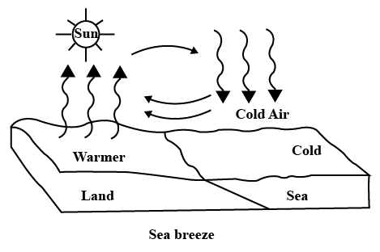
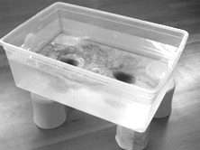
Marine
Education
Name:
Date:
marineeducation.com.au
16. Convection prac – Investigate convection
Convection Currents
Convection currents are heat-driven cycles that occur in the air, ocean and mantle. They are caused by
a difference in temperature. The difference in temperature relates directly to the density of the material. Convection currents can happen with any non-solid substance. Some convection currents are relatively quick cycles, like those in the atmosphere.Others are very slow, like in the mantle. Governed by the principle that warm (less dense) rises and cool (more dense) sinks, convection currents cause plate tectonics, storms, land and sea breezes, desert and tropical regions, and even Earth's magnetic field! ^{[1]}
Cold air sinking
Heat source
warm air rising
Question: What drives a convection current? Ans.
Difference in temperature
The Experiment
This experiment looks at convection currents in water, but the same principle applies for the air
and mantle. You will need a clear rectangular container, water, and red and blue food coloring.
1. Fill the container with water and let it come to room temperature.
2. Dye some water blue and put it into the freezer, long enough for it to be cold but not frozen.
3. Dye some water red and heat it in the microwave (or with a bunsen burner)
4. Pour the cold blue water into one side of the container and the hot red water into the other side of the container.
5. Watch the currents form!
Activity: describe your observations below
^{[1]} Berkeley UC Museum of Paleontology (n.d.). 1101 Valley Life Sciences Building, Berkeley, CA 94720-4780
© Marine Education 2023 CC BY-NC-SA
Unit 1 Topic 1 Science Inquiry Skills
25
Notes:
Image: https://www.toppr.com/ask/question/write-true-or-false-for-each-statement-land-and-sea-breezes-are-convection-currents-of/

Slide 35

Marine
Education
17. Density Divides - Investigate thermoclines (using ice and water, and hot and cold coloured water); salinity (using student-made straw hydrometers); stratification (using salt and fresh water).
Name:
Date:
marineeducation.com.au
Straw Hydrometer
The saltier a body of water, the denser it is. A hydrometer is used to measure the density of water.
A straw hydrometer consists of a straw with a plug at one end. When placed in salt water, the straw floats higher than when placed in less dense fresh water.
Materials
• 1x measuring cylinder
• Water
• Salt
• Playdough
• Drinking straws (e.g. sugarcane straws)
• Ruler
Methods
Fill a measuring cylinder with water
Press a small ball of playdough the size of a marble into one end of a straw to form a plug.
Put the straw hydrometer plug-end down into the water.
Remove or add playdough until the hydrometer floats, without touching the bottom of the cylinder.
Measure the length of the straw that is OUT of the water. Record your result.
Add salt to the measuring cylinder.
Measure the length of the straw that is OUT of the water. Record your result.
Activity: In the box below, write a scientific explanation for the results
© Marine Education 2023 CC BY-NC-SA
Unit 1 Topic 1 Science Inquiry Skills
26

