Slide 1
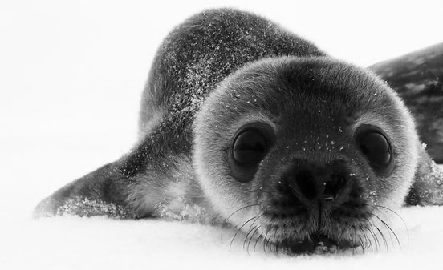
Marine
Education
Year 11 Marine Science
Student Workbook
Name:
Date:
marineeducation.com.au
Unit 2 Topic 1
Marine Ecology and Biodiversity
ANSWER BOOK
Content from Marine Science Syllabus
State of Queensland (QCAA) 2025 v1.2
By Gail Riches
© Marine Education 2024 CC BY-NC-SA

Slide 2

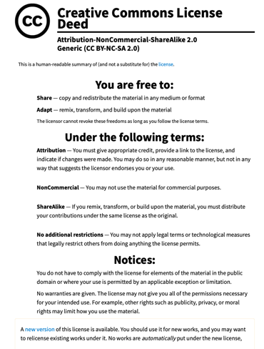
Marine
Education
marineeducation.com.au
© Marine Education 2024 CC BY-NC-SA
Published by Marine Education 2024
ABN: 48765406873
Author: Gail Riches
Email: info@marineeducation.com.au
www.marineeducation.com.au
Course Overview and Learning Objectives derived from Marine Science 2025 v1.2 General senior syllabus, October 2024.
Queensland Curriculum & Assessment Authority PO Box 307 Spring Hill QLD 4004 Australia.
https://www.qcaa.qld.edu.au/downloads/senior-qce/syllabuses/snr_marine_science_25_syll.pdf
Image (front page seal): https://www.pbs.org/video/how-antarcticas-cutest-baby-seals-stay-warm-te5klv/
Interested persons are invited to contact the author for information or to indicate errors and omissions.
This publication is available to download free-of-charge from the Marine Education website: www.marineeducation.com.au
The sale of this product is strictly prohibited.
Printing at a commercial printer such as Office Works is permitted for school-use only.
Marine Education would like to thank all the teachers, students and industry professionals who kindly shared their work.
© Marine Education 2024 CC BY-NC-SA

Slide 3
Marine
Education
Course Overview
marineeducation.com.au
Marine Science
Year 11 (this booklet)
Assessment
Data Test 10%
Student Experiment 20%
Research Investigation 20%
Exam 50% (only examines SU dot points)
Year 12 (next booklet)
Assessment
Data Test 10%
Student Experiment 20%
Research Investigation 20%
Exam 50% (only examines SU dot points)
Unit 1
Oceanography
Topic 1: An ocean planet
Topic 2: The dynamic shore
Unit 2
Marine Biology
Topic 1: Marine ecology and biodiversity
Topic 2: Marine environmental management
Unit 3
Marine systems – connections and change
Topic 1: The reef and beyond
Topic 2: Changes on the reef
Unit 4
Ocean issues and resource management
Topic 1: Oceans of the future
Topic 2 Managing fisheries
Syllabus Objectives
Describe ideas and findings
Apply understanding
Analyse data
Interpret evidence
Evaluate conclusions, claims and processes
Investigate phenomena
Science Strands
Science understanding (SU) - this is the ONLY Strand that is assessed in the (50%) exam
Science as a human endeavour (SHE)
Science inquiry skills (SIS)
© Marine Education 2024 CC BY-NC-SA
Course Overview

Slide 4
Marine
Education
marineeducation.com.au
Table of Contents
Unit 2 Marine Biology | Page
Topic 1: Marine Ecology and Biodiversity
Strand: SCIENCE UNDERSTANDING
Subject Matter: Biodiversity
1. Life’s Diversity: Describe the three main types of diversity, i.e. genetic, species and ecosystem. | 1
2. Marine Must-haves: Explain the three unique characteristics of marine biodiversity, i.e. wide dispersal at sea, the need for structural complexity, critical nursery habitats. | 3
3. A diverse Australia: Identify the variety of ecosystems (e.g. estuaries, coastal lakes, saltmarshes, mangroves, seagrass, rocky shores, temperate reefs, coral reefs, lagoons, shelf and deep water) that constitute Australia’s marine biomes. | 5
4. Connect…ivity: Describe the implications of connectivity to marine ecosystems, e.g. estuaries, mangroves, seagrass beds. | 7
5. Security breach: Identify factors that lead to a loss of diversity, e.g. natural hazard, loss/fragmentation of habitat, pollution, exploitation, introduction of new species, disease. | 9
6. Homer’s Index: Calculate the biodiversity of a marine ecosystem using Simpson’s Diversity Index (SDI), 𝑆𝐷𝐼 = 1 − [∑ 𝑛(𝑛−1)/𝑁(𝑁−1)] where N = total number of organisms of all species and n = number of organisms of one species. | 11
7. Formula Feast: Interpret data to determine the biodiversity of a marine ecosystem using diversity indices. | 13
8. Environmental Medical: Describe the concepts of ecosystem resilience, disturbance and recovery. | 15
Subject Matter: Biotic components of marine ecosystems
9. Bio…ta: Identify biotic components of marine ecosystems, i.e. trophic levels, food chains, food webs, interactions and population dynamics. | 17
10. Social Shenanigans: Classify biotic interactions based on the following terms - symbiosis (i.e. parasitism, mutualism, commensalism and amensalism) - competition (i.e. intraspecific and interspecific) - predation. | 19
11. Pick a name: Identify and describe marine species, using field guides and identification keys. | 21
12. Bring on the Buffet: Identify organisms in trophic levels in a food web based on the following terms - producers - primary consumers - secondary consumers - tertiary consumers - decomposers. | 23
© Marine Education 2024 CC BY-NC-SA

Slide 5
Marine
Education
marineeducation.com.au
Table of Contents
Unit 2 Marine Biology (continued) | Page
13. Toxic Catch: Describe how matter cycles through food webs, and the process of bioaccumulation (e.g. ciguatera and mackerel (Scomberomorus spp.); mercury and blacktip sharks (Carcharhinus spp.); and toxin accumulation on microplastics. | 25
14. Population Dynamics: Describe the concept of population dynamics using the terms population size, density, abundance, distribution (i.e. clumped, uniform, random), carrying capacity, niche, K-strategists and r-strategists, keystone species. | 27
15. Measuring populations: Interpret population data to determine population size, density, abundance, distribution, carrying capacity. | 29
Practice Research Question: Is there a significant difference in COTS Population size between 2012 and 2017? [RQ, Method, Results, Conclusion, Scaffolding for analysis, P value and error bars] | 31
16. BIDE model: Calculate the rate of change of a population using 𝑅 = (𝐵 + 𝐼) − (𝐷 + 𝐸) where R = the rate of change of a population, B = birth rate, D = death rate, I = immigration and E = emigration. | 35
Subject Matter: Abiotic components of the marine ecosystem
17. Abiotic Antics: Describe abiotic components of marine ecosystems: light availability, depth, stratification, temperature, currents (water and wind), tides, sediment type and nutrient availability. | 37
18. Wrapped in water: Explain how marine ecosystems are influenced and limited by abiotic factors differently than terrestrial ecosystems due to the different physical and chemical properties of water , e.g. light availability, buoyancy, pressure, temperature, viscosity, sound, salinity and sediment loading. | 39
19. Shelford & Leibig: Explain the concepts of limiting factors and tolerance limits and their importance in population distributions. | 41
20. Testing Tolerance: Interpret data to identify an organism’s tolerance limit, e.g. of intertidal organisms or mangrove zonation. | 43
21. Living in the Zone: Explain the concept of zonation using the following terms: intertidal, pelagic (neritic, oceanic), benthic and abyss. | 45
22. Beach excursion: Interpret field data from a local ecosystem. | 47
Subject Matter: Adaptation
23. Marine Match-up: Classify different groups of animals using structural characteristics. | 49
ECHINODERMS | 51
CRUSTACEANS | 52
MOLLUSCS | 53
VERTEBRATES | 54
© Marine Education 2024 CC BY-NC-SA

Slide 6
Marine
Education
marineeducation.com.au
Table of Contents
ANNELIDS AND NEMATODES | 55
CNIDARIANS | 56
PORIFERA | 57
CROSS WORD – MARINE CLASSIFICATION | 58
24. Life Hacks: Classify adaptations as anatomical (structural), physiological (functional) or behavioural. | 59
25. Life or Death: Describe the role of adaptation in enhancing an organism’s survival in a specific marine environment. | 61
Strand: SCIENCE AS A HUMAN ENDEAVOUR
26. Cyclone warning: Discuss how scientific evidence from the impact of cyclones and/or floods, allows scientists to offer reliable predictions about the loss of biodiversity of a chosen marine ecosystem. | 63
27. Reef Rescue: Discuss how scientists use the evidence from the monitoring and assessment of an ecosystem to inform scientific knowledge about ecosystem resilience and population recovery. | 64
28. Hitching a ride: Evaluate the role of biosecurity measures in preventing or responding to incursions of invasive marine species in Australian ports. | 65
Strand: SCIENCE INQUIRY
29. Rocky Shore Rambler: Investigate a local ecosystem to determine factors of population dynamics (e.g. density or distribution) and assess abiotic components, including - estimating populations, e.g. survey count, quadrats, species density, percentage coverage, indirect or direct observation, catch and release - using field guides to identify to a genus level - using a range of field equipment to measure biotic factors related to marine environments - conducting in-field mapping of food webs via gut analysis to determine food sources - identifying physical structures of a specific marine organism (this could be virtual, practical or as a demonstration). | 66
SPECIES ID GUIDE | 67
30. Science in the courtroom: Assess the limitations of a chosen field technique, e.g. quadrat, transect. | 68
© Marine Education 2024 CC BY-NC-SA

Slide 7
Marine
Education
Cognitive Verbs
marineeducation.com.au
Cognitive Verb | Description
Analyse | dissect to ascertain and examine constituent parts and/or their relationships; break down or examine in order to identify the essential elements, features, components or structure; determine the logic and reasonableness of information; examine or consider something in order to explain and interpret it, for the purpose of finding meaning or relationships and identifying patterns, similarities and differences
Apply | Use knowledge and understanding in response to a given situation or circumstance; carry out or use a procedure in a given or particular situation
Appreciate | recognise or make a judgment about the value or worth of something; understand fully; grasp the full implications of
Assess | Measure, determine, evaluate, estimate or make a judgement about the value, quality, outcomes, results, size, significance, nature or extent of something
Calculate | Determine or find (e.g. a number, answer) by using mathematical processes; obtain a numerical answer showing the relevant stages in the working; ascertain/determine from given facts, figures or information
Categorise | Place in or assign to a particular class or group; arrange or order by classes or categories; classify, sort out, sort, separate
Classify | Arrange, distribute or order in classes or categories according to shared qualities or characteristics
Consider | think deliberately or carefully about something, typically before making a decision; take something into account when making a judgment; view attentively or scrutinise; reflect on
Compare | Display recognition of similarities and differences and recognise the significance of these similarities and differences
Contrast | display recognition of differences by deliberate juxtaposition of contrary elements; show how things are different or opposite; give an account of the differences between two or more items or situations, referring to both or all of them throughout
Define | Give the meaning of a word, phrase, concept or physical quantity; state meaning and identify or describe qualities
Describe | Give an account (written or spoken) of a situation, event, pattern or process, or of the characteristics or features of something
Determine | establish, conclude or ascertain after consideration, observation, investigation or calculation; decide or come to a resolution
Discriminate | note, observe or recognise a difference; make or constitute a distinction in or between; differentiate; note or distinguish as different
© Marine Education 2024 CC BY-NC-SA
Cognitive Verbs

Slide 8
Marine
Education
Cognitive Verbs
marineeducation.com.au
Cognitive Verb | Description
Discuss | Examine by argument; sift the considerations for and against; debate; talk or write about a topic, including a range of arguments, factors or hypotheses; consider, taking into account different issues and ideas, points for and/or against, and supporting opinions or conclusions with evidence
Evaluate | Make an appraisal by weighing up or assessing strengths, implications and limitations; make judgements about ideas, works, solutions or methods in relation to selected criteria; examine and determine the merit, value or significance of something, based on criteria
Examine | investigate, inspect or scrutinise; inquire or search into; consider or discuss an argument or concept in a way that uncovers the assumptions and interrelationships of the issue
Explain | Make an idea or situation plain or clear by describing it in more detail or revealing relevant facts; give an account; provide additional information
Explain | Make an idea or situation plain or clear by describing it in more detail or revealing relevant facts; give an account; provide additional information
Explore | look into both closely and broadly; scrutinise; inquire into or discuss something in detail
Identify | Distinguish; locate, recognise and name; establish or indicate who or what someone or something is; provide an answer from a number of possibilities; recognise & state a distinguishing factor or feature
Infer | derive or conclude something from evidence and reasoning, rather than from explicit statements; listen or read beyond what has been literally expressed; imply or hint at
Interpret | use knowledge and understanding to recognise trends and draw conclusions from given information; make clear or explicit; elucidate or understand in a particular way; bring out the meaning of, e.g. a dramatic or musical work, by performance or execution; bring out the meaning of an artwork by artistic representation or performance; give one's own interpretation of; identify or draw meaning from, or give meaning to, information presented in various forms, such as words, symbols, pictures or graphs
Investigate | carry out an examination or formal inquiry in order to establish or obtain facts and reach new conclusions; search, inquire into, interpret and draw conclusions about data and information
Predict | give an expected result of an upcoming action or event; suggest what may happen based on available information
Recall | Remember; present remembered ideas, facts or experiences; bring something back into thought, attention or into one’s mind
Recognise | Identify or recall particular features of information from knowledge; identify that an item, characteristic or quality exists; perceive as existing or true; be aware of or acknowledge
Understand | Perceive what is meant by something; grasp; be familiar with (e.g. an idea); construct meaning from messages, including oral, written and graphic communication
© Marine Education 2024 CC BY-NC-SA
Cognitive Verbs

Slide 9

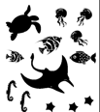

Marine
Education
1. Life’s Diversity – Describe the three main types of diversity, i.e. genetic, species and ecosystem
Name:
Date:
marineeducation.com.au
Genetic Diversity: the diversity of GENES
Genetic diversity is the variety of gene combinations in one species. More specifically, genetic diversity is the total number of genetic characteristics in the genetic makeup of one species. For example, LOW genetic diversity is when there is LOW diversity in the gene pool in one species – they’re all the same - they’ve made clones of themselves. In contrast, HIGH genetic diversity is when there is HIGH diversity in the gene pool of one species – there are many different gene combinations in one species – the DNA coding was reshuffled during asexual reproduction and meiosis. As a result, one individual might be smarter, brighter in colour, have longer legs, more hair, etc. It might be better adapted to its environment than another. The greater the genetic diversity, the greater chance a species has of adapting to change and avoiding extinction.
All dogs are the same species - Canis familiaris
Q. Why do so many dogs look different to each other? Answer by crossing out the wrong word.
HIGH or LOW Genetic Diversity
Species Diversity: the diversity of SPECIES
Species diversity is the diversity of species in a given location. It is often measured as the relative number of different species present. LOW species diversity has very low variety of species. HIGH species diversity has a high variety of all different kinds of species. An ecosystem with HIGH species diversity is a healthy ecosystem.
Q. Which ecosystem has the HIGHEST species diversity? Ecosystem A or Ecosystem B?
Answer by crossing out the wrong word (below).
Ecosystem A or B
Ecosystem A
Ecosystem B
Ecosystem Diversity: the diversity of ECOSYSTEMS
Ecosystem diversity is the diversity of ecosystems.
The greater the diversity, the more habitats for more species to occupy and travel between.
Activity: Complete the table below by filling in the blanks (the first one is done for you).
Genetic Diversity | Species Diversity | Ecosystem Diversity
The diversity of GENES | The diversity of ___species__ | The diversity of __ecosystems_
© Marine Education 2024 CC BY-NC-SA
Unit 2 Topic 1 Science Understanding
1

Slide 10
Marine
Education
Describe the three main types of diversity, i.e. genetic, species and ecosystem.
Name:
Date:
marineeducation.com.au
© Marine Education 2024 CC BY-NC-SA
NOTES AND EXAM REVISION
2

Slide 11
Marine
Education
2. Marine must-haves – Explain the three unique characteristics of marine biodiversity, i.e. wide dispersal at sea, the need for structural complexity, critical nursery habitats.
Name:
Date:
marineeducation.com.au
Marine Biodiversity has three unique characteristics: (1) wide dispersal at sea (2) the need for structural complexity and (3) critical nursery habitats. Without these characteristics, species go extinct.
Wide dispersal at sea
Wide D I S P E R S A L at sea Fill in the blanks.
Dispersal is when species swim (i.e. fish), drift (i.e. plankton), or are carried (i.e. seagrass seeds in dugong and turtle faeces) to a new location. Water provides this opportunity, and species sure take advantage of it! They move all about the place. Even species that are stuck to the bottom (‘sessile’) travel as larvae, hitching a ride in currents to a new location before settling into their new home. As a result, wide dispersal at sea maintains genetic diversity, rescues declining populations, and re-establishes extirpated (locally extinct) populations^{[2]}.
Q. What is dispersal? Ans.
When species swim, drift or are carried to a new location.
Q. How does WIDE dispersal at sea increase marine biodiversity? (Hint: last sentence) Ans.
Wide dispersal at sea maintains genetic diversity, rescues declining populations, and reestablishes extirpated (locally extinct) populations.
The need for structural complexity
Like an underwater city vs. an underwater desert, the more complex the structure, the more biodiversity.
E.g. picture a coral reef as an underwater city with lots of places to live, eat, work and visit, that wouldn’t exist without the complex city-like structures to accommodate everyone. Structural complexity increases the number of ecological niches (think of a niche as a ‘job description’ in the workforce of biodiversity).
Q. True of False? The more complex the structure, the more biodiversity. Ans.
TRUE
Critical nursery habitats
We all need a safe place to grow up. Put simply, no nursery, no life.
Habitats that function as nurseries include mangroves forests, seagrass meadows and coral reefs.
Activity: List 3 habitats that function as nurseries
Mangroves forests
Seagrass beds
Coral reefs
© Marine Education 2024 CC BY-NC-SA
Unit 2 Topic 1 Science Understanding
3

Slide 12
Marine
Education
Explain the three unique characteristics of marine biodiversity, i.e. wide dispersal at sea, the need for structural complexity, critical nursery habitats.
Name:
Date:
marineeducation.com.au
© Marine Education 2024 CC BY-NC-SA
NOTES AND EXAM REVISION
4

Slide 13
Marine
Education
3. A Diverse Australia – Identify the variety of ecosystems (e.g. estuaries, coastal lakes, saltmarshes, mangroves, seagrass, rocky shores, temperate reefs, coral reefs, lagoons, shelf and deep water) that constitute Australia’s marine biomes.
Name:
Date:
marineeducation.com.au
Activity: Where does it live? Find out where each species lives and write its name in the box (note: some live in more than one)
Staghorn coral (Acropora pulchra), Green Sea turtle (Chelonia mydas,) Eelgrass (Zostera capricorni), Calcified Red Seaweed (Corallina officinalis), Sea Cucumber (Holothuria leucospilota),
Hard Stony Coral (Porites lutea), Sea Mullet (Mugil cephalus), Bull Shark (Carcharhinus leucas),
Black coral (Cirrhipathes spiralis), Mangrove Jack (Lutjanus argentimaculatus),
Salt marsh rush (Jancus kraussii), Grey Mangrove (Avicennia marina).
Estuaries
Green Sea Turtle (C. mydas) Eelgrass (Z. capricorni)
Sea mullet (M. cephalus) Mangrove Jack (L. argentimaculuatus) Grey Mangrove (A. marina) Bull shark (C. leucas) Sea Cucumber (H. leucospilota),
Coastal Lakes
Eelgrass (Z. capricorni) Sea mullet (M. cephalus)
Grey Mangrove (A. marina) Bull Shark (C. leucas)
Green Sea Turtle (C. mydas). Sea Cucumber (H. leucospilota), Mangrove Jack (L. argentimaculuatus)
Saltmarshes
Salt marsh rush (J. kraussii)
Mangroves
Eelgrass (Z. capricorni) Sea mullet (M. cephalus)
Grey Mangrove (A. marina) Bull Shark (C. Leucas)
Mangrove Jack (L. argentimaculuatus)
Green Sea Turtle (Chelonia mydas)
Seagrass Beds
Green Sea Turtle (C. mydas)
Eelgrass (Z. capricorni) Grey Mangrove (A. marina)
Black sea cucumber (H. leucospilota)
Sea mullet (M. cephalus). Bull shark (C. leucas)
Rocky Shores
Calcified red seaweed (C. officinalis)
Black sea cucumber (H. leucospilota)
Temperate Reefs
Eelgrass (Z. capricorni) (0-7m)
Sea mullet (M. cephalus)
Green Sea Turtle (C. mydas)
Calcified red seaweed (C. officinalis)
Bull shark (C. leucas) Black coral (C. spiralis)
Coral Reefs
All except salt marsh and grey mangrove
Lagoons
Same as coral reefs
Continental Shelf
Most of the above
Deep Water
Black coral (C. spiralis)
Activity: Draw a line between ecosystems that are somehow connected to each other (i.e. via currents, dispersal, etc.) AND rely on each other (e.g. for food, filtering of water, nurseries, to recruit larvae for recovery post disturbance etc.).
© Marine Education 2024 CC BY-NC-SA
Unit 2 Topic 1 Science Understanding
5

Slide 14
Marine
Education
Identify the variety of ecosystems (e.g. estuaries, coastal lakes, saltmarshes, mangroves, seagrass, rocky shores, temperate reefs, coral reefs, lagoons, shelf and deep water) that constitute Australia’s marine biomes.
Name:
Date:
marineeducation.com.au
© Marine Education 2024 CC BY-NC-SA
NOTES AND EXAM REVISION
6

Slide 15


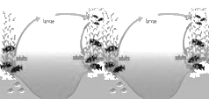
Marine
Education
4. Connect…ivity – Describe the implications of connectivity to marine ecosystems, e.g. estuaries, mangroves, seagrass beds.
Name:
Date:
marineeducation.com.au
Frank the fish
‘Frank’ the fish is getting too big for the nursery grounds in the mangroves, and is now ready to venture out to a nearby coral reef to meet a lady fish and make Frank juniors. The ability for Frank to move between ecosystems is very important. If he can’t, there’s little chance of any Frank Juniors in the future. This is bad news for fishermen. But not only that, it is bad news for coral reefs. You see, Frank is a herbivore and plays an important role on the reef. He eats the macro-algae that compete for space with corals. Following a disturbance, macro-algae can start to win that battle for space. Without Frank (eating the macro-algae) and without connectivity (to get him there), there’s only algae-dominated reefs with few fish. ☹
Connectivity is the web of links, relationships and connections that result from the movement of individuals (i.e. dispersal of eggs, larvae, juveniles and migration of adults) and materials
(i.e. nutrients) between spatially separated populations. Connectivity is also the process by which local marine populations recruit larvae from distant sources via the currents that connect one part of the ocean with another.
Q. What is connectivity? Hint: last paragraph in bold. Ans.
Connectivity is the web of links, relationships and connections that result from the movement of individuals (i.e. dispersal of eggs, larvae, juveniles and migration of adults) and materials (i.e. nutrients) between spatially separated populations.
Connectivity is also the process by which local marine populations recruit larvae from distant sources via the currents that connect one part of the ocean with another.
Connectivity rescues the damaged
Somebody help!
When one ecosystem is left damaged, its undamaged neighbour can come to the rescue. Notably, it helps when that neighbour is close by, so larvae don’t need to travel as far.
Connectivity connects mangroves to seagrass beds to reefs
Mangrove forests, seagrass meadows and coral reefs are all connected. Fish (like Frank) need more than one ecosystem to carry out their life cycle. When one marine ecosystem is left unprotected, it is vulnerable to damage (e.g. overexploitation or coastal development) which makes it no longer available as habitat, and no longer an emergency supply of larvae for its neighbours. Think of connectivity as a network of train stations. The water currents are the trains. The larvae are the travellers. The ecosystems are the stations. The environmental managers are security. If one station is damaged, connectivity brings passengers to help rescue it. Connectivity also ensures passengers reach their destination, safely.
TRUE FALSE
Q. True or False? Protecting mangroves benefits coral reefs. Ans.
© Marine Education 2024 CC BY-NC-SA
Unit 2 Topic 1 Science Understanding
7

Slide 16
Marine
Education
Describe the implications of connectivity to marine ecosystems, e.g. estuaries, mangroves, seagrass beds.
Name:
Date:
marineeducation.com.au
© Marine Education 2024 CC BY-NC-SA
NOTES AND EXAM REVISION
8

Slide 17
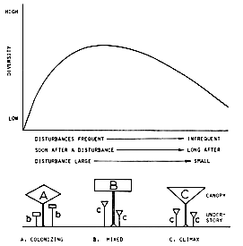
Marine
Education
5. Security Breach! – Identify factors that lead to a loss of diversity, e.g. natural hazard, loss/fragmentation of habitat, pollution, exploitation, introduction of new species, disease.
Name:
Date:
marineeducation.com.au
Natural Hazards (that are frequent and severe)
Intermediate Disturbance Hypothesis
If a natural hazard is too frequent or severe (far left of the graph), only highly resilient, colonising species survive. Likewise, if a natural hazard is too infrequent or weak (far right of the graph), climax species will continue to dominate, monopolise the space and eliminate others, resulting in a loss of diversity. Ironically, diversity is highest when natural hazards are of intermediate frequency, duration and size (not too damaging, not too weak). This occurs as competitive exclusion is balanced by the destruction of competitive dominants, whereby more space is created for more species to occupy. The phenomenon has been called the ‘intermediate disturbance hypothesis’ (Fig. 1).
Q. What dominates after many big cyclones?
Refer to Figure 1 to answer A, B or C. Ans.
A
Figure 1: Intermediate Disturbance Hypothesis^{[1]}
Loss/fragmentation of habitat
E.g. Mass coral bleaching events and COTS outbreaks both cause loss and fragmentation of coral reef habitat.
Pollution
E.g. Marine debris, carbon emissions, pesticides, sewage waste, oil spills, heavy metals and trace elements.
Exploitation
E.g. overfishing, illegal fishing, unregulated fishing, destructive fishing practices, unsustainable fishing practices.
Introduction of new species
E.g. species such as the European fan worm and Asian green mussel outcompete our native species.
Disease
E.g. coral disease, white spot disease, red spot disease and Turtle fibropapillomatosis (caused by herpes virus).
Activity: In the space below, write the factors (listed above) that lead to a loss of diversity.
Natural hazards (that are frequent and severe), loss/fragmentation of habitat, pollution, overexploitation, introduction of new species and disease.
^{[1]} From Connell, J. H. (1978). Diversity in Tropical Rain Forests and Coral Reefs. Science, New Series, Vol. 199. No. 4335. DOI: DOI: 10.1126/science.199.4335.1302. Reprinted with permission from AAAS.
© Marine Education 2024 CC BY-NC-SA
Unit 2 Topic 1 Science Understanding
9

Slide 18
Marine
Education
Identify factors that lead to a loss of diversity, e.g. natural hazard, loss/fragmentation of habitat, pollution, exploitation, introduction of new species, disease.
Name:
Date:
marineeducation.com.au
© Marine Education 2024 CC BY-NC-SA
NOTES AND EXAM REVISION
10

Slide 19
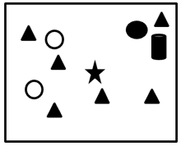
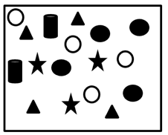
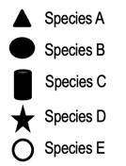
Marine
Education
6. Homer’s Index – Calculate the biodiversity of a marine ecosystem using Simpson’s diversity index (SDI)
Name:
Date:
marineeducation.com.au
∑n(n-1)
N(N-1)
Simpson’s Diversity Index (SDI) =
1-
N=total number of organisms of all species; n=number of organisms of one species
Zero to one
The Simpsons Diversity Index (SDI) provides a value between 0 and 1, indicating the level of species diversity. If an ecosystem has an SDI of 1, this means it has infinite diversity. If an ecosystem has an SDI of 0, this means it has zero diversity (i.e. only one species).
Note: SDI is actually calculating the probability that 2 randomly selected individuals will be of 2 different species (or categories). 100% = 1.0 and 0% = 0.
Activity: Complete the tables below using the following data. Hint: n(n-1) means n x (n-1)
Inshore Reef
Offshore Reef
Legend
INSHORE REEF
IDENTIFY | COUNT | STATS
Name | n | n(n -1)
Species A | 6 | 30
Species B | 1 | 0
Species C | 1 | 0
Species D | 1 | 0
Species E | 2 | 2
Total | N 11 | ∑n(n-1) 32
Simpsons Diversity Index Calculations | N(N-1)= 110 | SDI = 0.709
OFFSHORE REEF
IDENTIFY | COUNT | STATS
Name | n | n(n -1)
Species A | 4 | 12
Species B | 4 | 12
Species C | 2 | 2
Species D | 3 | 6
Species E | 4 | 12
Total | N 17 | ∑n(n-1) 44
Simpsons Diversity Index Calculations | N(N-1)= 272 | SDI = 0.838
Q. Which reef has the highest species diversity? Ans.
OFFSHORE
© Marine Education 2024 CC BY-NC-SA
Unit 2 Topic 1 Science Understanding
11

Slide 20
Marine
Education
Calculate the biodiversity of a marine ecosystem using Simpson’s diversity index (SDI)
Name:
Date:
marineeducation.com.au
© Marine Education 2024 CC BY-NC-SA
NOTES AND EXAM REVISION
12

Slide 21
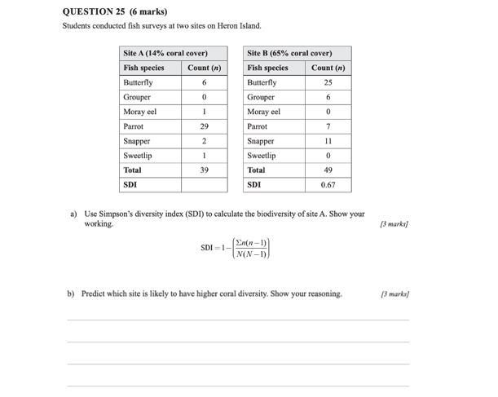
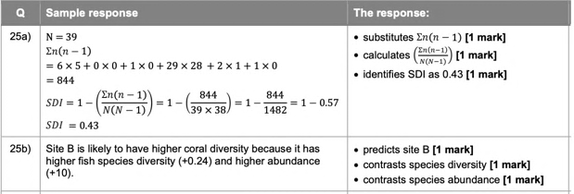
Marine
Education
7. Formula Feast – Interpret data to determine the biodiversity of a marine ecosystem using diversity indices.
Name:
Date:
marineeducation.com.au
Exam Question Practice
Below is question 25 in the final external exam paper 1 (question and response book) for 2022.
You can access all past external exam papers on the QCAA website for Marine Science.
Below is the marking guide for Question 25 a) and 25 b). Would you get full marks?
© Marine Education 2024 CC BY-NC-SA
Unit 2 Topic 1 Science Understanding
13

Slide 22
Marine
Education
Interpret data to determine the biodiversity of a marine ecosystem using diversity indices.
Name:
Date:
marineeducation.com.au
© Marine Education 2024 CC BY-NC-SA
NOTES AND EXAM REVISION
14

Slide 23
Marine
Education
8. Environmental Medical – Describe the concepts of ecosystem resilience, disturbance and recovery.
Name:
Date:
marineeducation.com.au
Ecosystem disturbance
Disturbance is an event of intense environmental stress, forcing change upon an ecosystem (e.g. virus).
For example, mass bleaching events, COTS outbreaks, drupella snail outbreaks and coral disease.
Activity: Define ecosystem DISTURBANCE
Disturbance is an event of intense environmental stress, forcing change upon an ecosystem. E.g. mass bleaching event, COTS outbreaks, disease, etc.
Ecosystem resistance
Resistance is the capacity to withstand a disturbance (e.g. to not get sick in the first place). High resistance means low damage. E.g. heat resistant corals, with heat resistant zooxanthellae, do not bleach as fast as other corals.
Activity: Define ecosystem RESISTANCE
Resistance is the capacity to withstand a disturbance (e.g. to not get sick in the first place). E.g. heat resistance corals do not bleach as fast as others.
Ecosystem resilience
Resilience is the capacity to recover from a disturbance or withstand ongoing pressures (e.g. immunity). In other words, it’s the ability to get back up after being knocked down, which all depends on its resistance (how hard it was knocked down in the first place – the amount of damage) and recovery (how fast it got back up again).
Activity: Define ecosystem RESILIENCE
Resilience is the capacity to recover from a disturbance or withstand ongoing pressures (e.g. immunity). Getting back up after being knocked down.
Ecosystem recovery
Recovery refers to the return of a damaged ecological system and associated ecosystem services to a stable state (i.e. an identifiable abundance and composition of species) (e.g. getting better again).
Activity: Define ecosystem RECOVERY
Recovery refers to the return of a damaged ecological system and associated ecosystem services to a stable state (i.e. an identifiable abundance and composition of species) (e.g. getting better again).
© Marine Education 2024 CC BY-NC-SA
Unit 2 Topic 1 Science Understanding
15

Slide 24
Marine
Education
Describe the concepts of ecosystem resilience, disturbance and recovery.
Name:
Date:
marineeducation.com.au
© Marine Education 2024 CC BY-NC-SA
NOTES AND EXAM REVISION
16

Slide 25
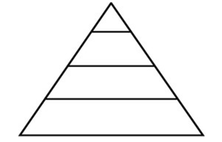

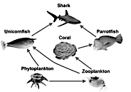
Marine
Education
9. Bio…ta – Identify biotic components of marine ecosystems, i.e. trophic levels, food chains, food webs, interactions and population dynamics.
Name:
Date:
Trophic levels: fill in the blanks
Tertiary consumers
4th Trophic Level
Secondary Consumers
omnivores, carnivores
3rd trophic level
Primary consumers
Zooplankton, herbivores, omnivores
2nd trophic level
Decomposers
Primary producers
Phytoplankton, algae, seaweed, seagrass,
1st Trophic Level
Food Chain (one direction): fill in the blank
Secondary Consumer
Food WEB (multi direction)
Basically, a food web represents multiple feeding relationships within a community. It shows what eats what.
Q. In the food web (right), what directly eats phytoplankton? Ans.
Zooplankton and unicornfish
Biotic interactions
Biotic interactions include symbiosis (2 different species living together), competition and predation.
Q. What is one example of predation? Ans.
Shark eating something?
Population Dynamics
Population dynamics measures changes to population size over time. It compares the number of individuals entering a population with how many are leaving a population, to calculate if a population is growing or shrinking.
Changes to the size of a population over time.
Q. True or False? Individuals entering a population include births and immigrants.
Whilst individuals leaving a population include deaths and emigrants. Ans.
True
© Marine Education 2024 CC BY-NC-SA
Unit 2 Topic 1 Science Understanding
17

Slide 26
Marine
Education
Identify biotic components of marine ecosystems, i.e. trophic levels, food chains, food webs, interactions and population dynamics.
Name:
Date:
marineeducation.com.au
© Marine Education 2024 CC BY-NC-SA
NOTES AND EXAM REVISION
18

Slide 27
Marine
Education
10. Social Shenanigans – Classify biotic interactions based on the following terms- symbiosis (i.e. parasitism, mutualism, commensalism and amensalism) - competition (i.e. intraspecific and interspecific) - predation.
Name:
Date:
marineeducation.com.au
To help or hinder?
Interactions are classified on the basis of the mechanism of the interaction (i.e. symbiosis, competition and predation) and the effects of the interaction, albeit positive (+), negative (-) or no effect/neutral (0).
Mechanism of Interaction |  | Effect on X | Effect on Y
Symbiosis | Parasitism | + | -
 | Mutualism | + | +
 | Commensalism | + | 0
 | Amensalism | 0 | -
Competition |  | - | -
Predation |  | + | -
guest
host
Symbiosis is a host-guest relationship whereby two different species live together, in direct contact, for an extended period of time. The ‘guest’ exploits a unique niche that the ‘host’ provides. Except for amensalism, the guest always benefits from the relationship. As for the host, the relationship can be beneficial (mutualism), have no effect (commensalism), or harmful (parasitism).
Unlike symbiosis, competition and predation are oppositional interactions. Intraspecific competition involves two of the same species (i.e. competing for a mate). Interspecific competition involves two different species (i.e. competing for space). Competitions intensify when resources are in short supply.
Activity: Complete the table below by categorising biotic interactions based on mechanism & effect
Biotic Interaction (between X & Y) | Mechanism of Interaction | Effect on X | Effect on Y
Zooxanthellae and corals | Mutualism | + | +
Barnacles attached to whales | Commensalism | + | 0
Decorator crab carrying a sponge | Mutualism | + | +
Remora ‘sucking’ to a manta ray | Commensalism | + | 0
Clownfish and anemones | Mutualism | + | +
Isopods and fish | Parasitism | + | -
Cleaner fish and organisms it cleans | Mutualism | + | +
Killer whales/orcas and sharks | Predation | + | -
Seaweed allelopathy and corals | Amensalism | 0 | -
Two male fiddler crabs fighting | Competition | - | -
Activity: Choose three more interactions that you find interesting to complete the table…
© Marine Education 2024 CC BY-NC-SA
Unit 2 Topic 1 Science Understanding
19

Slide 28
Marine
Education
Classify biotic interactions based on the following terms
symbiosis (i.e. parasitism, mutualism, commensalism and amensalism)
competition (i.e. intraspecific and interspecific)
predation.
Name:
Date:
marineeducation.com.au
© Marine Education 2024 CC BY-NC-SA
NOTES AND EXAM REVISION
20

Slide 29
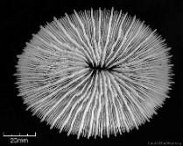
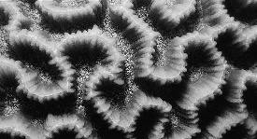
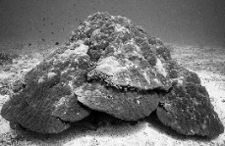
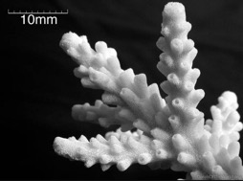
Marine
Education
11. Pick a name – Identify and describe marine species, using field guides and identification keys.
Name:
Date:
marineeducation.com.au
Identification keys
A dichotomous key is a scientific tool used to identify and categorize different organisms based on a series of choices that lead the user to the correct name or classification.
Activity: Use the dichotomous key to ID and write the Genus name below each coral sample
Genus ___Fungia________
Genus _____Platygyra________
Genus _____Porites_______
Genus _______Acropora______
Dichotomous Key
1a) Solitary …………………………….Fungia
b) Colonial ……………………………Go to 2
2a) Brain-like appearance present……Platygyra
b) Brain-like appearance absent........Go to 3
3a) Helmet shaped…….......................Porites
b) Branching shaped….……………...Acropora
‘Mushroom Corals’ are
solitary corals that do not cement themselves to the reef but rather live as one giant individual coral polyp, unattached to the bottom.
Genus
‘Brain Corals’ have sinuous valleys and ridges that look
similar in appearance to the human brain, hence the name.
Porites have many shapes. However, this ‘helmet shape’ is perhaps its ‘signature’ shape.
‘Branching corals’ provide shelter for small fish that can retreat
into the branches when danger approaches. Note: Acropora also have many shapes, but are best known as branching coral.
© Marine Education 2024 CC BY-NC-SA
Unit 2 Topic 1 Science Understanding
21

Slide 30
Marine
Education
Identify and describe marine species, using field guides and identification keys.
Name:
Date:
marineeducation.com.au
© Marine Education 2024 CC BY-NC-SA
NOTES AND EXAM REVISION
22

Slide 31
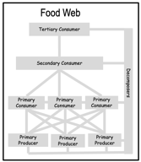
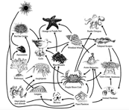
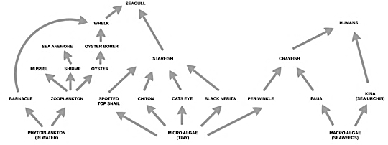
Marine
Education
12. Bring on the Buffet – Identify organisms in trophic levels in a food web based on the following terms: producers, primary consumers, secondary consumers, tertiary consumers, decomposers.
Name:
Date:
marineeducation.com.au
Activity: Complete the table below with names of organisms provided during your lesson (ppt)
Primary Producers 1st trophic level | Microscopic phytoplankton, green algae (seaweed), brown algae (seaweed), red algae (seaweed), cyanobacteria, lichens,
Primary Consumers 2nd trophic level | Zooplankton, barnacles, blue periwinkles, black nerite, zebra shells, sea hare, chiton, limpet
Secondary Consumers 3rd trophic level | Mulberry whelks, anemones, shore crabs, zooanthids, reef crabs, oystercatchers, bream
Tertiary Consumers 4th trophic level | Osprey, blue-ringed octopus, humans,
Decomposers | Microscopic bacteria, lug worm, sea cucumbers, lichens,
Scavengers | Hermit crabs, seagulls, sea eagles
Activity: Make a small food web in the box below
Source: https://seagrant.oregonstate.edu/visitor-center/marine-education/lab-and-field-experiences/rocky-intertidal-ecology
Activity: Below, use different colour pens to label the (1) Producers (2) Primary consumers
(3) Secondary consumers and (4) Tertiary consumers - colour coding the legend as well.
Legend
(1)
(2)
(3)
(4)
© Marine Education 2024 CC BY-NC-SA
Unit 2 Topic 1 Science Understanding
23

Slide 32
Marine
Education
Identify organisms in trophic levels in a food web based on the following terms: producers, primary consumers, secondary consumers, tertiary consumers, decomposers
Name:
Date:
marineeducation.com.au
© Marine Education 2024 CC BY-NC-SA
NOTES AND EXAM REVISION
24

Slide 33
Marine
Education
13. Toxic Catch – Describe how matter cycles through food webs, and the process of bioaccumulation e.g. ciguatera and mackerel (Scomberomorus spp.); mercury and blacktip sharks (Carcharhinus spp.); and toxin accumulation on microplastics.
Name:
Date:
marineeducation.com.au
Ciguatera Poisoning
Soon after Johnny ate spanish mackerel, he started to feel sick. Apart from the usual gastrointestinal symptoms that indicate food poisoning (vomiting, diarrhea, muscle pain) his nervous system started doing strange things, such as his mouth, lips and extremities felt numb, he felt dizzy (which made driving for help out of the question) and anything that was cold felt hot and vice versa. Johnny made it to the hospital and eventually recovered (it took a few months) but for many years to follow, the symptoms returned whenever he ate seafood again. Johnny had ciguatera poisoning. It comes from eating large reef fish, as in, larger than average for its species (and usually from the tropics). Take home message: throw the big ones back! Ciguatera poisoning is caused by the (bio)accumulation of CTX (ciguatoxin), a toxin produced by dinoflagellates (Genus Gambierdiscus) that live attached to certain corals, seaweeds and seagrasses. Primary consumers are the first to eat food containing CTX, followed by secondary and tertiary consumers. CTX remains stored in a fish’s body – it does not break down! Thus, the toxin accumulates over time as fish continue to eat lower order consumers and producers that contain CTX. Since large fish live longer and eat more, they bioaccumulate higher concentrations of CTX than smaller fish of the same species. Hence, don’t eat the big ones!
Increasing Toxicity
Tertiary Consumer
Decomposer
CTX
Secondary Consumer
CTX
CTX
Primary Consumer
CTX
CTX
CTX
CTX
Primary Producer
CTX
CTX
CTX
CTX
CTX
CTX
CTX
CTX
Figure 1: CTX bioaccumulation: the accumulation of CTX in fish over time following the repeated consumption of contaminated lower order consumers and producers.
Fish to avoid (if they are XL) include: Barracuda, Grouper, Cod, Coral trout, Red emperor, Chinaman, Paddletail, Red bass, Yellowtail kingfish, Trevally, Moray eel, Spanish mackerel and >400 other species!
Note: the term bioaccumulation also applies to other harmful chemicals that bioaccumulate in living organisms over time, such as heavy metals, persistent organic pollutants (POP’s) and micro-plastics.
Bioaccumulation is the accumulation of a toxic substance in one’s body over time.
Bioaccumulation is due to the repeated consumption of contaminated consumers and producers.
Bioaccumulation occurs when the rate of intake exceeds rate of excretion.
*Not to be confused with biomagnification which is when contaminant concentrations in consumers exceed the contaminant concentrations found in their prey (having magnified with every trophic level).
Activity: Define bioaccumulation (hint: see underlined):
Bioaccumulation is the accumulation of a toxic substance in one’s body over time.
© Marine Education 2024 CC BY-NC-SA
Unit 2 Topic 1 Science Understanding
25

Slide 34
Marine
Education
Describe how matter cycles through food webs, including the process of bioaccumulation
Name:
Date:
marineeducation.com.au
© Marine Education 2024 CC BY-NC-SA
NOTES AND EXAM REVISION
26

Slide 35
Marine
Education
14. Population Dynamics – Describe the concept of population dynamics using the terms population size, density, abundance, distribution (i.e. clumped, uniform, random), carrying capacity, niche, K-strategists and r-strategists, keystone species.
Name:
Date:
marineeducation.com.au
Population Size and Density
Measuring the exact size of a population is not easy to do! Quite often, we estimate population size instead.
We count the number of individuals in smaller samples of the population, and then use a math formula to convert it to total population size (see next page). The population size can then be converted to population density with the following formula: Population Density = Population Size / Area
2/ha
Q. What is the population density when the population size is 20 in an area of 10ha? Ans.
Dispersion Patterns
The accuracy and precision of a population size estimate will largely depend on sampling design. It is very easy to over or underestimate a population’s size. Especially if the dispersion patterns of the distribution (e.g. pictured right) are (a) clumped
(i.e. schooling fish), as opposed to (b) random or (c) uniform.
(a) clumped
(b) random
(c) uniform
Q. Which is easiest
to estimate? Ans.
Circle correct answer
(a) (b) (c)
Carrying Capacity (K)
Logistic Growth Curve
Pierre Verhulst in 1838 created a graph (right) that launched a thousand exam questions. The graph illustrates the growth of a population over time. Whereby, in stable predictable environments, a population will continue to grow in size until the environment reaches full capacity (i.e. overcrowded). Thus, the maximum size a population can grow (due to density-dependent effects such as overcrowding) is called its carrying capacity or K.
Population Size
Carrying Capacity (K)
Q. What is K? Ans.
Maximum size a population can grow to
Time
r-strategists and K-strategists
Species are sometimes referred to as r-strategists or K-strategists depending on the selective processes that have shaped their life history strategies. Activity: Complete the table pictured below
 | r–strategists The maximum population size is determined by how fast they can grow and reproduce between catastrophes, thus population dynamics is controlled by r (rate of increase), hence the name. | K-strategists Occur in stable predictable environments, thus mortality is controlled by K (the carrying capacity), hence the name.
Environment | Fluctuating, unpredictable | Stable, predictable
Mortality | Density-independent, high | Density-dependent, low
Growth | Fast, short life-span | Slow, long life-span
Reproduction | Early maturity, high fecundity | Late maturity, low fecundity
A Niche is...complete the sentence….
A Keystone Species is…complete the sentence….
The role or function of an organism in an ecosystem (‘job description’).
Where it lives and what it does.
A species whose niche acts like the ‘keystone’ in an arch, and if removed, the ecosystem changes dramatically
© Marine Education 2024 CC BY-NC-SA
Unit 2 Topic 1 Science Understanding
27

Slide 36
Marine
Education
Describe the concept of population dynamics using the terms population size, density, abundance, distribution (i.e. clumped, uniform, random), carrying capacity, niche, K-strategists and r-strategists, keystone species.
Name:
Date:
marineeducation.com.au
© Marine Education 2024 CC BY-NC-SA
NOTES AND EXAM REVISION
28

Slide 37
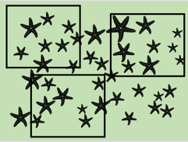


Marine
Education
15. Measuring Populations – Interpret population data to determine population size, density, abundance, distribution, carrying capacity.
Name:
Date:
marineeducation.com.au
Download the PowerPoint titled, Measuring Populations from www.marineeducation.com.au (worksheets tab)
Population Size Formula:
Width: 2.5m
Length: 2.5m
You want to know the size of a population (N), but you don’t have enough resources to count them all.
So, you sample the population instead using three 1mx1m quadrats (the squares pictured left).
You count how many sea stars are in each square.
You do NOT count the sea stars that are touching the edges of the quadrat.
You write down the count (in results table below left)
You calculate the sample mean , either manually (sum of all data points/count number of data points)
or in excel using the formula =AVERAGE( : )
You insert the sample mean into the formula for population size (N) = (total area of population)
area of one quadrat
Results Table
Q. What was your estimate of Population size (N)? Ans.
38
Activity: COUNT the actual number of sea stars. Q. Were you close? Ans.
Yes No
Q. What is the sea star’s dispersion pattern? Ans.
Clumped or Random or Uniform ?
Q. True of False? Dispersion patterns can affect accuracy. Ans.
True False
Population Density = Population Size / total Area of population
Q. What is the Population DENSITY? Ans. hint: total area is 2.5mx2.5m
6/m²
Carrying Capacity (K)
Carrying Capacity is the maximum population size that a given area can sustain.
Activity: Follow the game instructions on the ppt. Use results table below (graph paper next page)
My carrying capacity estimate is:
© Marine Education 2024 CC BY-NC-SA
Unit 2 Topic 1 Science Understanding
29

Slide 38
Marine
Education
Name:
Date:
marineeducation.com.au
Graph/Grid pad
Figure 1 illustrates….
© Marine Education 2024 CC BY-NC-SA
Unit 2 Topic 1 Science Understanding
30

Slide 39


Marine
Education
Name:
Date:
marineeducation.com.au
Practice Research Question
Research Question
Population SIZE of COTS
Q. Is there a significant difference in between & ?
2012
2017
Method
In 2012, four quadrats were positioned within Swains reef (at spot marked X). Each quadrat was 80m long and 5m wide (diagram below is not to scale). The total Area of population of COTS on Swains Reef was 580,000m². Divers counted the number of COTS inside each quadrat. This was repeated in 2017.
2012
Swains Reef
580,000m²
2017
Results
Activity: Complete the table below to calculate the mean and population size for 2017 (boxes)
 | Quadrat |  |  |  | Mean | Total Area of Population (m²) | Area of one Quadrat (m²) | Population Size “N”
 | 1 | 2 | 3 | 4
2012 | 1 | 0 | 2 | 3 | 1.5 | 580,000 | 400 (5x80) | 2175
2017 | 50 | 60 | 55 | 70 | 58.8 |  |  | 85260
Population Size (N) = x Total Area of Population
Area of one Quadrat
Conclusion
To statistically answer the research question, we must first conduct a t test to obtain a P value. If the P value is equal to or less than 0.05, the difference is significant. If greater than 0.05, there is no difference.
Activity: Complete the table below. Google t test calculator and click on GraphPad (next pages)
Group (ifor example, population) | Transect (quadrat) |  |  |  | N | P
 | 1 | 2 | 3 | 4
2012 | 1 | 0 | 2 | 3 | 2175 | 0.0001
2017 | 50 | 60 | 55 | 70 | 85260
Q. Is there a significant difference in COTS (N) between 2012 and 2017? Ans.
[Yes] [No]
Circle correct answer
© Marine Education 2024 CC BY-NC-SA
Practice Research Question
31

Slide 40
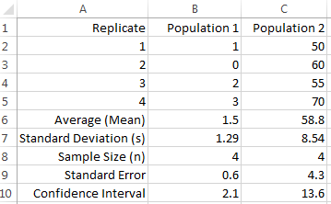
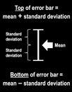
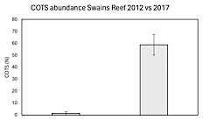
Marine
Education
Name:
Date:
marineeducation.com.au
Practice Research Question
It’s all about answering the Research Question!
When comparing two datasets, at what point is the difference between them considered to be significant?
To find out, we need to do some more calculations (begin by entering 2012 data into cells B2-B5 in Excel).
Measures of Central Tendency (i.e. medium, mean, mode).
A common measure of central tendency used in population dynamics is the mean, or average.
The mean of a population goes by the symbol µ
The mean of a sample (usually representative of the population) goes by the symbol
Always quote the mean to one decimal place more than the raw data. To calculate the mean:
In Excel, type in an empty space/cell at end of data (i.e. B6): =AVERAGE(B2:B5) (then press Enter)
Or, manually, add them all up (Σ x) and divide that total, by the number of observations ( = Σ x / n)
Measures of Dispersion (i.e. range, deviation & standard deviation).
The range is the distance between the lowest data point and the highest data point. Range is a very crude measure of dispersion because we still don’t know how close or far away each data point is from the mean (known as deviation). Hence, Standard deviation is a much better measure of dispersion.
The standard deviation of a population goes by the symbol σ (sigma)
The standard deviation of a sample (usually representative of the population) goes by the symbol s
Always quote the standard deviation one decimal place more than the mean. To calculate s:
In Excel, type in the next empty space/cell at end of data (i.e. B7): =STDEV(B2:B5)
Or, manually, square root the sum of the deviation squared, divided by the number of observations -1
Standard Error (SE) of the mean measures how well represents µ. Were we close?
The smaller the value, the more accurate the sample mean represents the population mean.
The standard error equals the standard deviation divided by the square root of the sample size (SE=s/√n).
In Excel, first type in the next empty space/cell at end of data (i.e.B8) =COUNT(B2:B5) to calculate ‘n’ (sample size). Then, type in the next empty space/cell (i.e. B9) the formula for SE =(B7)/SQRT(B8)
Error Bars represent the uncertainty in estimates. It is a line that passes through a point (or bar) on a graph, representing s or SE (SEM). If error bars do not overlap, the difference could be significantly different (answering your research question). However, to be sure, a t-test is required (see next page).
Activity: Copy the data pictured left (down to row 5) onto an Excel spreadsheet. Add the formulas (provided above) to calculate the same answers pictured left (rows 6-9). Highlight both Means and Insert Chart (column graph). Add error bars. Q. Do they overlap? Ans.
[Yes] [No]
P=0.0001
2012
2017
© Marine Education 2024 CC BY-NC-SA
Practice Research Question
32

Slide 41
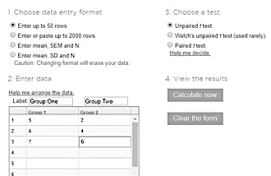

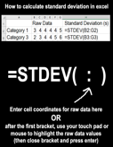
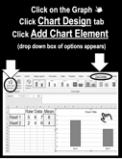
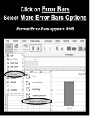

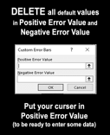

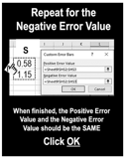
Marine
Education
Name:
Date:
marineeducation.com.au
Practice Research Question
How to identify a significant difference between 2 group means using a
t test (to obtain a P value)
Online
Google ‘t-test calculator’. Open GRAPHPAD at: https://www.graphpad.com/quickcalcs/ttest1.cfm
Enter data for Group 1 and Group 2. If P = <0.05, they are significantly different!
Maintain default values/assumptions: two sample t-test, two-tailed test, unpaired t-test, independent groups, groups have equal variance, 0.05 significant level.
P = < 0.05
There is a significant difference between 2 groups
Don’t change
P = > 0.05
There is NO significant difference between 2 groups
Enter Data
Calculate now
Note: The word SIGNIFICANT is ONLY used when a STATISTICS test, such as a t-test with a P value, has been used to answer the research question. Importantly, the word significant has NOTHING to do with the SIZE difference between 2 groups. Significant is a Science term. Its only purpose is to notify the audience that the research question was answered using a STATISTICS test.
How to create ERROR bars (using standard deviation ‘s’) in excel
© Marine Education 2024 CC BY-NC-SA
Practice Research Question
33

Slide 42
Marine
Education
Interpret population data to determine population size, density, abundance, distribution, carrying capacity.
Name:
Date:
marineeducation.com.au
© Marine Education 2024 CC BY-NC-SA
NOTES AND EXAM REVISION
34

Slide 43
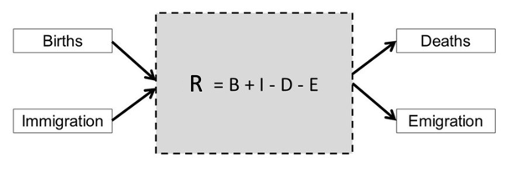
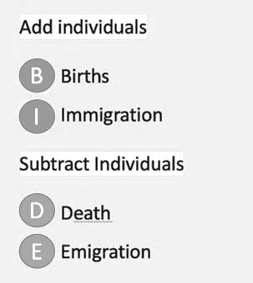
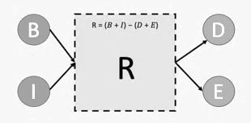
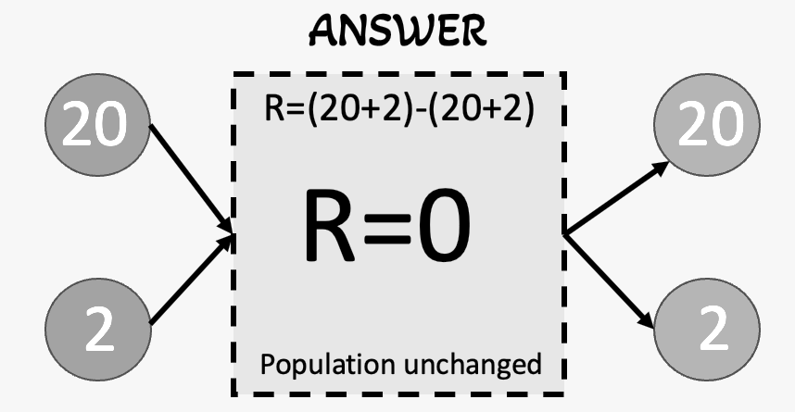
Marine
Education
16. BIDE model Calculate the rate of change of a population using 𝑅 = (𝐵 + 𝐼) − (𝐷 + 𝐸) where R = the rate of change of a population, B = birth rate, D = death rate, I = immigration and E = emigration.
Name:
Date:
marineeducation.com.au
Incoming - outgoing
The size of a population is always changing. It increases and decreases all the time. The rate (and direction) that it changes can be (roughly) measured using the BIDE model, whereby the number of incoming individuals - the births and immigrants - are subtracted from the number of outgoing individuals
– the deaths and emigrants. If more arrive than leave, the population increases in size and R is a positive value. Likewise, if more leave than arrive, the population decreases in size and R is a negative value.
Q. What is R if B=50 and I=10 and D=20 and E=0? Show working below.
Ans.
R=40 R=(50+10)-(20-0)
© Marine Education 2024 CC BY-NC-SA
Unit 2 Topic 1 Science Understanding
35

Slide 44
Marine
Education
Calculate the rate of change of a population using 𝑅 = (𝐵 + 𝐼) − (𝐷 + 𝐸) where R = the rate of change of a population, B = birth rate, D = death rate, I = immigration and E = emigration.
Name:
Date:
marineeducation.com.au
© Marine Education 2024 CC BY-NC-SA
NOTES AND EXAM REVISION
36

Slide 45
Marine
Education
17. Abiotic Antics – Describe abiotic components of marine ecosystems: light availability, depth, stratification, temperature, currents (water and wind), tides, sediment type and nutrient availability
Name:
Date:
marineeducation.com.au
Light availability
Light availability decreases with depth. In addition, suspended particles further reduce the depth that light can reach by scattering the light (measured as turbidity) and obstructing the transmittance of light.
Q. How is light availability measured? Ans.
Water clarity (i.e. turbidity NTU, secchi disc)
Depth
Depth has a significant effect on species abundance, distribution and community composition.
Q. How is depth measured? Ans.
Dive computer, Sounder, Satellite (i.e. Landsat)
Stratification
Stratification is the layering of water. Thermoclines, haloclines and pycnoclines form barriers to mixing.
Q. How is stratification measured? Ans.
Argo float & other measures of temp. & salinity
Temperature
Temperature controls the rate of fundamental biochemical processes, thus influencing species abundance and distribution. Species operate within a specific temperature range (Shelford’s Law).
Q. How is temperature measured? Ans.
Thermometer. Remote sensing of SST (sea surface temp)
Currents (water and wind)
Currents are Earth’s transport system. They deliver heat, food, nutrients, oxygen, larvae and plankton.
Q. How are currents measured? Ans.
Float & timer. Current meter. Remote sensors.
Tides
Tides are the daily ebb and flow of water. Tides are highly predictable in height and duration.
Q. What is the height of a tide measured from? Ans.
chart datum, LAT lowest astronomical tide
Sediment Type
Sediment size (gravel, sand or mud) changes the conditions in which benthic organisms must live.
Q. How is sediment size measured? Ans.
The Wentworth grain-size scale. Mesh size.
Nutrient Availability
Upwellings create productive fishing grounds by delivering limiting nutrients to the photic (sunlit) zone.
Q. How is nutrient availability measured? Ans.
Nutrient or Chl a analysis (fluorometer)
© Marine Education 2024 CC BY-NC-SA
Unit 2 Topic 1 Science Understanding
37

Slide 46
Marine
Education
Describe abiotic components of marine ecosystems: light availability, depth, stratification, temperature, currents (water and wind), tides, sediment type and nutrient availability
Name:
Date:
marineeducation.com.au
© Marine Education 2024 CC BY-NC-SA
NOTES AND EXAM REVISION
38

Slide 47
Marine
Education
18. Wrapped in Water – Explain how marine ecosystems are influenced and limited by abiotic factors differently than terrestrial ecosystems due to the different physical and chemical properties of water , e.g. light availability, buoyancy, pressure, temperature, viscosity, sound, salinity and sediment loading.
Name:
Date:
Define ‘abiotic’
Ecology is the scientific study of the interactions between organisms and their abiotic and biotic environment that determines their distribution and abundance^{[1]}.
The following worksheets focus on the abiotic environment part of this definition, which includes all the non-living components of an ecosystem (e.g. physico-chemical, not biological).
Q. What is meant by the ‘abiotic environment’ in the definition above? Provide 1 example. Ans.
All the non-living components of an ecosystem. E.g. Tides, currents, pH, DO…
Life in WATER vs Life on LAND
Life in water differs to life on land. Life in water is influenced and limited by abiotic factors such as: light availability, depth, buoyancy, pressure, pH, sound, temperature, viscosity, salinity, sediment loading, sediment type, tides, nutrient availability, DO, BOD, trace elements, solubility, high heat capacity etc. Living, working and playing in water is very different to living, working and playing on land. For example….
Activity: Circle or write the correct answers below:
Viscosity is much [greater][smaller] in water than in air.
Pressure increases by one atmosphere every [1 metre][2 metres][10 metres][100 metres].
Buoyancy must be controlled. How do fish control buoyancy? Ans. swim bladder (not all)
Sound travels [2][3][4] times faster in water than in air (making it difficult to pin-point the direction it’s coming from)
[True] or [False] Red blood appears as a shade of dark green in depths greater than 10m.
[True] or [False] A diver must add more weight when changing from fresh water to salt water
Salt water fish drink lots of water, whereas, fresh water fish do not drink water. Q. Why? Ans. osmoregulation (to counteract the effects of osmosis)
Activity: Indicate the direction of H₂O molecules diffusing across the membrane of the fresh water fish.
Note: Osmosis is the diffusion (high concentration → low concentration) of water (H₂0) molecules across a semipermeable membrane
Salt Water Fish
Fresh Water Fish
H2O
It’s SALTY! I’m thirsty!
H2O
The concentration of H₂O molecules in the fish is higher than the concentration of H₂0 molecules in the salt water.
The concentration of H₂O molecules in the surrounding fresh water is higher than inside the fish.
^{[1]} Adapted from: Krebs, C. J. (1972). Ecology: The experimental analysis of distribution and abundance. Harper & Row, Publishers, Inc., New York. Library of Congress Catalog Card Number: 70-184931.
© Marine Education 2024 CC BY-NC-SA
Unit 2 Topic 1 Science Understanding
39

Slide 48
Marine
Education
Explain how marine ecosystems are influenced and limited by abiotic factors differently than terrestrial ecosystems due to the different physical and chemical properties of water , e.g. light availability, buoyancy, pressure, temperature, viscosity, sound, salinity and sediment loading.
Name:
Date:
marineeducation.com.au
© Marine Education 2024 CC BY-NC-SA
NOTES AND EXAM REVISION
40

Slide 49
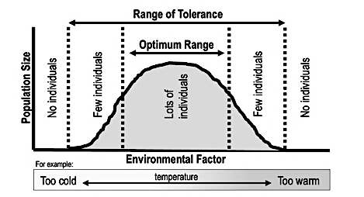
Marine
Education
19. Shelford & Leibig - Explain the concepts of limiting factors and tolerance limits and their importance in population distributions.
Name:
Date:
marineeducation.com.au
Shelford’s Law of Tolerance
To live in a given environment, a species must be able to survive, grow and reproduce. That requires a certain set of conditions to be just right for that species. When an environmental factor (such as temperature) is raised or lowered beyond the optimal range for that species, it struggles to live there. Shelford’s Law of Tolerance tells us that species have an upper limit and a lower limit to what conditions they can tolerate and therefore live in places that are within their range of tolerance. That’s why you never see a Greenland Shark in the tropics, or a Bull Shark in the Arctic.
Q. How does Shelford’s Law help us to understand population distributions? Ans. (hint: bold text)
It tells us that species have an upper limit and a lower limit to what conditions they can tolerate and therefore live in places that are within their range of tolerance.
Leibig’s Law of the Minimum
If an environmental factor is below the critical minimum (far left of the graph above) or above the maximum tolerable level (far right of the graph above) and it’s the only environmental factor restricting a population’s survival, growth or reproduction, it’s called the limiting factor. Leibig’s Law of the Minimum tells us that it only takes one factor to be outside a species range of tolerance for the population to be limited in its ability to survive, grow or reproduce there (regardless of the quantity of other factors within its range of tolerance). Note: if a limiting factor is reintroduced, growth can begin again.
Q. How does Leibig’s Law help us to understand what limits a population’s size? Ans. (hint: bold)
It tells us that it only takes one factor to be outside a species range of tolerance for the population to be limited in its ability to survive, grow and reproduce there (regardless of the quantity of other factors within its range of tolerance).
© Marine Education 2024 CC BY-NC-SA
Unit 2 Topic 1 Science Understanding
41

Slide 50
Marine
Education
Explain the concepts of limiting factors and tolerance limits and their importance in population distributions.
Name:
Date:
marineeducation.com.au
© Marine Education 2024 CC BY-NC-SA
NOTES AND EXAM REVISION
42

Slide 51
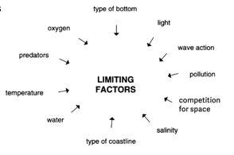
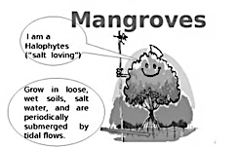
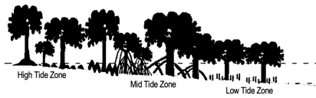
Marine
Education
20. Testing Tolerance – Interpret data to identify an organism’s tolerance limit, e.g. of intertidal organisms or mangrove zonation.
Name:
Date:
marineeducation.com.au
Zonation
Patterns of species abundance (how many there are) and distribution (where they are found).
Q. What is zonation? Ans.
Patterns of species abundance (how many there are) and distribution (where they’re found)
Rocky Shore Vertical Zonation
Rocky shores experience vertical zonation, which is the arrangement of plants and animals in distinct horizontal layers (with some overlap) caused by limiting factors of a combination of what each organism can tolerate physically as well as interactions between organisms ^{[1]}.
Activity: Circle the BIOTIC limiting factors.
Mangrove Zonation
Mangrove zonation is the predictable order of mangrove species that dominate in the low, mid and high tide zone of a mangrove forest (but can vary slightly with location).
In 2016, 40million mangrove trees died from thirst in the Gulf of Carpentaria. For 6 months, the sea level was 40cm lower than usual, due to El Nino. Q. What limiting factor caused them to die? Ans.
El Nino weather conditions causing a lack of water (they died of thirst)
^{[1]} Oregon State University (n.d.). Rocky Intertidal Ecology. Accessed July 2024 from: https://seagrant.oregonstate.edu/visitor-center/marine-education/lab-and-field-experiences/rocky-intertidal-ecology
© Marine Education 2024 CC BY-NC-SA
Unit 2 Topic 1 Science Understanding
43

Slide 52
Marine
Education
Interpret data to identify an organism’s tolerance limit, e.g. of intertidal organisms or mangrove zonation.
Name:
Date:
marineeducation.com.au
© Marine Education 2024 CC BY-NC-SA
NOTES AND EXAM REVISION
44

Slide 53
Marine
Education
21. Living in the Zone – Explain the concept of zonation using the following terms: intertidal, pelagic (neritic, oceanic), benthic and abyss.
Name:
Date:
marineeducation.com.au
Marine Life Zones
Abiotic factors such as water depth, light availability and distance from shore are used to divide the ocean into distinct marine life zones. The table below^{[1]} illustrates the characteristics that define each zone:
Basis | Marine Life Zone | Subdivision | Characteristics
Depth | Pelagic |  | All water above the seabed; organisms swim or float
 | Benthic |  | On the seabed; organisms attach to, burrow into, or crawl
 |  | Abyssal | Deep-sea bottom; dark, cold, high pressure; sparse life
Light Availability | Photic |  | Sunlit surface waters
 |  | Euphotic | Enough sunlight for photosynthesis
 | Aphotic |  | No sunlight; many organisms have bioluminescent capabilities
Distance from Shore | Intertidal |  | Narrow strip of land between high and low tide; dynamic area
 | Neritic |  | Above continental shelf; high biomass and diversity of species
 | Oceanic |  | Open ocean beyond the shelf break; low nutrient concentration
Q. What is the benthic zone (where ‘benthos’ live)? Ans.
the seabed
Q. What is the pelagic zone? Ans.
All water above the seabed
Intertidal
Neritic
Oceanic
Shelf break
Euphotic
High Tide
Low Tide
Continental Shelf
Enough light for photosynthesis
Photic
Continental Slope
Not enough light for photosynthesis
Complete Darkness
Aphotic
Continental Rise
Deep ocean-basin floor
Abyssal Plain
Activity: Shade the area in complete darkness above. Label the photic, euphotic & aphotic zone
Activity: Label the zones according to distance from shore (intertidal, neritic & oceanic)
^{[1]} Adapted from: Tarbuck E. J. & Lutgens, F. K. (2006). Earth Science: eleventh edition. Pearson Prentice Hall. New Jersey. USA. Pg.392
© Marine Education 2024 CC BY-NC-SA
Unit 2 Topic 1 Science Understanding
45

Slide 54
Marine
Education
Explain the concept of zonation using the following terms: intertidal, pelagic (neritic, oceanic), benthic and abyss.
Name:
Date:
marineeducation.com.au
© Marine Education 2024 CC BY-NC-SA
NOTES AND EXAM REVISION
46

Slide 55
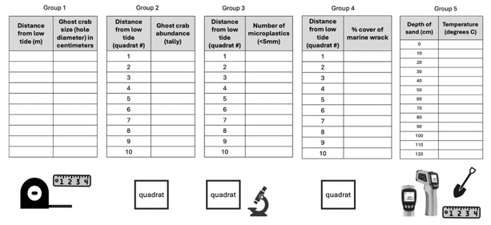
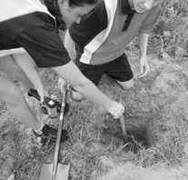
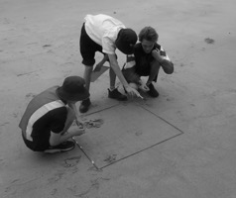
Marine
Education
22. Beach Excursion - Interpret field data from a local ecosystem.
Name:
Date:
marineeducation.com.au
Methodology and Research Question (RQ)
5 groups of students went to the beach to gather raw data. Each had a research question to answer:
Group 1 RQ: Is there a linear relationship between [ghost crab size] and [distance from low tide (m)]? Ans. [Yes] [No]
Group 2 RQ: Is there a linear relationship between [ghost crab abundance] and [distance from low tide (m)]? Ans. [Yes] [No]
Group 3 RQ: Is there a linear relationship between [number of microplastics] and [distance from low tide (m)]? Ans. [Yes] [No]
Group 4 RQ: Is there a linear relationship between [beach wrack % cover] and [distance from low tide (m)]? Ans. [Yes] [No]
Group 5 RQ: Is there a linear relationship between [temperature] and [depth of sand]? Ans. [Yes] [No]
Answering the Research Question
Their raw data was added to an excel spreadsheet. In excel, students made a scatterplot graph and generated an R² value (Pearson correlation coefficient) for each research question. Refer to the ‘little book of statistics’ to learn how to do this. Importantly, if the R² value was close to 1.0 (or -1.0) the answer to the research question was ‘yes’ (a linear relationship did exist). If the R² value was closer to zero, the answer to the research question was ‘no’ (a linear relationship did NOT exist). Their R² values are below.
Group | R² value
1 | 0.1146
2 | 0.3511
3 | unfinished*
4 | 0.3614
5 | 0.9185
Group 5
Group 2
Activity: Write the answer to each RQ by circling either [Yes] or [No] above (hint: R² value).
* Students were still analysing the raw data (identifying and counting microplastics under a microscope) at the time of the making of this worksheet.
© Marine Education 2024 CC BY-NC-SA
Unit 2 Topic 1 Science Understanding
47

Slide 56
Marine
Education
Interpret field data from a local ecosystem.
Name:
Date:
marineeducation.com.au
© Marine Education 2024 CC BY-NC-SA
NOTES AND EXAM REVISION
48

Slide 57
Marine
Education
23. Marine Match-up – Classify different groups of animals using structural characteristics.
Name:
Date:
marineeducation.com.au
Activity: Write the scientific name for each group of animal using the words from the word box below
Echinoderms Porifera Crustaceans Molluscs Cnidarians Vertebrates
Annelids & Nematodes
SCIENTIFIC NAME: ________________________
Radial Symmetry (like the spokes of a wheel)
Water vascular system (water instead of blood)
No heart, no brain, tube feet
Powers of regeneration
Complex central nervous system
Calcareous skeleton (i.e. spicules)
Echinoderms
Sea Urchin
Sea Star
Sea Cucumber
Crustaceans
SCIENTIFIC NAME: ________________________
Hard exoskeleton (which they ‘shed’ to grow)
Manoeuvrable Limbs
Head, thorax, abdomen and tail region
Prawn
Crab
Molluscs
SCIENTIFIC NAME: ________________________
Foot (used for moving &/or capturing prey)
Visceral mass (internal organs), Mantle
Clam
Octopus
Chiton
Vertebrates
SCIENTIFIC NAME: ________________________
Spinal chord or notochord (backbone/vertebrae)
Fish
Sea snake
Turtle
Dolphin
Annelids & Nematodes
SCIENTIFIC NAMES: ______________________
Worm-like
leeches
roundworms
Cnidarians
SCIENTIFIC NAME: ________________________
Medusa (free-swimming) or Polyp (sessile)
Nematocysts (stinging cells)
One opening (for mouth and anus)
Jellyfish (medusa)
anemone (polyp)
Coral
Porifera
SCIENTIFIC NAME: ________________________
Porous - small pores (ostia) & large openings (oscules)
Filter feeders (with beating flagellum that work like a pump)
Lots of different shapes and colours
Sponges
Q. Which of the following is NOT a mollusc?
Octopus, Chiton, Nudibranch, Clam, Barnacle?
Circle correct answer
Q. What is an invertebrate? Ans.
Anything that is NOT a vertebrate!
© Marine Education 2024 CC BY-NC-SA
Unit 2 Topic 1 Science Understanding
49

Slide 58
Marine
Education
Classify different groups of animals using structural characteristics.
Name:
Date:
marineeducation.com.au
© Marine Education 2024 CC BY-NC-SA
NOTES AND EXAM REVISION
50

Slide 59
Marine
Education
Name:
Date:
marineeducation.com.au
Echinoderms
Activity: Below, recall the characteristics that all Echinoderms have in common
Radial Symmetry (like the spokes of a wheel)
Water vascular system (water instead of blood)
No heart, no brain, tube feet
Powers of regeneration
Complex central nervous system
Calcareous skeleton (i.e. spicules)
Activity: Find-a-word
E | C | H | I | N | O | D | E | R | M | S | E | A
R | E | B | R | T | A | E | O | D | R | E | M | S
B | H | C | R | U | O | N | I | H | C | A | T | E
R | E | B | M | U | C | U | C | A | E | S | T | A
A | U | R | C | B | R | I | T | L | E | T | M | U
S | M | I | L | M | A | T | S | H | R | A | S | R
T | O | S | T | A | C | U | C | U | B | R | I | C
C | R | A | T | S | E | L | T | T | I | R | B | H
B | A | S | K | E | T | S | T | A | R | R | A | I
C | R | A | L | L | O | D | D | N | A | S | O | N
Echinoderms
SeaStar
SeaCucumber
SeaUrchin
BrittleStar
BasketStar
SandDollar
© Marine Education 2024 CC BY-NC-SA
NOTES AND EXAM REVISION
51

Slide 60
Marine
Education
Name:
Date:
marineeducation.com.au
Crustaceans
Activity: Below, recall the characteristics that all Crustaceans have in common
Hard exoskeleton (which they ‘shed’ to grow)
Manoeuvrable Limbs
Head, thorax, abdomen and tail region
Activity: Find-a-word
C | R | A | P | S | H | R | I | T | P | M | E | S
R | S | H | P | I | M | P | R | A | R | T | C | E
A | W | C | R | U | S | T | A | C | E | A | N | S
C | P | R | A | M | P | R | E | C | E | M | P | B
E | R | E | W | I | M | N | T | C | E | E | R | A
R | E | A | N | M | N | H | P | I | M | C | R | R
B | S | H | S | H | R | I | M | P | P | R | C | C
S | R | Y | C | R | U | S | T | M | U | P | U | T
H | T | I | S | E | L | C | A | N | R | A | B | S
R | I | P | E | A | N | S | E | T | U | N | A | B
Crustaceans
Crabs
Prawns
Shrimp
Barnacles
© Marine Education 2024 CC BY-NC-SA
NOTES AND EXAM REVISION
52

Slide 61
Marine
Education
Name:
Date:
marineeducation.com.au
Molluscs
Activity: Below, recall the characteristics that all Molluscs have in common
Foot (used for moving &/or capturing prey)
Visceral mass (internal organs),
Mantle
Activity: Find-a-word
C | E | P | H | A | L | O | P | O | D | S | A | G
E | V | H | T | O | N | S | E | C | E | V | L | A
T | A | E | R | N | C | H | I | T | O | N | S | S
H | L | S | C | S | U | L | L | O | M | O | L | T
E | E | H | H | B | R | U | V | P | A | L | V | R
S | S | E | I | I | A | N | C | U | H | E | S | O
V | B | I | V | A | L | V | E | S | N | D | O | P
B | R | M | O | L | T | O | P | U | S | O | D | O
O | M | P | E | V | H | C | E | P | H | A | O | D
N | U | D | I | B | R | A | N | C | H | S | C | S
Molluscs
Nudibranchs
Octopus
Chitons
Bivalves
Gastropods
Cephalopods
© Marine Education 2024 CC BY-NC-SA
NOTES AND EXAM REVISION
53

Slide 62
Marine
Education
Name:
Date:
marineeducation.com.au
Vertebrates
Activity: Below, recall the characteristics that all Vertebrates have in common
Spinal chord or notochord (backbone/vertebrae)
Activity: Find-a-word
R | E | S | E | T | A | R | B | E | T | R | E | V
E | C | H | I | U | R | E | M | U | M | N | I | P
P | O | T | U | R | T | L | E | S | T | H | E | D
T | R |  |  | T | H | E | R | D | R | O | F | O
I | C | S | E | A | S | N | A | K | E | S | O | L
L | O | H | S | F | I | C | H | R | T | E | O | P
E | D | A | H | U | F | I | S | T | H | S | E | F
S | I | R | A | S | P | S | H | R | U | T | L | I
S | E | K | R | H | O | R | O | L | P | H | I | S
F | Y | S | N | I | H | P | L | O | D | R | N | E
Vertebrates
Reptiles
Turtles
Fish
Sharks
Dolphins
SeaSnakes
© Marine Education 2024 CC BY-NC-SA
NOTES AND EXAM REVISION
54

Slide 63
Marine
Education
Name:
Date:
marineeducation.com.au
Annelids and Nematodes
Activity: Recall the characteristics that Annelids have in common (left box) and
Recall the characteristics that Nematodes have in common (right box)
Worm-like
segmented
Worm-like
Roundworms
Activity: Find-a-word
R | E | G | M | T | H | E | R | O | U | N | D | T
O | T | A | N | N | E | L | I | D | S | E | E | U
U | W | O | R | M | T | U | B | E | E | M | T | B
N | T | E | T | Y | U | N | H | I | G | T | G | E
D | W | M | G | E | Y | R | G | N | M | O | E | W
W | D | W | Q | R | D | V | R | H | E | E | M | O
O | S | E | D | O | T | A | M | E | N | R | D | R
R | F | R | F | T | H | O | P | L | T | D | E | M
M | R | R | H | I | U | L | N | M | E | T | S | R
S | S | M | R | O | W | L | E | E | D | H | T | P
Annelids
Segmented
Tubeworm
Nematodes
Roundworms
Eelworms
© Marine Education 2024 CC BY-NC-SA
NOTES AND EXAM REVISION
55

Slide 64
Marine
Education
Name:
Date:
marineeducation.com.au
Cnidarians
Activity: Below, recall the characteristics that all Cnidarians have in common
Medusa (free-swimming) or Polyp (sessile)
Nematocysts (stinging cells)
One opening (for mouth and anus)
Activity: Make your own Find-a-word
Cnidarians
Anemones
Corals
BlueBottle
Irukandji
BoxJellyfish
© Marine Education 2024 CC BY-NC-SA
NOTES AND EXAM REVISION
56

Slide 65
Marine
Education
Name:
Date:
marineeducation.com.au
Porifera
Activity: Below, recall the characteristics that all Sponges have in common
Porous - small pores (ostia) & large openings (oscules)
Filter feeders (with beating flagellum that work like a pump)
Lots of different shapes and colours
Activity: Make your own Find-a-word
Porifera
Sponges
Hexactinellida
Calcarea
Demospongiae
© Marine Education 2024 CC BY-NC-SA
NOTES AND EXAM REVISION
57

Slide 66
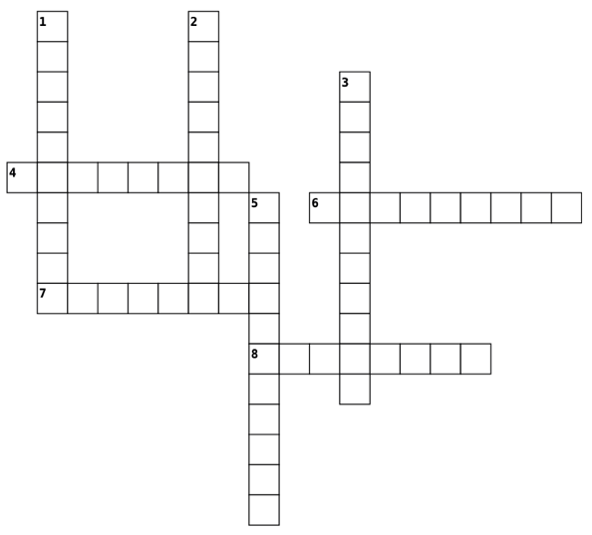
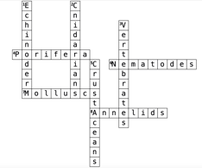
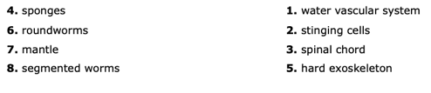
Marine
Education
Name:
Date:
marineeducation.com.au
Cross Word – Marine Classification
Across
Down
© Marine Education 2024 CC BY-NC-SA
NOTES AND EXAM REVISION
58

Slide 67
Marine
Education
24. Life Hacks – Classify adaptations as anatomical (structural), physiological (functional) or behavioural.
Name:
Date:
marineeducation.com.au
To Survive and Reproduce
Adaptations that aid our chance of survival and reproduction can be classified into 3 general categories:
1. Structural adaptations are structural features (i.e. fins, tentacles) that you can draw with pen and paper.
2. Functional adaptations are functional features (i.e. circulatory system, venom) that you usually can’t see.
3. Behavioural adaptations are behaviours (i.e. migrations), instinctual or learned, that you can observe.
Activity: Identify the adaptations below as structural, functional or behavioural (can be > 1)
The teeth of a shark: structural
The water vascular system of an Echinoderm: structural (tube feet) and functional
The barb of a sting ray: structural (the barb), functional (poison) and behavioural (use)
The camouflage of an octopus: functional (ability to change colour) and behavioural
The shape of the caudal fin in a thresher shark: structural
Activity: Complete the table. Use a ruler to measure the structural adaptations of the fish (in mm).
Total Length
Structural Adaptation | Length (mm)
Total Length | 72
Fork Length | 60
Standard Length | 55
Dorsal Fin base | 25
Caudal Peduncle Length | 13
Eye Diameter | 5
Total Height | 24
Jaw Length | 12
Head Length | 18
Pectoral Fin Length | 12
Anal Fin base Length | 13
Fork Length
Standard Length
Dorsal Fin base Length
Eye Diameter
Caudal Peduncle Length
Total Height
Jaw Length
Pectoral Fin Length
Anal Fin base Length
Head Length
(to edge of operculum)
Activity: Complete the table. Write the function of the functional adaptations labelled on the fish.
Swim Bladder
Functional Adaptation | Function
Swim Bladder | Buoyancy Control
Kidney | Excretion
Stomach & Intestines | Digestion
Liver | Hormone regulation and growth
Gills | Respiration
Heart | Blood Circulation
Gonads | Reproduction
Liver
Stomach
Kidney
SB
L
S
H
G
Gills
(underneath operculum)
Heart
Gonads
Intestine
Anus
Urogenital tract
© Marine Education 2024 CC BY-NC-SA
Unit 2 Topic 1 Science Understanding
59

Slide 68
Marine
Education
Classify adaptations as anatomical (structural), physiological (functional) or behavioural.
Name:
Date:
marineeducation.com.au
© Marine Education 2024 CC BY-NC-SA
NOTES AND EXAM REVISION
60

Slide 69
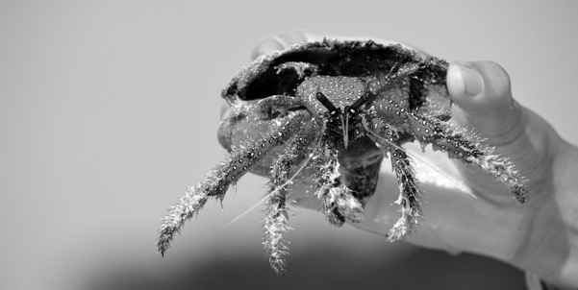
Marine
Education
25. Life or Death – Describe the role of adaptation in enhancing an organism’s survival in a specific marine environment.
Name:
Date:
marineeducation.com.au
Rocking it on a Rocky Shore
The rocky shore is a fascinating but formidable place. At high tide, waves batter the rocks and predators are common. At low tide, organisms are baked by the sun or drenched by fresh water from rain. However, we give thanks to these environmental challenges. Because it’s challenges like these, that have shaped the fascinating repertoire of adaptations that exist on Earth today. Not only do adaptations enhance each organism’s survival and reproductive success, but they’re also very entertaining to watch! And, on a rocky shore, you have a front row seat. For example, the frilly bits (cirri) that stick out from the shell of a barnacle are feet. Filter-feeding feet! Limpets (that look like a china-man’s hat) only start to move when the tide comes in (or at night) to seek out their favourite food, seaweed. At low tide, limpets and chitons use a powerful muscular foot as a suction cup to fix themselves to rocks to make a water-tight seal and prevent from drying out. The periwinkle has special ridges on its shell that act like cooling ribs on a car radiator to stop it from overheating. It’s the best show on Earth. And it’s all free!
North West Island, Capricorn Bunker Group November 2016. Photograph: Gail Riches
Activity: Describe the role of adaptation in enhancing an organism’s survival in a specific marine environment.
Adaptations may be structural, functional and/or behavioural.
Purpose: (1) survival (2) reproduction
Survival adaptations enable organisms to survive environmental challenges, both abiotic (i.e. temperature change) and biotic (i.e. competition, predation) so they, themselves, do not die. Examples: circadian and lunar rhythms, mimicry, aposematic colouration, vertical migration, etc.
Reproduction adaptations: enable organisms to reproduce so their population does not go extinct. Examples: r vs K strategists, fragmentation and budding, ovoviviparity, mass spawning events, hermaphroditism, parasitic mating, etc.
© Marine Education 2024 CC BY-NC-SA
Unit 2 Topic 1 Science Understanding
61

Slide 70
Marine
Education
Describe the role of adaptation in enhancing an organism’s survival in a specific marine environment.
Name:
Date:
marineeducation.com.au
© Marine Education 2024 CC BY-NC-SA
NOTES AND EXAM REVISION
62

Slide 71
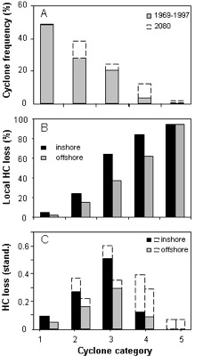
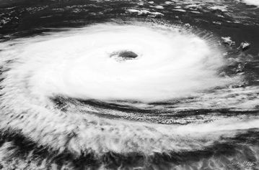
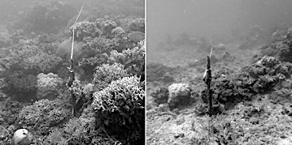
Marine
Education
26. Cyclone warning – Discuss how scientific evidence from the impact of cyclones and/or floods, allows scientists to offer reliable predictions about the loss of biodiversity of a chosen marine ecosystem.
Name:
Date:
marineeducation.com.au
Cyclones
Cyclones are damaging to hard corals which provide habitat for many species. Thus, measuring the percentage hard coral cover before and after a cyclone is one way to measure the effects of cyclones on biodiversity. Not surprisingly, as the intensity of the cyclone increases, the amount of damage to hard coral increases and, therefore, the loss of biodiversity increases. Predicting the loss of biodiversity on a coral reef after a cyclone is therefore directly related to the intensity of the cyclone ^{[1]}. Similarly, after a cyclone, a coral reef needs time to recover. The more time it has, the better its recovery. Under current climate change projections, both the severity and frequency of cyclones is predicted to increase in the future. This means more destruction and less time for recovery between cyclones ^{[1]}.
Figure 1: Percentage hard coral cover loss increases as cyclone intensity increases. Cyclones are predicted to increases in both intensity and frequency by 2080. Black and grey bars represent data from cyclones observed 1969-1997. %HC cover is GBR-wide ^{[1]}.
Figure 2: Before and After Category 4 Cyclone Ita (2014).
Q. What is the relationship between cyclone intensity and percentage hard coral cover loss? Ans.
As cyclone intensity increases, %HC cover loss increases.
^{[1]} Fabricius KE, De’ath G, Poutinen ML, Done T, Cooper TF, Burgess SC (2008) Disturbance gradients on inshore and offshore coral reefs caused by a severe tropical cyclone. Limnology and Oceanography 53: 690–704. Accessed from: https://eatlas.org.au/content/impacts-severe-tropical-cyclone-inshore-and-offshore-coral-reefs
^{[2]} AIMS ( 2017). News article: More intense cyclones pose threat to the world’s coral reefs. Australian Institute of Marine Science (AIMS). Accessed from: https://www.aims.gov.au/information-centre/news-and-stories/more-intense-cyclones-pose-threat-worlds-coral-reefs
© Marine Education 2024 CC BY-NC-SA
Unit 2 Topic 1 Science as a Human Endeavour
63

Slide 72
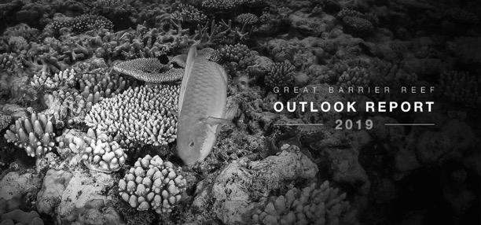
Marine
Education
27. Reef Rescue – Discuss how scientists use the evidence from the monitoring and assessment of an ecosystem to inform scientific knowledge about ecosystem resilience and population recovery.
Name:
Date:
marineeducation.com.au
The scientific evidence
“The scientific evidence is clear: initiatives that will halt and reverse the effects of climate change at a global level and effectively improve water quality at a regional scale are the most urgent to improve the Region’s long-term outlook” ^{[1]}. Check out the latest outlook report ^{[1]} – it includes all scientific monitoring and assessment of the GBR.
Q. What is the largest threat to the Great Barrier Reef? Ans.
climate change
To avoid a phase shift
For reefs to recover and avoid a phase shift (from a coral-dominated reef to an algae-dominated state) they need coral babies (coral larvae)^{[2]}. If the reef is too damaged to make its own babies, it needs the babies to arrive from elsewhere (e.g. nearby reef or coral nursery).
Coral babies need somewhere to settle
After they arrive, coral babies need a place to settle and grow. Coral babies do not settle where there is macroalgae and turf algae.
Note: macroalgae and turf algae grow fast after a disturbance event.
Herbivores such as surgeonfish eat macroalgae and turf algae.
Science is needed
Science is needed to inform and guide policy decisions.
E.g. scientists use the evidence from the monitoring and assessment of the GBR to inform policy-makers about its ability to recover from climate driven disturbance events, such as mass bleaching events^{[1]}.
Q. Where might coral babies arrive from? Ans.
Q. What eats macroalgae and turf algae? Ans.
Q. Example of a climate driven disturbance? Ans.
nearby reef
or coral nursery, delivered by boat or from an aquarium
Herbivores such as surgeonfish
Mass bleaching events; more frequent and/or severe cyclones…
^{[1]} Great Barrier Reef Marine Park Authority 2019, Great Barrier Reef Outlook Report 2019, GBRMPA, Townsville. Available: https://www2.gbrmpa.gov.au/our-work/outlook-report-2019
^{[2]} Marine Gouezo et al., (2019). Drivers of recovery and reassembly of coral reef communities. The Royal Society. https://royalsocietypublishing.org/doi/full/10.1098/rspb.2018.2908
© Marine Education 2024 CC BY-NC-SA
Unit 2 Topic 1 Science as a Human Endeavour
64

Slide 73

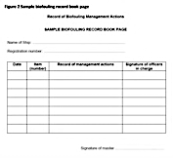
Marine
Education
28. Hitching a ride – Evaluate the role of biosecurity measures in preventing or responding to incursions of invasive marine species in Australian ports.
Name:
Date:
marineeducation.com.au
Prevention
Biosecurity Officers are employed by the Australian government to help stop invasive marine species from entering Australian ports. A maritime biosecurity officer earns approximately 85K/yr ^{[1]} and is required to conduct a full range of inspection activities onboard commercial and non-commercial vessels as well as cruise vessels and military vessels^{[1]}. One of those important inspections is the testing of ballast water.
Ballast Water
Ballast water is seawater that is added or removed by vessels to maintain vessel stability. If not managed properly, hitch-hikers within the ballast water can travel great distances. Biosecurity Officers are employed to check a vessel’s ballast water management plan, ballast water record book, ballast water management certificate, and/or sample the ballast water, issuing penalties when required.
Antifoul Paints
People paint the bottom of their boats with antifoul to deter organisms from attaching (fouling) to the submerged hull. Mainly to reduce drag. But, also to comply with Australian biofouling regulations^{[2]}. The paint is toxic - for good reason – to deter growth. Even so, organisms still grow. Some owners get in the water (or pay someone to) scrub the hull manually, sometimes as often as once a week. Others just let it grow and wait until the vessel is ‘slipped’ - taking it out of the water to clean (usually once/year, or 30 days prior to entering Australian waters). Owners must keep records for Biosecurity Officers to check (see right).
Q. What does a Maritime Biosecurity Officer do? Ans.
Prevents invasive marine species entering Australian ports by inspecting vessels, checking ballast water and biofouling management records, taking samples and issuing penalties when required.
Responding
Once an invasive species is here, the usual response is to: (1) List it under the EPBC Act; (2) Model its movements to identify emerging or future threats; (3) Remove it, or (4) Contain the invasive species; (5) Educate people; and (6) implement strong surveillance for rapid response and monitoring.
Q. What is one example of how we respond to invasive species? Ans.
Any word in bold
^{[1]} Department of Agriculture, Fisheries and Forestry. Biosecurity – Job List – All Vacancies. Accessed June 2024 from: https://awejobs.nga.net.au/cp/
^{[2]} Department of Agriculture, Fisheries and Forestry. Biosecurity – Australian Biofouling Requirements. Accessed June 2024 from: https://www.agriculture.gov.au/biosecurity-trade/aircraft-vessels-military/vessels/marine-pest-biosecurity/biofouling/australian-biofouling-requirements
^{[3]} Invasive species council. A Strategy For Dealing With Invasive Species In Australia. Accessed June 2024 from: https://invasives.org.au/our-work/feral-animals/strategy-invasive-species-australia/
© Marine Education 2024 CC BY-NC-SA
Unit 2 Topic 1 Science as a Human Endeavour
65

Slide 74
Marine
Education
29. Rocky Shore Rambler – Investigate a local ecosystem to determine factors of population dynamics (e.g. density or distribution) and assess abiotic components, including: estimating populations, e.g. survey count, quadrats, species density, percentage coverage, indirect or direct observation, catch and release; using field guides to identify to a genus level; using a range of field equipment to measure biotic factors related to marine environments; conducting in-field mapping of food webs via gut analysis to determine food sources; identifying physical structures of a specific marine organism (this could be virtual, practical or as a demonstration).
Name:
Date:
marineeducation.com.au
Activity: lay down a 10m transect parallel to the shore.
Transect zone (circle one): HIGH TIDE ZONE MID TIDE ZONE LOW TIDE ZONE
Activity: randomly place a quadrat down beside the transect
Distance of quadrat along the transect (m): _______ Side of quadrat (circle one): OCEAN or BEACH ?
QUADRAT number:
Activity: Complete the table below
 | Name (or description) | Tally (or % cover)
1
2
3
4
5
6
7
8
9
10
Abiotic factor | Amount | Unit of measurement
Temperature |  | degrees Celcius
Dissolved Oxygen
Salinity
© Marine Education 2024 CC BY-NC-SA
Unit 2 Topic 1 Science Inquiry
66

Slide 75
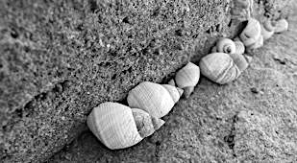








Marine
Education
29. Rocky Shore Rambler… Species ID guide
Name:
Date:
marineeducation.com.au
Little Blue Periwinkles
Limpet “Chinese hat snail”
Mulberry Whelk (Morula marginalba)
Chiton
Barnacle
Barnacle
Zebra shells (Austrocochlea species)
Cunjevoi ”sea squirt” (Pyura praeputialis)
Brown algae “Peacocks Tail” (Padina sp.)
Green algae “Sea lettuce” (Ulva sp.)
Red (coralline) algae
© Marine Education 2024 CC BY-NC-SA
Unit 2 Topic 1 Science Inquiry
67

Slide 76


Marine
Education
30. Science in the courtroom – Assess the limitations of a chosen field technique, e.g. quadrat, transect.
Name:
Date:
marineeducation.com.au
Sampling Techniques and Equipment
Your choice of sampling technique and equipment depends on a number of factors: the environment that you are sampling, the scale of the sample question, the size and mobility of the organisms, and time and budget constraints. Note: if you standardise the methodology by replicating what others have done in the past, you can compare data! Below is a comprehensive list of sampling techniques and equipment.
Addressing limitations
Every sampling technique, every piece of equipment and every methodology has certain limitations.
If you fail to identify these limitations, the validity of your experiment will be compromised.
E.g. you say YES to the research question when it should have been NO, or vice versa.
For example, pictured left is a crown of thorns starfish (note the spikes). It is tucked in behind the branches of a staghorn coral. Its hidden position may obscure it from view. As a result, the 2D (as opposed to 3D) nature of the quadrat is a limitation of the quadrat. Another limitation of the quadrat is when mobile animals ‘flee from the scene’. Or, if the quadrat is too large or too small (or out of focus) for the size and scale of what is being measured. Quadrats can be time consuming, and/or there is bias to where the quadrat is placed.
Question: What is one limitation to the quadrat? Ans.
any of the above mentioned
© Marine Education 2024 CC BY-NC-SA
Unit 2 Topic 1 Science Inquiry
68

