Slide 1
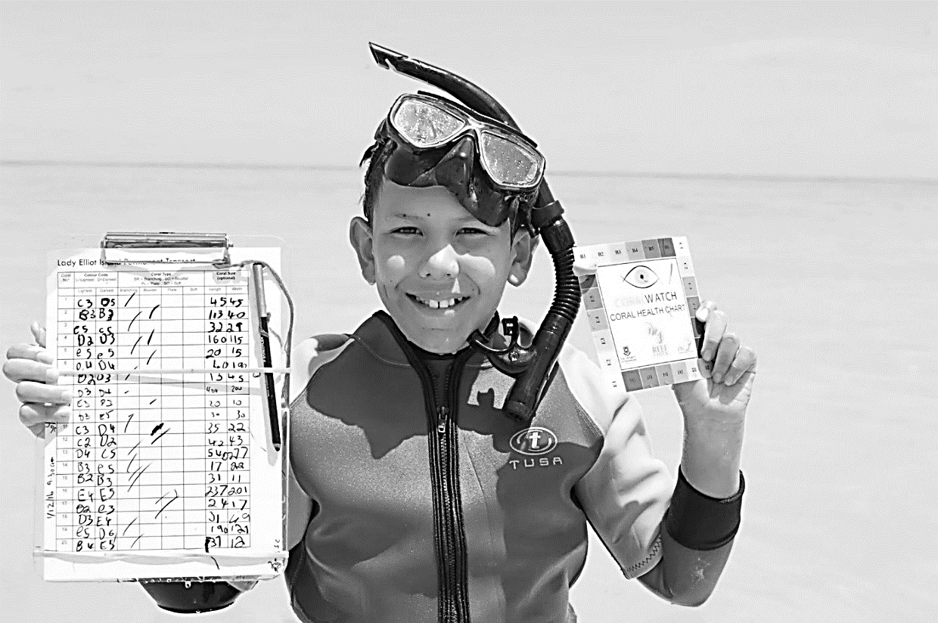
Marine
Education
Year 12 Marine Science
Name:
Date:
marineeducation.com.au
Unit 4 Ocean issues and resource management
Topic 1:
Oceans of the future
Management and conservation
Future Scenarios
CoralWatch Survey, North West Island Lagoon, Capricorn Bunker Group, Great Barrier Reef.
Note: waterproof paper and pencils are available at Officeworks.
Flinders Reef Moreton Bay Marine Park July 2016
© Marine Education 2024 CC BY-NC-SA

Slide 2
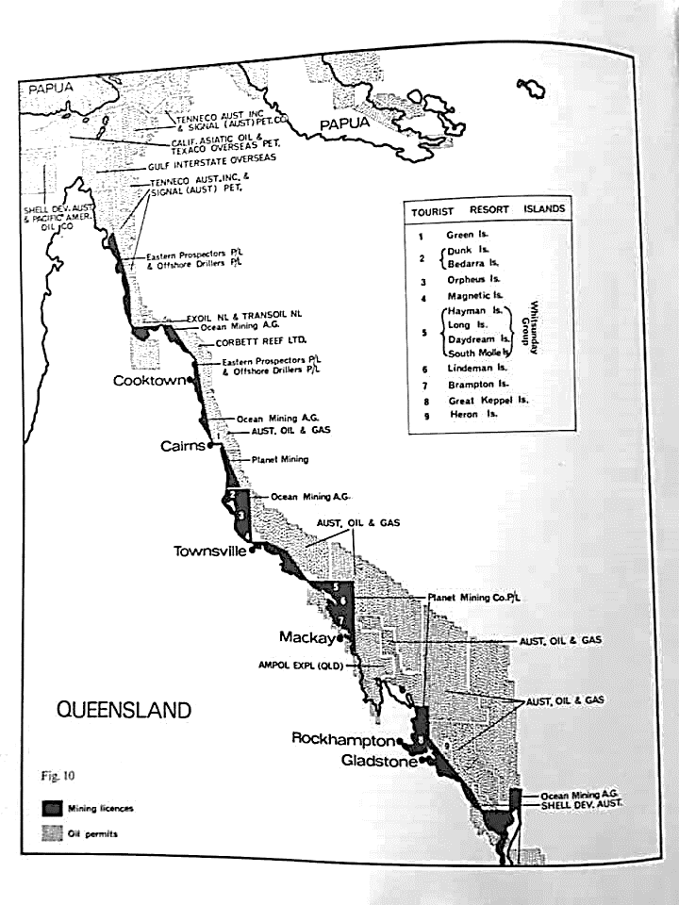
Marine
Education
1. Why Protect our Natural Assets? – Apply the arguments for preserving species and habitats to a given case study by identifying their associated direct and indirect values, including: ecological (e.g. source of genetic diversity); economic (e.g. ecotourism, recreation, yield); ethical (e.g. bio rights and stewardship); and aesthetic (e.g. source of beauty, spiritual connection.
Name:
Date:
marineeducation.com.au
Historical Fight for the Reef
The Great Barrier Reef was not always protected. Figure 2 was published in 1971 by (the legendary) Isabelle Bennett^{[3]}. It shows what ‘could have been’.
Figure 2: Mining licences (in black) and Oil permits (shaded areas) in 1971^{[3]}
Q. How do you feel about the Great Barrier Reef being mined? Ans.
Answers will vary
Conservationist and poet, Judith Wright, tells of her fight to protect the reef in her book ‘The Coral Battleground’ ^{[4]}.
Q. What do you think Judith Wright might have said to the prime minister, politicians and trade unions in the 1970s to convince them to protect (and not mine) the reef? Ans.
Ecological: source of genetic diversity
Economic: ecotourism, recreation, yield
Ethical: bio rights and stewardship
Aesthetic: source of beauty, spiritual connection
Note: these answers are straight from the syllabus. Student answers may vary.
Note: The Great Barrier Reef Marine Park (GBRMP) was established in 1975. In 1981, an area including the GBRMP was inscribed on the World Heritage List as GBRWHA.
^{[1]} Adapted from: Mohamed, M. (2007). Economic valuation of coral reefs: a case study of the costs and benefits of improved management of Dhigali Haa, a marine protected area in Baa atoll, Maldives. Thesis. University of Canterbury NZ.
^{[2]} Adapted from: TEEB (2010). The Economics of Ecosystems and Biodiversity: Mainstreaming the Economics of Nature: A synthesis of the Approach, Conclusions and Recommendations of TEEB. Accessed 16.04.2019 from: www.teebweb.org
^{[3]} Bennett, I. (1971). The Great Barrier Reef. Lansdowne Press. Victoria. Australia. Page 176.
^{[4]} Wright, J. (1977). The Coral Battleground. Thomas Nelson (Australia) Limited. Melbourne, Vic. Aust.
© Marine Education 2024 CC BY-NC-SA
Unit 4 Topic 1 Science Understanding – Management and Conservation

Slide 3
Marine
Education
Apply the arguments for preserving species and habitats to a given case study by identifying their associated direct and indirect values, including: ecological (e.g. source of genetic diversity); economic (e.g. ecotourism, recreation, yield); ethical (e.g. bio rights and stewardship); and aesthetic (e.g. source of beauty, spiritual connection.
marineeducation.com.au
Name:
Date:
© Marine Education 2024 CC BY-NC-SA
NOTES AND EXAM REVISION

Slide 4
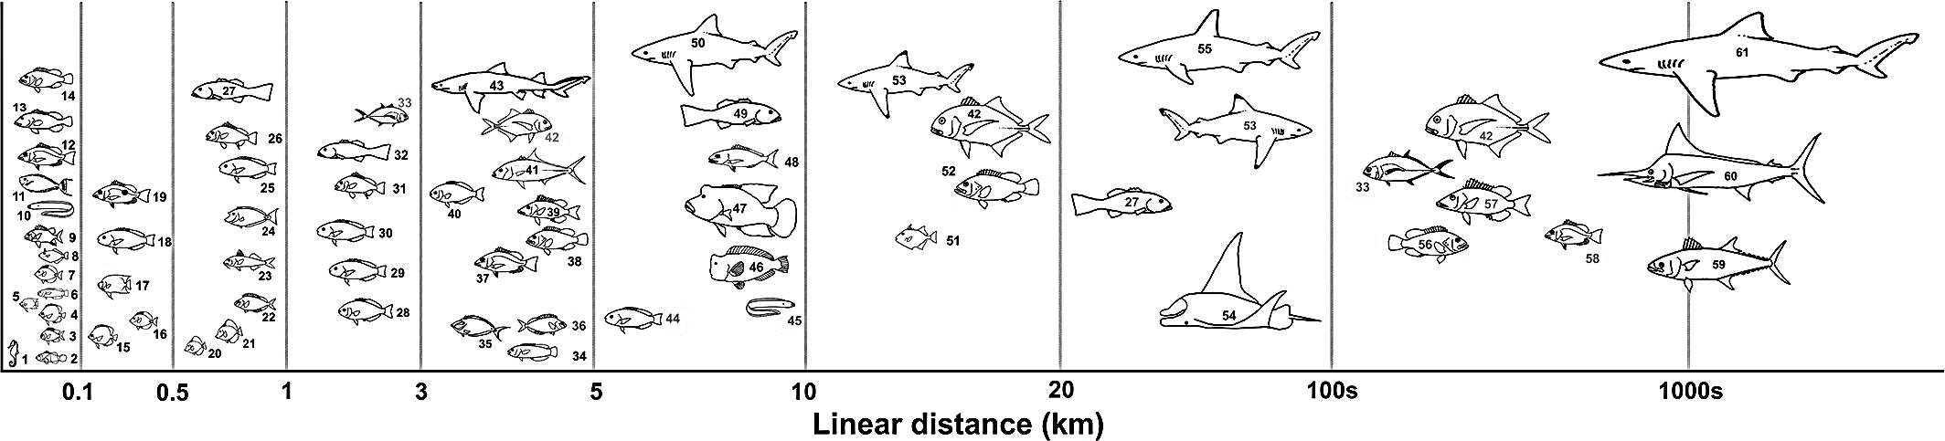
Marine
Education
2. How to Protect our Natural Assets? – Explain the criteria (i.e. site selection, networking and connectivity, replication, spacing, size and coverage) used to design protected marine areas.
Name:
Date:
marineeducation.com.au
How to design a marine reserve
Marine reserves* provide protection from extractive and destructive activities^{[1]}. Hence, there are rules. Thus, in order to be effective (and become powerful tools for conservation and management) they need to be designed well. When designing a marine reserve or marine reserve network, a few things need to be decided upon, such as where they should go (site selection, networking and connectivity), how big they need to be (size and coverage), how many there needs to be (replication), and how close together they need to be (spacing). As a rule of thumb, marine reserves should be at least twice the size of the home range of focal species for protection (in all directions), protect habitats critical to any stage of their life cycle (e.g. nursery grounds and spawning sites), and be spaced 10s to 100s of kilometres apart (depending on the larval dispersal distances of focal species) to allow for species replenishment^{[3]}.
Suggested Activity: Conduct one or more of the Practical Activities provided by Coral Watch^{[1]}
*A ‘marine reserve’ is a type of MPA that usually offers a higher rate of protection for a designated area and its species (usually fish). E.g. no-take areas.
Q. How many fish species in Fig. 1 would be protected by a reserve with a 1km diameter? Ans.
19
Figure 1: Linear scale of movement of coral reef and coastal pelagic fish species^{[1]}.
Note: the home range of a fish is the area in which an individual spends the majority of its time and engages in most of its routine activities including foraging and resting. Small-scale resident spawning aggregations are included in that home range. Larger scale movements to transient spawning aggregations are not^{[1]}.
Activity: Explain the following general recommendations for resilient MPA network design^{[2]}
Criteria | Recommendation | Explanation (the reason for the recommendation)
Site selection, Networking and Connectivity (where they should go) | Put them in habitats critical to any stage of the focal species life cycle | Areas with high habitat connectivity improve reserve performance^{[1]}
Size and Coverage (how big they need to be) | Be at least twice the size of the focal species home range | To ensure the reserve includes the entire home range of at least one individual, and will likely include many more with overlapping home ranges^{[1]}
Spacing (how close together they need to be) | Be spaced 10s to 100s of kilometres apart | To allow for species replenishment^{[1]}
Recommended Reading:
The Nature Conservancy (2019). MPA Network Design for Fisheries, Climate Change and Biodiversity Objectives. Conservation Gateway. Accessed 05.07.2019 from: http://nature.org/MPANetworkDesign
McLeod, E., Salm, R., Green, A., and Almany, J. (2008). Designing marine protected area networks to address the impacts of climate change. Frontiers in Ecology and the Environment. Volume 7. Issue 7. DOI: 10.1890/070211. https://www.researchgate.net/profile/Rodney_Salm/publication/303855892_Designing_marine_protected_area_networks_to_address_the_impacts_of_climate_change/links/57d079b508ae6399a389db6b/Designing-marine-protected-area-networks-to-address-the-impacts-of-climate-change.pdf
Green, A. L., Fernandes, L., Almany, G., Abesamis, R., McLeod, E., Alino, P., White, A. T., Salm, R., Tanzer, J. and Pressey, R.L. (2014). Designing Marine Reserves for Fisheries Management, Biodiversity Conservation, and Climate Change Adaptation. Coastal Management 42: 143-159. DOI: 10.1080/08920753.2014.877763. https://www.researchgate.net/publication/260555735_Designing_Marine_Reserves_for_Fisheries_Management_Biodiversity_Conservation_and_Climate_Change_Adaptation
^{[1]} Reproduced with permission from: Green, A.L., Maypa, A.P., Almay, G.R., Rhodes, K.L., Weeks, R., Abesamis, R. A., Gleason, M., Mumby, P. and White, A.T. (2014). Larval dispersal and movement patterns of coral reef fishes, and implications for marine reserve network design. Biological Reviews. Volume 90. Issue 4. DOI: 10.1111/brv.12155. CC BY-NC-ND 4.0
^{[3]} Dr. Alison Green, personal communication (04.07.2019). Note: originally, the rule of thumb was to space marine reserves no more than 15km apart^{[1]}. The science has recently changed with more empirical movement studies on more species. Therefore, now we say they should be spaced 10s or 100s of km apart, depending on larval dispersal distances of focal species^{[3]}.
© Marine Education 2024 CC BY-NC-SA
Unit 4 Topic 1 Science Understanding – Management and Conservation

Slide 5
Marine
Education
Explain the criteria (i.e. site selection, networking and connectivity, replication, spacing, size and coverage) used to design protected marine areas.
Name:
Date:
marineeducation.com.au
© Marine Education 2024 CC BY-NC-SA
NOTES AND EXAM REVISION

Slide 6
Marine
Education
3. In the Zone – Identify management strategies used to support marine ecosystem health, e.g. managing threats, zoning, permits, plans, longitudinal monitoring.
Name:
Date:
marineeducation.com.au
Zoning
Zoning is a management strategy that divides a Marine Park into zones, with different rules for each zone. It was initially applied to the Great Barrier Reef (GBR) in 1981 and is now widely regarded as the cornerstone of GBR management^{[1]}. It is interesting to note that many of the original GBR zone names are colloquially known by their colour as depicted on a zoning map^{[1]}. E.g. the Marine National Park Zone is called the green zone (‘no-take’ zone) and the Preservation Park Zone is called the pink zone (‘no-go’ zone)^{[2]}.
Suggested Activity: Conduct one or more of the Practical Activities provided by Coral Watch^{[1]}
Activity: Download the ‘Eye on the Reef’ app and explore zonings in ‘General Information’.
Activity: Complete the table below^{[2]}
Conservation Park Zone
(Yellow)
Preservation Park Zone
(Pink)
Activities Guide | General Use Zone (light Blue) | Habitat Protection Zone (Blue) |  | Buffer Zone (Brown) | Scientific Research Zone (Orange) | Marine National Park Zone (Green)
Aquaculture | Permit | Permit | Permit | X | X | X | X
Bait Netting |  |  |  | X | X | X | X
Boating, diving, photography |  |  |  |  |  |  | X
Crabbing (trapping) |  |  |  | X | X | X | X
Harvest fishing for aquarium fish, coral and beachworm | Permit | Permit | Permit | X | X | X | X
Harvest fishing for sea cucumber, trochus, tropical rock lobster | Permit | Permit | X | X | X | X | X
Limited collecting |  |  |  | X | X | X | X
Limited spearfishing (snorkel only) |  |  |  | X | X | X | X
Line fishing |  |  |  | X | X | X | X
Netting (other than bait netting) |  |  | X | X | X | X | X
Research (other than limited impact research) | Permit | Permit | Permit | Permit | Permit | Permit | Permit
Shipping (other than in a designated shipping area) |  | Permit | Permit | Permit | Permit | Permit | X
Tourism programme | Permit | Permit | Permit | Permit | Permit | Permit | X
Traditional use of marine resources |  |  |  |  |  |  | X
Trawling |  | X | X | X | X | X | X
Trolling |  |  |  |  | X | X | X
Reef 2050 Plan
The Australian and Qld. governments responded to increasing concerns about the health of the GBR^{[3]} with the Reef 2050 Plan – an overarching framework for protecting and managing the reef until 2050^{[4]}.
Q. How often will the Reef 2050 Plan be reviewed? Ans.
Every 5 years (starting 2020)
^{[1]} Day, J. C. (2002). Zoning – lessons from the Great Barrier Reef Marine Park. Ocean and Coastal Management. Volume 45. Issues 2-3. Pages 139-156. DOI: 10.1016/S0964-5691(02)00052-2
^{[2]} Adapted with permission from: Great Barrier Reef Marine Park Authority 2018, Maps. GBRMPA, Townsville. Accessed 18.04.2019 from: http://www.gbrmpa.gov.au/access-and-use/zoning/zoning-maps
^{[3]} Great Barrier Reef Marine Park Authority 2014, Great Barrier Reef Outlook Report 2014, GBRMPA, Townsville. Accessed 06.07.2019 from: http://www.gbrmpa.gov.au/our-work/reef-strategies/great-barrier-reef-outlook-report
^{[4]} Commonwealth of Australia (2018). The Reef 2050 Plan. The Australian Government: Department of Environment and Energy. Canberra. Accessed 18.04.2019 from: http://www.environment.gov.au/marine/gbr/long-term-sustainability-plan
© Marine Education 2024 CC BY-NC-SA
Unit 4 Topic 1 Science Understanding – Management and Conservation

Slide 7
Marine
Education
Identify management strategies used to support marine ecosystem health, e.g. managing threats, zoning, permits, plans, longitudinal monitoring.
Name:
Date:
marineeducation.com.au
© Marine Education 2024 CC BY-NC-SA
NOTES AND EXAM REVISION

Slide 8
Marine
Education
4. Successful MPAs – Interpret data to determine the success of a protected marine area.
Name:
Date:
marineeducation.com.au
Suggested Activity: Conduct one or more of the Practical Activities provided by Coral Watch^{[1]}
Teacher to write
Recommended Readings
^{[1]} Green, A., Smith, S.E., Lipsett-Moore, G., Groves, C., Peterson, N., Sheppard, S., Lokani, P., Hamilton, R., Almany, J., Aitsi, J. and Bualia, L. (2009). Designing a resilient network of marine protected areas for Kimbe Bay, Papua New Guinea. Oryx. 43(04):488 – 498. DOI: 10.1017/S0030605309990342
^{[2]} Alcala, A. C. (2004). Marine Reserves as Tools for Fishery Management and Biodiversity Conservation: Natural Experiments in the Central Philippines, 1974-2000. Silliman University-Angelo King Center for Research and Environmental Management, Dumaguete city. Accessed 19.04.2019 from: https://www.cbd.int/doc/nbsap/fisheries/ALCALA.pdf
^{[3]} United Nations Development Programme (2012). Nguna-Pele Marine and Land Protected Area Network, Vanuatu. Equator Initiative Case Study Series. New York, NY. Accessed 19/04.2019 from: https://www.equatorinitiative.org/wp-content/uploads/2017/05/case_1348163605.pdf
^{[4]} Craik, AM. W. (2017). Review of Governance of the Great Barrier Reef Marine Park Authority. Report. Canberra: Department of the Environment and Energy. Accessed 19.04.2019 from: http://www.environment.gov.au/system/files/resources/6a038c9a-34dd-42cb-a0b4-a688bd284658/files/final-report-review-governance-gbrmpa.pdf
© [Teacher name] year CC BY-NC-SA
Unit 4 Topic 1 Science Understanding – Management and Conservation

Slide 9
Marine
Education
Interpret data to determine the success of a protected marine area.
Name:
Date:
marineeducation.com.au
© Marine Education 2024 CC BY-NC-SA
NOTES AND EXAM REVISION

Slide 10
Marine
Education
5. Government and NGO Roles – Compare the roles of government and non-government organisations in the management and restoration of ecosystems and their relative abilities to respond, e.g. speed, diplomatic constraints, political influence, enforceability.
Name:
Date:
marineeducation.com.au
Marine Protected Areas were successful because of…
Marine Protected Areas failed
because of…
Suggested Activity: Conduct one or more of the Practical Activities provided by Coral Watch^{[1]}
High level of stakeholder participation
Lack of surveillance
N=12
N=6
Strong social networks / communication
Supporting legislation
Political interests over ecological needs
Lack of (or delayed) stakeholder engagement
N=7
Success
N=11
N=4
Failure
N=5
Explicit Objectives
Leadership
Low legal compliance
Institutional rivalry
N=7
N=8
N=5
N=5
Figure 1: Top 5 factors determining the success of 16 MPAs (left) and the failure of 11 MPAs (right) around the world, according to expert judgement^{[1]}.
Copyright © 2018 Giakoumi, McGowan, Mills, Beger, Bustamante, Charles, Christie, Fox, Garcia-Borboroglu, Gelcich, Guidetti, Mackelworth, Maina, McCook, Micheli, Morgan, Mumby, Reyes, White, Grorud-Colvert and Possingham.
Q. How can a government organisation help turn a failed MPA into a successful one? Ans.
Include in your answer a comment on the speed of their ability to respond, diplomatic constraints, political influence and enforceability.
Increase stakeholder engagement and participation (e.g. outreach to forge relationships with key individuals), demonstrate leadership, provide supporting legislation with explicit objectives, put ecological needs before political interests, actively work towards eliminating any institutional rivalry, and increase funding for surveillance.
Speed can be slow (must follow a process) with diplomatic constraints.
Governments generally have lots of political influence and enforceability.
Q. How can a non-government organisation (NGO) help turn a failed MPA into a successful one?
Include in your answer a comment on the speed of their ability to respond, diplomatic constraints, political influence and enforceability.
Through advocacy (by drawing attention to it, lobbying, rallying support, etc.); By providing scientific data and expertise (e.g. citizen science initiatives increasing stakeholder engagement and participation); By taking on a management role (habitat restoration, co-management with government); By being a watchdog (monitoring for compliance and publicizing infractions), and; By being an enabler (fundraising, networking, stakeholder engagement)^{[2][3]}.
Speed, diplomatic constraints and political influence largely depend on existing community beliefs and values. Enforceability can be limited to shaming.
^{[1]} Adapted with permission from: Giakoumi, S., McGowen, J., Mills, M., Beger, M., Bustamante, R.H., Charles, A., Christie, P., Fox, M., Garcia-Borboroglu, P., Gelcich, S., Guidetti, P., Mackelworth, P., Maina, J., McCook, L., Micheli, F., Morgan, L.E., Mumby, P., Reyes, L.M., White, A., Grorud-Colvert, K. and Possingham, H.R. (2018). Revisiting “Success” and “Failure” of Marine Protected Areas: A Conservation Scientist Perspective. Frontiers in Marine Science. Volume 5. Article 223. DOI: 10.3389/fmars.2018.00223
^{[2]} Brumbaugh, D. R. (2017). Co-Management of Marine Protected Areas: A suggested framework for The Bahamas. Report to the Nature Conservancy, Northern Caribbean Program, Nassau, Bahamas. 32pp. Accessed 20.04.2019 from: file:///C:/Users/riche/Downloads/Co-Management-Framework-Final2.pdf
^{[3]} Crosman, K. M. (2013). The roles of non-governmental organizations in marine conservation. Thesis. University of Michigan. Accessed 20.04.2019 from: https://deepblue.lib.umich.edu/bitstream/handle/2027.42/99557/Crosman_Roles_of_NGOs_in_Marine_Conservation_Final.pdf?sequence=1
© Marine Education 2024 CC BY-NC-SA
Unit 4 Topic 1 Science Understanding – Management and Conservation

Slide 11
Marine
Education
Compare the roles of government and non-government organisations in the management and restoration of ecosystems and their relative abilities to respond, e.g. speed, diplomatic constraints, political influence, enforceability.
Name:
Date:
marineeducation.com.au
© Marine Education 2024 CC BY-NC-SA
NOTES AND EXAM REVISION

Slide 12
Marine
Education
6. Future Scenarios – Interpret datasets about atmospheric conditions to predict future scenarios for a given marine system.
Name:
Date:
marineeducation.com.au
Activity: Describe the atmospheric conditions (e.g.W/m², CO2, °C) in 2100 for each of the RCPs. Then, evaluate the future of a named marine system for each of the RCPs. Hint: see pages 89 & 27.
Name of Marine System:
Atmospheric Conditions
Radiative Forcing 8.5W/m². CO2e 1370ppm. CO2 936ppm (p.89).
More unlikely than likely the temperature will stay below 4°C (p.89).
Future of Coral Reefs
Not dominated by coral (p.27).
Annual bleaching (p.89).
Global sea level rise will be ~0.75m (IPCC WG1 AR5 Chapter 13. p.1181).
RCP8.5
Atmospheric Conditions
Radiative Forcing 6.0W/m². CO2e 850ppm. CO2 670ppm (p.89).
More unlikely than likely the temperature will stay below 3°C (p.89).
Future of Coral Reefs
Not dominated by coral (p.27).
Annual bleaching (p.89).
Global sea level rise will be ~0.55m (IPCC WG1 AR5 Chapter 13, p.1181).
RCP6.0
Atmospheric Conditions
Radiative Forcing 4.5W/m². CO2e 650ppm. CO2 538ppm (p.89).
More unlikely than likely the temperature will stay below 2°C (p.89).
Future of Coral Reefs
Not dominated by coral (p.27).
Annual bleaching (p.89).
Global sea level rise will be ~0.525m (IPCC WG1 AR5 Chapter 13, p.1181).
RCP4.5
Atmospheric Conditions
Radiative Forcing 2.6W/m². CO2e <490ppm. CO2 421ppm (p.89).
More unlikely than likely the temperature will stay below 1.5°C (p.89).
Future of Coral Reefs
10-30% of reefs might be saved (p.89).
Global sea level rise will be ~0.45m (IPCC WG1 AR5 Chapter 13, p.1181).
RCP2.6
© Marine Education 2024 CC BY-NC-SA
Unit 4 Topic 1 Science Understanding – Future Scenarios

Slide 13
Marine
Education
Interpret datasets about atmospheric conditions to predict future scenarios for a given marine system.
Name:
Date:
marineeducation.com.au
© Marine Education 2024 CC BY-NC-SA
NOTES AND EXAM REVISION

Slide 14
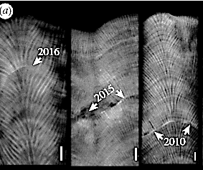
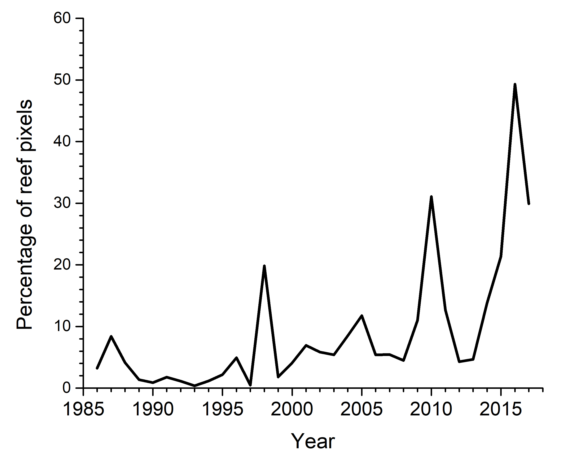
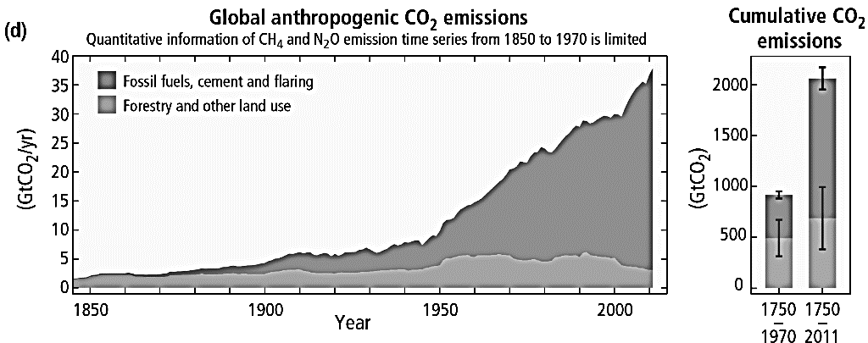
Marine
Education
7. Trends through Time – Compare historical geological evidence (e.g. of coral cores) with changes in land use practices
and global carbon dioxide and temperature levels.
Name:
Date:
marineeducation.com.au
Porites coral cores
Global reefs exposed to ≥4DHW
Suggested Activity: Conduct one or more of the Practical Activities provided by Coral Watch^{[1]}
Figure 2: Percentage of global reefs exposed to bleaching-level heat stress of ≥4 Degree Heating Weeks (DHW). Note the peaks in 1998, 2010, 2015, 2016 and 2017, which were all considered to be global bleaching events in terms of extent. Graph courtesy of Dr. William J. Skirving^{[2]}.
Figure 1: Stress bands on Porites coral cores from the Great Barrier Reef^{[1]}
(a)
(b)
Figure 3: (a) Global anthropogenic CO2 emissions from burning fossil fuels, cement production and flaring, as well as from forestry and other land uses; (b) Cumulative emissions of CO2 from these sources, and their uncertainties^{[3]}.
Activity: Below, identify any obvious trends, patterns or relationships between Figures 1-3
CO2 emissions, the number of reefs exposed to ≥4DHWs (globally), and coral stress events all increase over time. Figure 3 clearly shows the steep climb in CO2 emissions since 1950 (compared to the relatively slow increases prior to 1950). The temperature spikes in Figure 2 correspond to the coral stress bands in Porites coral cores in Figure 1.
^{[1]} Adapted with permission from: De Carlo, T.M., Harrison, H.B., Gajdzik, L., Alaguarda, D., Rodolfo-Metalpa, R., D’Olivo, J., Liu, G., Patalwala, D. and McCulloch, M.T. (2019). Acclimatization of massive reef-building corals to consecutive heatwaves. Proc. R. Soc. B. 286. DOI: 10.1098/rspb.2019.0235
^{[2]} Adapted with permission from: Skirving, W.J., Heron, S.F., Marsh, B.L., Liu, G., De La Cour, J.L., Geiger, E.F. and Eakin, C.M. (2019). The relentless march of mass coral bleaching: a global perspective of changing heat stress. Coral Reefs. Report. DOI: 10.1007/s00338-019-01799-4
^{[3]} IPCC, 2014: Climate Change 2014: Synthesis Report. Contribution of Working Groups I, II and III to the Fifth Assessment Report of the Intergovernmental Panel on Climate Change [Core Writing Team, R.K. Pachauri and L.A. Meyer (eds.)]. IPCC, Geneva, Switzerland, 151 pp.
© Marine Education 2024 CC BY-NC-SA
Unit 4 Topic 1 Science Understanding – Future Scenarios

Slide 15
Marine
Education
Compare historical geological evidence (e.g. of coral cores) with changes in land use practices and global carbon dioxide and temperature levels.
Name:
Date:
marineeducation.com.au
© Marine Education 2024 CC BY-NC-SA
NOTES AND EXAM REVISION

Slide 16
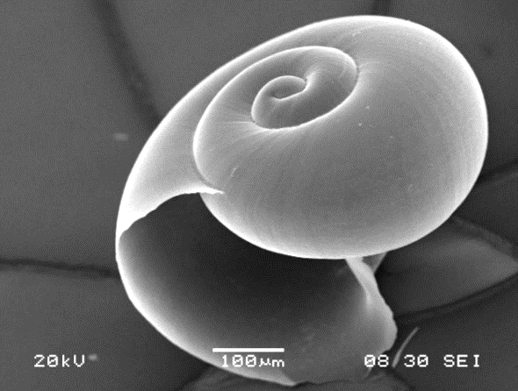
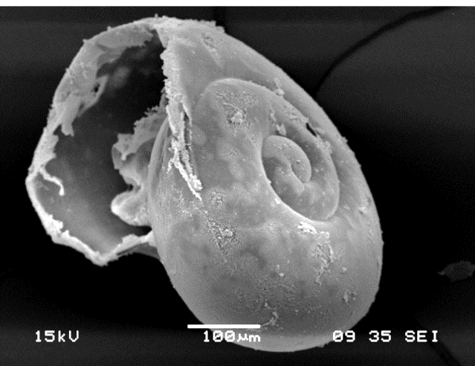
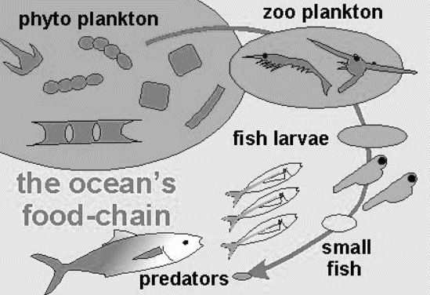
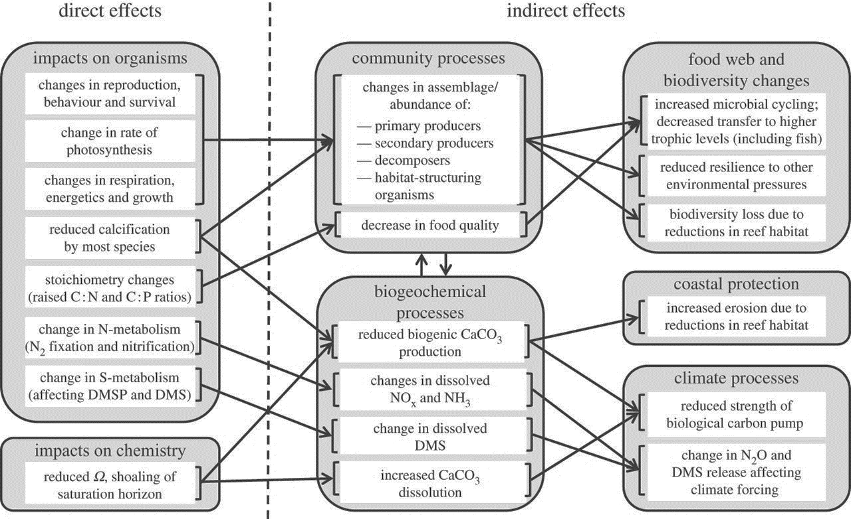
Marine
Education
8. Shell Shock – Explain the indirect consequences that ocean acidification has on the ocean and its uses, including: changes in food webs, lowering of coral bleaching temperature thresholds, habitat destruction, coastal protection and, effects on fisheries, medicine, tourism and recreation.
Name:
Date:
marineeducation.com.au
Figure 1 (left): A pteropod shell taken from ambient seawater with supersaturated conditions for omega typically has a smooth, sleek shell surface^{[1]}.
Figure 2 (right): Progressive roughening of the shell surface induced by dissolution. Shell integrity is lost and prone to fragmentation and increased frailness^{[1]}.
Suggested Activity: Conduct one or more of the Practical Activities provided by Coral Watch^{[1]}
Diatoms
Pteropods
Juvenile Alaskan Pink Salmon
Humans
Figure 3: In the ocean, all creatures depend on the supply of plankton (tiny plants and animals) at the bottom of the food chain^{[2]}. Many of which are made of calcium carbonate (CaCO3). E.g. coccolithophores and pteropods are both made of CaCO3.
Activity: Draw a food chain featuring a Pteropod (hint: Juvenile Alaskan Pink Salmon eat Pteropods)
Activity: Find Figure 3 in Williamson & Turley (2012)^{[3]}. Fill in the blanks below.
DIRECT EFFECTS
INDIRECT EFFECTS
Change in abundance of:
Primary producers
Secondary producers
Decomposers
Habitat-formers
Animals, plants and microbes
Reduced calcification by most species
Biodiversity loss
People (costs and values)
Reduced strength of biological pump
Increased CaCO3 dissolution
Figure 4: Conceptual representation of possible future ocean acidification direct effects on organisms and chemistry, and indirect effects on ecosystems and ecosystem services^{[3]}.
^{[1]} Adapted with permission from: Bednarsek, N., Tarling, G.A., Bakker, D.C.E., Fielding, S., Cohen, A., Kuzirian, A., McCorkle, D., Leze, B. and Montagna, R.(2012). Description and quantification of pteropod shell dissolution: a sensitive bioindicator of ocean acidification. Global Change Biology. Volume 18. Issue 7. Pages 2378-2388. DOI: 10.1111/j.1365-2486.2012.02668.x
^{[2]} Adapted with permission from: Climate Kids (2019). What is happening in the ocean? NASA. Accessed 20.04.2019 from: https://climatekids.nasa.gov/ocean/. Courtesy NASA/JPL-Caltech.
^{[3]} Adapted with permission from: Williamson, P. and Turley, C. (2012). Ocean acidification in a geoengineering context. Philosophical Transactions of the Royal Society. 370, 4317-4342. DOI:10.1098/rsta.2012.0167
© Marine Education 2024 CC BY-NC-SA
Unit 4 Topic 1 Science Understanding – Future Scenarios

Slide 17
Marine
Education
Explain the indirect consequences that ocean acidification has on the ocean and its uses, including: changes in food webs, lowering of coral bleaching temperature thresholds, habitat destruction, coastal protection and, effects on fisheries, medicine, tourism and recreation.
Name:
Date:
marineeducation.com.au
© Marine Education 2024 CC BY-NC-SA
NOTES AND EXAM REVISION

Slide 18
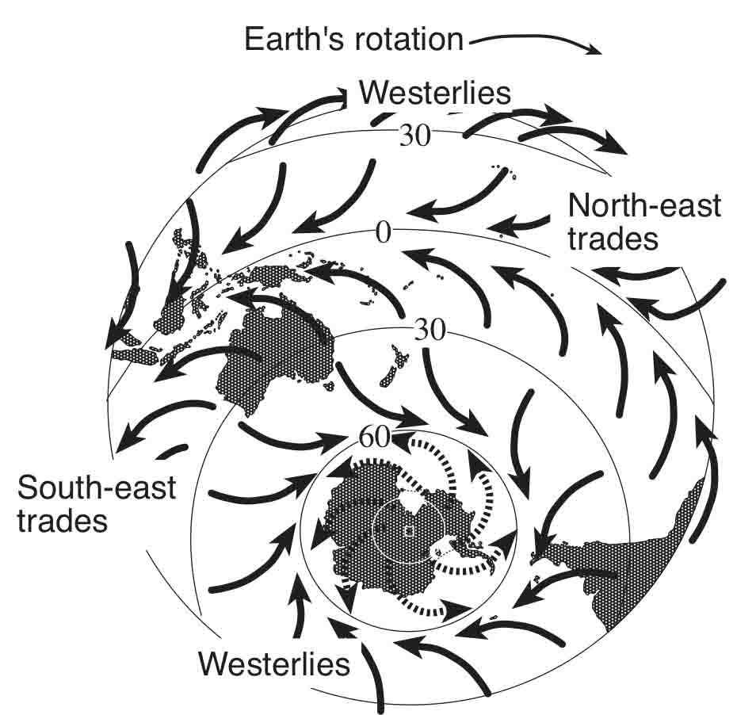
Marine
Education
9. The Way the Wind Blows – Identify the interactions between the atmosphere and the oceans that drive weather patterns
and climate, e.g. temperature, wind speed and direction, rainfall, breezes and barometric pressure.
Name:
Date:
marineeducation.com.au
Weather or Climate?
Weather and climate are not the same thing. Weather is short-term. Climate is long-term.
Weather is what you see outside. Climate is the pattern of many weather events over a long period of time.
As Dr. J. Marshall Shepherd^{[1]} explains, ‘weather is your mood and climate is your personality’.
Suggested Activity: Conduct one or more of the Practical Activities provided by Coral Watch^{[1]}
Q. What is climate? Ans.
Long term average of weather events in one location
^{[1]} Shepherd, J. M. (2019). 3 kinds of bias that shapes your worldview. TedxUGA on YouTube. Accessed 21.04.2019 from: https://www.youtube.com/watch?v=LcNvkhS4UYg
Sea Breeze
Warm air rises
Cold air sinks
Cold air sinks
Warm air rises
same day
30°C
SEA BREEZE
15°C
LAND BREEZE
Land heats up
24°C
Land cools down
24°C
Q. What time of day is a sea breeze usually at its strongest? Ans.
Midday → mid afternoon
Q. Which one has the highest heat capacity….the ocean or the land? Ans.
the ocean
Q. If you are in a boat, far away from land, and your barometer is reading 2008 hPa and falling fast,
what sort of weather is headed your way? Ans.
Bad weather!!!!
Global Atmospheric Circulation Patterns
Activity: Draw and label the following on the diagram below left: Hadley Cell, Ferrel Cell, Polar
Cell, South-east Trade Winds, North-east Trade Winds, Westerlies, Polar Easterlies (incl. arrows)
Remember: wind always blows from a high (H) to a low (L). And, the Coriolis Effect steers wind to the left in the southern hemisphere and to the right in the northern hemisphere.
90°N
Polar Cell
H
60°N
Polar Easterlies
Ferrel Cell
L L L L L L L L L L L L L L L L L L L L L
30°N
Westerlies
H H H H H H H H H H H H H H H H H H H H H H H H H
Hadley Cell
0°
NE Trade Winds
L L L L L L L L L L L L L L L L L L L L L L L L L L L L L L L L
SE Trade Winds
Hadley Cell
30°S
H H H H H H H H H H H H H H H H H H H H H H H H H
Westerlies
Ferrel Cell
60°S
L L L L L L L L L L L L L L L L L L L L L L L
Polar Easterlies
H
Polar Cell
90°S
Figure 1: Prevailing wind directions influenced by Earth’s rotation. https://dumielauxepices.net/drawn-ocean/drawn-ocean-southern
© Marine Education 2024 CC BY-NC-SA
Unit 4 Topic 1 Science Understanding – Future Scenarios

Slide 19
Marine
Education
Identify the interactions between the atmosphere and the oceans that drive weather patterns and climate, e.g. temperature, wind speed and direction, rainfall, breezes and barometric pressure.
Name:
Date:
marineeducation.com.au
© Marine Education 2024 CC BY-NC-SA
NOTES AND EXAM REVISION

Slide 20
Marine
Education
10. Our Changing Climate in a Nutshell – Explain the impact of average temperature increases on the marine environment, including: altering thermal regimes, and, changing physical and chemical parameters of the ocean, e.g. aragonite saturation levels and rising sea levels.
Name:
Date:
marineeducation.com.au
Activity: In the space below, draw a mind map to consolidate your understanding of the impact of increasing CO2 on the physical, chemical and biological parameters of the ocean
Physical
Chemical and Biological
C
CO2 increases at an alarming rate, mainly from burning fossil fuels for energy
CO2 is absorbed by the ocean
Carbonate buffer system overwhelmed by rate of CO2 input
Greenhouse Effect intensifies
Sea surface temperatures (SSTs) increase
pH and aragonite and calcite saturation states (Ω) decline (ocean acidification)
Bleaching occurs
Calcification rates decline
Severe weather events intensify in severity and frequency
Loss of Plankton (Pteropods, Forams and some Coccolithophores)
Sea levels rise (from melting ice and thermal expansion)
Thermohaline circulation slows (?)
Shallowing of CCD and ACD
Loss of habitat (phase shifts, reef erosion exceeds reef accretion)
Loss of Biodiversity (nature’s workforce)
Loss of ecosystem services
© Marine Education 2024 CC BY-NC-SA
Unit 4 Topic 1 Science Understanding – Future Scenarios

Slide 21
Marine
Education
Explain the impact of average temperature increases on the marine environment, including: altering thermal regimes, and, changing physical and chemical parameters of the ocean, e.g. aragonite saturation levels and rising sea levels.
Name:
Date:
marineeducation.com.au
© Marine Education 2024 CC BY-NC-SA
NOTES AND EXAM REVISION

Slide 22
Marine
Education
11. Title – Evaluate efforts (i.e. global agreements, national frameworks, industry participation, community decisions, and individual actions) to reduce the effects of climate change and consider the complexity of these interactions.
Name:
Date:
marineeducation.com.au
Suggested Activity: Conduct one or more of the Practical Activities provided by Coral Watch^{[1]}
Teacher to write
© [Teacher name] year CC BY-NC-SA
Unit 4 Topic 1 Science as a Human Endeavour

Slide 23
Marine
Education
12. Title – Consider how scientific knowledge of the loss of coral reefs can be used to evaluate projected economic (e.g. fisheries, tourism), social (e.g. recreation) and environmental (e.g. food webs,
habitat changes) impacts.
Name:
Date:
marineeducation.com.au
Suggested Activity: Conduct one or more of the Practical Activities provided by Coral Watch^{[1]}
Teacher to write
© [Teacher name] year CC BY-NC-SA
Unit 4 Topic 1 Science as a Human Endeavour

Slide 24
Marine
Education
13. Title – Consider the evidence that enables scientists to predict that when thermoclines and upwellings are disrupted to shut down the ‘global ocean conveyor’ and the effect of this on global ocean productivity.
Name:
Date:
marineeducation.com.au
Suggested Activity: Conduct one or more of the Practical Activities provided by Coral Watch^{[1]}
Teacher to write
© [Teacher name] year CC BY-NC-SA
Unit 4 Topic 1 Science as a Human Endeavour

Slide 25
Marine
Education
Name:
Date:
marineeducation.com.au
14. Title – Evaluate the success of a named protected marine area..
Suggested Activity: Conduct one or more of the Practical Activities provided by Coral Watch^{[1]}
Teacher to write
© [Teacher name] year CC BY-NC-SA
Unit 4 Topic 1 Science Inquiry

