Slide 1
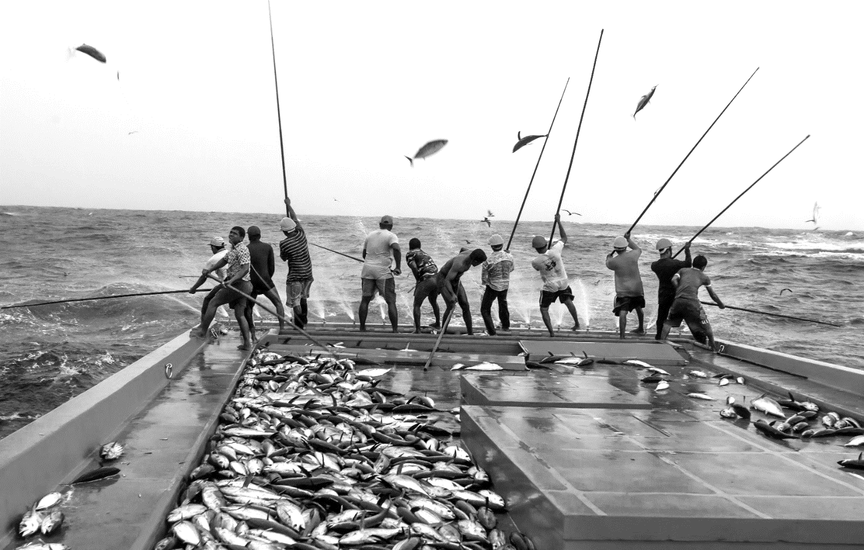
Marine
Education
Year 12 Marine Science
Name:
Date:
marineeducation.com.au
Unit 4 Ocean issues and resource management
Topic 2:
Managing fisheries
Fisheries and population dynamics
Australia’s fisheries management
Aquaculture
Above: Fishermen in the Maldives, pole and line fishing for Skipjack Tuna (Katsuwonus pelamis). This fishing method is regarded as a more sustainable way to catch tuna. Only fish of a certain size are caught, leaving juveniles to grow to spawning age. Small bait fish are thrown over the side of the boat to lure the tuna to the water surface. The fishermen use the acceleration of the fish as they race to get their prey, hook them and fling them onto the ship’s flat deck^{[1]}. Photograph © Paul Hilton. Reprinted with permission^{[2]}.
^{[1]} ABC News Rural. (2017). Pole and Line Fishing for Tuna. ABC News Rural. Accessed 08.06.2019 from: https://www.abc.net.au/news/rural/2017-12-22/pole-and-line-fishing-for-tuna/9279282
^{[2]} Paul Hilton is a conservation photojournalist and wildlife trade consultant. Visit:paulhiltonphotography.com or donate and follow Paul’s work at https://www.patreon.com/paulhilton
© Marine Education 2024 CC BY-NC-SA

Slide 2
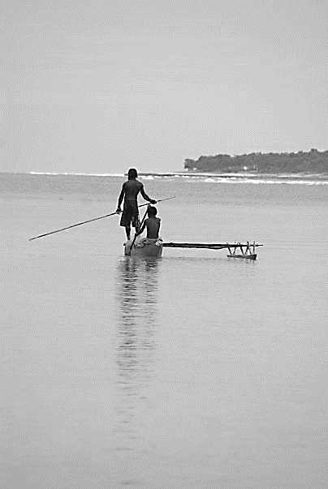
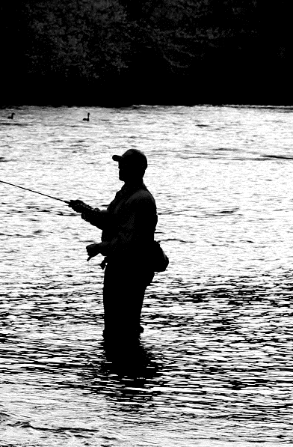
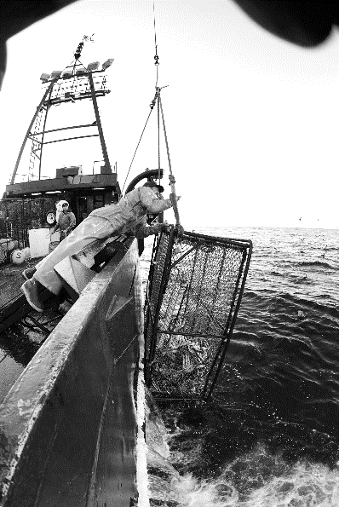
Marine
Education
1. Gone Fish’n – Discriminate between the three main types of fishery (i.e. artisanal, recreational and commercial) and describe the variety of meanings of the term fishery.
Name:
Date:
marineeducation.com.au
For Survival
Artisanal/subsistence fishing
For Fun
Recreational fishing
For Big Profits
Commercial fishing
Low levels of sea life discard
Figure 1: Vanuatu.
Photograph © 2009 Gail Riches
Figure 2: Fly fishing. Photograph: © 2019
West Virginia State Parks. www.stateparks.com/
Figure 3: Crab fishing.
Photograph © SAGA www.fv-saga.com/
Q. What are the three main types of fishery? Ans.
Artisanal/subsistence
Recreational
Commercial
Fishing for Names
A fishery can be named after many things. E.g. it can be named after a target species (e.g. Northern Prawn Fishery). It can be named after a place of fishing (e.g. The Coral Sea Fishery). It can even
be named after a method of fishing (e.g. Offshore Net and Line Fishery). Or any combination of these!
Activity: Below, name at least 10 Fisheries (hint: explore the AFMA website: www.afma.gov.au/).
For example,
Southern and Eastern Scalefish and Shark Fishery
Southern Squid Jig Fishery
Torres Strait Fisheries
Western Deepwater Trawl Fishery
Bass Strait Central Zone Scallop Fishery
Eastern Tuna and Billfish Fishery
The Southern Bluefin Tuna Fishery
Macquarie Island Toothfish Fishery
Norfolk Island Fishery
North West Slope Trawl Fishery
© Marine Education 2024 CC BY-NC-SA
Unit 4 Topic 2 Science Understanding – Fisheries & Population Dynamics

Slide 3
Marine
Education
Discriminate between the three main types of fishery (i.e. artisanal, recreational and commercial) and describe the variety of meanings of the term fishery.
Name:
Date:
marineeducation.com.au
© Marine Education 2024 CC BY-NC-SA
NOTES AND EXAM REVISION

Slide 4


2. QUITE A CATCH:
ESTIMATING GLOBAL FISH STOCKS
Marine
Education
Name:
Date:
marineeducation.com.au
The art of counting fish
Fish live underwater and can swim out of sight making them very difficult to count. But we need to know how many there are, so we know how many we can take. The FAO (Food and Agriculture Organization of the United Nations) uses various sources to estimate global fish stocks and trends as accurately as possible. The results are published every 2 years in the SOFIA report^{[1]}. Below shows you how they do it^{[2]}.
STOCK SIZES
Fishing Vessel
National Authority
Sends stock calculation upon request
FAO
Sends catch data
Collates and publishes data; makes no assessment of its own
Gathers catch data
Scientists
on board
Sends catch data
Sends fishery-dependent data
Science Council
Sends unreliable or incomplete catch data
National Institute
for Scientific Research
Sends adjusted catch data
Calculates the status of stocks
Sends unreliable or incomplete catch data
Research Vessel
Sends fishery-independent data
Evaluates & adjusts data
Developing Countries
Figure 1: Global estimates of fish abundance. Data on the status of fish stocks is provided by fisheries and scientists^{[2]}.
Q. What is the latest estimate of wild fish stocks in millions of tonnes^{[1]}? Ans.
90.9 (2016)
excluding aquaculture
CPUE: Fishing Vessel log book catch data
Fishermen’s log books record how many fish were caught, what gear was used, and how much effort it took for the fishermen to catch those fish (e.g. time spent fishing). That information gives a ‘catch rate’, or CPUE (catch per unit effort) which is then used to estimate the abundance of the unit stock.
For example, if more fish are caught (per same unit of effort) there must be more fish in the sea, right?!
Q. What does CPUE estimate? Ans.
Abundance of the unit stock (population)
Suggested Practical^{[2]}
1. Fill a fish tank with lots of small fish (count them)
2. Use a net and make one sweep across the tank
3. Do not put them back in the same tank
4. Count the number of fish caught (per unit effort)
5. Repeat steps 2-4 using the same unit of effort.
CPUE: 3/net/sweep
CPUE: 2/net/sweep
CPUE: 1/net/sweep
net
Fish tank (side view)
Q. Does CPUE increase or decrease when abundance declines? Ans.
decrease
^{[1]} Fisheries and Aquaculture Department (2018). The State of World Fisheries and Aquaculture (SOFIA). FAO. Accessed 29.04.2019 from: http://www.fao.org/fishery/sofia/en
^{[2]} Adapted with permission from Jan Lehmköster, World Ocean Review (2013). 2 The Future of Fish – The Fisheries of the Future. Maribus gGmbH. Pg. 44/45. Accessed 24.04.2019 from: https://worldoceanreview.com/en/
^{[3]} Adapted from: Fishwell Consulting (2013). Fisheries Stock Assessment Modelling Video 07 - Catch Per Unit Effort. YouTube. Accessed 03.08.2019 from: https://www.youtube.com/channel/UC90sh0piBbxe3iXwlPOZtig
© Marine Education 2024 CC BY-NC-SA
Unit 4 Topic 2 Science Understanding – Fisheries & Population Dynamics

Slide 5
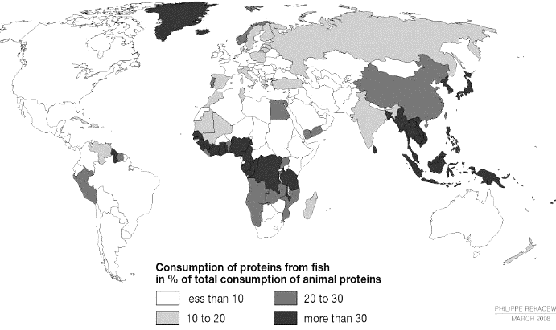
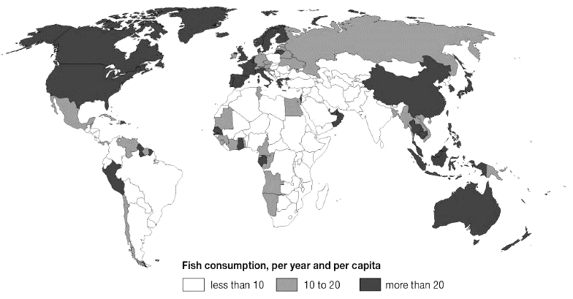
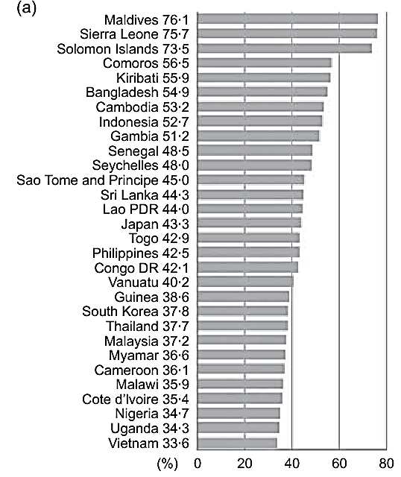
Marine
Education
3. Packets of Protein – Explain the global significance of wild caught fish as a source of protein.
Name:
Date:
marineeducation.com.au
Figure 1: Consumption of proteins from fish in % of total consumption of animal proteins. Image © Cartographer: Philippe Rekacewicz, February 2006. Source: www.grida.no/resources/5620
Figure 2: Fish protein intake in kilograms per year (average 2001-2003). Image © Cartographer: Philippe Rekacewicz, February 2006.
Source: www.grida.no/resources/5637
<10%
Q. In Figure 1, what % of total animal protein consumed in Australia was fish? Ans.
Q. On average, how much fish (kg) did an Australian eat every year in Figure 2? Ans.
>20 kg
Fish % of Animal Protein
While fish provide a significant percentage of animal protein globally, this percentage can be higher in communities by the sea. For example, fish comprise 76.1% of the animal protein intake of people in the island nation of the Maldives (Figure 3)*.
Q. What does fish contain that makes it so good for you? Ans.
Protein, omega-3, Vit. A, I, Fe, Ca, Zn, etc.
Q. What is a health benefit to eating fish? Ans.
Lowers risk of heart disease
Q. What is the daily recommended dietary intake of protein (not just fish) per day? Ans.
0.8 grams of protein per kg. of body weight (E.g. 100kg person = 80g protein)
Figure 3: Fish protein as a percentage of animal protein consumption (%) in 30 countries with the highest proportion of fish in the animal-based part of their diet^{[1][2]}. Calculated from FAO Food Balance Sheets.
* Note: The sources of fish supply in Figure 3 include wild-caught fisheries as well as aquaculture fisheries and land-locked freshwater fisheries.
^{[1]} Adapted from: Allison, E. H. (2011). Aquaculture, Fisheries, Poverty and Food Security. The WorldFish Centre. Penang. Malaysia. Page 19.
^{[2]} Adapted with permission from: Kawarazuka, N. and Bene, C. (2011). The potential role of small fish species in improving macronutrient deficiencies in developing countries: building evidence. Public health Nutrition. 14(11): 1927-1938. DOI: 10.1017/S1368980011000814
© Marine Education 2024 CC BY-NC-SA
Unit 4 Topic 2 Science Understanding – Fisheries & Population Dynamics

Slide 6
Marine
Education
Explain the global significance of wild caught fish as a source of protein
Name:
Date:
marineeducation.com.au
© Marine Education 2024 CC BY-NC-SA
NOTES AND EXAM REVISION

Slide 7
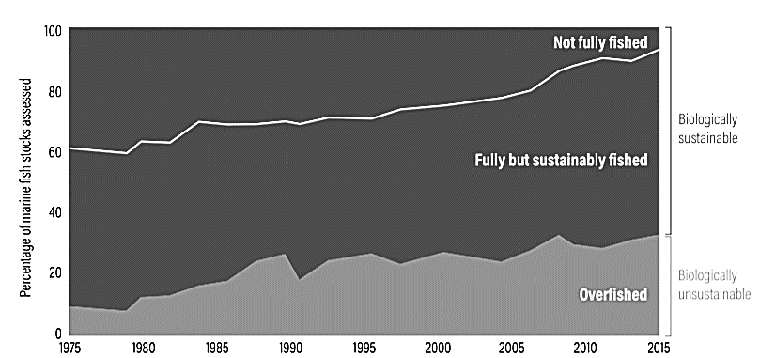
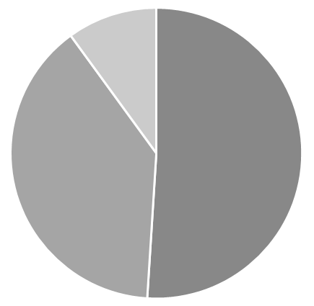
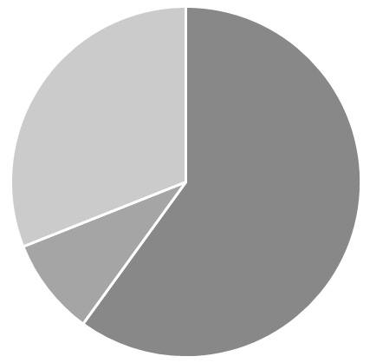
Marine
Education
4. Gone OverFish’n – Describe causes for the decline in world fisheries, including overfishing, destructive fishing practices, industrial fishing, illegal fishing, fishing down the food chain, pollution, climate change, habitat destruction and shifting baselines.
Name:
Date:
marineeducation.com.au
Figure 1: Global trends in the state of world marine fish stocks, 1974-2015. The percentage of overfished stocks (in grey) is increasing^{[1][2]}.
Q. What percentage of global fish stocks were ‘overfished’ in 1975? Ans.
~10%
Q. What percentage of global fish stocks were ‘overfished’ in 2015? Ans.
~30%
Activity: Draw a PIE CHART and LEGEND to illustrate Figure 1 data for 1975 (left) and 2015 (right)
Note: if you want to know how many degrees of the circle equals the percentage of a piece of the pie, simply divide 360 (the number of degrees in a circle) by 100 to get 3.6 (thus 3.6° equals 1% of the pie), and then multiply the percentage of a piece of the pie by 3.6 (e.g. if the percentage is 50%, 50 x 3.6 = 180°).
1975
2015
Legend
Fully but sustainably fished
Not fully-fished
Over-fished
^{[1]} FAO (2018). The State of World Fisheries and Aquaculture 2018 - Meeting the sustainable development goals. Rome. Licence: CC BY-NC-SA 3.0 IGO.
^{[2]} Searchinger, T., Waite, R., Hanson, C. and Ranganathan, J. (2018). World Resources Report: Creating a Sustainable Food Future. A Menu of Solutions to Feed Nearly 10 Billion People by 2050. World Resources Institute. Washington DC. USA. p.9 https://www.wri.org/our-work/project/world-resources-report/world-resources-report-creating-sustainable-food-future
© Marine Education 2024 CC BY-NC-SA
Unit 4 Topic 2 Science Understanding – Fisheries & Population Dynamics

Slide 8
Marine
Education
Describe causes for the decline in world fisheries, including overfishing, destructive fishing practices, industrial fishing, illegal fishing, fishing down the food chain, pollution, climate change, habitat destruction and shifting baselines.
marineeducation.com.au
Name:
Date:
© Marine Education 2024 CC BY-NC-SA
NOTES AND EXAM REVISION

Slide 9
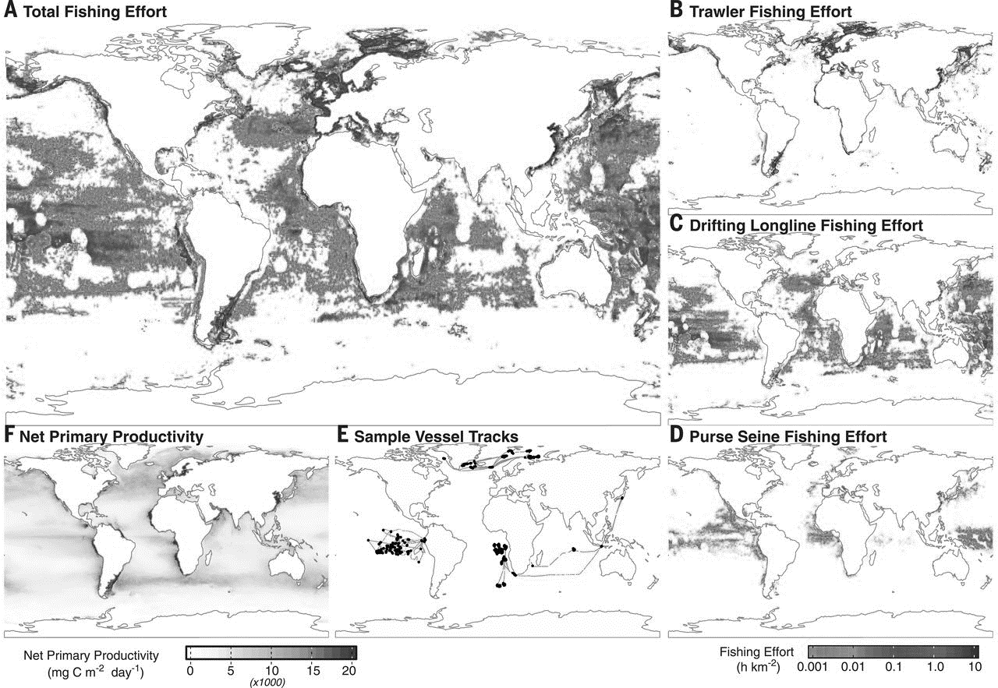
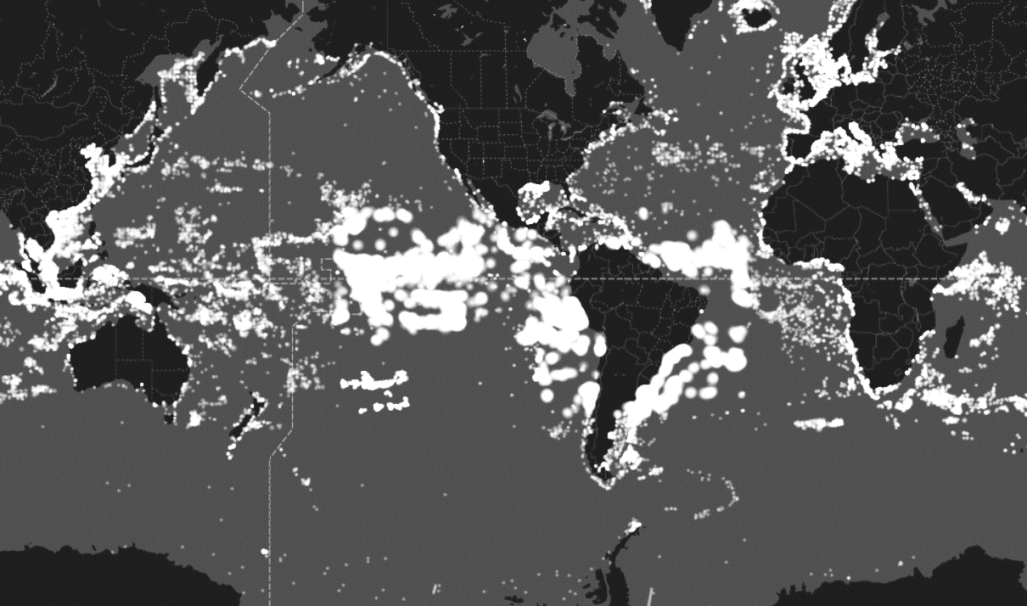
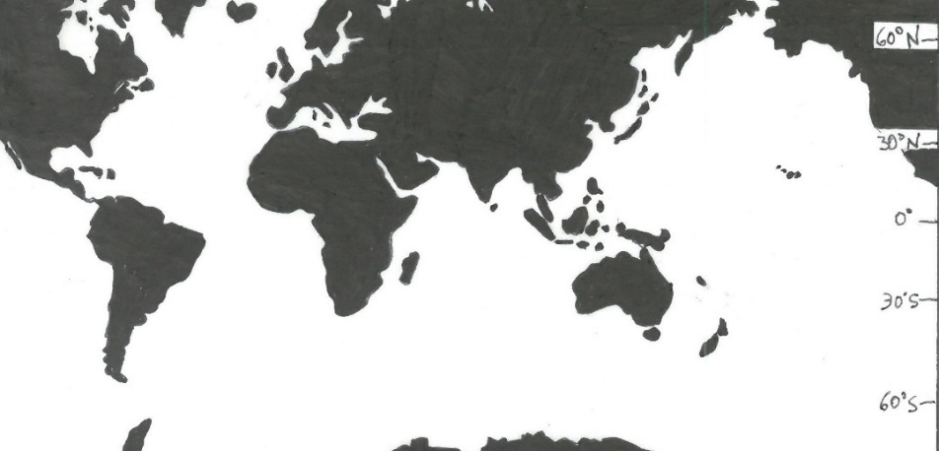
Marine
Education
5. Fertilizing the Ocean – Explain how the distributions of fish populations are determined by temperature, primary
productivity and nutrient dispersal, and how these factors are influenced by currents, upwelling and seasonal factors.
Name:
Date:
marineeducation.com.au
Nutrients = Primary Productivity = FISH!
Figure 1: Global patterns of average annual NPP (expressed as milligrams of carbon uptake per square meter per day)^{[1]}
Figure 2: The location of 9,387,301 vessels tracked by Global Fishing Watch^{[2]} on Thursday 9th May 2019.
Fishing Hotspots
Fishing hotspots are commonly found in areas with high chlorophyll-a concentrations (the green pigment in plants commonly used to indicate phytoplankton abundance) resulting from oceanographic processes such as upwellings, cyclonic gyres and eddies^{[3]}. The sea surface temperature (SST) of hotspots is often cold,
from the surfacing of deep-water masses (from below the pycnocline) that deliver nutrients to the surface^{[3]}.
Activity: Indicate the regions of upwelling that are well-known fishing hotspots, listed 1-11 below
Four major western boundary upwellings: (1) Canary (2) Benguela (3) California and (4) Peru currents. Equatorial upwelling regions: (5) Equatorial Pacific (6) Equatorial Atlantic. Others: (7) Somalia Coast (8) Yucatan Shelf (9) Cabo Frio, Brazil (10) Samalga, Alaska and (11) Costa Rica Dome.
10
3
8
1
11
6
7
4
5
9
2
^{[1]} From Kroodsma, D. A., Mayorga, J., Hochberg, T., Miller, N.A., Boerder, K., Ferretti, F., Wilson, A., Bergman, B., White, T.D., Block, G.A., Woods, P., Sullivan, B., Costello, C. and Worm, B. (2018). Tracking the global footprint of fisheries. Science. Vol.359. Issue 6378. P. 904-908. DOI: 10.1126/science.aao5646. Reprinted with permission from AAAS.
^{[2]} Global Fishing Watch (2016-2019). Global Fishing Watch. Accessed 09.05.2019 from: https://globalfishingwatch.org/map/
^{[3]} Valavanis, V.D, Kapantagakis, A., & Katara, I. and Palialexis, A. (2004). Critical regions: A GIS-based model of marine productivity hotspots. Aquatic Sciences 66(1): 139-148. DOI: 10.1007/s00027-003-0669-2.
© Marine Education 2024 CC BY-NC-SA
Unit 4 Topic 2 Science Understanding – Fisheries & Population Dynamics

Slide 10
Marine
Education
Explain how the distributions of fish populations are determined by temperature, primary productivity and nutrient dispersal, and how these factors are influenced by currents, upwelling and seasonal factors.
Name:
Date:
marineeducation.com.au
© Marine Education 2024 CC BY-NC-SA
NOTES AND EXAM REVISION

Slide 11
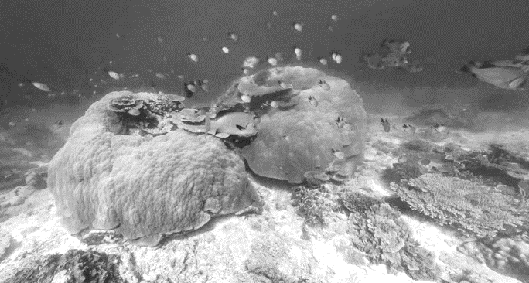
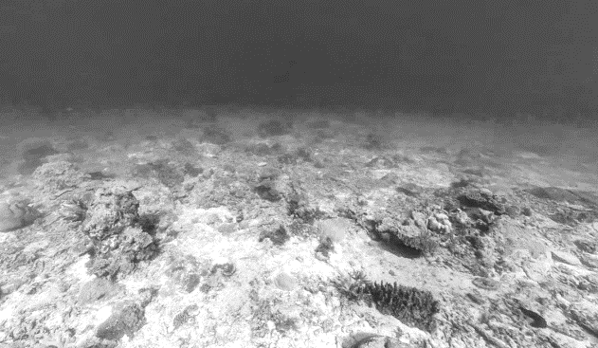
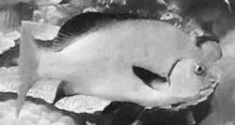
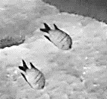
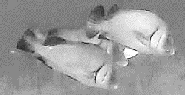
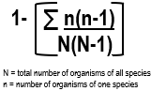
Marine
Education
6. Rugosity Rocks – Analyse rugosity data and link this to fish diversity
Name:
Date:
marineeducation.com.au
T136
Activity: Measure and record the rugosity (C) and fish diversity (SDI) of Sites 1 & 2 below.
Hint: The formula for rugosity is C=a/b. Use a ruler to measure the length of b. Then, use a piece of string to follow the contours of the chain (a) to measure its length.
Site 1
Site 2
b
b
b
a
a
No fish!
Lutjanus rivulatus
Abudefduf sp.
Plectorhinchus gibbosus
Figure 1: Image (of Lady Elliot Island) sourced from the XL Catlin Global Reef Record. © Underwater Earth / XL Catlin Seaview Survey
Figure 2: Image (of Lady Elliot Island) sourced from the XL Catlin Global Reef Record. © Underwater Earth / XL Catlin Seaview Survey
Site 1
RUGOSITY (C):
IDENTIFY | COUNT | STATS
Species Name | n | n(n -1)
Lutjanus rivulatus | 1 | 0
Abudefduf sp. | 30 | 870
Plectorhinchus gibbosus | 10 | 90
Total | N 41 | ∑n(n-1) 960
= | N(N-1)= 1640 | SDI = 0.41
Site 2
RUGOSITY (C):
IDENTIFY | COUNT | STATS
Species Name | n | n(n -1)
Total | N | ∑n(n-1)
SDI = | N(N-1)= | SDI = 0
C=10cm/7cm=1.43
C=7.5cm/5.5cm=1.36
Simpson’s Diversity Index (SDI)
What does it mean?
0: no diversity
1: infinite diversity
Activity: Explain how habitat complexity (rugosity), established by corals, effects fish diversity
Page 65: Healthy, thriving, busy, city-like coral reefs, with high rugosity, provide more organisms with more places to live, and more places to hide than unhealthy, struggling, desert-like coral rubble banks with low rugosity. Reefs that are structurally complex have more surface area for larval settlement, more refuge for prey species, more vertical relief and more microhabitat variability for more species to live in (i.e. fish)!
© Marine Education 2024 CC BY-NC-SA
Unit 4 Topic 2 Science Understanding – Fisheries & Population Dynamics

Slide 12
Marine
Education
Analyse rugosity data and link this to fish diversity
Name:
Date:
marineeducation.com.au
© Marine Education 2024 CC BY-NC-SA
NOTES AND EXAM REVISION

Slide 13
Marine
Education
7. We are what we eat – Determine the impact of bioaccumulation and biomagnification through the food web into
edible seafood, e.g. ciguatera, heavy metals and microplastics
Name:
Date:
marineeducation.com.au
CIGUATERA poisoning
CTX (ciguatoxin) is a toxin produced by dinoflagellates (Genus Gambierdiscus) that live attached to certain corals, seaweeds and seagrasses.
BIOACCUMULATION & BIOMAGNIFICATION
Primary consumers
eat primary producers, and attached CTX
Secondary consumers eat primary consumers, accumulating more CTX
Tertiary consumers eat secondary consumers, accumulating more CTX
Fish containing all their accumulated CTX are caught
for human consumption
Q. What is the source of the toxin CTX? Ans.
Dinoflagellate Gambierdiscus sp.
Q. What could happen to you if you ate an extra-large tropical fish? Ans.
You could get ciguatera poisoning. Apart from the usual gastrointestinal symptoms that indicate food poisoning (vomiting, diarrhea, muscle pain) the nervous system starts doing strange things, such as the mouth, lips and extremities start to feel numb, you feel dizzy, and anything that is cold feels hot and vice versa. It takes months to get better and symptoms return whenever you eat seafood again.
Activity: Identify 2 SOURCES of HEAVY METALS and MICROPLASTICS in the spaces below left.
Industrial waste
(e.g. waste water from a factory or mine)
Extended flooding
HEAVY METAL poisoning
BIOACCUMULATION & BIOMAGNIFICATION
e.g. mercury
Cosmetic industry
Fishing industry
Packaging
Single-use plastics
Plastic Bags
MICROPLASTICS poisoning
BIOACCUMULATION & BIOMAGNIFICATION
© Marine Education 2024 CC BY-NC-SA
Unit 4 Topic 2 Science Understanding – Fisheries & Population Dynamics

Slide 14
Marine
Education
Determine the impact of bioaccumulation and biomagnification through the food web into edible seafood, e.g. ciguatera, heavy metals and microplastics
Name:
Date:
marineeducation.com.au
© Marine Education 2024 CC BY-NC-SA
NOTES AND EXAM REVISION

Slide 15
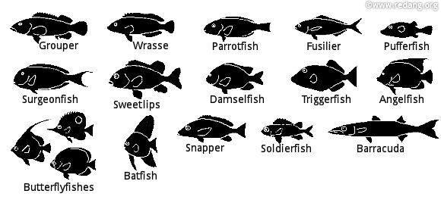
Marine
Education
8. Fishy Futures – Explain how the alteration of thermal regimes caused by climate change is affecting the distribution of fish populations.
Name:
Date:
marineeducation.com.au
Fish need to move
The alteration of thermal regimes caused by climate change is affecting the distribution of fish populations
in a number of ways. On one hand, some warm water species have been able to extend their distribution into waters previously too cold^{[1]}. On the other hand, not all species have been able to do so. For example, when temperatures get too warm and start to exceed the thermal thresholds of ectothermic animals, such as fishes, their metabolisms slow down. That slows down their reproduction and growth rates, movements and behaviors and consequently their fitness and survival^{[1]}. They get sluggish. To make matters worse, there is less oxygen in warmer water. Which means even less energy to swim, forage, evade predators or relocate^{[1]}.
Q. What happens to fish when temperatures exceed their thermal threshold? Ans.
They get sluggish. Their metabolisms slow down. Which slows down their reproduction and growth rates, movements and behaviors and consequently their fitness and survival.
Fish need a home
Even with enough energy to relocate, fish still need to find a place in which to relocate to!
Mass Bleaching = Coral Loss = Habitat Loss = Fish Loss
Q. What happens to coral-dependent fish when large areas of reef suffer consecutive mass bleaching events? Ans.
They lose their habitat.
Mass bleaching = coral loss = habitat loss = fish loss
Figure 1: Common reef fish that rely on coral for habitat and food^{2]}.
Fish also need FOOD
Currents carry nutrients. More nutrients, more phytoplankton, more productivity, more food, more fish.
Currents (surface currents and deep-water currents) are expected to change with climate change^{[3][4]}.
Activity: Complete the sentence below
Less Nutrients = Less Phytoplankton = Less Food = Less
Fish
^{[1]} Scott, M., Heupel, M., Tobin, A. and Pratchett, M. (2017). A large predatory reef fish species moderates feeding and activity patterns in response to seasonal and latitudinal temperature variation. Nature. Scientific Reports Volume 7, Article number: 12966. DOI: 10.1038/s41598-017-13277-4
^{[2]} Redang Island Rendezcous (1998-2003). Marine Life: Identifying Fishes: How to identify fishes. Redang Island. Accessed 27.04.2019 from: https://www.redang.org/fishid.htm
^{[3]} Winder, M. and Sommer, U. (2012). Phytoplankton response to a changing climate. Hydrobiologica 698(1):5 -16. DOI: 10.1007/s10750-012-1149-2
^{[4]} Brierley, A S. and Kingsford, M. J. (2009). Impacts of Climate Change on Marine Organisms and Ecosystems. Current Biology, 19, R602-R614. DOI: 10.1016/j.cub.2009.05.046
© Marine Education 2024 CC BY-NC-SA
Unit 4 Topic 2 Science Understanding – Fisheries & Population Dynamics

Slide 16
Marine
Education
Explain how the alteration of thermal regimes caused by climate change is affecting the distribution of fish populations.
Name:
Date:
marineeducation.com.au
© Marine Education 2024 CC BY-NC-SA
NOTES AND EXAM REVISION

Slide 17
Marine
Education
9. Fish Management Highs and Lows – Compare a case study of a fish population in decline (e.g. Atlantic cod (Gadus morhua), Pacific bluefin tuna (Thunnus orientalis)) with a case study of a fish population that is in recovery (e.g. coral trout (Plectropomus leopardus)) in relation to fisheries management practices.
Name:
Date:
marineeducation.com.au
“Fisheries management is about managing people, not fish stocks”
Dr. Michael King^{[1]}
Q. What is the meaning of this quote? Ans.
Fisheries management is just as much a social science, as it is a biological one. Measures put in place to manage a fishery are about managing people, not fish.
“I believe that the cod fishery, the herring fishery, pilchard fishery, the mackerel fishery, and probably all the great sea fisheries are inexhaustible: that is to say that nothing we do seriously affects the numbers of fish. And any attempt to regulate these fisheries seems consequently, from the nature of the case, to be useless”.
Thomas. H. Huxley, Inaugural Address. Fisheries Exhibition, London (1883)^{[1][2]}
The words of Thomas M. Huxley in 1883 may seem naïve to us today. However back then, fishing boats still used sails, there were no large international fishing fleets, and the world population was less than one third of what it is today^{[1]}.
Activity: Research the decline of Atlantic Cod (Gadus morhua)
Activity: In the space provided below, LIST the factors that contributed to its decline
Overfishing
Improvements to equipment and technology
(sounders, navigation gear, etc.) made it easier to find and catch the fish.
The arrival of large factory trawlers in the late 50’s meant they were able to harvest cod offshore in winter months and fish new areas.
Large catch amounts by factory trawlers caused an overestimation of stock.
Increased bycatch amounts included prey species of the cod – capelin
Activity: Research the recovery of Coral Trout (Plectropomus leopardus)
Note: Coral Trout is a primary target species of the Coral Reef Fin Fish Fishery (CRFFF) on the Great Barrier Reef.
Activity: In the space provided below, LIST the factors that contributed to its recovery^{[3]}
Reduced Fishing
The fishery was restructured in 2004, introducing a (reduced) TACC (total allowable commercial catch) limit of 1288 tonnes managed through Individual Transferable Quotas (ITQ), as well as spawning closures.
Stakeholder involvement in decision-making.
The Great Barrier Reef Marine Park was rezoned in 2004, closing more areas to fishing.
^{[1]} Reproduced with permission from: King, M. (2007). Fisheries Biology, Assessment and Management. Blackwell Publishing. Victoria Australia. Preface Page xii.
^{[2]} Thomas H. Huxley, Inaugural Address for the Fisheries Exhibition, London (June 18,1883), available at https://mathcs.clarku.edu/huxley/SM5/fish.html
^{[3]} Leigh, G.M., Campbell, A.B., Lunow, C.P. and O’Neill, M.F. (2014). Stock assessment of the Queensland east coast common coral trout (Plectropomus leopardus) fishery. The State of Queensland.
Accessed 29.04.2019 from: http://era.daf.qld.gov.au/id/eprint/4547/1/CoralTroutStockAssessment2014.pdf
© Marine Education 2024 CC BY-NC-SA
Unit 4 Topic 2 Science Understanding – Fisheries & Population Dynamics

Slide 18
Marine
Education
Compare a case study of a fish population in decline (e.g. Atlantic cod (Gadus morhua), Pacific bluefin tuna (Thunnus orientalis)) with a case study of a fish population that is in recovery (e.g. coral trout (Plectropomus leopardus)) in relation to fisheries management practices.
Name:
Date:
marineeducation.com.au
© Marine Education 2024 CC BY-NC-SA
NOTES AND EXAM REVISION

Slide 19
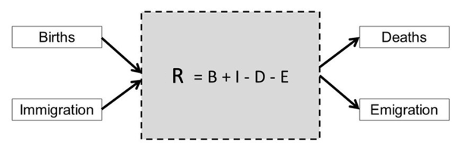
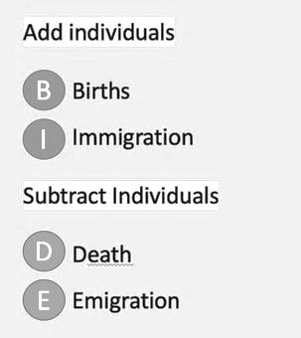
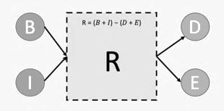
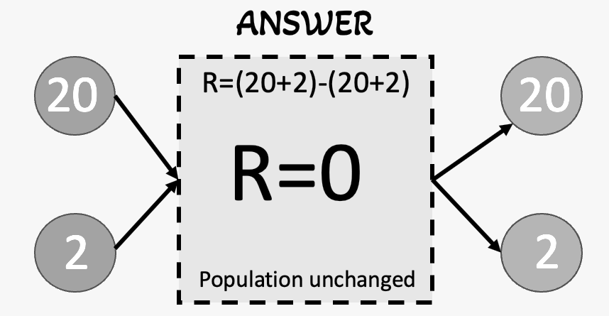
Marine
Education
10. BIDE model Calculate fish population size using the BIDE model of population dynamics
Name:
Date:
marineeducation.com.au
Incoming - outgoing
The size of a population is always changing. It increases and decreases all the time. The rate (and direction) that it changes can be (roughly) measured using the BIDE model, whereby the number of incoming individuals - the births and immigrants - are subtracted from the number of outgoing individuals
– the deaths and emigrants. If more arrive than leave, the population increases in size and R is a positive value. Likewise, if more leave than arrive, the population decreases in size and R is a negative value.
Q. What is R if B=50 and I=10 and D=20 and E=0? Show working below.
Ans.
R=40 R=(50+10)-(20-0)
© Marine Education 2024 CC BY-NC-SA
Unit 4 Topic 2 Science Understanding – Fisheries & Population Dynamics

Slide 20
Marine
Education
Calculate fish population size using the BIDE model of population dynamics
Name:
Date:
marineeducation.com.au
© Marine Education 2024 CC BY-NC-SA
NOTES AND EXAM REVISION

Slide 21


Marine
Education
11. Capture and Recapture – Apply the Lincoln index to a capture-recapture scenario, using where M = number of individuals caught, marked and released initially, n = number of individuals caught on second sampling and
m = number of individuals recaptured that were marked.
Name:
Date:
marineeducation.com.au
Total Allowable Catch (TAC): The total allowable fish catch or fishing effort allowed in a fishery for a particular species or stock over a fishing season^{[1]}.
Quotas: The allocation of a share of the fish catch or fishing effort allowed in a fishery^{[1]}.
Note: In fisheries biology, sometimes the word ‘stock’ is used instead of ‘population’. A population is a group of individuals belonging to the same species in the same place at the same time^{[2]}. A stock is a distinct, reproductively isolated population which exists within a defined spatial range^{[2]}.
Estimating Stock Size using the Lincoln Index (capture-recapture)
One way to estimate stock size in a given area is to catch a bunch of fish, tag them, let them go again
(hope they don’t die), wait for them to swim about and mix in with the other fish, before catching some
more (using the same unit of effort as before) and counting how many are tagged.
Then apply a simple formula (N=Mn/m) to estimate the size of the stock.
The assumption is that the ratio of tagged fish (M) in the stock (N) is equal to the ratio of recaptured tagged fish (m) in the second catch (n). Whereby, M/N=m/n is rearranged to become N=Mn/m.
+
=
Stock size (N) =
18
=
Tagged (M) =
6
+
=
Second catch (n) =
3
=
Recaptures (m) =
1
Figure 1: The large rectangle on the left represents a unit stock of fish with a total of six tagged fish (shaded).
The small box inside the large rectangle represents the second catch of three fish, whereby one has a tag^{[2]}.
Activity: Model the capture-recapture method by following the steps below
Step 1: Take a small unknown quantity of A4 paper (not too much – we want to save trees!).
Step 2: Cut them into small squares of equal size. Put them in a box and close the lid. Shake the box.
Step 3: Ask a student to put their hand in the box and pull out a square one by one. Stop after 20 seconds.
Step 4: Ask the student to mark every piece of paper they pulled out of the box (i.e. the ‘tagging’ process).
Step 5: Count the number of marked pieces of paper. This is the value for ‘M’.
Step 6: Return all marked pieces of paper back into the box. Shake the box.
Step 7: Repeat Step 3 (note: student is not allowed to peak in the box to see which square to pick)
Step 8: Count the number of pieces of paper the student pulled out of the box. This is the value for ‘n’.
Step 9: Count the number of MARKED pieces of paper the student pulled out of the box. This is the value for ‘m’.
Step 10: Apply the formula: Population size (N) = M x n / n to estimate population size (number of squares)
Step 11: Count the total number of squares in the box. How close was your population size estimate?!
M
n
m
N
Q. How reliable was this method for estimating population size (&, later, safe catch limits)? Ans.
answers may vary
Note: assumptions that are made when using this method are that no individuals die between tagging events, and that tagged individuals are no easier nor harder to catch (each has an equal chance of being recaptured).
^{[1]} Australian Fisheries Management Authority (2018). What is Fishing Quota? AFMA. Accessed 29.04.2019 from: https://www.afma.gov.au/what-fishing-quota
^{[2]} Adapted with permission from: King, M., Blanc, M., Desurmont, A., Sharp, M. and Barre, C. (2014). Guide to Teachers’ Resource Sheets on Fisheries for the Cook Islands. Secretariat of the Pacific Community (SPC) Coastal Fisheries Programme. New Caledonia. Accessed 29.07.2019 from: https://coastfish.spc.int/en/publications/technical-manuals/education/421-teachers-resource-kit-on-fisheries
© Marine Education 2024 CC BY-NC-SA
Unit 4 Topic 2 Science Understanding – Fisheries & Population Dynamics

Slide 22
Marine
Education
Apply the Lincoln index to a capture-recapture scenario, using
where M = number of individuals caught, marked and released initially,
n = number of individuals caught on second sampling and
m = number of individuals recaptured that were marked.
Name:
Date:
marineeducation.com.au
© Marine Education 2024 CC BY-NC-SA
NOTES AND EXAM REVISION

Slide 23
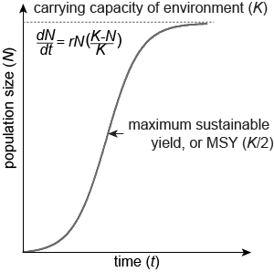
Marine
Education
12. Fishing for Data – Describe how factors (including sampling techniques, fish behaviour, temporal and spatial movement, life history) affect the reliability of fisheries population data and how this informs
fisheries management decision-making on quota and total allowable catch.
Name:
Date:
marineeducation.com.au
Sampling techniques: see below under ‘Data Collection’.
Fish behaviours: schooling, spawning aggregations, diel vertical migrations, learned trap avoidance, feeding behaviours, etc.
Temporal and spatial movement: Movement over time (temporal) and space (spatial).
Life history: r-strategists (short-lived, boom and bust life history) or K-strategists (long-lived, slow-to-grow and slow-to reproduce life history) including information about rates of growth, natural mortality, sexual maturity, reproduction, and fecundity (number of offspring per adult fish).
Single-species stock assessment
It is important to know how many fish there are, to know how many fish to catch. Data is collected from fishers, scientists and market places etc., to measure a population in a stock assessment. Whereby, the maximum number of fish that can be caught (e.g. MSY) is calculated. Then, management controls are enforced to contain fishing (input controls), protect the environment, and restrict the catch (output controls).
Data Collection
Stock Assessment
Management^{[1]}
Data from the Fishers
- Log books (including catch and effort details)
- Vessel tracking systems (usually mandatory)
- Catch disposal records
- e-monitoring (e.g. mandatory cameras on board)
- Telephone Survey data (recreational fishing)
- Portside sampling data (e.g. creel surveys)
Ecosystem
Harvest Sector
Fishers
Communities
Fleets
Fish Stock
Post Harvest Sector
Catch
Processors
Marketers
Data from the Scientists
- On-board sampling (e.g. capture-recapture method, underwater visual census, acoustic method, egg production methods, depletion method, etc.).
- Portside sampling (e.g. otoliths, fish frames)
Controls on Fishing
Controls to protect marine ecosystems
Controls on Catch
Maximum sustainable yield (MSY)
The maximum number of fish that can be caught without long-term depletion (supposedly).
Management Sector
Research, Policy, Planning, Management
Data from the market place
Activity: The table below features factors that determine the reliability of fisheries population data. Complete the table using the Southern Bluefin Tuna (Thannus maccoyii) Fishery as a case study to
(i) provide examples for each factor (hint: see top of page) and (ii) identify the limitations of each example.
Factors | Examples (using the SBT Fishery as a case study) | Limitations (of each example)
Sampling Techniques | Creel survey – asking recreational anglers questions about their fishing trip and catch (note: the name comes from the creel or woven wooden basket that anglers used to hold fish). | Anglers may not have been targeting SBT. Costly and time consuming. Inconsistencies in reporting from a non-scientific survey method. Small sample size reduces the reliability of the predicted population.
 | High-level apex predator. Opportunistic feeder. Migratory species (travels long distances). Gather at spawning grounds. Post spawning, females move south. Swims in both shallow and deep water. | Difficult to count over large areas, across more than one jurisdiction, and when spatial variability (both laterally and vertically) is so high. Risk overestimating population size when they are altogether to spawn. Localised collection of data - problematic.
Life History | Warm blooded. K-strategist. Sexually mature ~11-12 yrs. Live for 40+ yrs. Females release ~50million eggs/spawning event. | Difficult to count how many of the ~50 million eggs survive to become reproducing adults 11-12 years later. Age of the dataset is too small.
Fish Behaviours
and
Temporal and
Spatial movements
^{[1]} Adapted with permission by John Wiley and Sons from: King, M. (2007). Fisheries Biology, Assessment and Management. Blackwell Publishing. Victoria, Australia. Page 297.
© Marine Education 2024 CC BY-NC-SA
Unit 4 Topic 2 Science Understanding – Fisheries & Population Dynamics

Slide 24
Marine
Education
Describe how factors (including sampling techniques, fish behaviour, temporal and spatial movement, life history) affect the reliability of fisheries population data and how this informs fisheries management decision-making on quota and total allowable catch
Name:
Date:
marineeducation.com.au
© Marine Education 2024 CC BY-NC-SA
NOTES AND EXAM REVISION

Slide 25
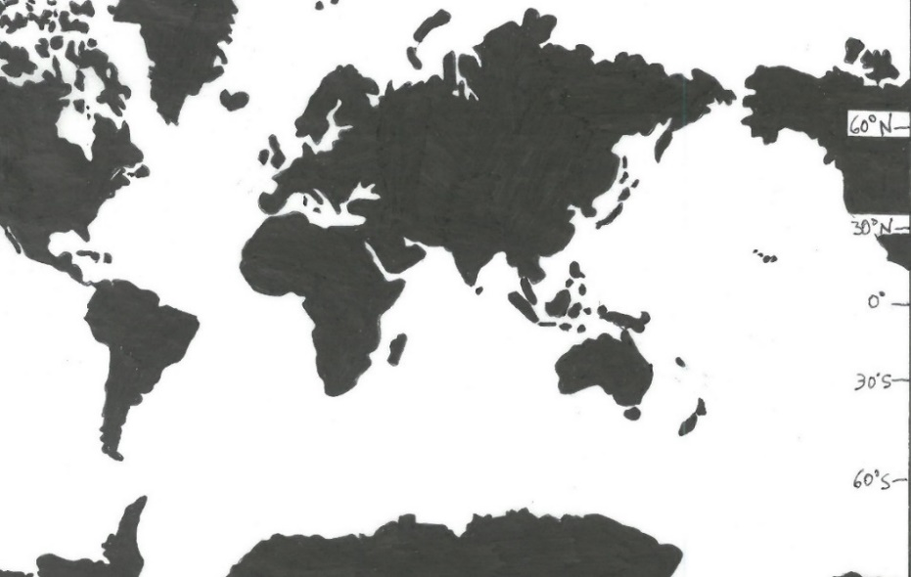
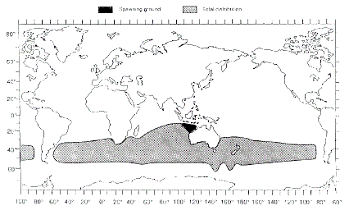
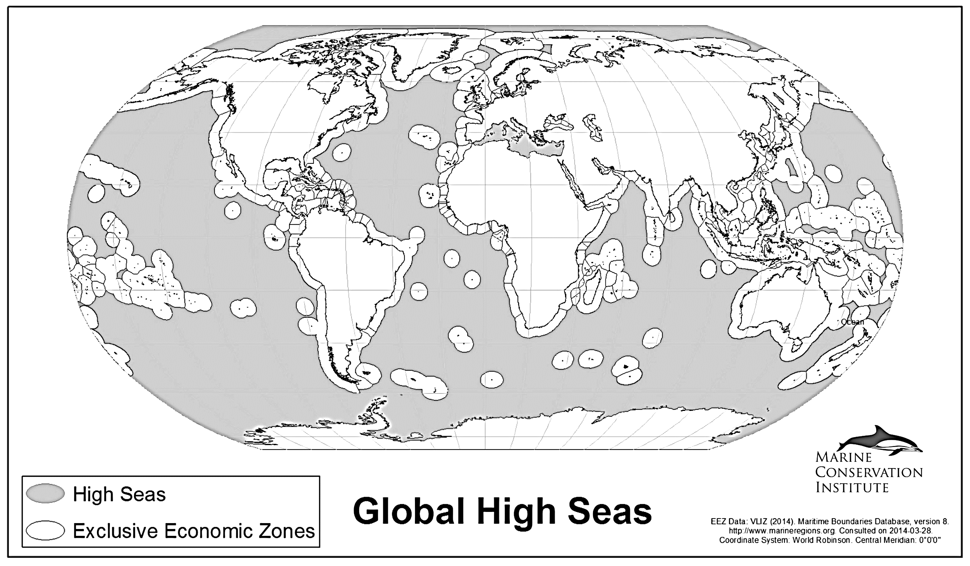
Marine
Education
13. Fish with No Borders – Identify an international agreement that is used to manage migratory pelagic species.
Name:
Date:
marineeducation.com.au
The High Seas
Almost two thirds of the ocean is High Seas^{[1]}. There are no official laws in the high seas (yet). Only agreements between countries. Agreements that are more-or-less hand-shake deals, formalised by the signing of a convention, that usually prompt the creation of a commission or organization (e.g. Regional Fisheries Management Organizations) that set catch limits for species swimming between jurisdictions.
Q. How are the high seas managed? Ans.
Through regional fisheries management organizations (RFMOs) that are born from international agreements (formalised by the signing of a convention).
Activity: Shade the distribution of Thannus maccoyii. Darken any areas in the ‘High Seas’.
Figure 1: Spawning ground (black) and total distribution (grey) of Southern Bluefin Tuna^{[2]}
Figure 2: High Seas (dark) and EEZs (light). MPAtlas.org. [Current 07/2019]^{[3]}.
Q. What is the conservation status of Thannus maccoyii? Ans.
Critically endangered
Convention for the Conservation of Southern Bluefin Tuna (CCSBT)
In the 1980s, Japan, Australia and New Zealand began applying quotas to Southern Bluefin Tuna Fisheries in efforts to conserve stocks for the future. The voluntary arrangements were later formalised with the signing of the Convention for the Conservation of Southern Bluefin Tuna (CCSBT) which came into force in May 1994. Additional countries have since signed the convention^{[4]}.
Activity: What was the purpose of creating a convention for the conservation of T. maccoyii?
To reduce fishing pressure on Southern Bluefin Tuna and conserve stocks for the future.
^{[1]} IUCN (2008). 10 Principles for High Sea Governance. IUCN. Accessed 16.06.2019 from: https://www.iucn.org/downloads/10_principles_for_high_seas_governance___final.pdf
^{[2]} Caton, A. E. (1994). Review of aspects of southern bluefin tuna biology, population, and fisheries. FAO. Accessed 04.05.2019 from: http://www.fao.org/3/t1817e/T1817E15.htm
^{[3]} Adapted from: MPAtlas (2019). High Seas. Atlas of Marine Protection. Marine Conservation Institute. Accessed 04.05.2019 from: http://www.mpatlas.org/data/map-gallery/
^{[4]} CCSBT (2019). Origins of the Convention. Commission for the Conservation of Southern Bluefin Tuna. Accessed 05.05.2019 from: https://www.ccsbt.org/en/content/home
© Marine Education 2024 CC BY-NC-SA
Unit 4 Topic 2 Science Understanding – Fisheries & Population Dynamics

Slide 26
Marine
Education
Identify an international agreement that is used to manage migratory pelagic species.
Name:
Date:
marineeducation.com.au
© Marine Education 2024 CC BY-NC-SA
NOTES AND EXAM REVISION

Slide 27
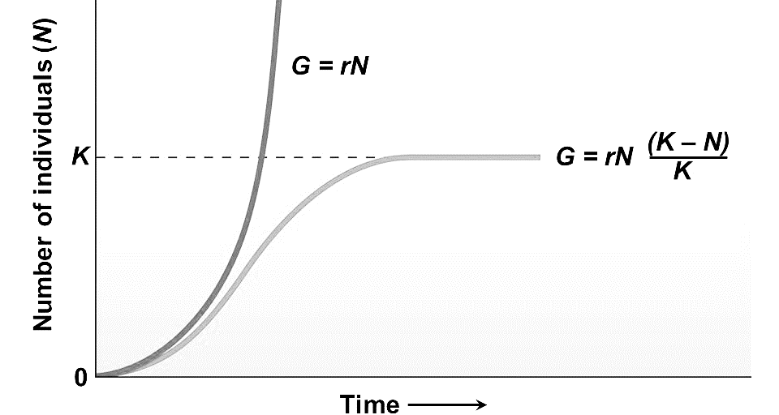
Marine
Education
14. What’s the Catch? – Compare the use of maximum sustainable yields and maximum economic yields.
Name:
Date:
marineeducation.com.au
Maximum Sustainable Yield (MSY)
MSY is the largest average catch (or yield) that can be continuously taken from a stock under existing environmental conditions^{[1]}. MSY was originally set at half the carrying capacity by Milner Schaefer in 1954^{[1]}.
Note: Initially, a population starts out small (e.g. after a major disturbance or when new habitat becomes available). The growth rate of the population (G) is also small because only a small number of individuals can reproduce. But, as time goes by, more offspring are born. And, if the environment can sustain (‘carry’) all the newborns, which later grow into reproducing adults, the growth rate of the population (G) will keep increasing at a rate of G=rN (Figure 1).
The maximum growth rate of a population occurs at half the carrying capacity (see ‘MSY’ in Figures 1 and 2). After that point, the growth rate slows down. It eventually stops when the number of individuals added to the population equals the number of individuals removed from the population. They are removed (i.e. die) because the population has reached the maximum number of individuals that the environment can carry, called its carrying capacity (K). Which is also the max. size a population can grow to. Environmental factors that restrict population growth are called limiting factors, denoted as (K-N)/K.
G = population growth rate
r = intrinsic rate of increase
N = number of individuals
K = carrying capacity
(K-N)/K = limiting factors
Population Growth Rate
MSY (K/2)
Note: At MSY, individuals removed from a population are replaced with newborns in the fastest amount of time.
MSY (K/2)
Number of Individuals (N)
K/2
K
Figure 1: The exponential growth model (G=rN), the logistic growth model (G=rN(K-N)/K, and the location of MSY (K/2). Note: If the environmental conditions deteriorate, the carrying capacity (K) can drop^{[1]}.
Figure 2: At K/2, the population growth rate (the rate that removed stocks are replaced) is at its maximum. Hence, the maximum sustainable yield (MSY) was set at K/2^{[2][3]}.
Q. Why was Maximum Sustainable Yield (MSY) set at half the carrying capacity (K/2)? Ans.
At K/2, the population growth rate is at its maximum.
Maximum Economic Yield (MEY)
MEY is the amount of catch (or yield) that gives a fishery maximum economic return (assuming the cost of fishing is directly proportional to fishing effort).
A fishery (as a whole) makes money (economic rent) when the revenue (the $ made on fish sold at market) is more than the cost of fishing (i.e. fuel, labour, etc.).
A fishery makes its most money at MEY, when revenue and cost are the greatest distance apart (longest dotted line in Figure 3).
Notably, MEY requires less fishing effort than MSY.
Fishery makes the most money
COST
Revenue and Cost
MSY
MEY
Making money
Losing Money
Fishing Effort
REVENUE
© Marine Education 2019
Figure 3: The curve is revenue (price of fish x number of fish). A fishery performs best at MEY (the longest dotted line)^{[3][4].}
Q. Which requires less fishing effort AND costs less?….MEY or MSY? Ans.
MEY
^{[1]} Adapted from: Campbell, N. A., Reece, J.B., Taylor, M.R. and Simon, E.J. (2008). Biology: Concepts and Connections: Fifth Edition. Pearson Education Inc. San Francisco, CA 94111. Page 730.
^{[2]} Tsikliras, A. C. and Froese, R. (2018). Maximum sustainable yield. In book: Reference Module in Earth Systems and Environmental Sciences. DOI:10.1016/B978-0-12-409548-9.10601-3
^{[3]} Adapted from: World Bank (2017). The Sunken Billions Revisited: Progress and Challenges in Global Marine Fisheries. Washington, DC: World Bank. Environment and Sustainable Development series. DOI:10.1596/978-1-4648-0919-4. License: Creative Commons Attribution CC BY 3.0 IGO.
^{[4]} Allison, E. H. (2011). Aquaculture, Fisheries, Poverty and Food Security. The WorldFish Centre. Penang. Malaysia. Page 27.
© Marine Education 2024 CC BY-NC-SA
Unit 4 Topic 2 Science Understanding – Fisheries & Population Dynamics

Slide 28
Marine
Education
Compare the use of maximum sustainable yields and maximum economic yields.
Name:
Date:
marineeducation.com.au
© Marine Education 2024 CC BY-NC-SA
NOTES AND EXAM REVISION

Slide 29
Marine
Education
15. The Bigger Picture – Contrast ecosystem-based fisheries management and traditional single species maximum
sustainable yield
Name:
Date:
marineeducation.com.au
What to focus on?
Traditional single-species MSY focuses only on the target species (magnifying glass). Ecosystem-based fisheries management (EBFM) focuses on the ecosystem that supports the fishery.
Marine Protected Areas
bycatch reduction
Ecosystem-based Fisheries Management (EBFM)
Diversity
Nutrients
°C
Competition
“As a model, maximum sustainable yield (MSY) has been one of the most influential concepts to inform fish stock management.
It has been criticized as a fisheries management tool as it ignores the size and age of the animal being harvested, its reproductive status and the effects of fishing on the ecosystem more broadly” ^{[1]}.
pH
MSY
O2
Single-species MSY
Prey
“The aim (of EBFM) is to sustain healthy marine ecosystems and the fisheries they support by addressing some of the unintended consequences of fishing, such as habitat destruction, incidental mortality of non-target species (i.e. bycatch) and changes in the structure and function of ecosystems. An ecosystem approach to fisheries requires that fisheries should be managed to limit their impact on the ecosystem to the extent possible” ^{[2]}.
Predators
Clarity
Q. What is the difference between traditional single-species MSY and EBFM? Ans.
Traditional single-species MSY focuses only on the target species.
EBFM focuses on the ecosystem that supports the fishery.
Q. What do MSY models in traditional single-species fisheries management ignore? Ans.(hint: see bold)
The size and age of the animal being harvested, its reproductive status and the effects of fishing on the ecosystem more broadly^{[1]}.
Q. What are the unintended consequences of fishing that MSY models fail to address? Ans.
Habitat destruction and bycatch. As well as any serious deterioration in trophic levels and ecosystem structure by removing top predators with unpredicted consequences at bottom trophic levels^{[2]}.
EBFM tools in action
EBFM tools are often context-specific, matching local goals for management^{[3]}.
Two common EBFM tools include Marine Protected Areas and bycatch reduction.
Activity: Name 2 EBFM tools:
Marine Protected Areas and bycatch reduction
^{[1]} QCAA (2018). Marine Science 2019 v1.2: General Senior Syllubus. QCAA. Accessed 13.04.2019 from: https://www.qcaa.qld.edu.au/senior/senior-subjects/sciences/marine-science/syllabus
^{[2]} Zhou, S., Smith, A.D.M., Punt, A., Richardson, A.J., Gibbs, M., Fulton, E.A., Pascoe, S., Bulman, C., Bayliss, P. and Sainsbury, K. (2010). Ecosystem-based fisheries management requires a change to the selective fishing philosophy. PNAS 107(21):9485-9 DOI: 10.1073/pnas.0912771107
^{[3]} Trochta, J.T., Pons, M., Rudd, M.B., Krigbaum, M., Tanz, A. and Hilborn, R. (2018). Ecosystem-based fisheries management: Perception on definitions, implementations, and aspirations. PLoS ONE 13(1):e0190468. DOI: 10.1371/journal.pone.0190467
© Marine Education 2024 CC BY-NC-SA
Unit 4 Topic 2 Science Understanding – Fisheries & Population Dynamics

Slide 30
Marine
Education
Contrast ecosystem-based fisheries management and traditional single species maximum sustainable yield
Name:
Date:
marineeducation.com.au
© Marine Education 2024 CC BY-NC-SA
NOTES AND EXAM REVISION

Slide 31
Marine
Education
16. Title - Explain the benefits of marine protected areas to fisheries, e.g. spill-over effect, fisheries replenishment, bycatch reduction, insurance.
Name:
Date:
marineeducation.com.au
Teacher to write
© Marine Education 2024 CC BY-NC-SA
Unit 4 Topic 2 Science Understanding – Fisheries & Population Dynamics

Slide 32
Marine
Education
Explain the benefits of marine protected areas to fisheries, e.g. spill-over effect, fisheries replenishment, bycatch reduction, insurance.
Name:
Date:
marineeducation.com.au
© Marine Education 2024 CC BY-NC-SA
NOTES AND EXAM REVISION

Slide 33
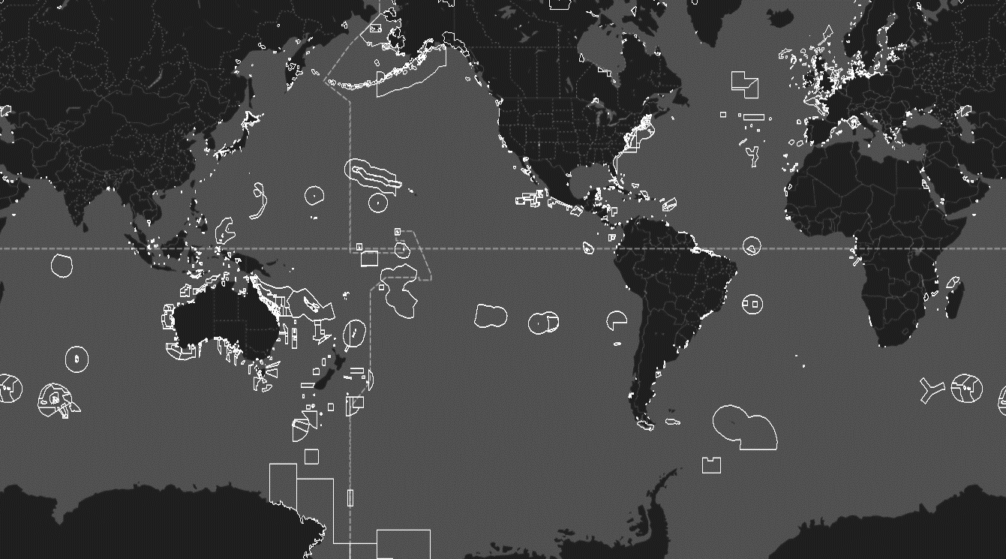
Marine
Education
17. MPAs – Justify the use of estuarine and open-water marine protected areas for fishery sustainability.
Name:
Date:
marineeducation.com.au
These are all the marine protected areas (MPAs) around the world in May, 2019^{[1]}.
This is a picture of 14,830 MPAs, covering 7.59% of the ocean, protecting a total area of 27,495,595km². This is a ten-fold increase from the year 2000 when MPAs only covered ~2,000,000km². National waters comprise 39% (protects 17.7%). The high seas comprise 61% (but only protect 1.18% of the high seas)^{[2]}.
Q. How many MPAs exist today? ^{[2]} Ans.
“Spill-over” effects
MPA formula for more fish!
Protect specific life stage (e.g. nursery ground, spawning season)
Protect critical functions (e.g. feeding grounds and spawning grounds)
Protect dispersion centers for the supply of larvae to a fishery
Protect critical environmental requirements for fished species
Protect ecosystem services (provisional, cultural, supporting, regulating)
MPA
Q. How are estuarine and open water MPAs of value to fisheries sustainability? Ans.
Any of the above
^{[1]} Global Fishing Watch (2016-2019). Global Fishing Watch. Accessed 09.05.2019 from: https://globalfishingwatch.org/map/
^{[2]} Protected Planet (2014-2019). Explore the World’s Marine Protected Areas. UNEP-WCMC. Accessed 09.05.2019 from: https://www.protectedplanet.net/marine
© Marine Education 2024 CC BY-NC-SA
Unit 4 Topic 2 Science Understanding – Fisheries & Population Dynamics

Slide 34
Marine
Education
Justify the use of estuarine and open-water marine protected areas for fishery sustainability.
Name:
Date:
marineeducation.com.au
© Marine Education 2024 CC BY-NC-SA
NOTES AND EXAM REVISION

Slide 35
Marine
Education
18. Australian Fishing Zone – Identify the Australian Fishing Zone (AFZ)
Name:
Date:
marineeducation.com.au
The Australian Fishing Zone is defined as follows in the Fisheries Management Act 1991^{[1]}
(a) the waters adjacent to Australia within the outer limits of the
exclusive economic zone adjacent to the coast of Australia; and
(b) the waters adjacent to each external territory within the outer limits of the exclusive economic zone adjacent to the coast of the external Territory;
but does not include:
(c) coastal waters of, or waters within the limits of, a State or internal Territory; or
(d) waters that are excepted waters (specified by Proclamation under section 11)
Territorial Sea
Exclusive Economic Zone (EEZ)
3nm^{[2]}
12nm
200nm
Coastal Waters
Australian Fishing Zone (AFZ)
The
High Seas
Sea Floor
Not to scale
Q. How many nautical miles offshore does the AFZ (usually) start and finish? Ans.
The AFC (usually) starts at 3nm and finishes at 200nm.
The Cannon Shot Rule to UNCLOS
In the seventeenth century, nations began to defend their coastlines with the use of cannons. A cannon shot could reach 3 nautical miles (nm). Hence, the territorial sea of a country (where a country has full sovereignty) was declared at 3nm (dubbed the ‘cannon shot rule’). But, by the 1900s, tensions arose when countries started extending their jurisdictions out to 4, 6, 10 and 12nm. It was not until 1982 that countries finally agreed that their territorial seas would stop at 12nm, but each could have exclusive economic rights over a 200nm zone along its shore (EEZ). These decisions were part of a monumental piece of international legislation called the United Nations Convention on the Law of the Sea^{[3]}.
Q. What does UNCLOS stand for? Ans.
The United Nations Convention on the Law of the Sea
Q. True or False? ‘Illegal fishing’ is when foreign vessels fish for stocks within the
AFZ without authorisation from the relevant Australian authorities (e.g. AFMA). Ans.
True
^{{1}} Federal Register of Legislation (2017). Fisheries Management Act No. 162 of 1991 as amended, taking into account amendments up to Fisheries Legislation Amendment (Representation) Act 2017. Australian Government. Accessed 18.05.2019 from: https://www.legislation.gov.au/Details/C2017C00363
^{[2]} Note: in some places, coastal waters stretch out further than 3 nautical miles, but never more than 12 nautical miles.
^{[3]} Oceans and the Law of the Sea (2018). The United Nations Convention on the Law of the Sea (A historical perspective). United Nations. Accessed: 18.05.2019 from: https://www.un.org/Depts/los/index.htm
© Marine Education 2024 CC BY-NC-SA
Unit 4 Topic 2 Science Understanding – Australia’s Fisheries Management

Slide 36
Marine
Education
Identify the Australian Fishing Zone (AFZ)
Name:
Date:
marineeducation.com.au
© Marine Education 2024 CC BY-NC-SA
NOTES AND EXAM REVISION

Slide 37
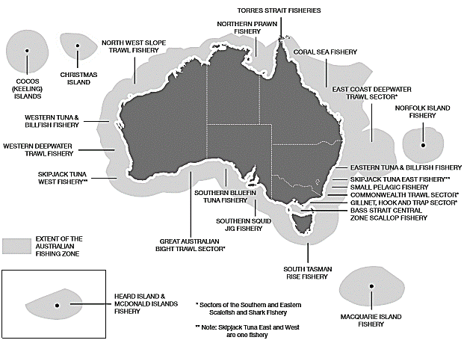
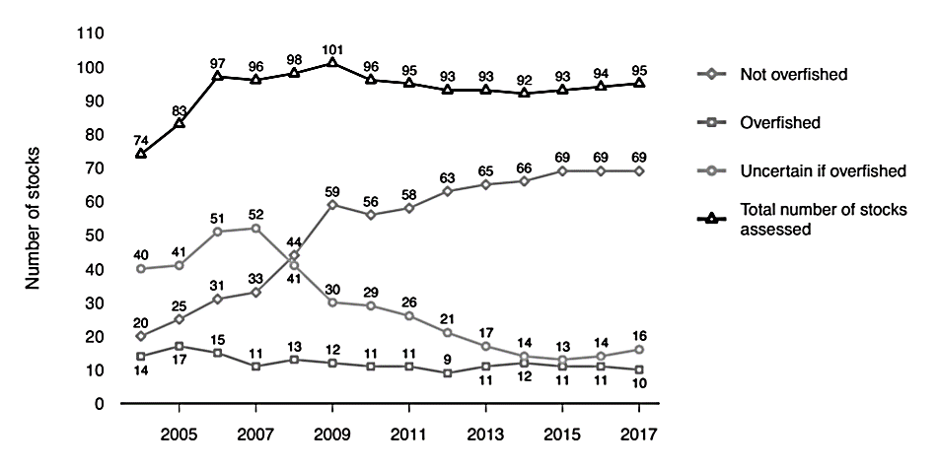
Marine
Education
19. Aussie Aussie Aussie – Explain that the status of Australian fisheries is due to science-based management, the rule of law and good governance.
Name:
Date:
marineeducation.com.au
Figure 1: Major fisheries in the AFZ managed by the Australian Fisheries Management Authority (AFMA)^{[1]}.
Figure 2: The biomass status of 95 fish stocks across 22 fisheries managed solely or jointly by the Australian government from 2004 to 2017^{[2]}
Q. What percentage of fish stocks in Figure 2 were not overfished in 2017? Ans.
73% (69/95)
Activity: Download the following app to your phone: SAFS Sustainable Fish Stocks
A product of the FRDC: the status of Australian Fish Stocks (& a much larger suite of assessments from a range of Australian fisheries)
Scroll through the A-Z list.
Red is overfished and depleted. Yellow is depleting. Orange is recovering. Green is sustainable. Grey is undefined. White is negligible.
Q. What is your assessment of the status of Australian Fisheries? Ans.
Answers may vary
Activity: Infer that the status of Australian fisheries is due to science-based management, the rule of law and good governance
Suggested Activity: Compare Australia to another country’s sustainability reporting
(for example, https://www.fisheries.noaa.gov/national/2018-report-congress-status-us-fisheries)
Suggested Activity: Compare Top-down Governance to Bottom-up Governance
(recall from Year 11 workbook, Unit 2, Topic 2).
Suggested Activity: Discuss the importance of (and access to) funding towards compliance
Q. Are people more likely to comply to the rules, when they know the rule of law is informed by science?
Q. Does every country have enough money to fund science-based management?
Q. Does top-down governance work in countries with little money?
Q. In wealthy countries, are attempts to maintain scientifically robust information to inform the public easily overridden by emotive information? (refer to worldviews: Year 11 workbook Unit 2, Topic 2)
Q. Can a fishery still be sustainable without scientific information (i.e. without a stock assessment)?
Suggested Activity: Comment on how many fisheries versus how many stocks are assessed
Activity: Observe boat activity on the AFZ border at www.globalfishingwatch.org/map/
^{[1]} Graphic kindly provided by Natalie Jorna of the Australian Fisheries Management Authority, 23rd July 2019.
^{[2]} Adapted from: Patterson, H, Larcombe, J, Nicol, S and Curtotti, R 2018, Fishery status reports 2018, Australian Bureau of Agricultural and Resource Economics and Sciences, Canberra. Page 6. Accessed 24.04.2019 from: http://www.agriculture.gov.au/SiteCollectionDocuments/abares/publications/fsr2018.pdf CC BY 4.0.
© Marine Education 2024 CC BY-NC-SA
Unit 4 Topic 2 Science Understanding – Australia’s Fisheries Management

Slide 38
Marine
Education
Explain that the status of Australian fisheries is due to science-based management, the rule of law and good governance.
Name:
Date:
marineeducation.com.au
© Marine Education 2024 CC BY-NC-SA
NOTES AND EXAM REVISION

Slide 39
Marine
Education
20. Exports and Imports – Identify an example of a major Australian edible seafood export product and an import
product.
Name:
Date:
marineeducation.com.au
Activity: Identify an example of a major Australian edible seafood EXPORT product
Prawns!
Fish caught in the Eastern Tuna and Billfish Fishery (and adjacent high seas) that are processed and packed for export markets (i.e. Japan, USA and the EU by air freight, and can be delivered to Asia within 1 day^{[1]}) include:
Yellowfin Tuna
Big Eye Tuna
Albacore Tuna
Broadbill Swordfish
Mahi-Mahi
Striped Marlin
Spanner Crabs (Note: Queensland has the largest spanner crab fishery in the world, with Mooloolaba as the largest spanner crab port. Most of them are exported live and frozen to the Hong Kong and Taiwan markets)^{[1]}.
Southern Bluefin Tuna (Southern Bluefin Tuna Fishery) are caught in the Southern Ocean and then fattened up in Port Lincoln and sold to Japan^{[2]}.
Our Lobsters and Abalone are loved in China^{[3]}
Activity: Identify an example of a major Australian edible seafood IMPORT product
Australia’s seafood imports consist largely of lower value products such as frozen fillets (61%), frozen prawns (18%) and canned fish^{[2]}.
For example,
Frozen and thawed basa (catfish) come from farms in Vietnam^{[2]}
Canned skipjack tuna come from Thailand (no significant canning of tuna has taken place in Australia since May 2010, when the tuna cannery in Port Lincoln closed)^{[2]}
White-fleshed fish species such as snapper and blue grenadier (hoki) come from New Zealand^{[2]}
Barramundi (an iconic Australian fish) come from Vietnam^{[3]}
Bright yellow-dyed smoked cod come from South Africa^{[3]}
Frozen prawns, squid and octopus come from China, Taiwan, Thailand, Malaysia and Vietnam^{[2][3]}
^{[1]} Gary Heilmann. Managing Director De Brett Seafood Pty Ltd. Mooloolaba, Queensland. Personal Communication.
^{[2]} Department of Agriculture (2015). Australia’s Seafood Trade. Commonwealth of Australia. Accessed 20.05.2019 from: http://www.agriculture.gov.au/SiteCollectionDocuments/fisheries/aus-seafood-trade.pdf
^{[3]} Australian Marine Conservation Society (2019). Australia’s Sustainable Seafood Guide: Australian Seafood Overview. AMCS. Accessed 20.05.2019 from: https://www.sustainableseafood.org.au/pages/.html
© Marine Education 2024 CC BY-NC-SA
Unit 4 Topic 2 Science Understanding – Australia’s Fisheries Management

Slide 40
Marine
Education
Identify an example of a major Australian edible seafood export product and an import product.
Name:
Date:
marineeducation.com.au
© Marine Education 2024 CC BY-NC-SA
NOTES AND EXAM REVISION

Slide 41
Marine
Education
21. Fish flying in and out – Discuss the factors that lead to a higher proportion of the seafood consumed in Australia being
imported.
Name:
Date:
marineeducation.com.au
TOP 5 seafoods Aussies love to eat^{[1]}
Australians eat
on average
3.1 meals a week
with seafood in it ^{[1]}
1st
PRAWNS
Imported farmed prawns come from Thailand, Vietnam and China^{[2]}
2nd
Canned Tuna
No significant canning of tuna has taken place in Australia since May 2010, when the tuna cannery closed in Port Lincoln, South Australia^{[2]}
3rd
Crumbed and Battered Fish
>60%
of our seafood is IMPORTED
Imported white-fleshed fish species such as snapper and blue grenadier (hoki) come from New Zealand^{[2]}
[1]
4th
Squid (calamari)
Imported squid come from China, Taiwan, Thailand and Malaysia^{[2]}
5th
Fresh Salmon
Imported farmed salmon come from New Zealand^{[3]}
Exports are dominated by high unit value products such as rock lobster, tuna and abalone^{[2]}.
Imports are dominated by low unit value products such as frozen and canned fish and frozen prawns^{[2]}.
Australia’s apparent consumption of seafood increased, on average, at an annual rate of 1.1 % between 2005-6 and 2015-16. Over the same period, domestic seafood supply remained steady, whilst imports increased at an average rate of 1.7 % per year^{[2]}.
Australian waters are nutrient poor with low levels of primary production (compared to other countries).
…when each yellowfin tuna can weigh 70kg, and when the finest yellowfin can command
3000 yen a kilo (~$32/kilo) at the Japanese fish markets, a good day can be lucrative.
“One tonne a day keeps the bank away,” Pavo Walker says laughing^{[4]}
Q. What are the factors that lead to a higher proportion of the seafood consumed in Australia being imported? Ans.
Answers may vary.
E.g. Social Factors, Economic Factors ($), Environmental Factors
^{[1]} Mobsby, D. and Koduah, A. (2017). Australian fisheries and aquaculture statistics 2016. Fisheries Research and Development Corporation project 2017-095. ABARES, Canberra, December. CC BY 4.0.
Accessed 20.05.2019 from: http://www.frdc.com.au/Services/Australian-Fisheries-Statistics
^{[2]} Department of Agriculture (2015). Australia’s Seafood Trade. Commonwealth of Australia. Accessed 20.05.2019 from: http://www.agriculture.gov.au/SiteCollectionDocuments/fisheries/aus-seafood-trade.pdf
^{[3]} Australian Marine Conservation Society (2019). Australia’s Sustainable Seafood Guide: Seafood Search. AMCS. Accessed 20.05.2019 from: https://www.sustainableseafood.org.au/fish.php
^{[4]} The Australian – by Sarah Elks (2015). Walker Seafoods Australia earns Marine Stewardship Council certification. Walker Seafoods Australia. Accessed 25.05.2019 from: https://www.walkerseafoods.com.au/
© Marine Education 2024 CC BY-NC-SA
Unit 4 Topic 2 Science Understanding – Australia’s Fisheries Management

Slide 42
Marine
Education
Discuss the factors that lead to a higher proportion of the seafood consumed in Australia being imported.
Name:
Date:
marineeducation.com.au
© Marine Education 2024 CC BY-NC-SA
NOTES AND EXAM REVISION

Slide 43
Marine
Education
22. Ecological Economics – Identify the economic value of Australian Fisheries.
Name:
Date:
marineeducation.com.au
Revenue - Cost
The value of Australia’s commercial fisheries and aquaculture industry reached 3.18 billion in 2017-18^{[1]}.
The direct use value is usually calculated as the revenue (yield x fish price) minus the costs (the cost of fuel, labour, repairs, bait, capital, maintenance, administration, opportunity costs, etc.)^{[2]}.
Q. How is the direct use value of a commercial fishery usually calculated? Ans. (hint: see bold)
Revenue (yield x fish price) – cost (e.g. fuel, labour, repairs, bait, capital, etc.)
‘Fishing (in anything other than a subsistence-based economy) is an economic activity.
The species that fisheries target, the level of exploitation, and the gear that they use
are all influenced by the benefits they receive (i.e. the revenue) and the costs they incur’…
…‘Fisheries management change the set of incentives facing fishers, and in doing so
change their behaviour’
Dr. Sean Pascoe. Marine Resource Economist^{[3]}
(a)
Point of break-even
COST
Revenue and Cost
REVENUE
COST
Revenue and Cost
REVENUE
(b)(c)
COST
Fishing Effort
X
Fishing Effort
X
X
© Marine Education 2019
© Marine Education 2019
Population size
Population size
Figure 2: Population size (X) at the point of break-even when revenue EQUALS cost (assuming costs are directly proportional to fishing effort)^{[4].}
Figure 3: (a) Management impose costs to reduce fishing effort.
(b) Management subsidise costs to avoid bankruptcy.
(c) New technology reduce costs (increases fishing effort that can lead to stock collapse, such as the Atlantic northwest cod fishery)^{[5].}
Q. Does fishing effort go up or down when costs are reduced in open access fisheries? Ans.
UP
COSTS that do not have a clear dollar value, such as the cost of habitat damage, biodiversity loss and bycatch, can easily be overlooked. As a result, the cost of fishing can be underestimated.
Q. Does fishing effort go up or down when the cost of fishing is underestimated? Ans.
UP
^{[1]} Steven, AH, Mobsby, D and Curtotti, R. (2020). Australian fisheries and aquaculture statistics 2018, Fisheries Research and Development Corporation project 2019-093, ABARES, Canberra, April. CC BY 4.0. https://doi.org/10.25814/5de0959d55bab.
^{[2]} Adapted with permission from: King, M., Blanc, M., Desurmont, A., Sharp, M. and Barre, C. (2014). Guide to Teachers’ Resource Sheets on Fisheries for the Cook Islands. Secretariat of the Pacific Community (SPC) Coastal Fisheries Programme. New Caledonia. Accessed 29.07.2019 from: https://coastfish.spc.int/en/publications/technical-manuals/education/421-teachers-resource-kit-on-fisheries
^{[3[} Pasco, S. (2006). Economics, fisheries, and the marine environment. ICES Journal of Marine Science. Volume 63, Issue 1, Pages 1-3. DOI: 10.1016/j.icesjms.2005.11.001
^{[4]} Adapted with permission by John Wiley and Sons from: King, M. (2007). Fisheries Biology, Assessment and Management. Blackwell Publishing. Victoria, Australia. Page 276.
^{[5]} Adapted from: Berkes, F., Mahon, R., McConney, P., Pollnac, R. and Pomery, R. (2001). Managing Small-scale Fisheries. International Development Research Centre. Canada. ISBN 0-88936-943-7. Accessed 07.08.2019 from: https://www.idrc.ca/sites/default/files/openebooks/310-3/index.html
© Marine Education 2024 CC BY-NC-SA
Unit 4 Topic 2 Science Understanding – Australia’s Fisheries Management

Slide 44
Marine
Education
Identify the economic value of Australian Fisheries.
Name:
Date:
marineeducation.com.au
© Marine Education 2024 CC BY-NC-SA
NOTES AND EXAM REVISION

Slide 45
Marine
Education
23. Sharing Pieces of the Fish Pie – Explain monitoring and control of total allowable catch and fixed quotas
Name:
Date:
marineeducation.com.au
Sharing the Total Allowable Catch
The Total Allowable Catch (TAC) is commonly divided into quota units to stop people ‘racing’ to catch fish. Instead of all the fishers fighting over who gets what, management decides! E.g. if a fishery has a TAC of 4 fish, management can decide to give all 4 fish to one fisher, or, split it between 4 fishers* (Figure 1).
$100,000
$25,000
$25,000
$25,000
$25,000
OR
Figure 1: Left: one individual fisher has been allocated a fixed quota of 100% of the TAC (worth $100,000);
Right: each fisher has been allocated a fixed quota of 25% of the TAC (worth $25,000 each).
Q. How much money is each fish worth in Figure 1? Ans.
$25,000
Having fewer quota units makes it easier to monitor and control who is catching what. But at what price?
Activity: Discuss which is better….
(a) one large operator or (b) lots of small family-owned operators?
ITQs
Individual Transferable Quotas (ITQs) give fishers permission to catch a certain percentage of the TAC**. ITQs can sometimes be quite expensive (e.g. abalone are worth lots of money, thus, so are their quotas). However, whilst ITQs may be expensive, they are transferrable (can be sold or leased). Hence the word ‘Transferable’ in the name. Note: additional restrictions may also apply (e.g. size limits to protect spawning biomass). And, heavy penalties apply for non-compliance.
Q. What purpose do ITQs serve? Ans.
Stop people ‘racing’ to catch fish
Activity: Explain monitoring and control of total allowable catch (TAC) and fixed quotas
TAC is an output control (vs an input control) that limits the number of individuals that can be caught. TAC is commonly divided into quota units to stop people ‘racing’ to catch fish. Quotas give fishers permission to catch a certain percentage of the TAC**. ITQs are sometimes quite expensive, but also transferrable (can be sold or leased). The performance of a fish stock is closely monitored by fishers, scientists, markets and other stakeholders. Notably, TAC may change from year to year or from season to season, to ensure there are still enough fish to catch in the future.
* Alternatively, management decide on the number of quotas available. Then, fishers bid $ to buy the quotas at an auction.
** or; TACC (Total Allowable Commercial Catch).
© Marine Education 2024 CC BY-NC-SA
Unit 4 Topic 2 Science Understanding – Australia’s Fisheries Management

Slide 46
Marine
Education
Explain monitoring and control of total allowable catch and fixed quotas
Name:
Date:
marineeducation.com.au
© Marine Education 2024 CC BY-NC-SA
NOTES AND EXAM REVISION

Slide 47
Marine
Education
24. Dynamic Management Tools – Describe dynamic spatial zoning fish management (including e-monitoring) as a fish management technique in terms of ecosystem-based management in relation to a case study, e.g. southern bluefin tuna (Thunnus maccoyii).
Name:
Date:
marineeducation.com.au
Dynamic spatial zoning fish management: a management tool used to restrict fisher access to predicted dynamic habitats of protected species e-monitoring: electronic monitoring (e.g. cameras, GPS) that collect catch data on fishing vessels to verify fisher logbook reports.
Bycatch: species that physically interact with fishing vessels and/or fishing gear and are not usually kept by commercial fishers^{[1]}.
Discards: Any part of the catch which is returned to the sea, dead or alive^{[1]}.
Dynamic Spatial Zoning Fish Management
What is dynamic spatial zoning fish management? Let’s look at each word individually….
Dynamic means constantly changing. Spatial means relating to or occupying space (e.g. location). Zoning outlines activities not allowed in an MPA. Fish, in this case, refers to protected species.
Management, in this case, refers to ecosystem-based management (not single species management).
A dynamic tool to reduce bycatch
Sometimes non-target species are caught by accident, called bycatch. Managers try to reduce the amount of bycatch as much as possible. Particularly for protected species (e.g. turtles, dugongs).
A management strategy to reduce bycatch is to limit fishing access along the migratory pathways and hotspots of protected species. Importantly, the migratory pathways and hotspots of protected species vary from season to season. Therefore, zones (that prohibit activities in an area) must be dynamic (not static). Management use ‘habitat models’ to predict the whereabouts of a protected species (or species of interest) at any given time. Management then draw lines on a map (across a certain distance, and down to a certain depth) that tell fishers where they can and cannot fish. As the species move (predicted by the models and reported by the fishers), the boundaries of the zones move too. Surveillance systems (e.g. e-monitoring) monitor fishing activity and promote compliance to the rules^{[2]}.
Activity: Describe dynamic spatial zoning fish management (including e-monitoring) as a fish management technique in terms of ecosystem-based management in relation to a case study.
Suggestions include TurtleWatch (NOAA Fisheries), eCatch, and the East Australian Longline Fishery avoiding Southern Bluefin Tuna as bycatch^{[3]}.
answers may vary
^{[1]} AFMA. (2019). Bycatch and Discarding. Australian Fisheries Management Authority. Accessed 14.06.2019 from: https://www.afma.gov.au/sustainability-environment/bycatch-discarding
^{[2]} AFMA. (2019). E-monitoring requirements. Australian Fisheries Management Authority. Access 14.06.2019 from: https://www.afma.gov.au/fisheries-services/e-monitoring-requirements
^{[3]} Hobday, A.J., Hartog, J.R., Timmiss, T. and Fielding, H. (2010). Dynamic spatial zoning to manage southern bluefin tuna (Thannus maccoyii) capture in a multi-species longline fishery. Fisheries oceanography. 19:3, 243-253. DOI: 10.1111/j.1365-2419.2010.00540.x
© Marine Education 2024 CC BY-NC-SA
Unit 4 Topic 2 Science Understanding – Australia’s Fisheries Management

Slide 48
Marine
Education
Describe dynamic spatial zoning fish management (including e-monitoring) as a fish management technique in terms of ecosystem-based management in relation to a case study, e.g. southern bluefin tuna (Thunnus maccoyii).
Name:
Date:
marineeducation.com.au
© Marine Education 2024 CC BY-NC-SA
NOTES AND EXAM REVISION

Slide 49
Marine
Education
25. The preCAUTIONary Principle – Describe the use of the precautionary principle as applied to ecosystem management, e.g. through by-catch reduction devices, closures, marine protected areas, licensing, gear restrictions, protected species, size limits, bag limits.
Name:
Date:
marineeducation.com.au
Principle decisions
When management are busy making decisions, if they believe a decision has the potential to put the environment (or human health) at risk, but there’s not enough scientific data to know with confidence the outcome of their decision (and it will take too long to find out), but they still need to make a decision regardless, then the precautionary principle applies.
Should we allow people to keep fishing there?
No?
Say No
(Your reason? When scientific data does not permit a complete evaluation of the risk, recourse to the principle may, for example, be used to decline the application)
Say Yes, but modify or safeguard the activity
Suggest alternative/s
Yes?
Precautionary Principle applies
Is there enough scientific data to know with confidence the outcome of my decision?
No
Conduct a standard risk assessment and make a decision
Yes
Q. When does the precautionary principle apply? Ans.
When decision-makers believe a decision has the potential to put the environment (or human health) at risk, but there is not enough scientific data to know with confidence the outcome of their decision.
Exercising CAUTION
Fisheries managers constantly make management decisions. These decisions require careful consideration before implementation, as the wrong decisions may have negative consequences or impacts on the environment putting many species, including humans, at risk. The potential danger arises when there is insufficient scientific data known about an area, population or species, to support, with a high degree of confidence, the outcomes of their proposed management decisions. To avoid any negative outcomes, the Precautionary Principle is applied. Examples of precautionary measures which have been implemented in fisheries management include bycatch reduction devices, size and bag limits, marine protected areas, closures, licensing, gear restrictions and protected species.
Activity: Below is a list of questions. Assume the answer to each question is ‘Yes’, but there is not enough scientific data to know with confidence the outcome of that decision. Name a precautionary measure that could modify or safeguard the activity (hint: suggestions above).
Question
Decision
Precautionary Measure
Q1. Can people keep fishing where turtles are being caught as bycatch?
Ans. Yes,
but only if…
they use a
bycatch reduction device
Q2. Can people keep fishing WHEN coral reef fin fish aggregate to spawn?
Ans. Yes, but only if…
there are closures
Q3. Can people keep collecting oysters from the rocky shore?
Ans. Yes, but only if…
they have bag limits
© Marine Education 2024 CC BY-NC-SA
Unit 4 Topic 2 Science Understanding – Australia’s Fisheries Management

Slide 50
Marine
Education
Describe the use of the precautionary principle as applied to ecosystem management, e.g. through by-catch reduction devices, closures, marine protected areas, licensing, gear restrictions, protected species, size limits, bag limits.
Name:
Date:
marineeducation.com.au
© Marine Education 2024 CC BY-NC-SA
NOTES AND EXAM REVISION

Slide 51
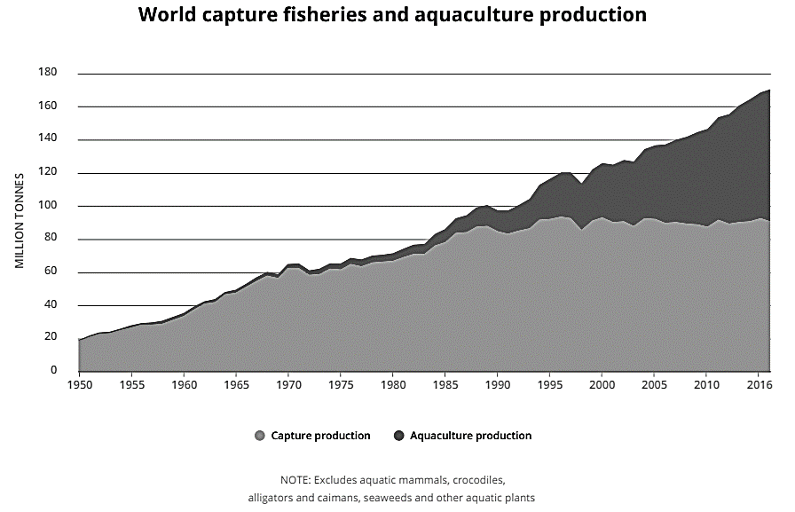
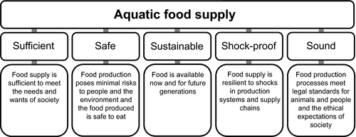
Marine
Education
26. The Blue Revolution – Explain the importance of aquaculture in addressing global food security
Name:
Date:
marineeducation.com.au
Aquaculture BOOM!
Capture fishery production has been relatively static since the late 1980s. Aquaculture has since been responsible for continued growth in the supply of fish for human consumption (Figure 1)^{[1]}.
The term ‘Blue Revolution’ is used in literature to reference the potential for aquaculture to address food security, and to describe the recent boom in aquaculture production. Previous ‘revolutions’ include
‘the Green Revolution’ – the agricultural boom, and the ‘White Revolution’ – the dairy boom (i.e. in India).
Q. What is the ‘Blue Revolution’? Ans.
The ‘Blue Revolution’ is a term used in literature to reference the potential for aquaculture to address food security, and to describe the recent boom in aquaculture production.
Aquaculture Production
Capture Production
Figure 1: Aquaculture represented 47% of the total global fish production in 2016, most of which is derived from China^{[1]}.
Note: the term ‘fish’ indicates fish, molluscs and other aquatic animals, but excludes aquatic mammals, crocodiles, caimans, seaweeds and other aquatic plants^{[1]}.
The 5 S’s of Food Security
Food security requires aquatic food supplies to be Sufficient, Safe, Sustainable, Shock-proof and Sound (Fig. 1).
Activity: In the blank space below, explain the importance of aquaculture in addressing global food security
Figure 2: Critical elements of food security. In general terms, an aquatic food supply contributes to food security when the food supply is sufficient, safe, sustainable, shockproof and sound^{[2]}.
Answers will vary
^{[1]} FAO (2018). The State of World Fisheries and Aquaculture 2018 - Meeting the sustainable development goals. Rome. Page 3. Licence: CC BY-NC-SA 3.0 IGO.
^{[2]} Jennings, S., Stentiford, G.D, Leocardio, A.M., Jeffery, K.R., Metcalfe, J.D., Katsiadaki, J., Auchterlonie, N.A., Mangi, S.C., Pinnegar, J.K., Ellis, T., Peeler, E.J., Luisetti, T., Baker-Austin, C., Brown, M., Catchpole, T.L., Clyne, F.J., Dye, S.R., Edmonds, N.J., Hyder, K., Lee, J., Lees, D.N., Morgan, O.C., O’Brien, C.M., Oidtmann, B., Posen, P.E., Santos, A.R., Taylor, N.G.H., Turner, A.D., Townhill, B.L., Verner-Jeffreys, D.W. (2016). Aquatic food security: insights into challenges and solutions from analysis of interactions between fisheries, aquaculture, food safety, human health, fish and human welfare, economy and environment. Fish and Fisheries. 17, 893-938. CC by 4.0.
^{[3]} Costa-Pierce, B. (2002). The ‘Blue Revolution’ – Aquaculture Must Go Green. World Aquaculture 33(4).
^{[4]} O’Shea, T., Jones, R., Markham, A., Norell, E., Scott, J., Theuerkauf, S.,and Waters, T. (2019) Towards a Blue Revolution: Catalyzing Private Investment in Sustainable Aquaculture Production Systems.
The Nature Conservancy and Encourage Capital, Arlington, Virginia, USA.
© Marine Education 2024 CC BY-NC-SA
Unit 4 Topic 2 Science Understanding – Aquaculture

Slide 52
Marine
Education
Explain the importance of aquaculture in addressing global food security
Name:
Date:
marineeducation.com.au
© Marine Education 2024 CC BY-NC-SA
NOTES AND EXAM REVISION

Slide 53
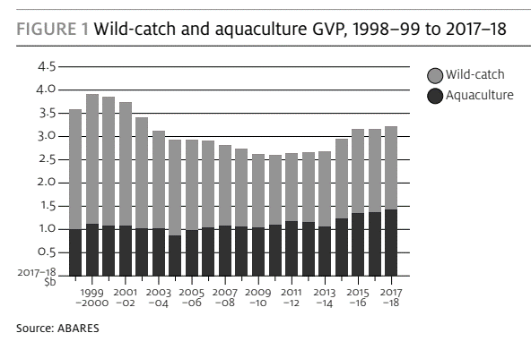
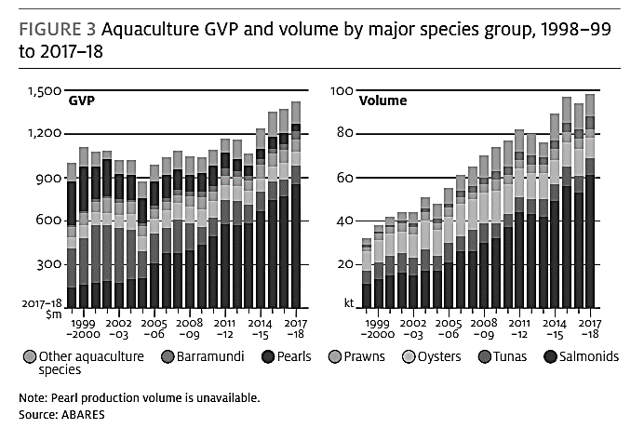
Marine
Education
27. ABARES – Interpret evidence from Australian Bureau of Agricultural and Resource Economics and Sciences (ABARES) fisheries reports to determine changes in fisheries practices over the past 10 years, including
- economic contribution of aquaculture relative to wild catch
- the top five aquaculture species in Australia by volume and value.
Name:
Date:
marineeducation.com.au
Activity: Download the latest ABARES fisheries and aquaculture report^{[1]}
Activity: Identify the economic contribution of aquaculture to wild catch in Australia
Value in billions ($)
Note: GVP = Gross Value of Production
Activity: Identify the top 5 aquaculture species in Australia by volume and value
TOP 5 (2017-18)
Salmonids ($855 million)
Tunas ($126 million)
Oysters ($102 million)
Prawns ($80.5 million)
Barramundi ($54 million)
Value in millions ($)
Activity: COMPARE Queensland trends to Australian trends in aquaculture value and volume.
Hint: Download the latest Industry Performance Annual Report from the Queensland Government’s Department of Agriculture and Fisheries website www.daf.qld.gov.au > Home > Business Priorities > Fisheries > Aquaculture > Aquaculture Investment > Industry Performance Annual Reports.
^{[1]} Steven, AH, Mobsby, D and Curtotti, R. (2020). Australian fisheries and aquaculture statistics 2018, Fisheries Research and Development Corporation project 2019-093, ABARES, Canberra, April. CC BY 4.0. https://doi.org/10.25814/5de0959d55bab.
© Marine Education 2024 CC BY-NC-SA
Unit 4 Topic 2 Science Understanding – Aquaculture

Slide 54
Marine
Education
Interpret evidence from Australian Bureau of Agricultural and Resource Economics and Sciences (ABARES) fisheries reports to determine changes in fisheries practices over the past 10 years, including
- economic contribution of aquaculture relative to wild catch
- the top five aquaculture species in Australia by volume and value.
Name:
Date:
© Marine Education 2024 CC BY-NC-SA
NOTES AND EXAM REVISION

Slide 55
Marine
Education
28. Fishing for Information – Describe attributes
(e.g. resilience, growth rate, feed conversion ratio) of an aquaculture species detailing its life cycle, adaptations, requirements and marketability that would make a species desirable to farm
Name:
Date:
marineeducation.com.au
Activity: Pretend you know a farmer who wants to begin an aquaculture farm. Below is a list of criteria, that was made by a family member of the farmer, to help the farmer decide on what species to farm.
As a friend of the farmer, your task is to select 3 species for the farmer to choose from (write them below). For each species that you suggest, you must also provide the farmer with details of its life cycle, adaptations, requirements and marketability, so the farmer can make an informed decision.
They are nutritious, tasty, marketable
They grow fast
Their food is cheap and accessible
You can grow them from larvae
They do not die easy
They do not care if it is crowded!
They do not care if the water quality is not the best
They are resistant to disease
They have a low-feed conversion ratio or FCR^{[1]}
1
Suggestions from the syllabus
bluefin tuna (Thunnus maccoyii), salmon (Oncorhynchus spp.), barramundi (Lates calcarifer), freshwater fish including eels (Anguilla spp.), abalone (Haliotidae), oysters (mainly Crassostreas gigas, Saccostrea glomerata), prawns (Penaeus spp., Fenneropenaeus merguiensis), yabbies (Cherax destructor), redclaw crayfish (Cherax quadricarinatus), silver perch (Bidyanus bidyanus) or Murray cod (Maccullochella peelii peelii).
2
Recommended Reading
Queensland Government Business Queensland website www.business.qld.gov.au/ (Home > Industries > Farms, Fishing and Forestry > Fishing and Aquaculture > Aquaculture > Aquaculture species).
Suggested Practical (syllabus)
Investigate factors that affect the growth rate of an aquaculture species
3
What is the ‘feed conversion ratio’? FCR is the weight of feed administered over the lifetime of an animal (i.e. kg of feed) divided by weight gained
(i.e. kg of edible biomass). This ratio measures how efficiently a kilogram of animal feed is converted into animal weight or biomass^{[1]}.
For example, the FCR of fish is lower (and therefore more efficient at converting food to biomass) than the FCR of, say, a cow or a sheep^{[1]}.
Q. Is the list of criteria realistic (can the farmer realistically tick all those boxes)? WHY? Ans..
answers may vary. E.g. No – unrealistic Or, Yes – suggestion of species.
^{[1]} Fry, J., Mailoux, N.A., Love, D.C., Milli, M.C. and Cao, L. (2018). Feed conversion efficiency in aquaculture: do we measure it correctly? Environmental Research Letters, Volume 13. Number 2. DOI: 10.1088/1748-9326/aaa273
© Marine Education 2024 CC BY-NC-SA
Unit 4 Topic 2 Science Understanding – Aquaculture

Slide 56
Marine
Education
Describe attributes (e.g. resilience, growth rate, feed conversion ratio) of an aquaculture species detailing its life cycle, adaptations, requirements and marketability that would make a species desirable to farm
Name:
Date:
marineeducation.com.au
© Marine Education 2024 CC BY-NC-SA
NOTES AND EXAM REVISION

Slide 57
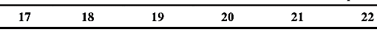
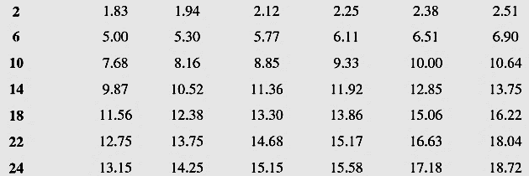
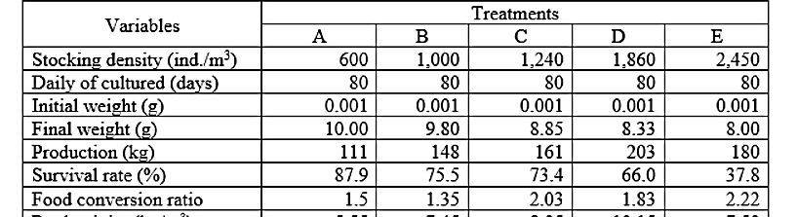
Marine
Education
29. 1 Fish, 2 Fish, Red Fish, Blue Fish – Predict how the size of ponds or tanks, the requirement of a species and farming technique influence the maximum carrying capacity of an aquaculture system.
Name:
Date:
marineeducation.com.au
Maximum Carrying Capacity?
If you have invested a lot of money into an aquaculture business, you may be tempted to overcrowd the pond or tank, to sell more fish down the track. As tempting as that may be, overcrowding a tank can be costly in the long run. Every tank or pond has a limit to how many fish you can put in it. It pays to know the maximum carrying capacity of your aquaculture system. This will begin as a prediction based on the size of the ponds or tanks, the requirements of a species and farming technique.
The larger the tank or pond,
the greater its (carrying) capacity
Table 1: Data from a Tilapia farm in Inhasorro, Mozambique, with ponds stocked with 3 fish per square metre (open system)^{[1]}.
 | Pond Size (m²) | Stocking of Pond
Pond 1 | 35 000 | 105 000 fish
Pond 2 | 25 000 | 75 000 fish
Pond 3 | 22 500 | 67 500 fish
Pond 4 | 20 000 | 60 000 fish
Activity: Complete the table above
Table 2: The required aeration time (in hours) per tank to maintain a DO within 4-5ppm for different fish stocking densities of carp (kg/m³) and for different water temperatures (°C)^{[2]}.
The larger the aeration capacity of the tank or pond, the greater its (carrying) capacity
Kg per m³ water
Aeration in hours for water temperatures 17-22°C
Q. Why is aeration important? Ans.
Fish need to breathe
Water movement
(i.e. no stratification)
Waste Removal (more fish = more waste)
Table 3: The effect of stocking density on shrimp (Litopenaeus vannamei) in 5 tanks (A-E) that were each 5m x 1.5m and filled with 20m³ sea water^{[3]}.
Growth rates and survival rates can, for some species, decline as stocking density increases
Q. Which treatment (A-E) in Table 3 causes the shrimp survival rate (%) to plummet? Ans.
E
Q. At what stocking density would you choose to farm L. vannamei, based on the data in Table 3? Justify your decision. Ans.
(hint: compare the feed conversion ratios!)
The perfect stocking density amount largely depends on the requirements of the species
answers may vary
Note: feed conversion ratio is smallest for Treatment B.
Q. Why the difference in stocking density between Tilapia in Table 1 and shrimp in Table 3 (B)? Ans.
Because they are different species with different requirements.
Different farming technique.
^{[1]} Adapted from: Schnell, C. and Schnell, A. (2017). Tilapia Farm in Inhasorro. Xibaha. Accessed 24.06.2019 from: http://xibaha.info/tilapia-farm-in-inhasorro/
^{[2]} Adapted with permission from: Elmessery, W.M. and Abdallah, S.E. (2014). Intelligent Dissolved Oxygen Control System for Intensive Carp System. Journal of Agricultural Engineering and Biotechnology. Vol. 2. Issue 4. Pp. 49-62. DOI: 10.18005/JAEB0204001
^{[3]} Adapted from: Tahe, S. and Makmur (2016). The effect of stocking density on productions of Super intensive white shrimp (Litopenaeus vannamei) cultured in fiberglass tanks. Asian-Pacific Aquaculture 2016 – Meeting Abstract. World Aquaculture Society Inc. (US). Accessed 24.06.2019 from: https://www.was.org/meetings/ShowAbstract.aspx?Id=43456
© Marine Education 2024 CC BY-NC-SA
Unit 4 Topic 2 Science Understanding – Aquaculture

Slide 58
Marine
Education
Predict how the size of ponds or tanks, the requirement of a species and farming technique influence the maximum carrying capacity of an aquaculture system.
Name:
Date:
marineeducation.com.au
© Marine Education 2024 CC BY-NC-SA
NOTES AND EXAM REVISION

Slide 59
Marine
Education
30. Dynamic Systems – Contrast different aquaculture systems, e.g. open, closed or recirculating, intensive and
extensive
Name:
Date:
marineeducation.com.au
Open system
Semi-closed system
Closed system
Open vs. Closed
Open systems rear organisms in nature. No water is pumped or reused.
E.g. floating netpens, floating racks, longlines, on-bottom culture, cages^{[2]}.
Semi-closed systems rear organisms in man-made impoundments. Water is pumped or diverted from nature.
E.g. ponds and raceways, tanks^{[2]}.
Closed systems use sophisticated water filtration and treatment systems.
E.g. aquariums, aquaponics^{[2]}.
Water Re-use Rates
0%
50%
100%
Figure 1: Water re-use rates for open, semi-closed and closed systems^{[1]}.
Q. Which system in Fig. 1 re-uses the most water? Ans.
Closed system
Extensive System
Intensive system
Extensive vs. Intensive
Extensive systems are in natural waters where it is left up to nature to feed the organisms and maintain water quality. E.g. oyster farms.
Semi-intensive systems include the addition of feed and fertilizers.
Intensive systems are highly controlled systems (inside or outside) to maximise production in minimal space. E.g. trout raceways, prawns.
Semi-intensive system
Level of Management
Stocking Density
Yield
HIGH
LOW
Figure 2: Difference between extensive and intensive culture systems^{[2]}.
Q. Which system in Fig. 2 has the highest capacity to control water quality? Ans.
Intensive
Activity: Complete the table below.
 | Extensive System | Intensive System
Description | Low level of management Low stocking density Low yield | High Level of management High stocking density High yield
Examples | Oyster farms Herbivore farms | Trout raceways Prawns (all same size) Crayfish
^{[1]} Adapted from: Florida Atlantic University Harbour Branch (n.d.). Recirculating Aquaculture Systems. SlidePlayer. Accessed 21.06.2019 from: https://slideplayer.com/slide/6021113/
^{[2]} Adapted from: Jayachandran, P.R. (2015). Jayachandran aquaculture systems. SlideShare. Accessed 21.06.2019 from: https://www.slideshare.net/JayachandranPR/jayachandran-aquaculture-systems
© Marine Education 2024 CC BY-NC-SA
Unit 4 Topic 2 Science Understanding – Aquaculture

Slide 60
Marine
Education
Contrast different aquaculture systems, e.g. open, closed or recirculating, intensive and extensive
Name:
Date:
marineeducation.com.au
© Marine Education 2024 CC BY-NC-SA
NOTES AND EXAM REVISION

Slide 61
Marine
Education
31. Issues with Aquaculture – Identify and explain issues associated with aquaculture production, including output pollution, biosecurity, waste removal and feed production.
Name:
Date:
marineeducation.com.au
What is the issue?
Loss or alteration of natural habitat (i.e. mangroves and wetlands)
Displacement of indigenous fisheries with multi-national corporations
Uneaten food and waste products can smother benthic organisms
Uneaten food and waste products can over-fertilise the water (leading to eutrophication)
Fish meal and fish oil can go into water column (from oily fish like mackerel and anchovies)
Ammonia (from fish urine and gill excretion) can be toxic if not removed.
Illegally sourced feed product is a biosecurity threat (heavy penalties apply)
The introduction of non-native seed stock can be a biosecurity threat
(i.e. importing Atlantic salmon eggs from Europe)
Feed stock supply may be coming from an unsustainable source
Disease risks to the stock (see right)
Drug resistant pathogens can prevail, making disease outbreaks difficult to avoid or fix
Drugs (antibiotics, hormones, anaesthetics, etc.) and herbicides can go into the water column
Genetically modified species can escape and threaten local species with extinction
Disease threats
Infectious disease agents
Ectoparasites (e.g. Cryptocaryon)
Bacteria (e.g. Vibrio spp.)
Fungi (e.g. Saprolegnia)
Viruses (e.g. koi herpes virus, whispovirus)
Non-infectious disease agents
Water quality problems
Nutritional deficiencies or excess nutrients
Toxicity (e.g. heavy metals, pesticides)
Activity: Complete the table below
Issue | Why it is an issue (hint: see above)
Output Pollution | Uneaten food and waste products can over-fertilise the water (leading to eutrophication). Drugs, herbicides, etc.
Biosecurity | Genetically modified species can escape. Illegally sourced feed product and seed stock.
Waste Removal | Uneaten food and waste products can smother benthos. Ammonia can be toxic if not removed.
Production of Feed for Aquaculture | Fish meal and fish oil can go into the water column. Finding enough supply from a sustainable, legal source.
Aquaponics: Aqua Gardening
Aquaponics is the combination of aquaculture and hydroponics (gardening without soil). The aquaculture system acts as a source of organically fertilized irrigation water (from fish waste water) for the hydroponics system, and, the hydroponics system acts as a filter for the aquaculture system. It is a win-win!
Q. How does aquaponics solve the issue of waste removal in aquaculture? Ans.
3
Fish waste is used for plant growth. Whereby, the aquaculture system acts as a source of organically fertilised irrigation water (from fish waste water) for the hydroponics system.
FISH WASTE WATER
2
CLEAN WATER
1
Air pump
Figure 1: Fish waste water passes through the mechanical filter (1) biofilter (2) and sump (3) of the hydroponics system, which cleans the return water.
© Marine Education 2024 CC BY-NC-SA
Unit 4 Topic 2 Science Understanding – Aquaculture

Slide 62
Marine
Education
Identify and explain issues associated with aquaculture production, including output pollution, biosecurity, waste removal and feed production.
Name:
Date:
marineeducation.com.au
© Marine Education 2024 CC BY-NC-SA
NOTES AND EXAM REVISION

Slide 63

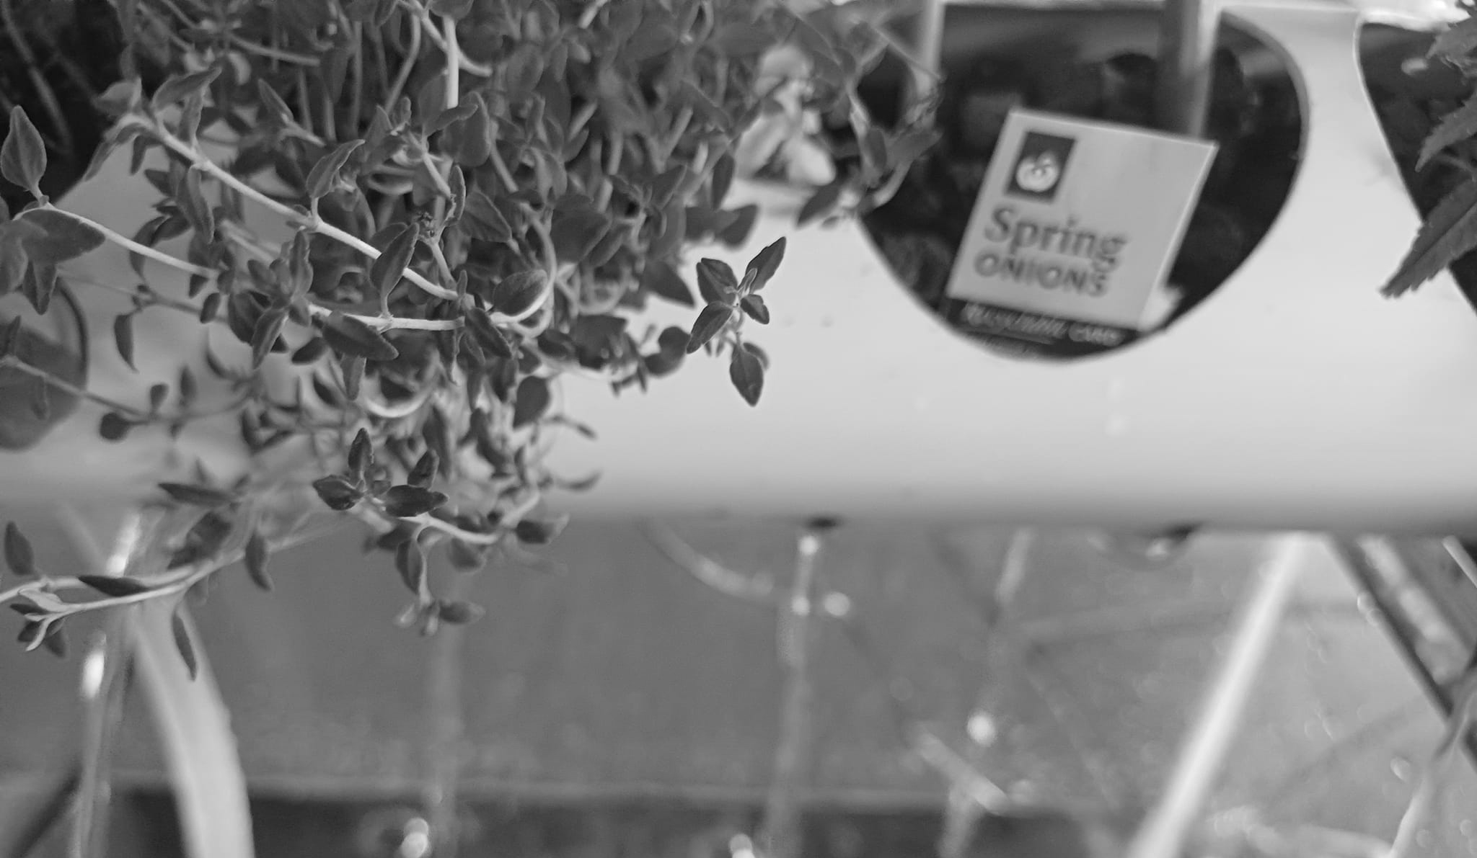
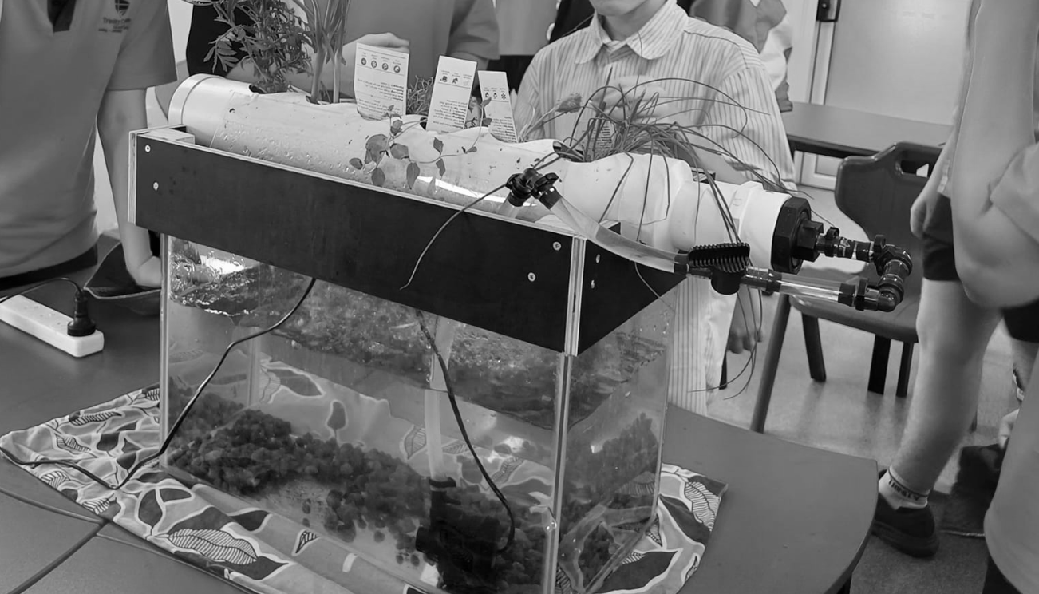
Marine
Education
32. Make an aquaponics tank! – Mr Noah Thomas of Trinity College Gladstone has kindly shared his very own aquaponics setup he designed specifically for the classroom.
Contact: noaht@trinitygladstone.qld.edu.au
Name:
Date:
marineeducation.com.au
© Marine Education 2024 CC BY-NC-SA
Unit 4 Topic 2 Science Understanding – Aquaculture

Slide 64
Marine
Education
33. Title - Consider Aboriginal peoples’ and Torres Strait Islander peoples’ voluntary management of traditional use activities on sea country, e.g. Traditional Use of Marine Resources Agreements — TUMRA.
Name:
Date:
marineeducation.com.au
Teacher to write
© Marine Education 2024 CC BY-NC-SA
Unit 4 Topic 1 Science as a Human Endeavour

Slide 65
Marine
Education
34. Title - Examine the issue of overfishing, which — due to insufficient reliable data — continues to be a problem that requires a review of management policies.
Name:
Date:
marineeducation.com.au
Teacher to write
© Marine Education 2024 CC BY-NC-SA
Unit 4 Topic 1 Science as a Human Endeavour

Slide 66
Marine
Education
35. Title - Examine how enforcement logistics, identification of multiple uses of an area (e.g. fishing, recreation and tourism), Aboriginal peoples’ and Torres Strait Islander peoples’ usage rights, and area size required for biodiversity contribution are used to identify and classify a chosen marine reserve area.
Name:
Date:
marineeducation.com.au
Teacher to write
© Marine Education 2024 CC BY-NC-SA
Unit 4 Topic 1 Science as a Human Endeavour

Slide 67
Marine
Education
36. Title - Examine the scientific evidence for intensive aquaculture farming practice impacts (e.g. water quality) that can be used to inform the monitoring, assessment and evaluation of risk for local fisheries and tourism.
Name:
Date:
marineeducation.com.au
Teacher to write
© Marine Education 2024 CC BY-NC-SA
Unit 4 Topic 1 Science as a Human Endeavour

Slide 68
Marine
Education
37. Title - Recognise that some scientists predict that regional increases in primary production, due to increased global carbon dioxide concentrations, may be offset by large predicted losses in productivity around the polar regions due to ice cap contraction.
Name:
Date:
marineeducation.com.au
Teacher to write
© Marine Education 2024 CC BY-NC-SA
Unit 4 Topic 1 Science as a Human Endeavour

Slide 69
Marine
Education
38. Title - Recognise that maximum sustainable yield (MSY) has been one of the most influential concepts to inform fish stock management, although it has been criticised as a fisheries management tool as it ignores the size and age of the animal being harvested, its reproductive status and the effects of fishing on the ecosystem more broadly.
Name:
Date:
marineeducation.com.au
Teacher to write
© Marine Education 2024 CC BY-NC-SA
Unit 4 Topic 1 Science as a Human Endeavour

Slide 70
Marine
Education
39. Title - Appreciate that aquaculture productivity is seen as essential to achieving food security. However, it has implications for health, sustainable economic development, environmental protection and trade. It can lead to a focus on farming high yield species, which may in itself lead to a decrease in the genetic diversity of global food species.
Name:
Date:
marineeducation.com.au
Teacher to write
© Marine Education 2024 CC BY-NC-SA
Unit 4 Topic 1 Science as a Human Endeavour

Slide 71
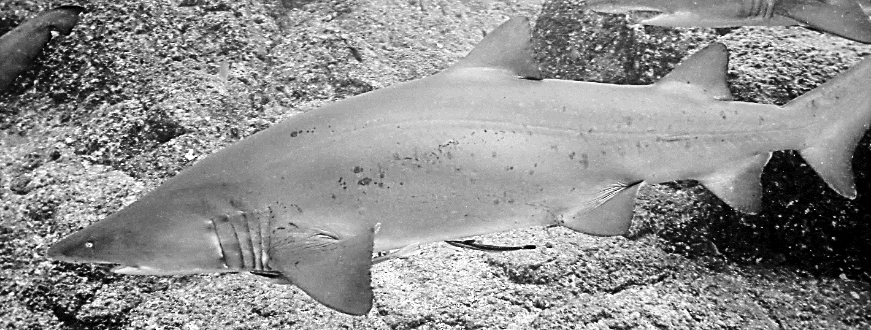
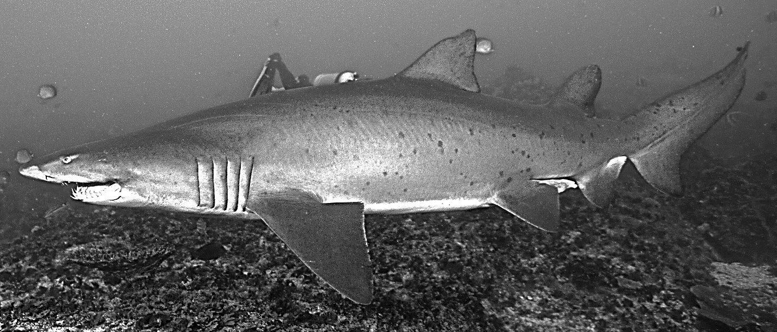
Marine
Education
40. Counting Sharks – Investigate fisheries populations by applying the Lincoln index to a capture-recapture scenario.
Name:
Date:
marineeducation.com.au
BEFORE GOING ANY FURTHER, REVISE CONCEPTS INTRODUCED ON PAGE 134 TITLED, ‘CAPTURE AND RECAPTURE’
Natural Tags on Grey Nurse Sharks (Carcharias taurus)
Below are pictures that were kindly donated by Grey Nurse Shark Watch (GNSW), a community Grey Nurse Shark photographic identification program^{[1]}. The Australian east coast sub-population of Grey Nurse Shark were hunted almost to extinction in the 1950’s. They are now critically endangered.
The Grey Nurse Shark Watch program tags each shark by giving it a name. Each shark is recognizable from the unique arrangement of spots on the side of its body that act as a ‘natural tag’. Once a shark has been photographed, it is named or matched to a previous photograph. Note: the sharks often swim in a circuit-like configuration, allowing divers to sit in one spot and wait for the sharks to predictably swim past (usually very close) and have their picture taken. The sharks only ‘look’ dangerous because they can not cover their teeth (another common name is ‘ragged-tooth shark’). They are not dangerous at all.
Activity: ‘Tag’ each shark by giving it a name (write the name in the empty box provided).
Note: for a closer look, you can view all original colour photos at marineeducation.com.au
158_1FLWR190107cbg
1819_1MLATCFtRJ020815dbm
^{[1]} Photographs © Dr. Carley Kilpatrick from Grey Nurse Shark Watch - Reef Check Australia at https://www.reefcheckaustralia.org/grey_nurse_shark_watch
© Marine Education 2024 CC BY-NC-SA
Unit 4 Topic 2 Science Understanding – Science Inquiry

Slide 72
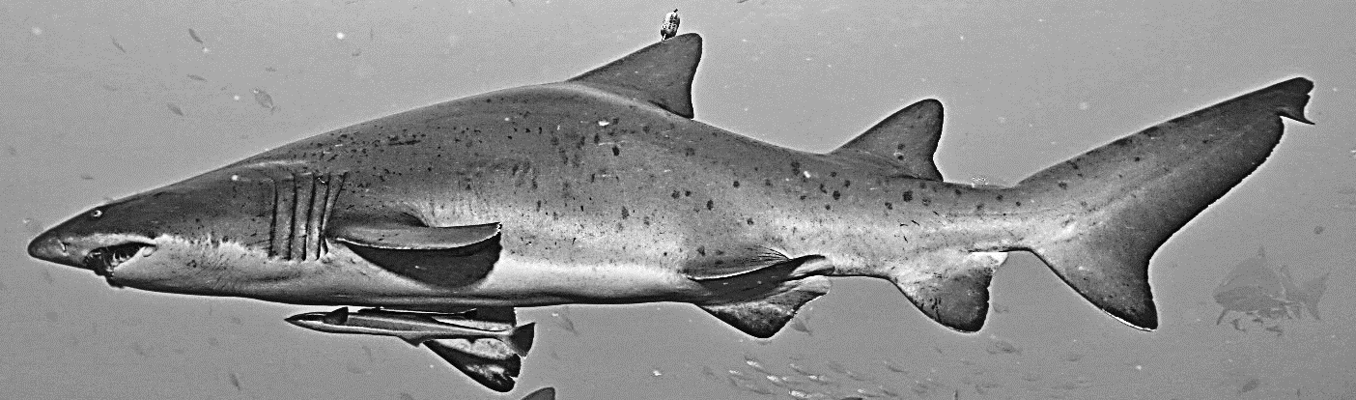
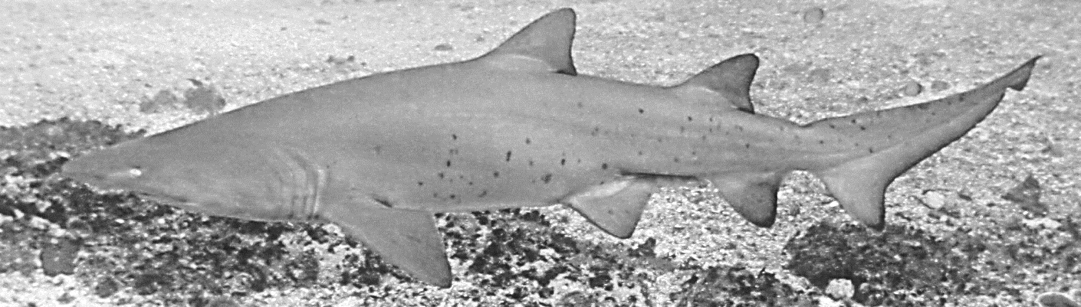
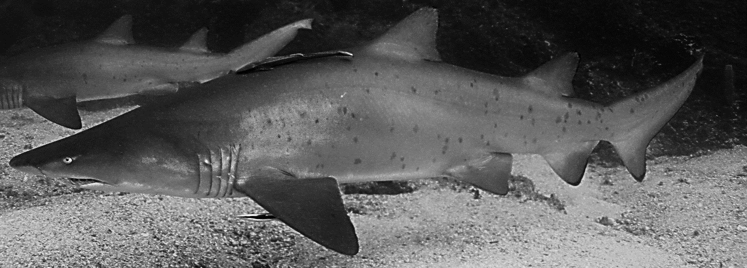
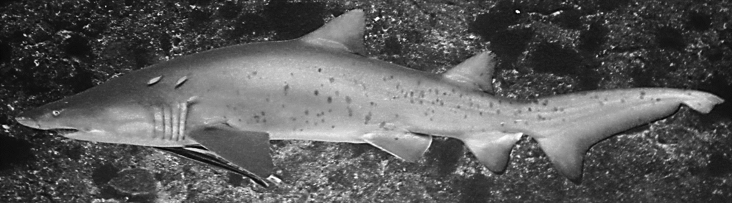
Marine
Education
Name:
Date:
marineeducation.com.au
First Catch (tagging)
41_1FLAWRm030207cbg
1866_1MLATCFtR090815ckm
142_1FLFR040707cbm
5_1FLFtR310704cbg
^{[1]} Photographs © Dr. Carley Kilpatrick from Grey Nurse Shark Watch - Reef Check Australia at https://www.reefcheckaustralia.org/grey_nurse_shark_watch
© Marine Education 2024 CC BY-NC-SA
Unit 4 Topic 2 Science Understanding – Science Inquiry

Slide 73
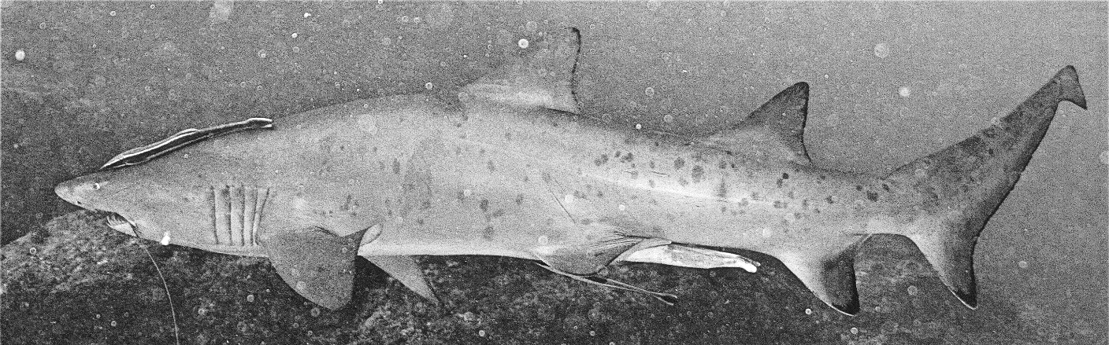
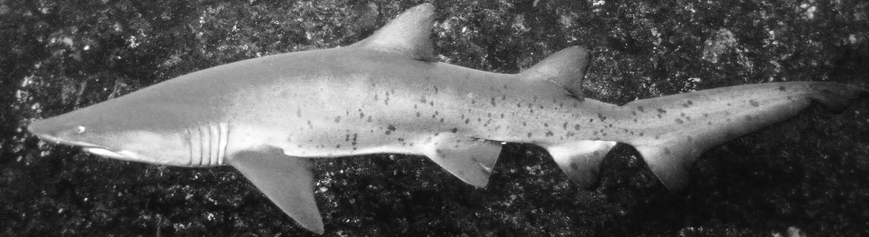
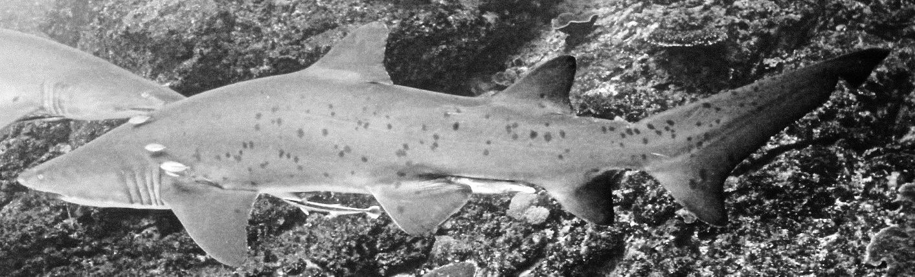

Marine
Education
Name:
Date:
marineeducation.com.au
First Catch (tagging)
26_1MLMA150707cbg
48_1MLFR100307cbg
568_1MLAFtRf040806cbg
294_1FLAFR220208cbm
^{[1]} Photographs © Dr. Carley Kilpatrick from Grey Nurse Shark Watch - Reef Check Australia at https://www.reefcheckaustralia.org/grey_nurse_shark_watch
© Marine Education 2024 CC BY-NC-SA
Unit 4 Topic 2 Science Understanding – Science Inquiry

Slide 74



Marine
Education
Name:
Date:
marineeducation.com.au
Second Catch (recapture)
Activity: This ‘second catch’ also includes 10 sharks. Identify the sharks that you already named (tagged) in the first catch. If it is a new shark, give it a new name in the box provided.
Note: for a closer look, you can view all original colour photos at marineeducation.com.au
1659_1FLAWRm170214ckm
26_1MLAFR030606swrdcm
5_1FLFtR310704cbg
Hint: this shark is a recapture (and not the only one)
^{[1]} Photographs © Dr. Carley Kilpatrick from Grey Nurse Shark Watch - Reef Check Australia at https://www.reefcheckaustralia.org/grey_nurse_shark_watch
© Marine Education 2024 CC BY-NC-SA
Unit 4 Topic 2 Science Understanding – Science Inquiry

Slide 75




Marine
Education
Name:
Date:
marineeducation.com.au
Second Catch (recapture)
172_1FLAMAj090307cbg
31_1MLAPFj120208cbm
48_1MLJFRfj230208cbg
621_1MLSAFRfj230208cbm
^{[1]} Photographs © Dr. Carley Kilpatrick from Grey Nurse Shark Watch - Reef Check Australia at https://www.reefcheckaustralia.org/grey_nurse_shark_watch
© Marine Education 2024 CC BY-NC-SA
Unit 4 Topic 2 Science Understanding – Science Inquiry

Slide 76



Marine
Education
Name:
Date:
marineeducation.com.au
Second Catch (recapture)
337_1FLSAGI180707phm
383_1FLAWRp020607cbm
534_1MLAFtRj040806cbg
Total number of sharks in the first catch | M | 10
Total number of sharks in the second catch | n | 10
Number of recaptures in the second catch (how many already had a name?) | m | 3
Estimated population size (to the nearest whole number) | N | 33
^{[1]} Photographs © Dr. Carley Kilpatrick from Grey Nurse Shark Watch - Reef Check Australia at https://www.reefcheckaustralia.org/grey_nurse_shark_watch
© Marine Education 2024 CC BY-NC-SA
Unit 4 Topic 2 Science Understanding – Science Inquiry

Slide 77










Marine
Education
Name:
Date:
marineeducation.com.au
FOOD FOR THOUGHT
Activity: Refer to Figure 1 (below) to check your estimate of the population.
Rocky pinnacle
second catch (cave)
Figure 1: All the sharks in the first catch are pointing to the right. All the sharks in the second catch (recaptures) are in the cave (although, they may not have been photographed whilst in a cave; and the size of the sharks in Figure 1 are not representative of the size of the sharks in the photographs).
Activity: Discuss the assumptions that are made when estimating population size using this method.
Code Names
Grey Nurse Shark Watch use a code to name their sharks. The code goes like this: the first number is the unique ID number for that shark. Underscore. The photo number for that individual shark on that day and at one site. Then, the gender of the shark, whereby males have claspers (Male/Female/Unknown). Then, the side of the shark that the photograph was taken (Left/Right). Followed by the maturity of the shark (Adult/Sub-Adult/Juvenile). Then, the site code (note: these sharks often aggregate at a particular site at a particular time of year, e.g. Solitary Islands, Wolf Rock, Flat Rock, Julian Rocks). If applicable, any other information such as fishing gear (f) jaw injury (j) mating scars (m) pregnant (p) tag or tag tether present (t). Lastly the date, the initials of the photographer and the photo quality (good, medium, poor)^{[2]}.
Q. Is the following shark male or female? 1_3FRSAWRjp100815jgm Ans.
Female
Combing through the Grey Nurse Shark database to find a match for a photograph of a shark is quite the task.
The code names make it a little easier to narrow it down. But a software program would make it a lot easier!
You just tried to find a match for 10 sharks. Imagine trying to find a match for hundreds of sharks!
If you would like to donate to Grey Nurse Shark Watch to help them raise money for a shark matching software program, or if you want to volunteer to match sharks, or take photographs of grey nurse sharks in the wild to upload to the database, visit their website at https://www.reefcheckaustralia.org/grey_nurse_shark_watch
^{{1}} Department of Environment (2014). Recovery Plan for the Grey Nurse Shark (Carcharius taurus). Commonweath of Australia. Accessed 12.05.2019 from: https://www.environment.gov.au/resource/recovery-plan-grey-nurse-shark-carcharias-taurus
^{[2]} Methodology © Dr. Carley Kilpatrick from Grey Nurse Shark Watch - Reef Check Australia at https://www.reefcheckaustralia.org/grey_nurse_shark_watch
© Marine Education 2024 CC BY-NC-SA
Unit 4 Topic 2 Science Understanding – Science Inquiry

Slide 78
Marine
Education
41. Title - Explore the life history of a fish by reviewing otoliths using a microscope.
Name:
Date:
marineeducation.com.au
Teacher to write
© Marine Education 2024 CC BY-NC-SA
Unit 4 Topic 1 Science Inquiry

Slide 79
Marine
Education
42. Title - Examine a water or sand sample to identify the presence of microplastics.
Name:
Date:
marineeducation.com.au
Teacher to write
© Marine Education 2024 CC BY-NC-SA
Unit 4 Topic 1 Science Inquiry

Slide 80
Marine
Education
43. Title - Investigate factors that affect the growth rate of an aquaculture species.
Name:
Date:
marineeducation.com.au
Teacher to write
© Marine Education 2024 CC BY-NC-SA
Unit 4 Topic 1 Science Inquiry

